Slide 1

Welcome to Flask Python Framework

Slide 2
Flask
Flask is a web application framework written in Python
Flask is based on the Werkzeug WSGI toolkit and Jinja2 template engine
Web Server Gateway Interface (WSGI) has been adopted as a standard for Python web application development. Its an interface between the web server and the web applications.
Werkzeug is a WSGI toolkit, which implements requests, response objects, and other utility functions.
Jinja2 is a popular templating engine for Python, render dynamic web pages.

Slide 3
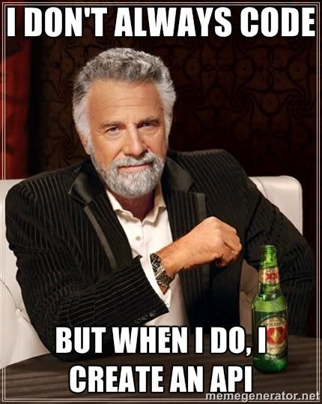

Slide 4
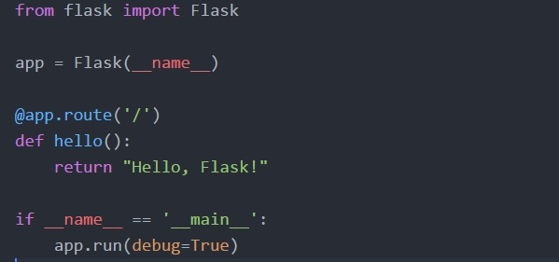
Create an API - this is enough

Slide 5
Requirements
Create a virtual environment and activate it.
virtualenv --python=python3.6 env
source env/bin/activate
Install Flask by using pip
pip install flask

Slide 6
4 Steps to Create an API
Importing flask module in the project is mandatory.
from flask import Flask
Flask constructor takes the name of current module (__name__) as argument.
app = Flask(__name__)
The route() decorator in Flask is used to bind URL to a function
app.route(rule, options)
run() method runs the application on the local development server.
app.run(host, port, debug, options)

Slide 7


Slide 8
How to become an Expert in Python Flask ?
1. Dynamic URL binding
2. HTTP methods of data retrieval from specified URL
3. Send and Receive response to webserver using REST API CLIENT
4. Jinja2 is a popular templating engine for Python, render dynamic web pages.
5. Results to serve as an API
6. Globally Depoly our application. Our Local system as a Web Server. No need AWS, GCP and other Cloud platform for deploy our application.

Slide 9
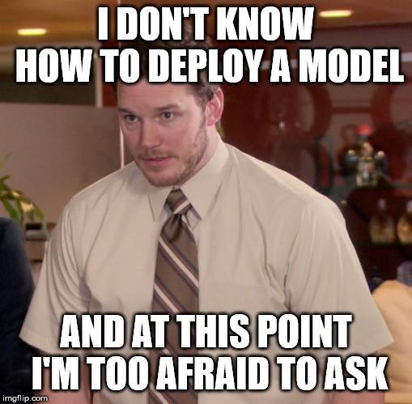

Slide 10
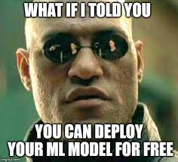

Slide 11
Don’t afraid because now you know
How to deploy a application
Let’s GO For Practical Session

