Slide 1

SMART INDIA HACKATHON 2026
TITLE PAGE
Problem Statement ID – SIH26085
Problem Statement Title – Urban Flood Nowcasting System (Drainage and Rainfall Coupling)
Theme – Disaster Management
PS Category – Software
Team ID – 166925
Team Name – Singularity@
VARUNETRA
Urban Flood Intelligence & Response Platform

Slide 2
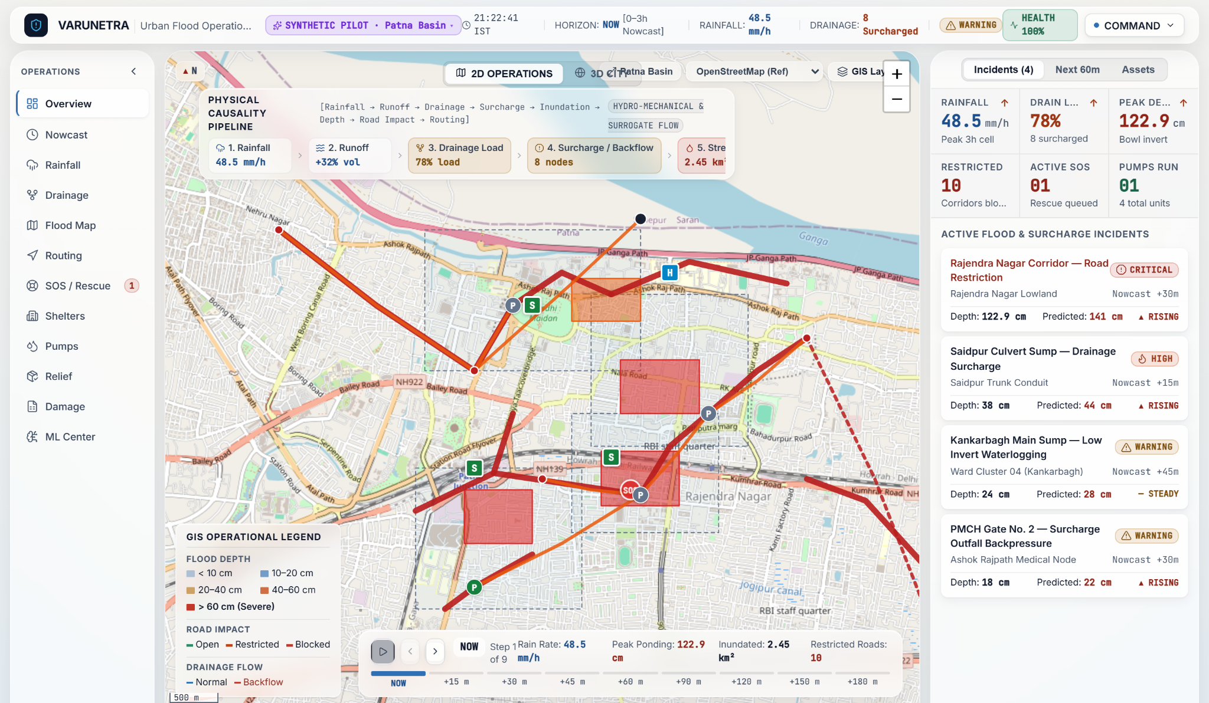
IDEA TITLE
Singularity@
VARUNETRA
PROPOSED SOLUTION
A rainfall–drainage coupled urban flood nowcasting platform that transforms rainfall forecasts into street-level flood-depth, road-impact and actionable response intelligence.
Urban Flood Intelligence & Response Platform
PROBLEM
Rainfall forecast ≠ street-level flood information
INNOVATION AND UNIQUENESS
1. Coupled intelligence
Rainfall, terrain and drainage are analysed together.
HOW IT ADDRESSES THE PROBLEM
RAINFALL NOWCAST
2. Street-level output
Produces spatial flood extent and depth intelligence.
TERRAIN / DEM
RUNOFF
DRAINAGE NETWORK
3. Drainage-aware modelling
Considers surcharge and backflow instead of rainfall-only mapping.
SURCHARGE / BACKFLOW
STREET INUNDATION
FLOOD DEPTH
4. Prediction → Action
Flood intelligence feeds road-impact analysis and operational routing.
VARUNETRA Main Command Center — 2D Operations
SYNTHETIC PILOT · Patna Urban Basin · simulated outputs, not field-validated
ROAD IMPACT
FLOOD-AWARE ROUTING

Slide 3
TECHNICAL APPROACH
Singularity@
METHODOLOGY AND PROCESS FOR IMPLEMENTATION
RAIN + TERRAIN + DRAINAGE COUPLING
MULTI-SOURCE INPUTS
Rainfall / radar / weather
DEM / elevation
Land surface
Drainage GIS
Road network
Historical flood data
PRE-PROCESSING
Spatial alignment
Rainfall accumulation
Catchment delineation
Network preparation
COUPLED FLOOD ENGINE
Surface runoff
+
Drainage hydraulic response
SURCHARGE / BACKFLOW
Network overload and outfall backpressure
FLOOD EXTENT + DEPTH
Street-level inundation extent and depth (cm)
SPATIAL INTELLIGENCE
Flood hotspots
Road impact
Uncertainty
DECISION SUPPORT
Flood-aware routing
SOS / rescue
Shelters
Pump deployment
0–180 MINUTE
NOWCAST
NOW
+15
+30
+45
+60
+90
+120
+150
+180
TECHNOLOGIES TO BE USED
FRONTEND
React + TypeScript
Leaflet + CesiumJS
BACKEND
Python + FastAPI
GEOSPATIAL
PostgreSQL + PostGIS
MODELLING
Hydrologic / hydraulic simulation
Drainage network modelling
ML surrogate + explainability

Slide 4
FEASIBILITY AND VIABILITY
Singularity@
TECHNICAL FEASIBILITY
Pilot geography: synthetic Patna Urban Basin
01
Modular data-provider architecture
02
Coupled surface + drainage modelling
03
GIS-based spatial outputs
04
API-driven decision support
05
Catchment-based deployment
06
2D + 3D visualization
KEY CHALLENGES → MITIGATION
CHALLENGE
Drainage data availability
Network topology, capacity and asset data may be incomplete.
MITIGATION
Data adapters + provenance
Every layer labelled REAL / SIMULATED / SYNTHETIC / DEMO / CACHED.
CHALLENGE
Local calibration
Urban hydraulic behaviour varies by catchment.
MITIGATION
Event-based calibration
Use historical rainfall and observed inundation where available.
CHALLENGE
Live-data access
Operational feeds may require approved credentials.
MITIGATION
Physics + ML
Physics-based modelling as engineering reference; ML as accelerator / surrogate where justified.
CHALLENGE
Computational cost
High-resolution simulation can be expensive.
MITIGATION
Incremental deployment
Start with a catchment / ward and scale after validation.
PROTOTYPE EVIDENCE
Software / prototype validation only — not field validation.
0–180 min Nowcast
2D GIS
3D City
Routing
SOS
Pumps
11/11 automated backend tests passed
Frontend production build passed

Slide 5
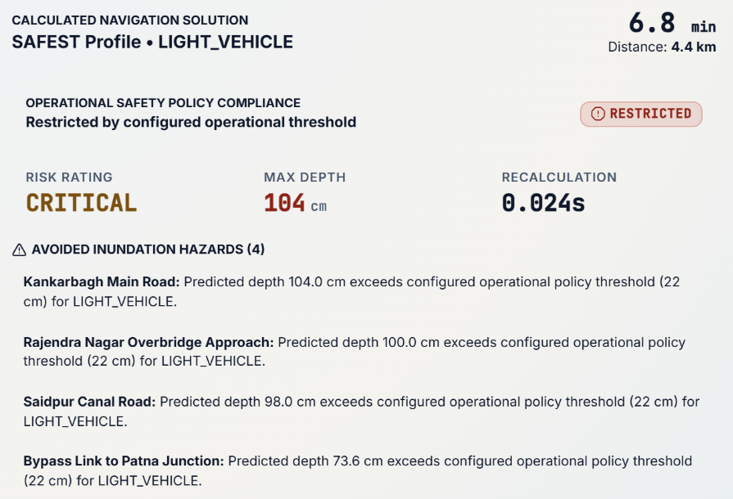
IMPACT AND BENEFITS
Singularity@
PREDICT
WARN
MAP
ROUTE
RESPOND
RECOVER
POTENTIAL IMPACT ON TARGET AUDIENCE
MUNICIPAL / DISASTER AUTHORITIES
EMERGENCY SERVICES
Street-level situation awareness
Drainage stress monitoring
Flood hotspot identification
Response prioritisation
Flood-aware routing
SOS prioritisation
Rescue dispatch support
Shelter accessibility
CITIZENS
RECOVERY TEAMS
Localised flood awareness
Impacted-road visibility
Alternative-route information
Shelter discovery
Damage assessment
Road restoration prioritisation
Pump / dewatering coordination
Post-event analysis
Routing console · synthetic pilot
Policy-based clearance check — decision support, not a safety guarantee.
BENEFITS OF THE SOLUTION
SOCIAL
Earlier and more localised flood awareness.
OPERATIONAL
Better prioritisation of roads, drainage nodes and emergency resources.
ECONOMIC
Potentially reduced disruption through earlier operational decisions.
ENVIRONMENTAL
Supports targeted drainage and dewatering interventions.

Slide 6
RESEARCH AND REFERENCES
Singularity@
BEFORE → AFTER • EVIDENCE-BASED EVOLUTION
From Distributed Flood Information to Integrated Urban Flood Intelligence
BEFORE — EXISTING INFORMATION & MODELLING LANDSCAPE
INTEGRATION GAP
Rainfall, flood, inundation and modelling capabilities exist across different systems and tools.
Challenge addressed: rainfall + terrain + drainage + flood impact + routing in one urban decision workflow.
AFTER — VARUNETRA INTEGRATED URBAN FLOOD INTELLIGENCE
Rainfall / weather
IMD forecasts, warnings and nowcast products
RAINFALL
TERRAIN
DRAINAGE
0–180 MIN NOWCAST
Bihar flood information
FMIS hydromet status, bulletins, inundation maps
FLOOD IMPACT
ROAD ROUTING
RESPONSE
Satellite flood mapping
FMIS inundation from RADARSAT / NRSC layers
Copernicus GLO-30 DSM → slope, flow accumulation, depressions, HAND
Flood depth: SIMULATED — NOWCAST MODEL OUTPUT
Flood conditions → road impact, passability, flood-aware routing
Response workflow with 2D GIS + 3D Cesium visualization
Surrogate ML: MODEL REQUIRES RECALIBRATION / RETRAINING
Urban drainage modelling
EPA SWMM runoff and drainage-system modelling
Coupled flood research
Itzï surface + drainage dynamic simulation
01
Bihar FMIS (WRD, Govt of Bihar)
Rainfall, hydromet status, flood bulletins and inundation products.
fmiscwrdbihar.gov.in/fmis/
02
IMD · India Meteorological Dept.
Warnings, forecasts and nowcasts as meteorological inputs.
mausam.imd.gov.in
03
MOSDAC / ISRO
Satellite and meteorological geospatial data resources.
mosdac.gov.in
04
U.S. EPA SWMM
Established urban rainfall-runoff and drainage-system modelling.
epa.gov/…/storm-water-management-model-swmm
05
Itzï Urban Flood Model
Research reference for coupled surface / drainage flood simulation.
itzi.readthedocs.io
06
Copernicus DEM GLO-30 (DSM)
30 m Digital Surface Model: current terrain baseline of VARUNETRA.
dataspace.copernicus.eu/…/COP-DEM
DATA PROVENANCE
REAL INPUT
DERIVED OUTPUT
SIMULATED / ESTIMATED
DEMO CONTROL
VARUNETRA is a team-developed prototype. It is not an official government product. References are provided as methodological, data-source and ecosystem references.

