Slide 1
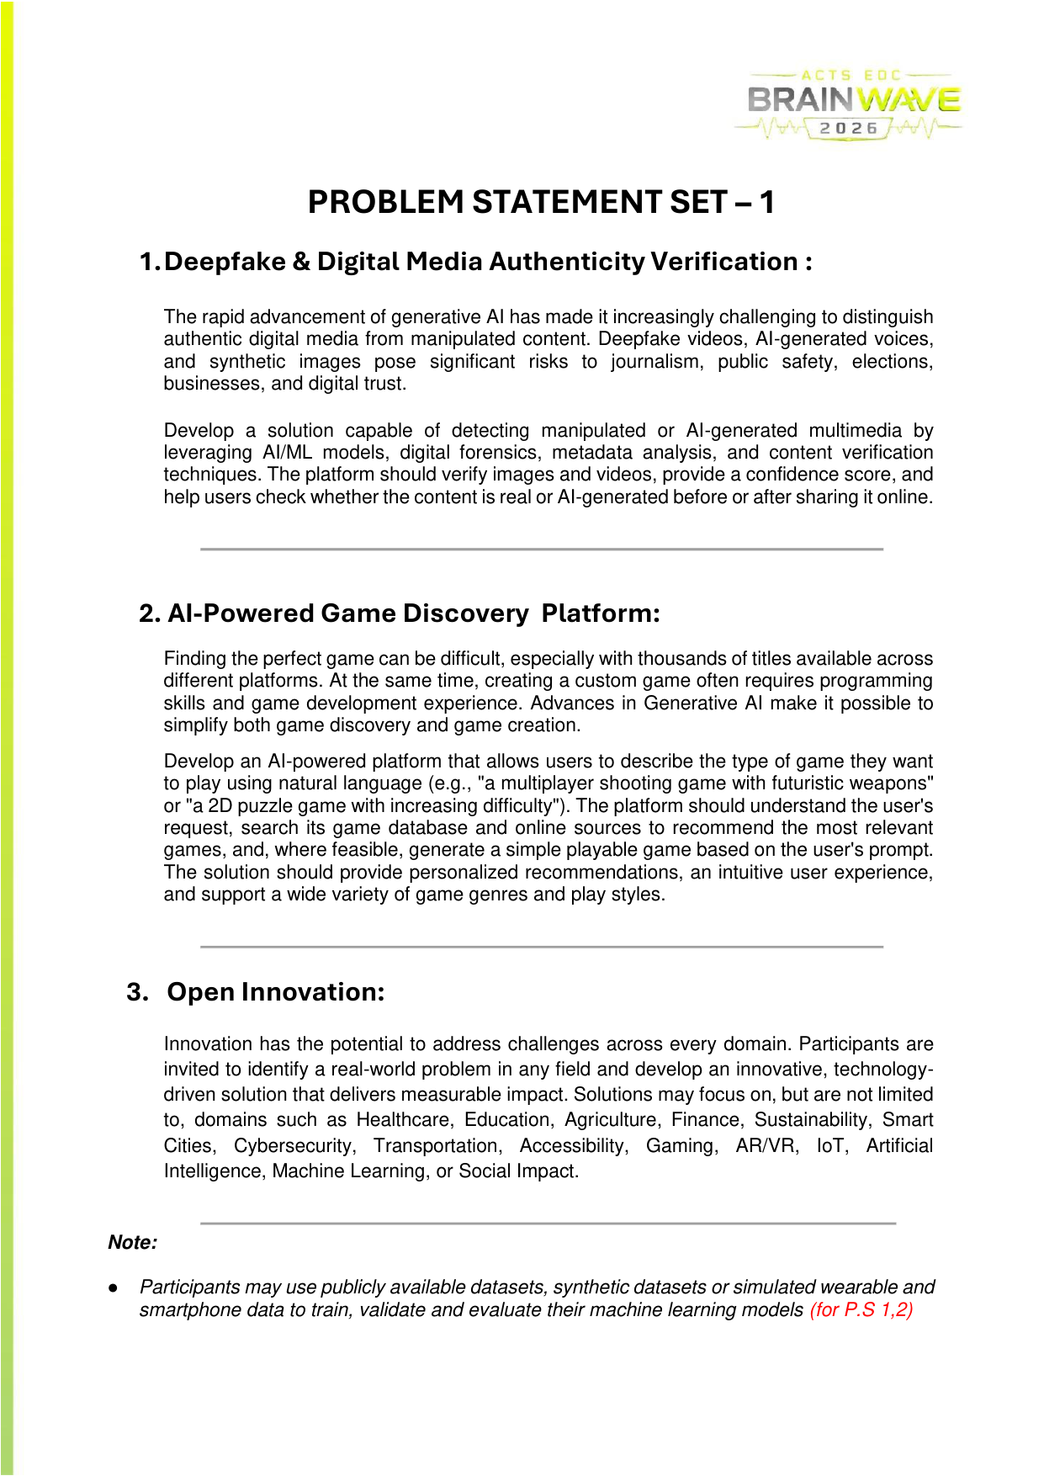
CivicShield AI
Smart city operations • AI-driven incident detection & response

Slide 2

Problem: Urban infrastructure issues go undetected or take too long to resolve
Citizens report incidents sporadically; authorities lack prioritized, verifiable, and routed reports with SLA tracking.

Slide 3
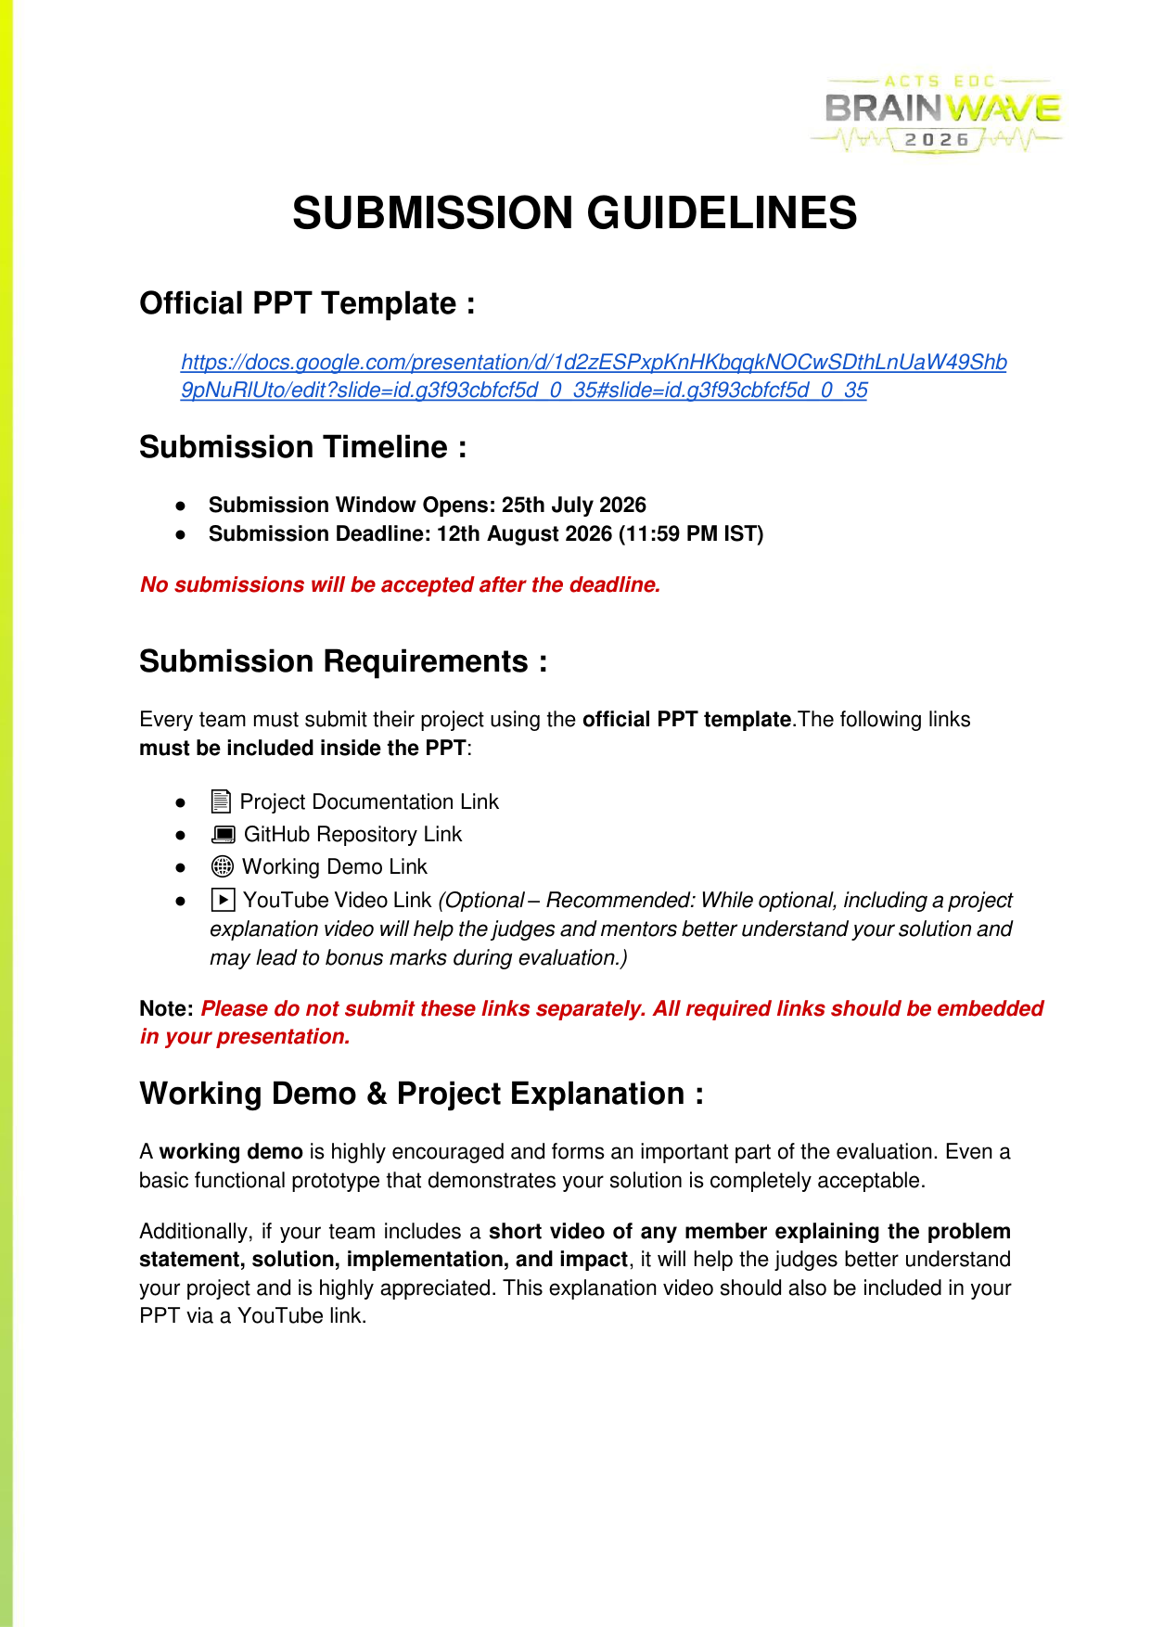
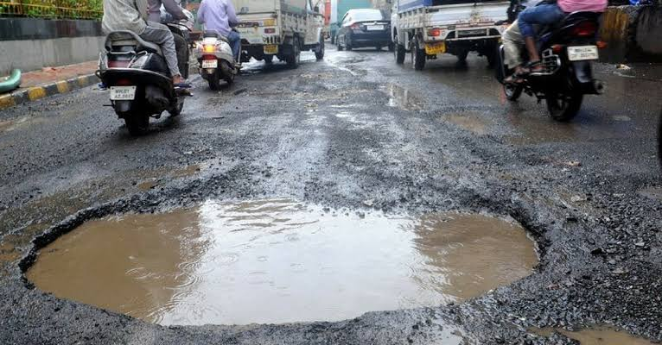
Solution: CivicShield AI
AI-powered image analysis (YOLO), priority engine, hotspot detection, SLA manager, and authority dashboard for real-time operations.

Slide 4
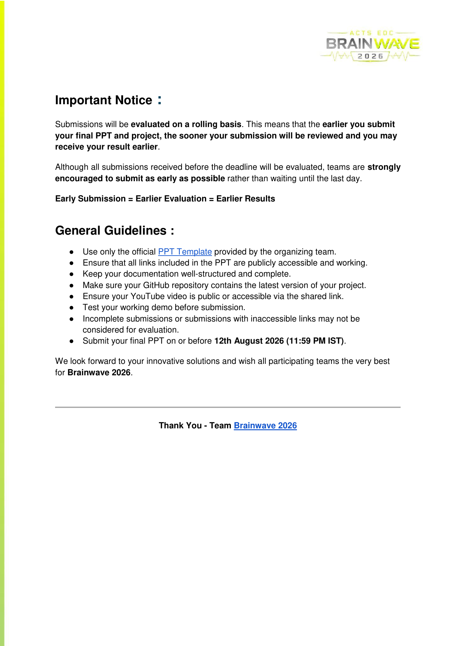
Architecture
Frontend (Vite + React) – FastAPI backend – AI services (YOLO inference) – PostgreSQL/SQLite – Authority dashboard & Map APIs.

