Slide 1
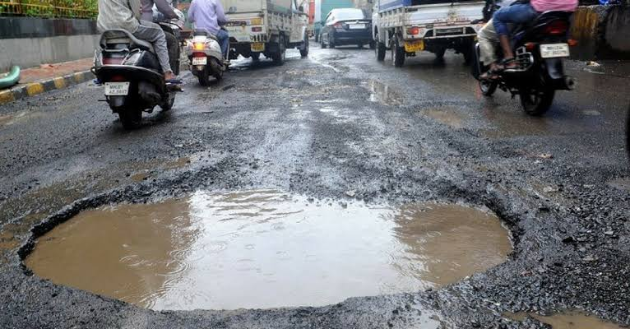
CIVICSHIELD AI
AI-Powered Smart City Civic Infrastructure Command Center
Detect • Prioritize • Dispatch • Verify

Slide 2
THE CIVIC INFRASTRUCTURE CHALLENGE
Citizen reports are fragmented, manual prioritization delays response, and verification is missing. CivicShield AI addresses potholes, garbage, broken streetlights, road damage, water leaks and infrastructure failures.
Delayed response
Manual prioritization
Scattered reports
Repeated duplicate issues
Poor SLA visibility
Weak resolution verification

Slide 3

CIVICSHIELD AI
End-to-End Smart City Command Pipeline
Citizen / Image → AI Vision → Detection → Severity & Safety → Priority → Hotspot → Department → SLA → Verification
AI-powered
Real-time
Priority-driven
Location-aware
Resolution-aware

Slide 4
AI-POWERED CIVIC INCIDENT INTELLIGENCE
Pothole detected with 95% confidence. Severity 8.8/10, Safety Risk HIGH, Priority 92/100. Recommended department: ROAD MAINTENANCE.
AI Detection
Priority Engine
Department Recommendation

Slide 5
REAL-TIME CIVIC OPERATIONS
Live dashboard monitoring with 83 total reports, 26 critical incidents, 18 high-priority issues, hotspot awareness, SLA tracking and map-driven dispatch.
83 Total Reports
26 Critical
18 High Priority
Civic Hotspots
SLA Monitoring
Live Map

Slide 6
FROM DETECTION TO RESOLUTION
Hotspots cluster nearby reports for escalation. SLA intelligence tracks targets, deadlines, due soon and breaches. Resolution verification compares before/after evidence with AI validation.
Hotspot cluster detection
Targeted SLA tracking
Evidence-based resolution verification

