Slide 1

LINKLINE
Multi-Room Chat Application using Flask and Socket.IO

Slide 2

Project Description
A real-time web-based chat system that allows multiple users to communicate simultaneously across different chat rooms. Built using Flask (Python backend) and Socket.IO for real-time communication.

Slide 3
Introduction
Communication systems are a core aspect of networking.
Chat applications facilitate real-time message exchange between clients through a server.
This project focuses on enabling multiple users to join specific chat rooms, enhancing privacy and scalability.

Slide 4
Literature
Review Early chat systems used simple client-server TCP connections.
Modern systems leverage WebSockets for low-latency, bi-directional communication.
Frameworks like Flask-SocketIO make it easier to build real-time applications in Python.
Similar platforms: Slack, Discord, and IRC — all based on room-based architectures.

Slide 5
Existing Methods
Method | Technology Used | Limitation
IRC Chat | TCP / UDP | Lacks GUI, outdated interface
Simple Flask Chat | HTTP Polling | High latency and inefficient real-time updates
Node.js Socket.IO Chat | JavaScript (Node.js) | Not Python-based; limited integration with Flask
Our Proposed System | Flask + Socket.IO | Lightweight, Python-native, supports real-time multi-room chat

Slide 6
Functionalities
Implemented User login with a username.
Multiple chat rooms support.
Real-time message broadcasting.
User join/leave notifications.
Smooth chat UI with scroll and styling

Slide 7
Advantages
Real-time, low-latency communication.
Simple and scalable backend.
Cross-browser compatibility.
Easy to extend for future features (like file sharing or private chat).

Slide 8
Limitations
No database persistence (messages disappear on refresh).
Basic security — lacks authentication and encryption.
Limited UI customization.

Slide 9
Performance Comparison
Feature | Our Application | Existing Applications
Latency | Low (real-time response) | Moderate (depends on polling or heavier frameworks)
Tech Stack | Flask + Socket.IO (Python-based) | Node.js / React (JavaScript-based)
Simplicity | High — minimal, easy-to-understand codebase | Complex — multiple dependencies and frameworks
Deployment | Easy — lightweight, Python-native environment | Requires additional setup and configuration

Slide 10
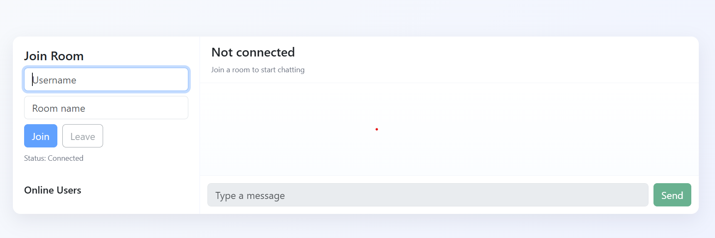
Login page

Slide 11
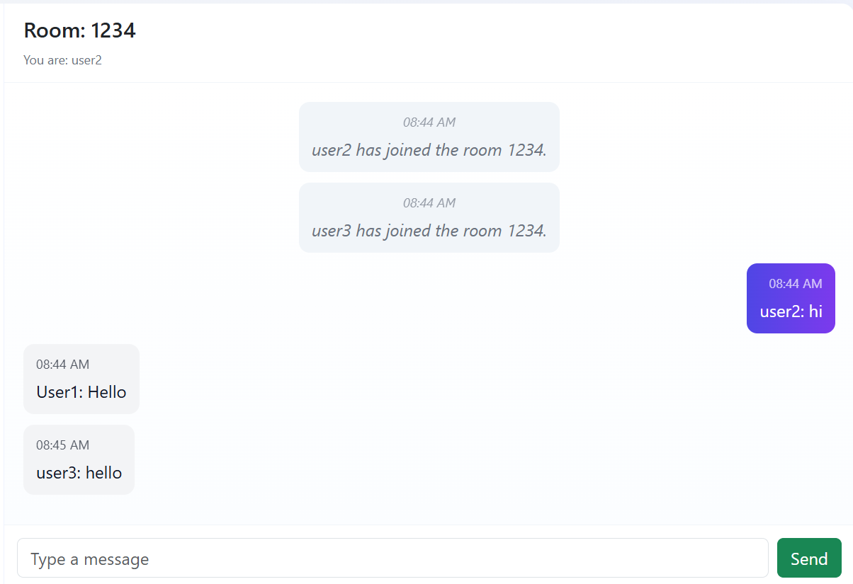
Chat room with messages:

Slide 12
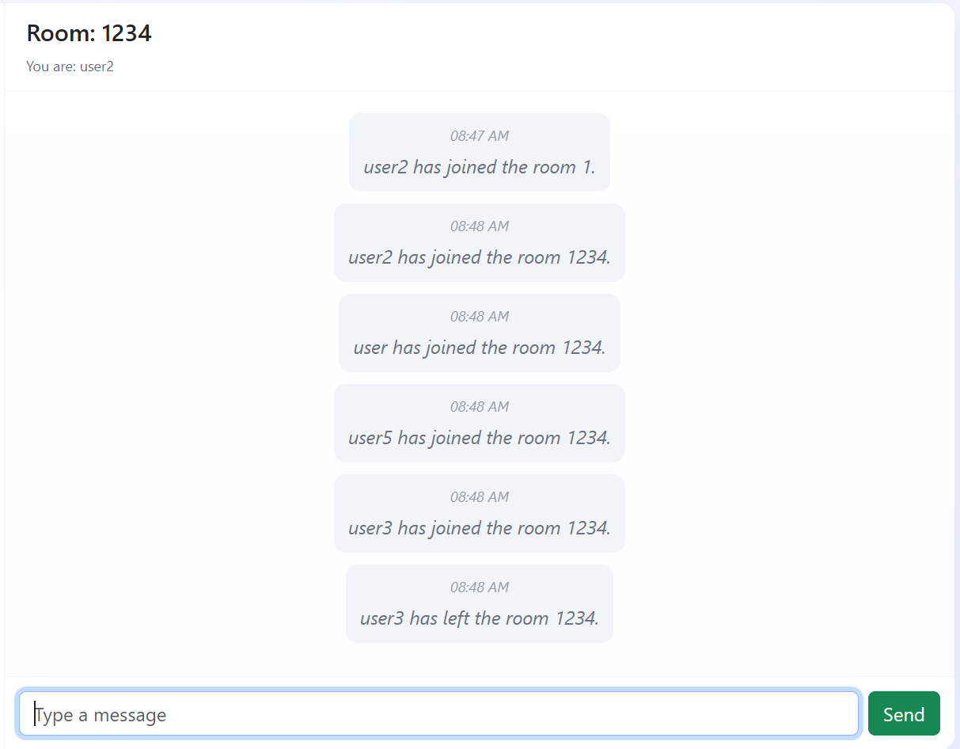
Multiple users joining

Slide 13
Conclusion
The Multi-Room Chat Application successfully demonstrates real-time message exchange across rooms using Flask and Socket.IO.
It is efficient, simple to deploy, and provides a foundation for scalable communication systems.

Slide 14
References (IEEE Format)
1. M. Grinberg, Flask Web Development, O’Reilly Media, 2018.
2. Socket.IO Documentation, “Socket.IO - Real-time bidirectional event-based communication,” [Online]. Available: https://socket.io/docs/
3. A. Tanenbaum and D. Wetherall, Computer Networks, 5th ed., Pearson, 2011.
4. Python Software Foundation, “Flask Framework,” [Online]. Available: https://flask.palletsprojects.com/

