Slide 1
ASTLI
Advanced
Smart
Traffic Lights
Andrea Leganza
Ghenadie Artic
Alberto Coluzzi

Slide 2
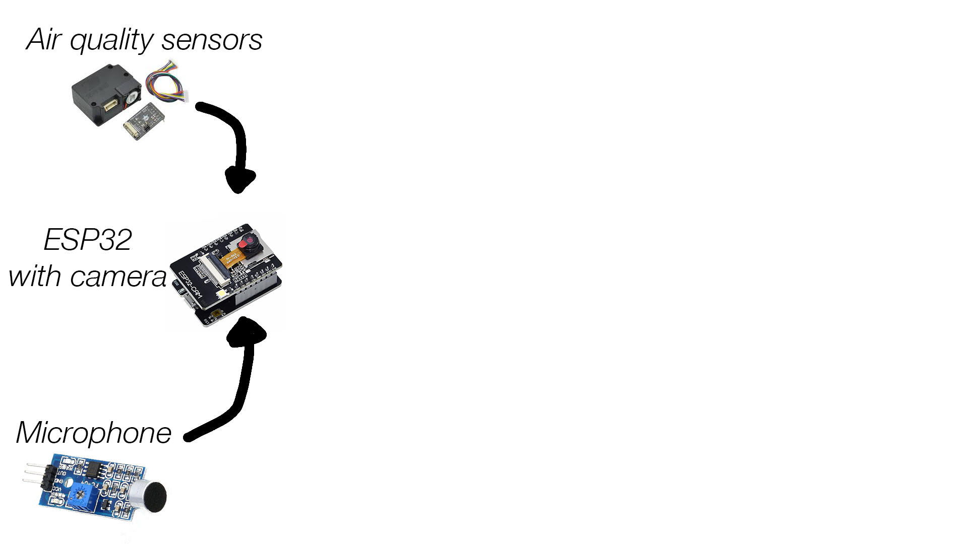
ASTLI
Detection of CO2 and PM10
Detection of traffic jam
Detection of emergency vehicles

Slide 3
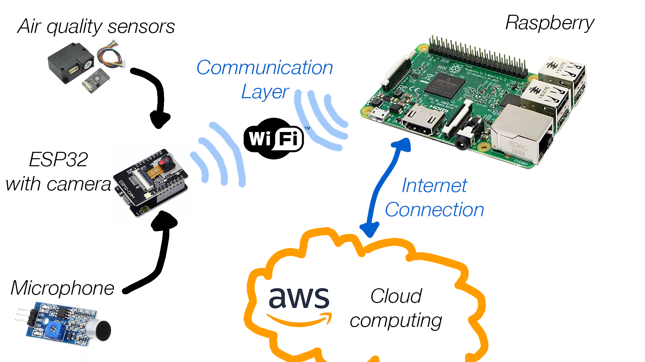
ASTLI

Slide 4
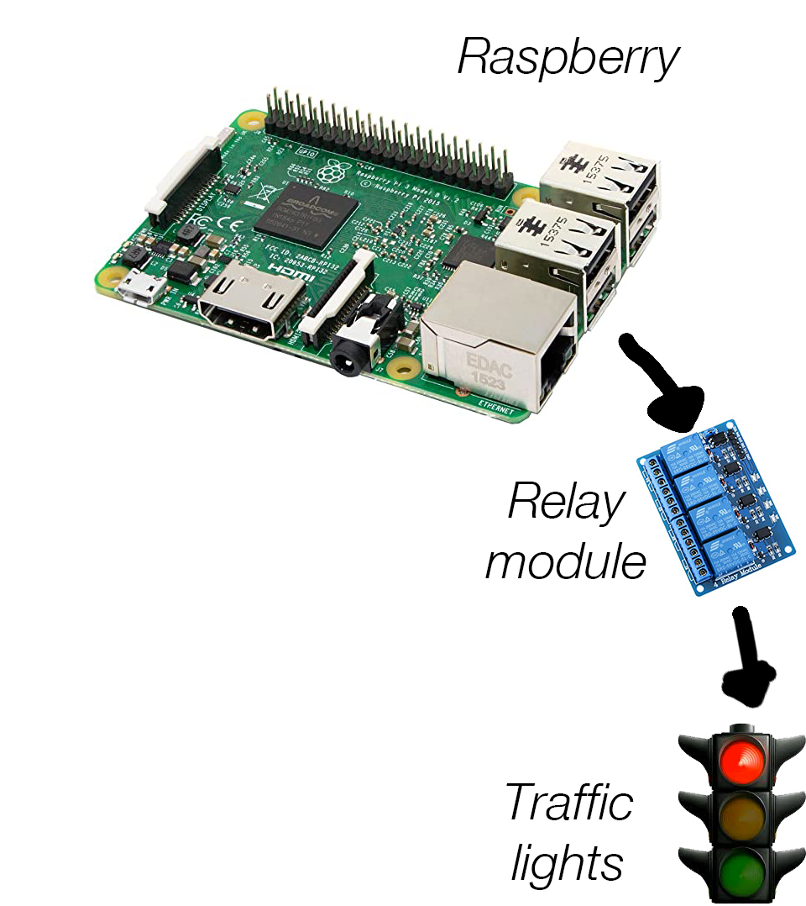
ASTLI

Slide 5
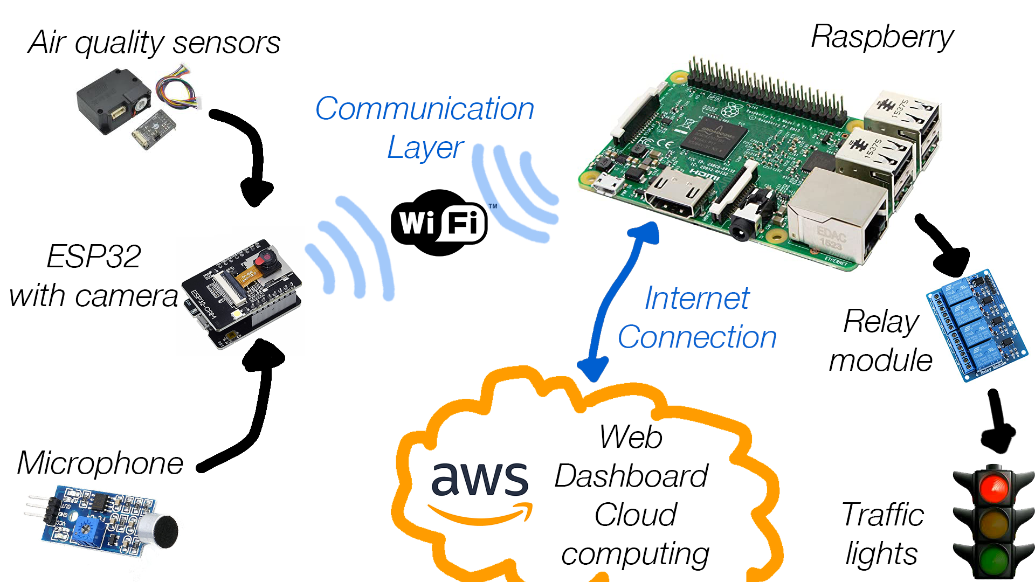
ASTLI

