Slide 1
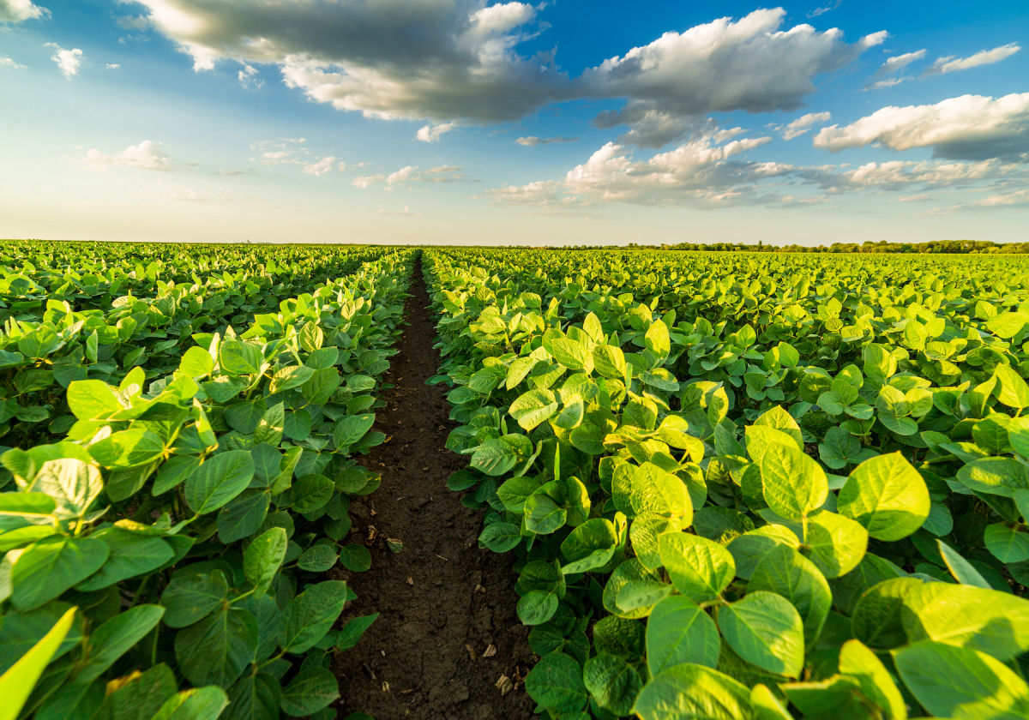
OPTIMAL PLANTING DAY
This is the graph that would be similar to the graph inside DM 44x31 – DM 51x61. It is essentially the deviation of each Maturity Group for each planting day from the Maturity Group’s mean. 43 days after 5/1 would have the highest loss of yield and 1 day after 5/1 would have the highest yield overall- meaning the red-er the column is, the higher the yield would be. If the famer is scheduling planting dates for soybean, according to this dataset, 1 day after would have the highest yield.

Slide 2
However, this conclusion was not supported by any statistical significance test. It is nothing more than basic calculation. Therefore, I dived into more detail in the mds.html file on how a proper statistic would suggest and what dates to plant would have the optimal yield.

