Slide 1
WEB DEVELOPMENT LAB – I
FINAL PROJECT
Presented By – Alok Kumar
Scholar No – 202120145
Sub To – Prof. Anirban Chaudhary

Slide 2
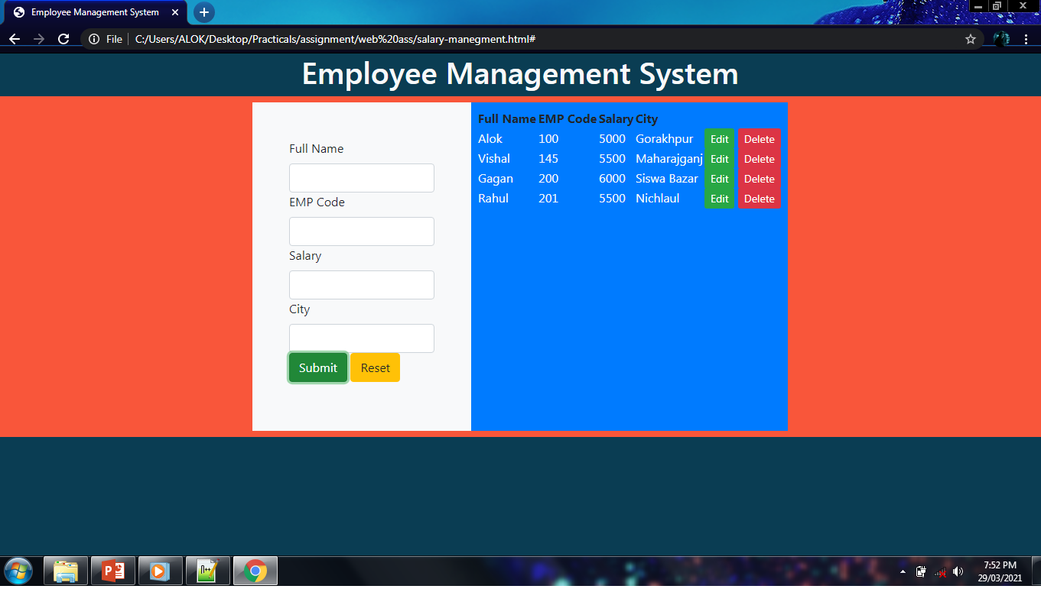
Project : Employee Management System
In this project we can store the name of employee,employee code, salary and the city of employee. Structure and Layout of this project is designed by using HTML and CSS. This project work on javascript functions. For inserting or deleting or editing there is a function created in javascript.

Slide 3
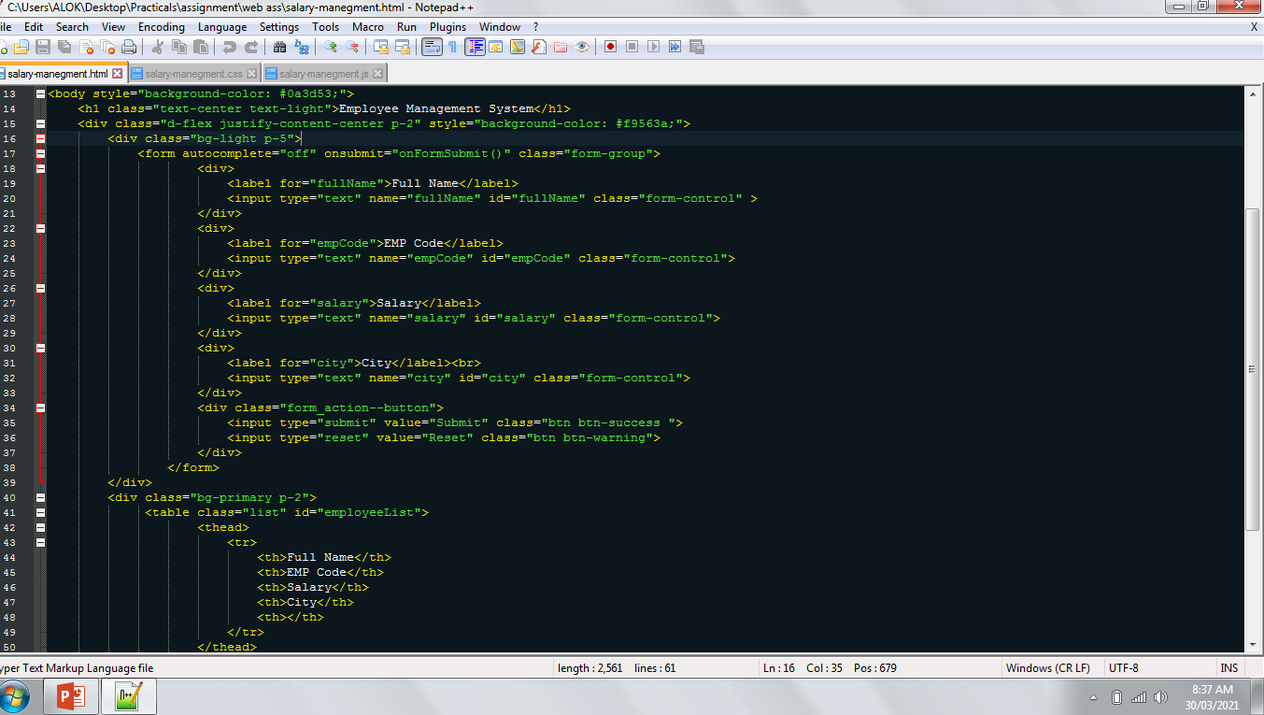
Snapshot of HTML File :

Slide 4
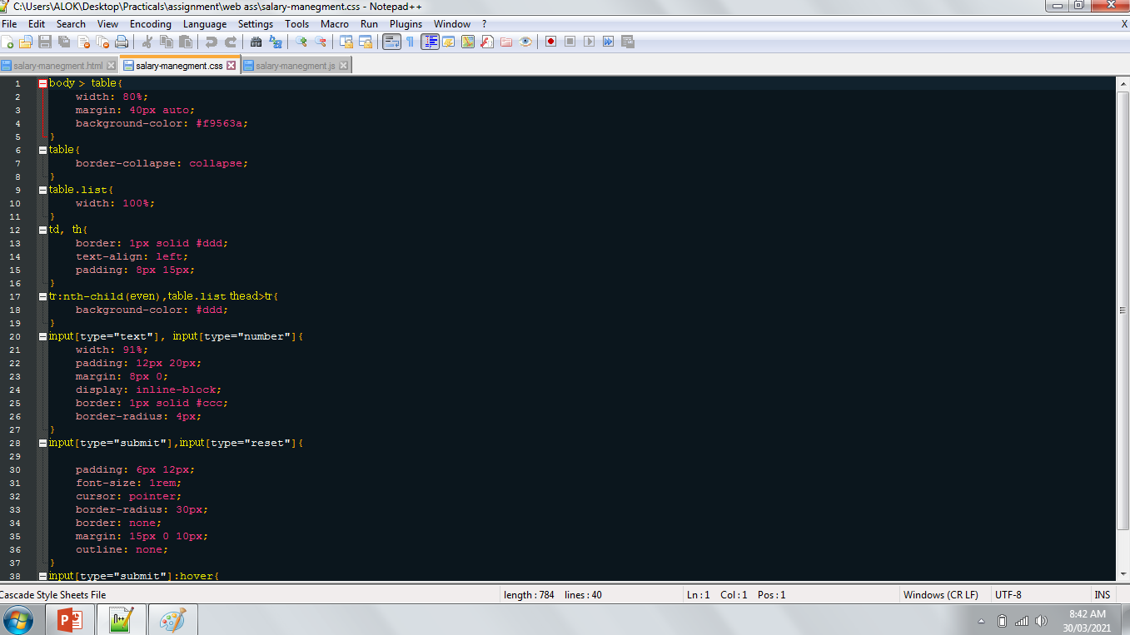
Snapshot of CSS File :

Slide 5
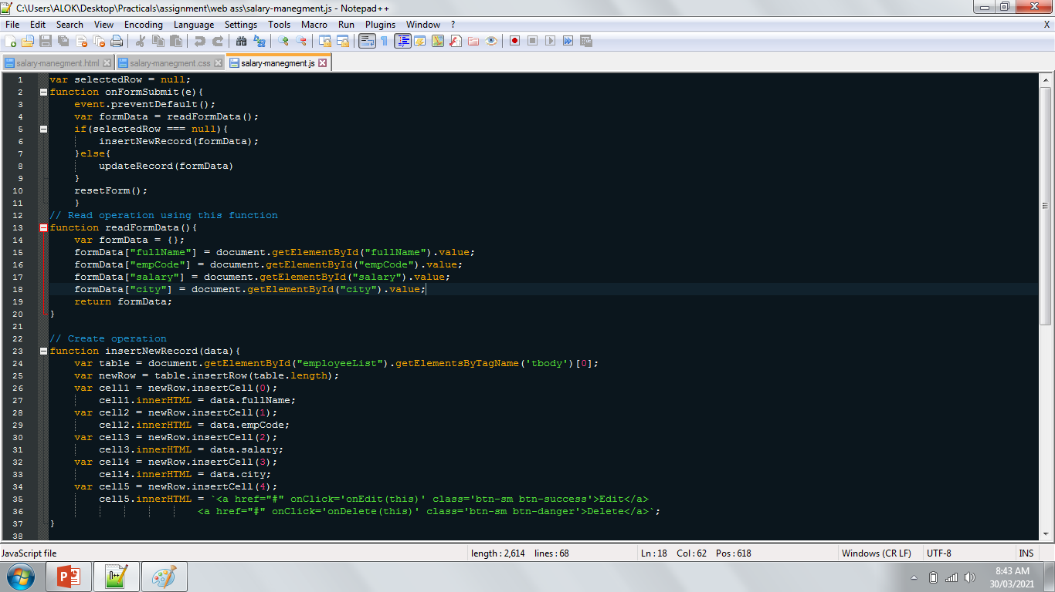
Snapshot of JS File :

Slide 6
Introduction : Employee management system In this project we can store some local data of employee
like employee name , employee code , employee salary, and the city.
Languages : HTML , CSS , JavaScript.
Tags used in HTML are following : -
Tags | References
head | Contains metadata/information for the document
title | Defines a title for the document
style | Defines style information for a document
body | Defines the document's body
h1 | Defines HTML headings
div | Defines a section in a document
form | Defines an HTML form for user input
label | Defines a label for an <input> element
input | Defines an input control
table | Defines a table
thead | Groups the header content in a table
script | Defines a client-side script

Slide 7
Used CSS properties are following : -
CSS Properties | References
Width | Sets the width of an element
Margin | Sets all the margin properties in one declaration
Background-color | Specifies the background color of an element
Border-collapse | Sets whether table borders should collapse into a single border or be separated
border | A shorthand property for border-width, border-style and border-color
Text-allign | Specifies the horizontal alignment of text
Padding | A shorthand property for all the padding-* properties
Display | Specifies how a certain HTML element should be displayed
Border-radius | A shorthand property for the four border-*-radius properties
Font-size | Specifies the font size of text
Cursor | Specifies the mouse cursor to be displayed when pointing over an element
Outline | A shorthand property for the outline-width, outline-style, and the outline-color properties
Height | Sets the height of an element

Slide 8
Terms Used in JavaScript File : -
Terms | References
Var | JavaScript variables are containers for storing data values e.g. - var x = 5; var y = 6; var z = x + y;
Function | A JavaScript function is a block of code designed to perform a particular task.A JavaScript function is executed when "something" invokes it (calls it). e.g. - function myFunction(p1, p2) { return p1 * p2; //function returns the product of p1 and p2 }
Event | HTML events are "things" that happen to HTML elements. When JavaScript is used in HTML pages, JavaScript can "react" on these events. e.g. - <element event='some JavaScript'>
If-else | Conditional statements are used to perform different actions based on different conditions. Use if to specify a block of code to be executed, if a specified condition is true Use else to specify a block of code to be executed, if the same condition is false
document | Returns the Document object for the window
onclick | The event occurs when the user clicks on an element. e.g. - <button onclick="myFunction()">Click me</button>

Slide 9
Terms | References
getElementById() | Returns the element that has the ID attribute with the specified value
getElementsByTagName() | Returns a HTMLCollection containing all elements with the specified tag name
value | Change the value of a text field. Eg. - document.getElementById("myText").value = "Johnny Bravo";
Return | The return statement stops the execution of a function and returns a value from that function. e.g. - function myFunction(a, b) { return a * b; // Function returns the product of a and b }
lenght | Returns the number of <iframe> elements in the current window
innerhtml | Sets or returns the content of an element e.g. - document.getElementById("demo").innerHTML = "Paragraph changed!";
null
alert | Displays an alert box with a message and an OK button
confirm | Displays a dialog box with a message and an OK and a Cancel button

Slide 10
Thank you

