Slide 1
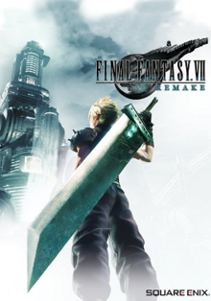
Final Fantasy 7 Remake

Slide 2
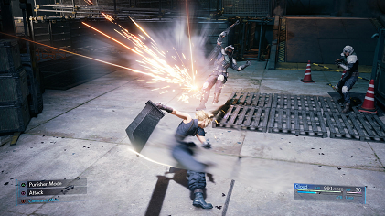
Gameplay
Players control Cloud Strife, a former Shinra soldier turned mercenary who joins the eco-terrorist group AVALANCHE to fight the Shinra Corporation, who have been draining the planet's life energy. Every element has been remade, using real-time polygonal graphics as opposed to the pre-rendered environments of the original. The story includes major expansions to character development and some notable plot additions.

Slide 3
Plot
Cloud Strife (Cody Christian/Takahiro Sakurai) is a former member of SOLDIER, the elite warriors of the Shinra Electric Power Company. Shinra uses Mako, a refined form of the Planet's spiritual energy harvested by massive reactors, to power the metropolis of Midgar and develop cutting-edge technology. Disillusioned with Shinra, and at the request of his childhood friend Tifa Lockhart (Britt Baron/Ayumi Ito), Cloud takes a mercenary job for Avalanche, an eco-terrorist organization, led by Barret Wallace (John Eric Bentley/Masahiro Kobayashi). Barret believes excessive Mako harvesting harms the planet, leading a bombing attack on a Mako reactor. In the aftermath, Cloud is haunted by memories of Sephiroth (Tyler Hoechlin/Toshiyuki Morikawa), an enigmatic former SOLDIER member, and meets the florist Aerith Gainsborough (Briana White/Maaya Sakamoto). Strange ghost-like entities, who alternately help and hinder Cloud throughout the game, cause him to be recruited for another attack, in which he goes missing in action. Cloud meets Aerith again and protects her from Shinra forces. After they reunite with Tifa, the trio learns that Shinra plans to collapse a piece of the "plate" onto the Sector 7 slums. Avalanche fails to stop Shinra's plan, and the plate falls. Aerith helps most of the population and Barret's daughter Marlene evacuate in time, but is captured by Shinra.

Slide 4
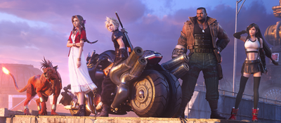
Design
The game entered full production by late 2015, led by Business Division 1, an internal production team within Square Enix. While Nomura was involved with the project from the start, he only discovered he was the director after seeing himself credited in an internal company presentation video, as he had expected Kitase to fill the role.

