Slide 1
Log Parsing and Code Analysis
Hana Frluckaj - cmu
Rama Mannava - CMU

Slide 2
Project 4 Overview
Problem:
Want an analysis of software error logs
Gain crucial insights into how clients use applications
Indicate where effort should be directed
Predict future weak points

Slide 3
Ideal Solution
Level 1:
Application will read in, parse, and process sample data
Output a summary of the number of errors
Level 2:
Platform can identify unique errors
Report errors to given subscribers by email, given certain filters
Level 3:
Application will categorize errors and recognize patterns
Be able to predict likely points of failure

Slide 4
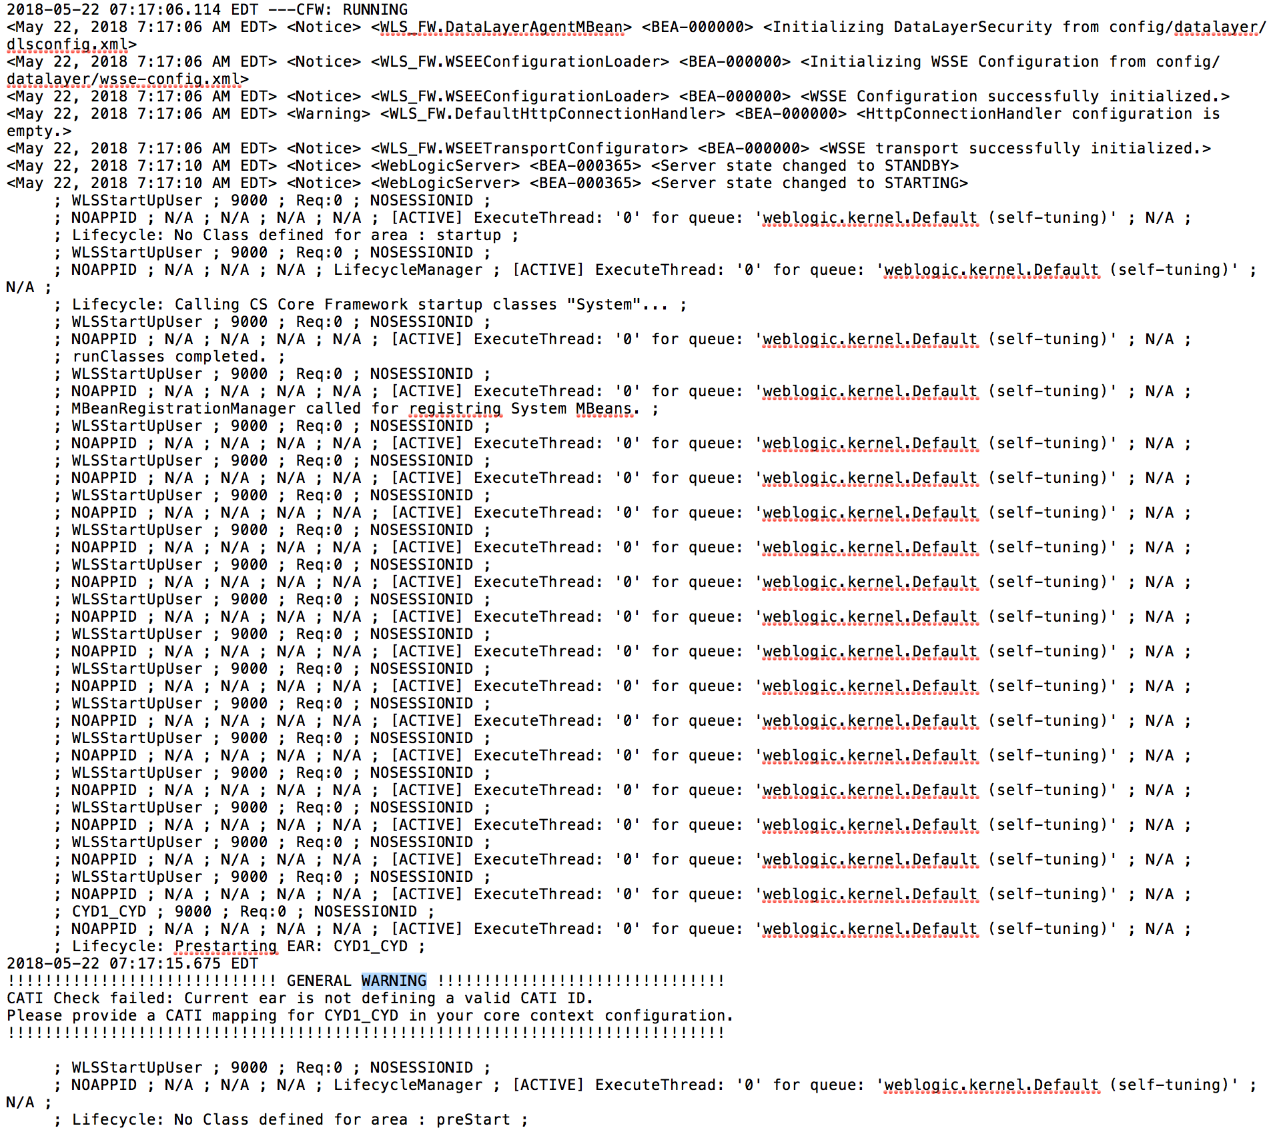
Sample Input
Throughout the sample file, we receive several different types of warnings with different severities.
Hierarchy of warnings is determined by log4j logging framework.
Time stamps connected to each warning can be used to predict patterns.

Slide 5
Error Levels
Type of Error: | Role and Definition
TRACE | Most detailed information provided
DEBUG | Provides support for application developers
INFO | Gives the progress and chosen state information
WARNING | Indicates use of deprecated API’s, poor use of API, ‘almost’ errors, and other undesirable runtime errors
ERROR | Gives information about a serious error which may result in an unstable state
FATAL | Result in premature termination
OFF | Turns off logging

Slide 6
Code

Slide 7
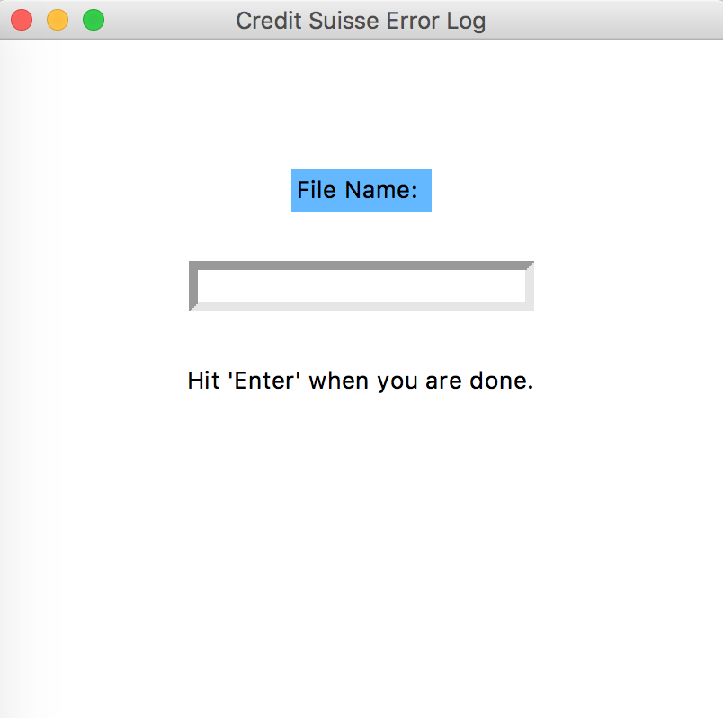
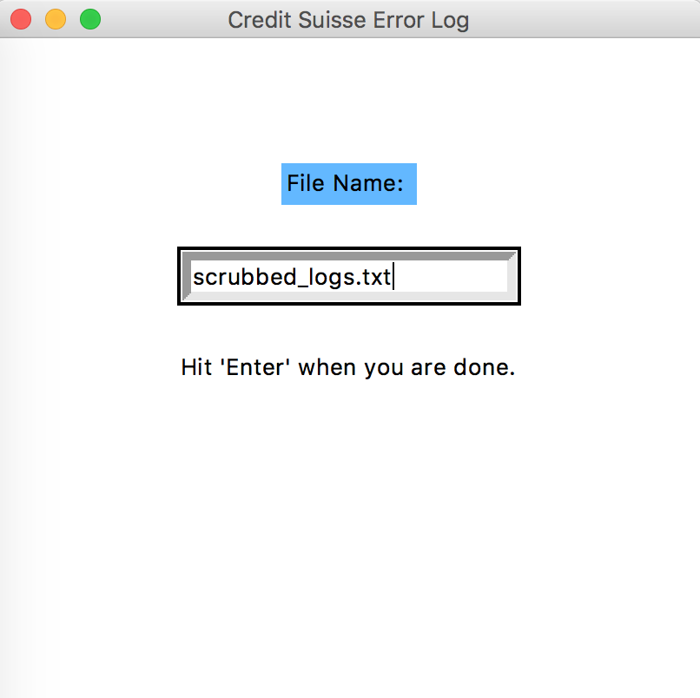
GUI
Start screen
Input log text file

Slide 8
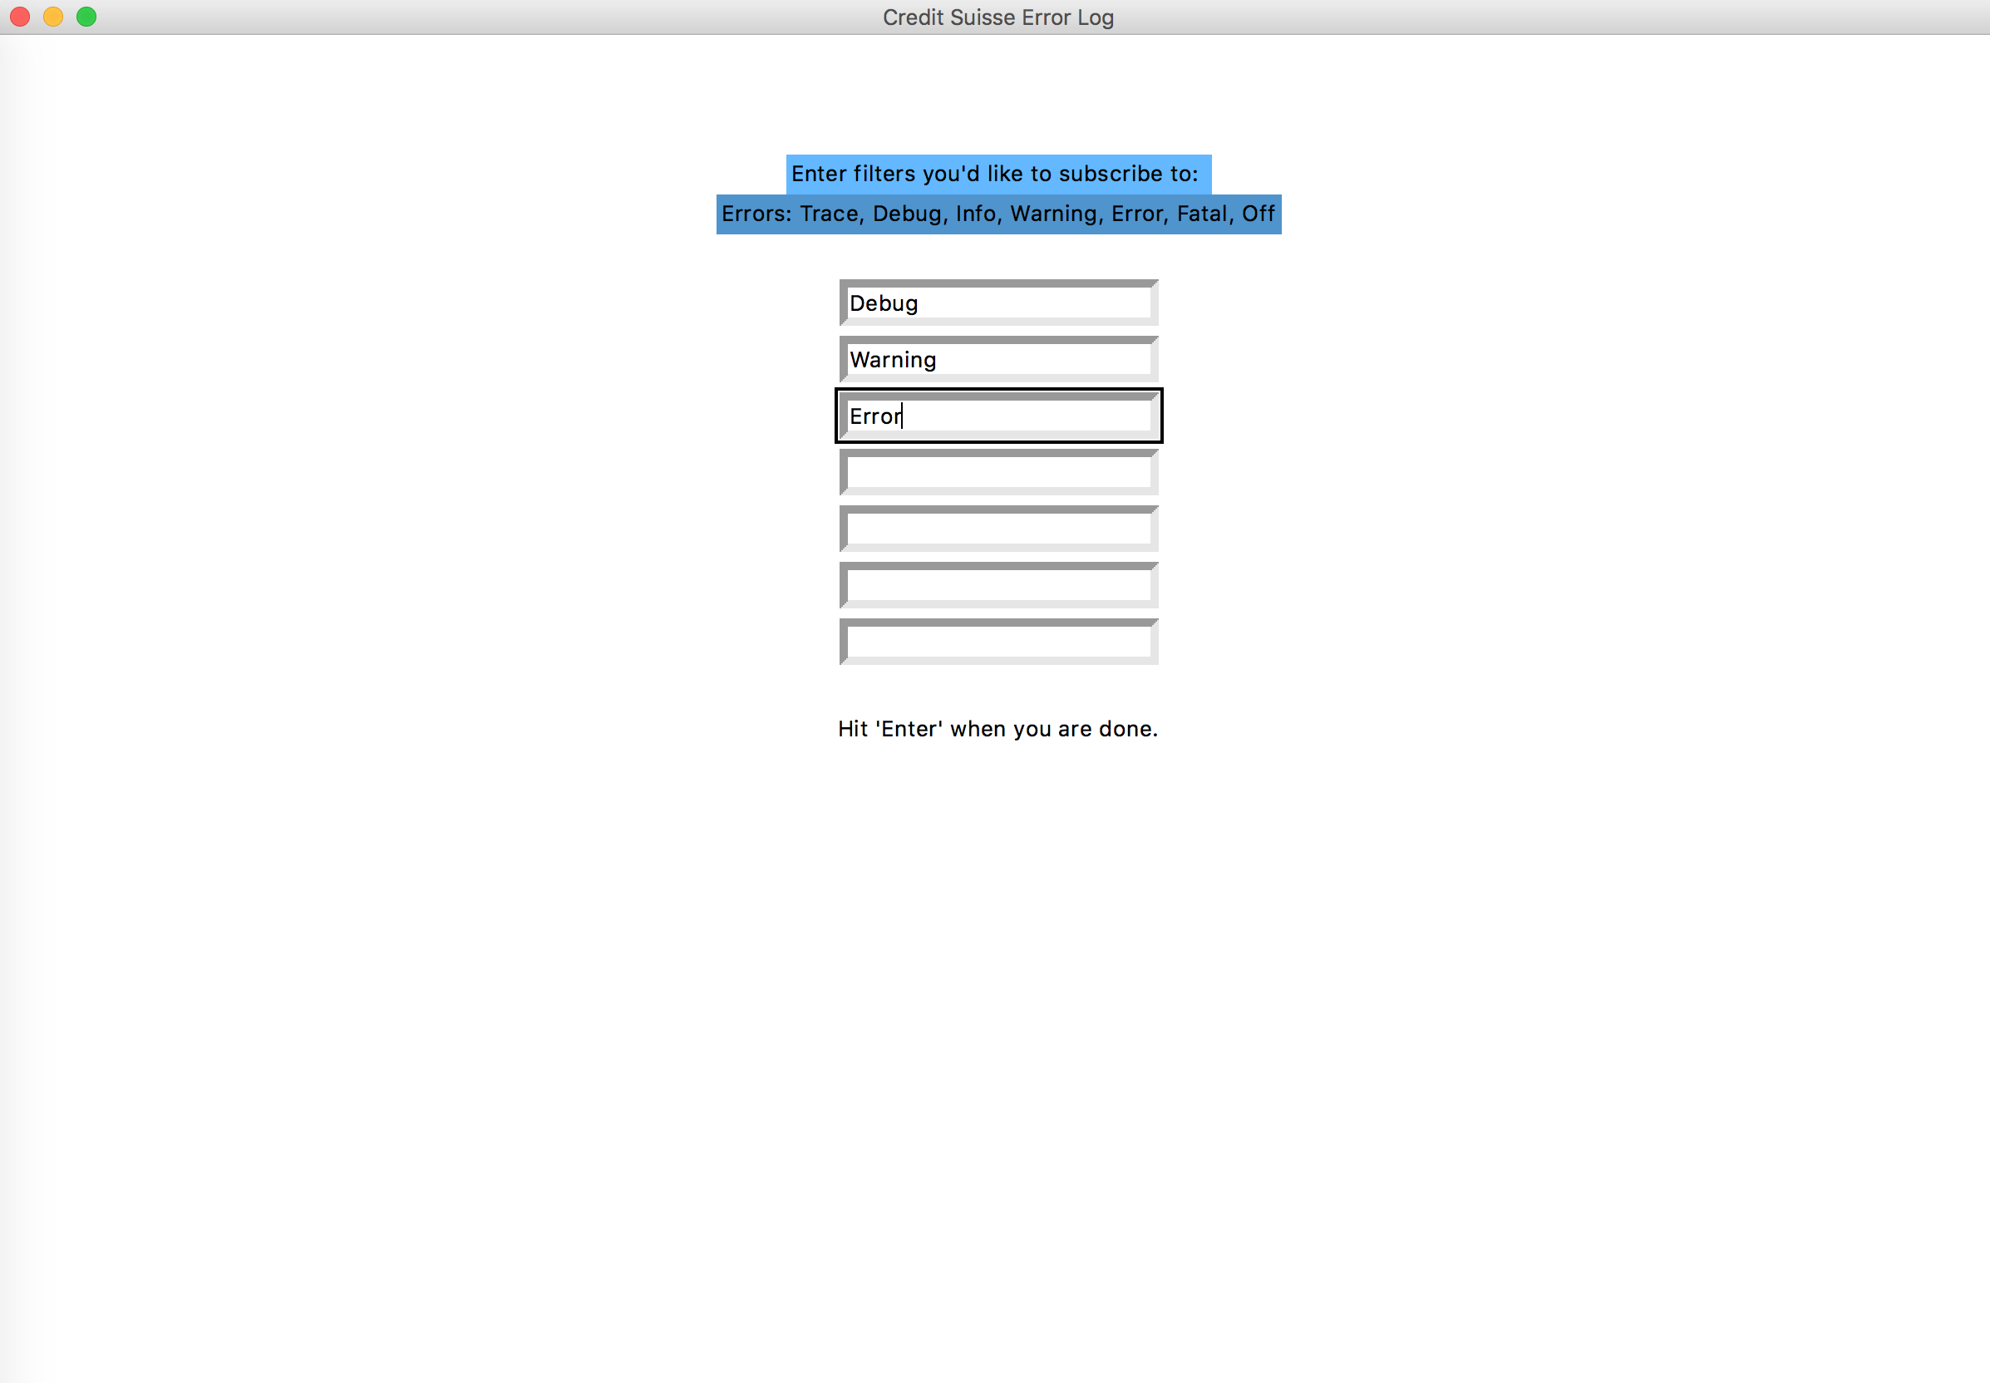
GUI

Slide 9
Future STeps
Improve the GUI
Allow users to subscribe to errors occurring within a given timeframe
Implement email-sending functionality (instead of printing to console)
Input a file containing all possible error messages
More versatile; can use application on error logs from different sources
Use Machine Learning methods to categorize data
Determine most used features
Determine which sections of code are called from the most number or sources
Determine most error prone features
Cloud
Allow users to access as a service; run continually and give output in real time

Slide 10
Why This matters
Ability to identify and categorize errors is a powerful tool
Focus efforts to eliminate errors resourcefully
Identify error-prone areas
Predict where errors might occur in the future
Save clients lots of time and money

Slide 11
Issues we ran into
GUI

Slide 12
Special Thanks to:
Chuck Russell
Alison Kiing
Sai Donthi

Slide 13
Questions?

