Slide 1
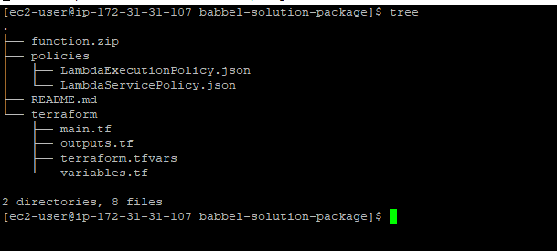
Test Execution
> Package structure

Slide 2
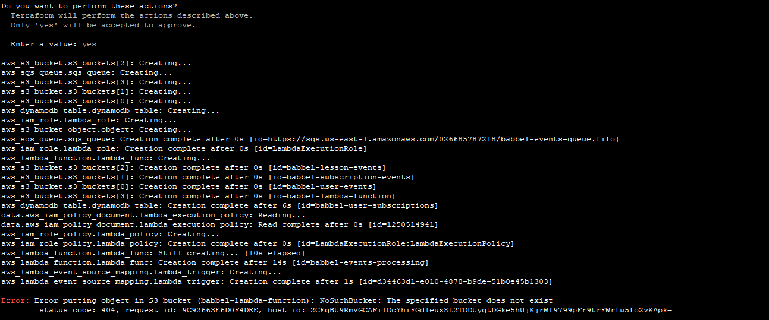
> Run Terraform Script from terraform directory
Note: Instance has an IAM Role added with Admin permissions.
terraform init
terraform apply
* error due to s3 bucket create consistency. Running “terraform apply” again will resolve it.

Slide 3
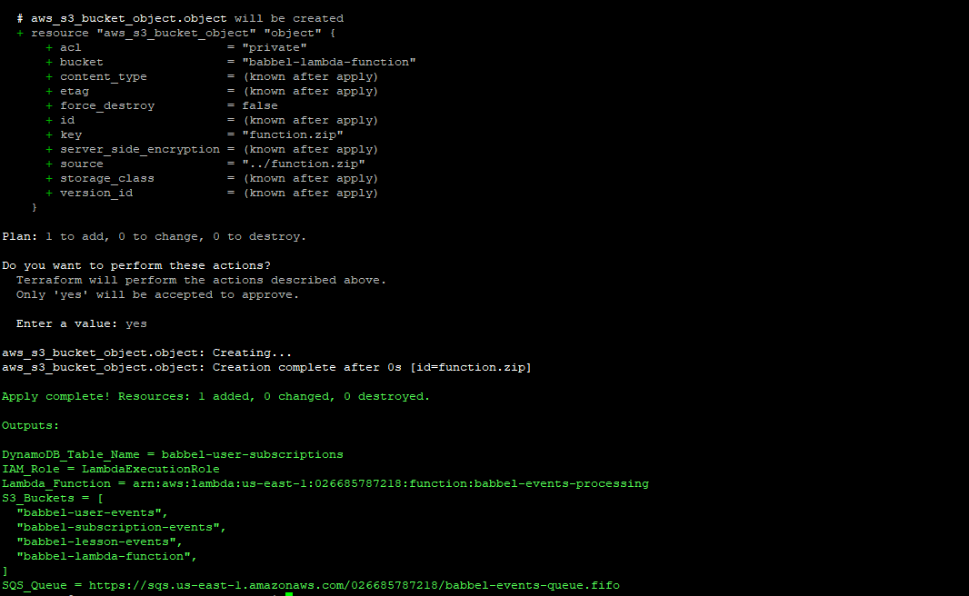
> Successfully deployed services on AWS

Slide 4
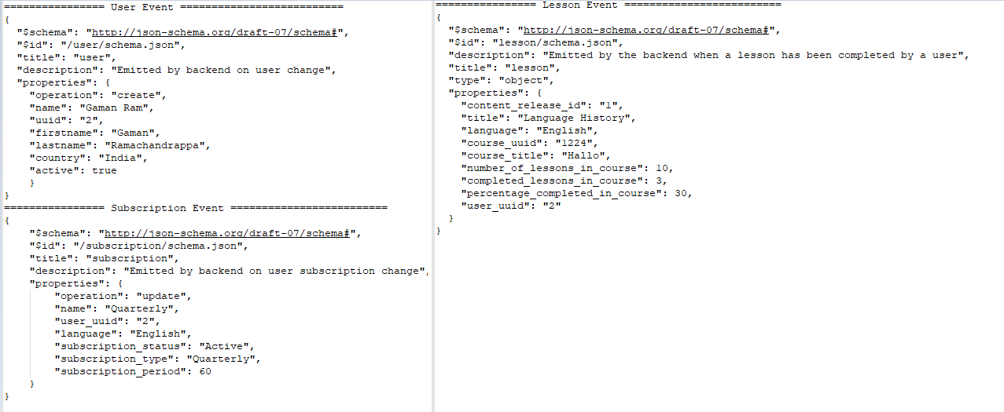
> Events..

Slide 5
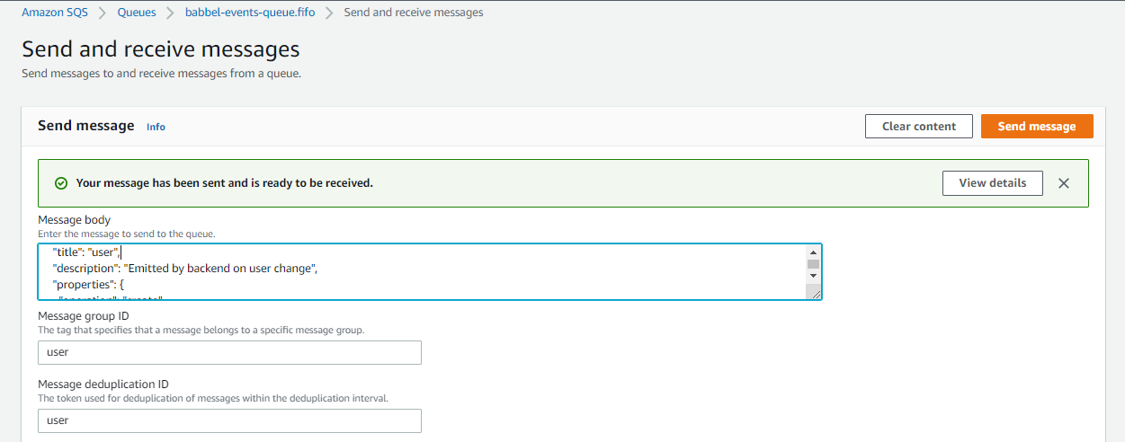
> Send events to SQS queue for processing..

Slide 6
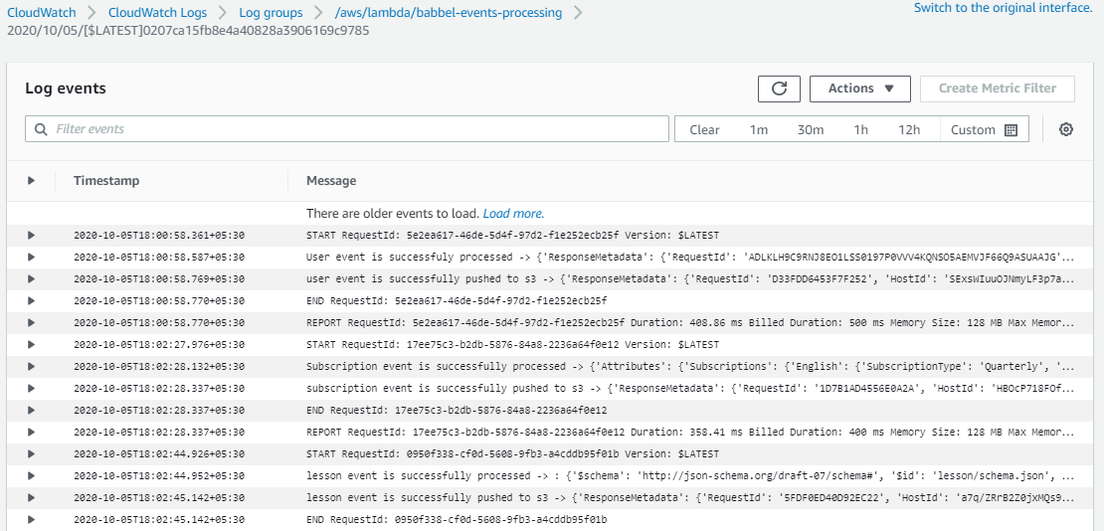
> Cloud Watch Logs

Slide 7
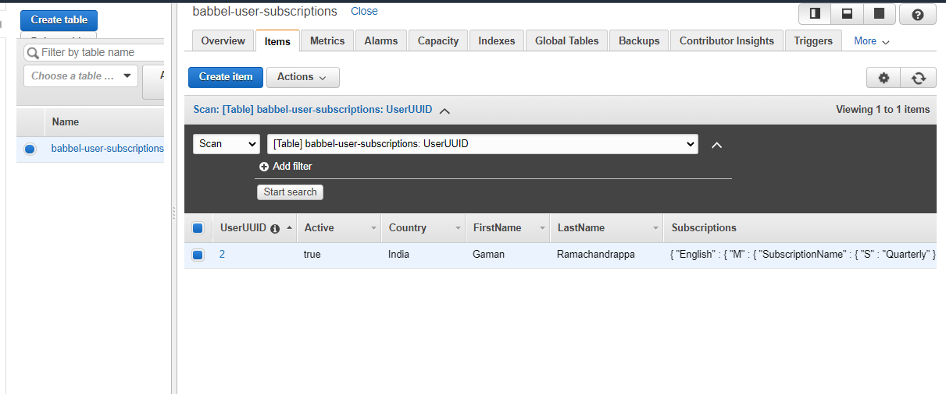
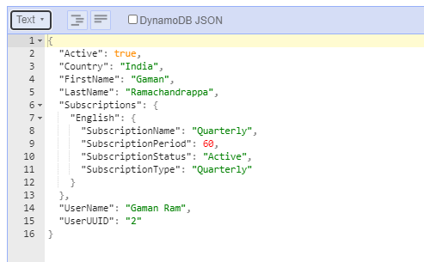
> DynamoDB Table

Slide 8
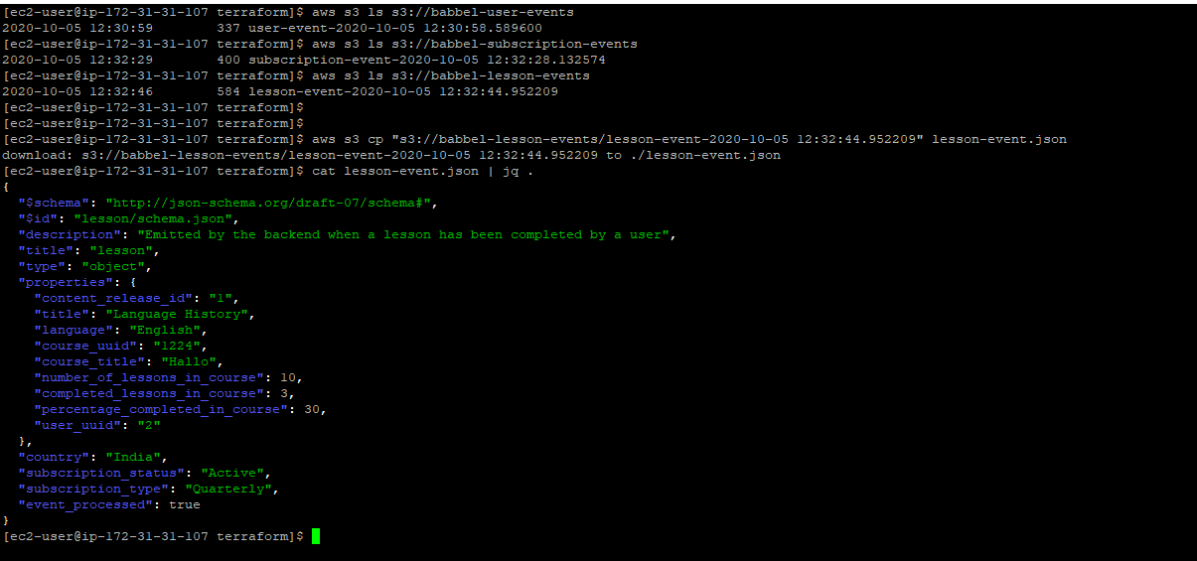
> Example of “lesson event” after processing

