Slide 1
Project
Maria Ramirez
CS579

Slide 2
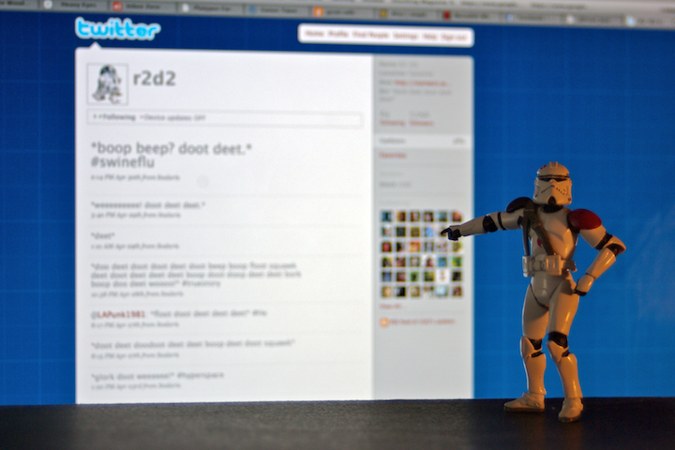
The Problem
Detect bot operated accounts on Twitter
Hypothesis:
Can we use active learning methods to learn an effective bot classifier based on text content?
faz besharatian ©2009
Notes:
Twitter: as many as 23 millions accounts (8.3%) have automated content our of 271 mill user
According to twitter < 5% MAU are spam
Automatic content generation for online social media:
Bot and astroturfing
Spam
Unwanted marketing
Account purchase
Misinformation
There are several proposed methods that use machine learning

Slide 3
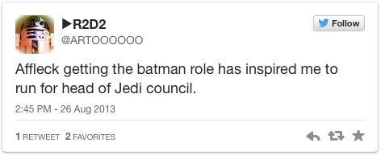
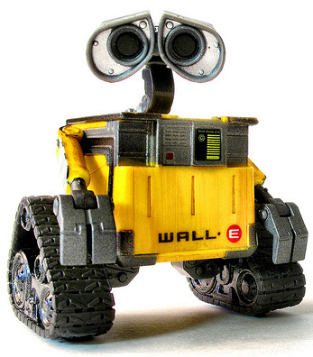
The Method
bot?
U
$
Tweets
L
Yes/No
Learner
Expert
Labeled

Slide 4
Data
Collect twitter user data:
Timeline of 200 most recent tweets
1000 users of each kind
Data from Lee et.al. 2011

Slide 5
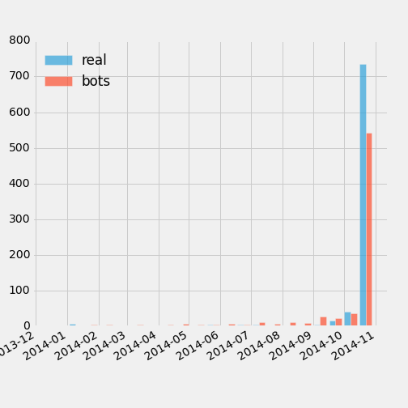
Data Stats
Activity on 2014 only
Data:
46% minority class (bots)
Legit: 838, Bots: 725
Average timeline length:
~196 tweets per user
Feature-vector
13k features
Notes:
N-grams:1
URL and mention collapse
The preprocessing didn’t affect the performance significantly, so I decided to go with less features

Slide 6
Classification Models
Logistic Regression
Penalty: L1, L2
C: 1, 10, 100
Multinomial Naïve Bayes
Alpha =1
Evaluation
5-fold cross validation
Train-test splits (5 trials)

Slide 7
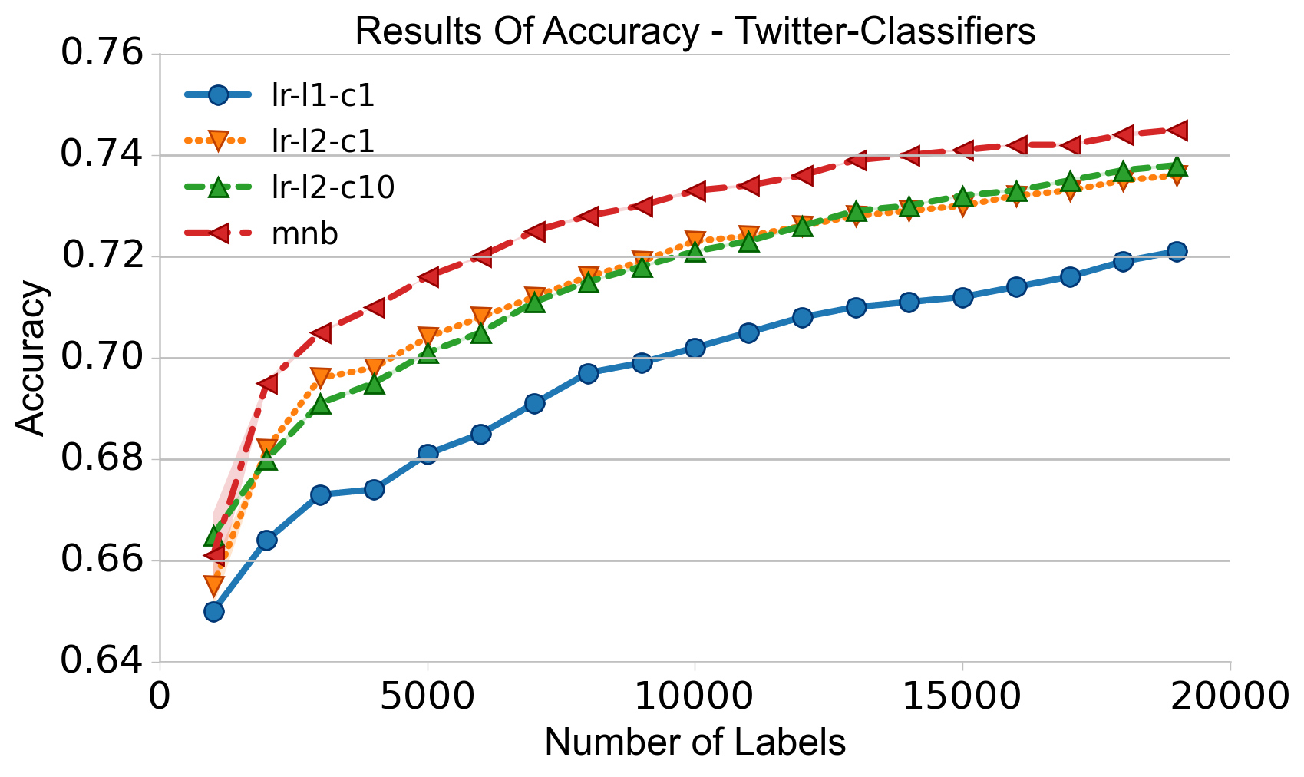
Results – Oracle Accuracy

Slide 8
Analysis: Mistakes
Other languages (e.g., Spanish)
Mentions and URLs only
Predict more bots than humans

Slide 9
Bot Predicted as Human
MENTION MENTION otro ,que a lo mejor no sabe que es la udef
Top Terms:
que -2.025
es -1.541
mention -1.537
lo -0.665
sabe -0.627
otro -0.560
no -0.382
la -0.292
mejor -0.255
a -0.204
pred=0 (0.972298) truth=1
text=rt MENTION 👻
Top Terms:
rt -1.973
mention -1.537

Slide 10
Human as Bot
massive roi for uk affiliate marketing in 2013 TURL via TMENTION
Top Terms:
mention -1.537
in 0.112
uk 0.463
massive 0.532
url 0.738
roi 1.076
for 1.389
2013 1.611
via 3.345
marketing 3.655
affiliate 4.092
top 5 tips of what to do with your tax refund: URL
Top Terms:
5 0.019
of 0.416
to 0.660
do 0.676
url 0.738
with 1.143
tax 1.223
what 1.235
refund 1.747
top 2.811
your 3.196
tips 3.762

Slide 11

Implemented Methods
Uncertainty sampling
Select first tweet
Select most important tweet
Objective
Uncertainty
First tweet
Random tweet
Best tweet

Slide 12
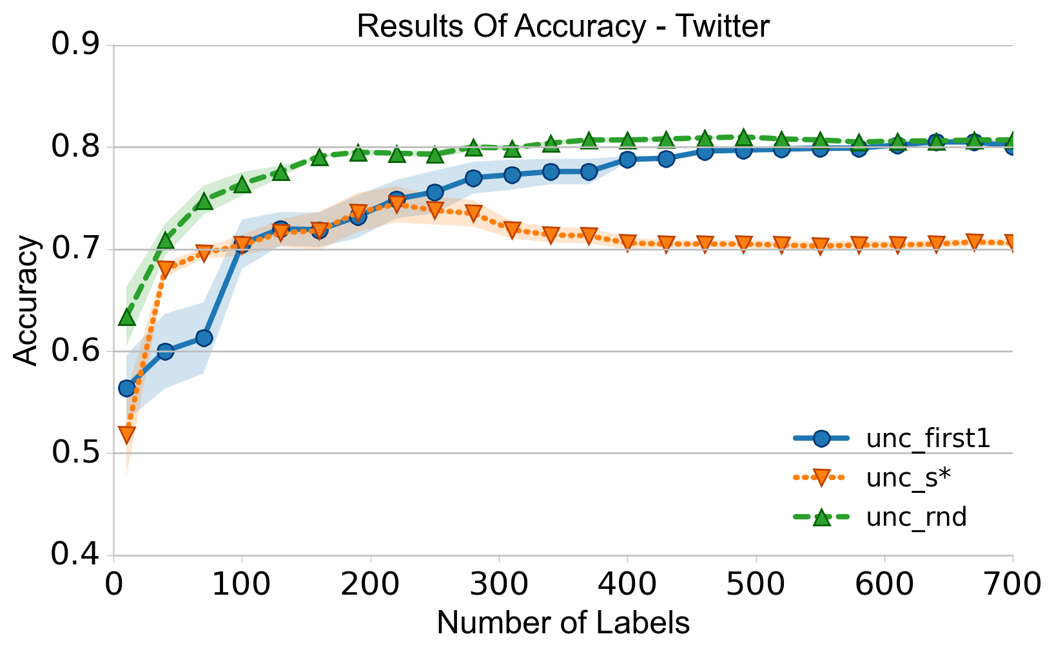
Result – Active Learning

Slide 13
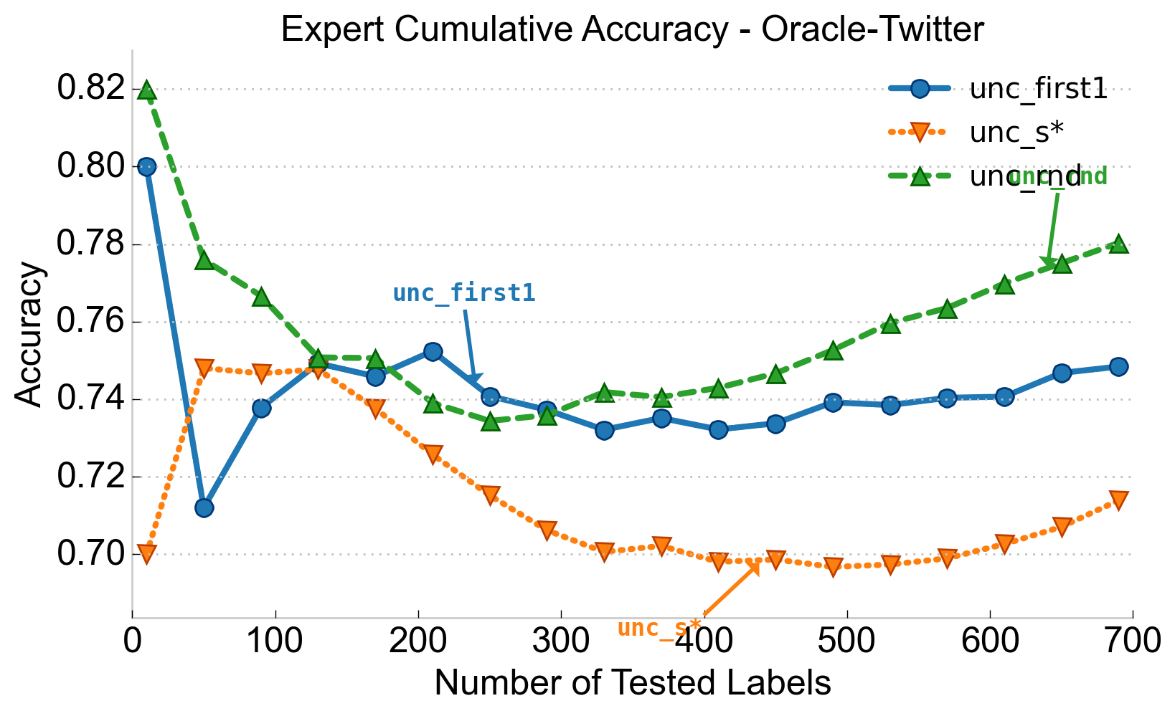
Oracle Accuracy

Slide 14
Next?
Human class imbalanced
Use threshold for best tweet
Try bigger bootstrap
Representation
Use more features one-grams and two-grams

Slide 15
Related Work
Truthy and Bot-or-not
Propose set of features
Require a lot of data
This approach:
Active learning with anytime capabilities
Novel

Slide 16
References
Ferrara, Emilio, Onur Varol, Clayton Davis, Filippo Menczer, and Alessandro Flammini. 2014. “The Rise of Social Bots” (July 19). http://arxiv.org/abs/1407.5225v1.
Lee, Kyumin, BD Eoff, and James Caverlee. 2011. “Seven Months with the Devils: A Long-Term Study of Content Polluters on Twitter.” Proceedings of the Fifth International AAAI Conference on Weblogs and Social Media (ICWSM). http://www.aaai.org/ocs/index.php/ICWSM/ICWSM11/paper/viewFile/2780/3296.
Lee, Kyumin, Prithivi Tamilarasan, and James Caverlee. “Crowdturfers , Campaigns , and Social Media : Tracking and Revealing Crowdsourced Manipulation of Social Media.”
Ratkiewicz, Jacob, Michael Conover, Mark Meiss, Bruno Gonçalves, Snehal Patil, Alessandro Flammini, and Filippo Menczer. "Truthy: mapping the spread of astroturf in microblog streams." In Proceedings of the 20th international conference companion on World wide web, pp. 249-252. ACM, 2011.
Chu, Zi, Steven Gianvecchio, Haining Wang, and Sushil Jajodia. "Who is tweeting on Twitter: human, bot, or cyborg?." In Proceedings of the 26th annual computer security applications conference, pp. 21-30. ACM, 2010.

Slide 17
Extra slides

Slide 18

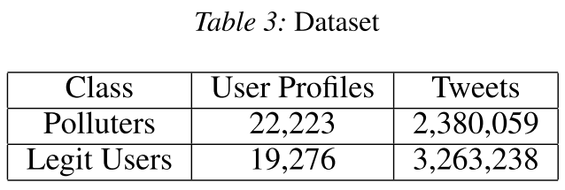
The Problem
Training model, update
Ground truth
Human annotators
Example (from Lee,2011):
Notes:
The resulting classifier obtained 98.42% accuracy but gathering the data took 7 months

Slide 19
The Problem
faz besharatian ©2009
Notes:
Twitter: as many as 23 millions accounts (8.3%) have automated content our of 271 mill user
According to twitter < 5% MAU are spam
Automatic content generation for online social media:
Bot and astroturfing
Spam
Unwanted marketing
Account purchase
Misinformation

Slide 20
Preprocessing
N-grams
URL and mention collapse

