Slide 1
Project
Maria Ramirez
CS579

Slide 2
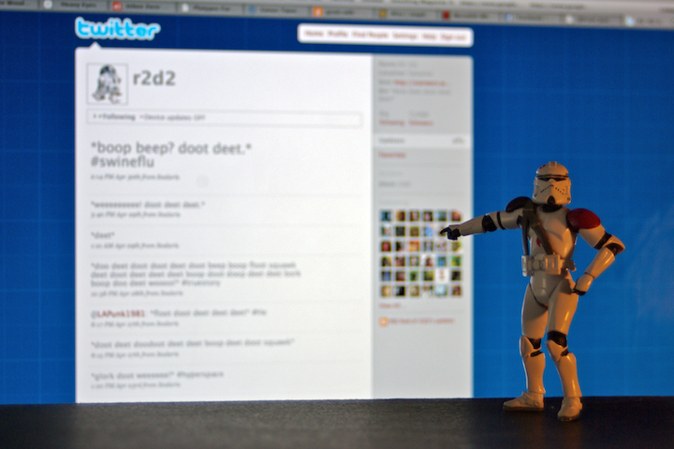
The Problem
Automatic content generation for online social media:
Bot and astroturfing
Spam
Unwanted marketing
Account purchase
Misinformation
faz besharatian ©2009
Notes:
Twitter: as many as 23 millions accounts (8.3%) have automated content our of 271 mill user
According to twitter < 5% MAU are spam
Automatic content generation for online social media:
Bot and astroturfing
Spam
Unwanted marketing
Account purchase
Misinformation
There are several proposed methods that use machine learning

Slide 3
Hypothesis
Can we use active learning methods to learn an effective bot classifier based on text content?

Slide 4
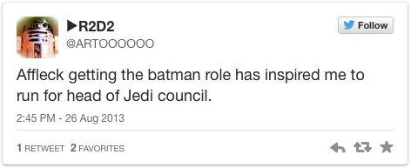
The Method
bot?
U
$
Tweets
L
Yes/No
Learner
Expert
Labeled

Slide 5
The Method
Active learning*
Evaluation:
Train-test split
5 trials
Measures: accuracy, auc

Slide 6
Data
Collect twitter user data:
Timeline of 200 most recent tweets
Activity only during 2014
Data: 46% minority class (bots)
Legit: 838
Bots: 725
Data from Lee et.al. 2011

Slide 7
Data Stats
Average timeline length: ~196 tweets per user

Slide 8
Classification Models
Logistic Regression
Penalty: L1, L2
C: 1, 10, 100
Multinomial Naïve Bayes

Slide 9
Preprocessing
N-grams
URL and mention collapse

Slide 10
Implemented Methods
Random sampling
Select the first tweet
Select a random tweet
Uncertainty sampling
Select first tweet
Select most important tweet

Slide 11
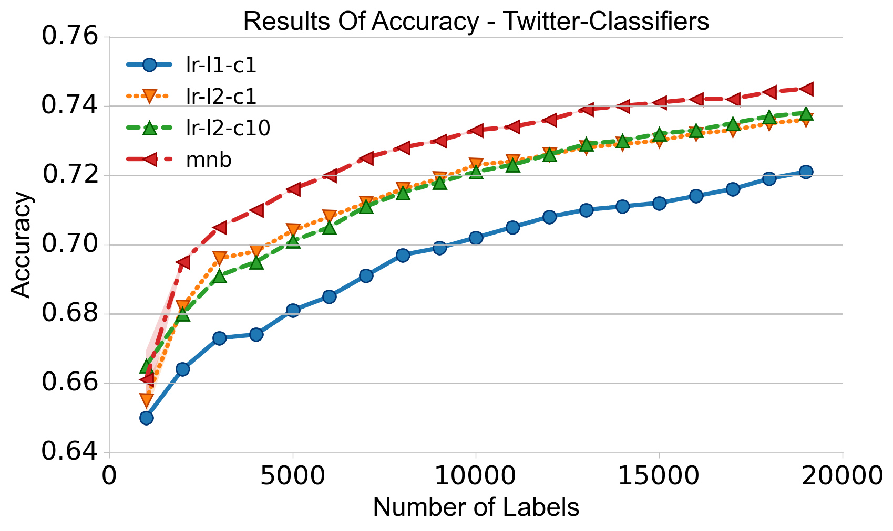
Results – Oracle Accuracy

Slide 12
Related Work
Truthy and Bot-or-not
Propose set of features
Require a lot of data
This approach:
Active learning with anytime capabilities
Novel

Slide 13
References
Ferrara, Emilio, Onur Varol, Clayton Davis, Filippo Menczer, and Alessandro Flammini. 2014. “The Rise of Social Bots” (July 19). http://arxiv.org/abs/1407.5225v1.
Lee, Kyumin, BD Eoff, and James Caverlee. 2011. “Seven Months with the Devils: A Long-Term Study of Content Polluters on Twitter.” Proceedings of the Fifth International AAAI Conference on Weblogs and Social Media (ICWSM). http://www.aaai.org/ocs/index.php/ICWSM/ICWSM11/paper/viewFile/2780/3296.
Lee, Kyumin, Prithivi Tamilarasan, and James Caverlee. “Crowdturfers , Campaigns , and Social Media : Tracking and Revealing Crowdsourced Manipulation of Social Media.”
Ratkiewicz, Jacob, Michael Conover, Mark Meiss, Bruno Gonçalves, Snehal Patil, Alessandro Flammini, and Filippo Menczer. "Truthy: mapping the spread of astroturf in microblog streams." In Proceedings of the 20th international conference companion on World wide web, pp. 249-252. ACM, 2011.
Chu, Zi, Steven Gianvecchio, Haining Wang, and Sushil Jajodia. "Who is tweeting on Twitter: human, bot, or cyborg?." In Proceedings of the 26th annual computer security applications conference, pp. 21-30. ACM, 2010.

Slide 14
Extra slides

Slide 15

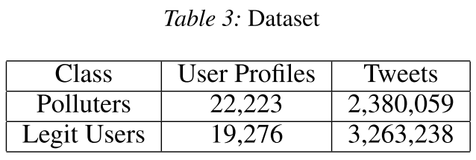
The Problem
Training model, update
Ground truth
Human annotators
Example (from Lee,2011):
Notes:
The resulting classifier obtained 98.42% accuracy but gathering the data took 7 months

Slide 16
The Problem
faz besharatian ©2009
Notes:
Twitter: as many as 23 millions accounts (8.3%) have automated content our of 271 mill user
According to twitter < 5% MAU are spam
Automatic content generation for online social media:
Bot and astroturfing
Spam
Unwanted marketing
Account purchase
Misinformation

