Slide 1
Project
Maria Ramirez
CS579

Slide 2
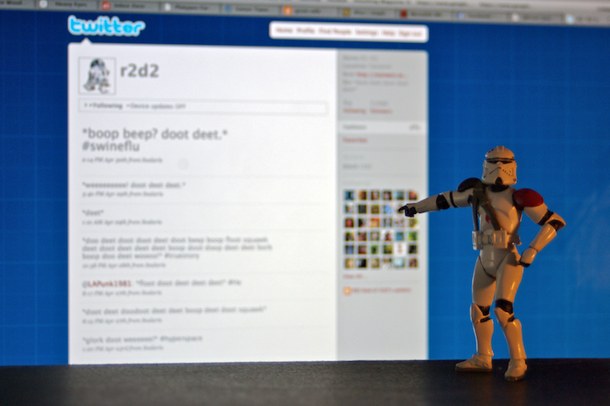
The Problem
Automatic content generation for online social media:
Bot and astroturfing
Spam
Unwanted marketing
Account purchase
Misinformation
faz besharatian ©2009
Notes:
Twitter: as many as 23 millions accounts (8.3%) have automated content our of 271 mill user
According to twitter < 5% MAU are spam
Automatic content generation for online social media:
Bot and astroturfing
Spam
Unwanted marketing
Account purchase
Misinformation
There are several proposed methods that use machine learning

Slide 3

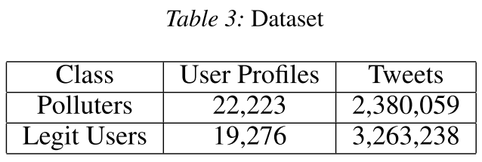
The Problem
Training model, update
Ground truth
Human annotators
Example (from Lee,2011):
Notes:
The resulting classifier obtained 98.42% accuracy but gathering the data took 7 months

Slide 4
The Problem
faz besharatian ©2009
Notes:
Twitter: as many as 23 millions accounts (8.3%) have automated content our of 271 mill user
According to twitter < 5% MAU are spam
Automatic content generation for online social media:
Bot and astroturfing
Spam
Unwanted marketing
Account purchase
Misinformation

Slide 5
Hypothesis
Can we use active learning methods to learn an effective bot classifier?

Slide 6
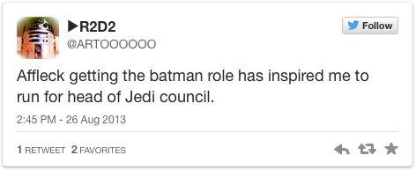
The Method
bot?
U
$
Tweets
L
Yes/No
Learner
Expert
Labeled

Slide 7
The Method
Active learning*
Evaluation:
Train-test split
10 trials
Measures: accuracy, precision, recall

Slide 8
Data
Collect twitter user data:
user profile (name, description, followers, friends)
200 most recent tweets (timeline)
Collect 1000 user from each type (legit, bots)
How to know the types:
List of researched accounts known to be bots/legit
See: Ferrara et.al. 2014, Lee et.al. 2011

Slide 9
Related Work
Truthy and Bot-or-not
Propose set of features
Require a lot of data
This approach:
Active learning with anytime capabilities
Novel

Slide 10
Timeline
Collect data (1 wk)
Preprocess data (1 wk)
Test and adjust method (1 wk)
Report results (1 wk)

Slide 11
References
Ferrara, Emilio, Onur Varol, Clayton Davis, Filippo Menczer, and Alessandro Flammini. 2014. “The Rise of Social Bots” (July 19). http://arxiv.org/abs/1407.5225v1.
Lee, Kyumin, BD Eoff, and James Caverlee. 2011. “Seven Months with the Devils: A Long-Term Study of Content Polluters on Twitter.” Proceedings of the Fifth International AAAI Conference on Weblogs and Social Media (ICWSM). http://www.aaai.org/ocs/index.php/ICWSM/ICWSM11/paper/viewFile/2780/3296.
Lee, Kyumin, Prithivi Tamilarasan, and James Caverlee. “Crowdturfers , Campaigns , and Social Media : Tracking and Revealing Crowdsourced Manipulation of Social Media.”
Ratkiewicz, Jacob, Michael Conover, Mark Meiss, Bruno Gonçalves, Snehal Patil, Alessandro Flammini, and Filippo Menczer. "Truthy: mapping the spread of astroturf in microblog streams." In Proceedings of the 20th international conference companion on World wide web, pp. 249-252. ACM, 2011.
Chu, Zi, Steven Gianvecchio, Haining Wang, and Sushil Jajodia. "Who is tweeting on Twitter: human, bot, or cyborg?." In Proceedings of the 26th annual computer security applications conference, pp. 21-30. ACM, 2010.

