Slide 1


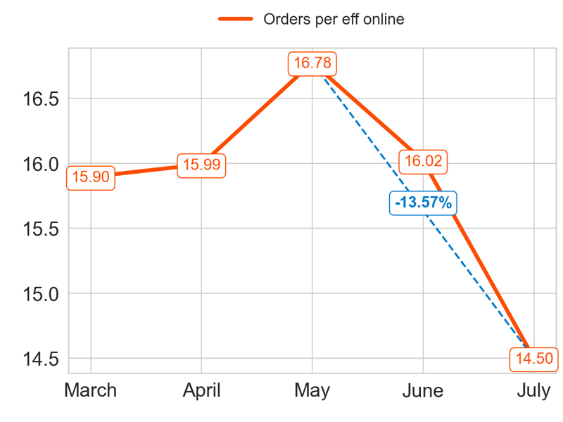
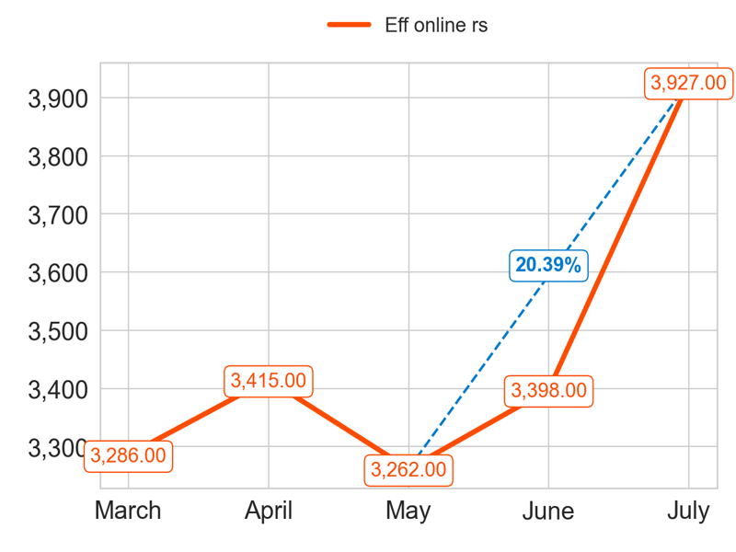
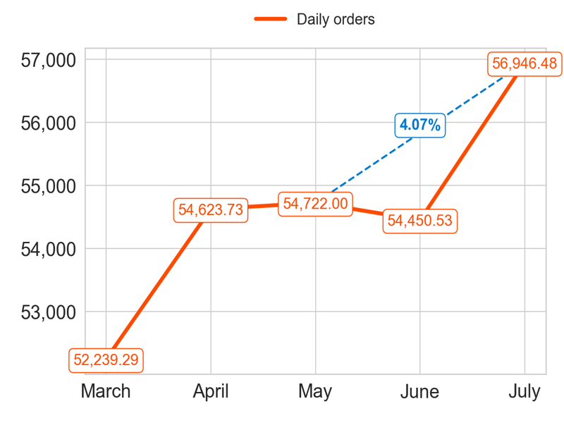
PERFORMANCE
Action Title
Priority 1 -
Insights
Mean over the last 4 months: 15.82
Mean over the last 4 months: 3500.5
Mean over the last 4 months: 55185.69

Slide 2
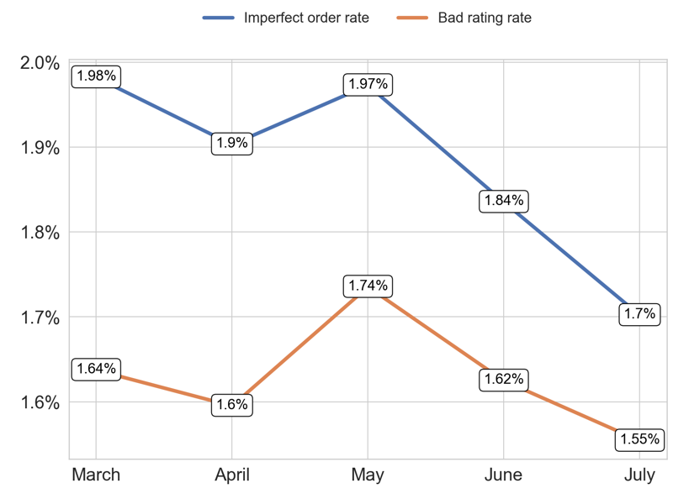
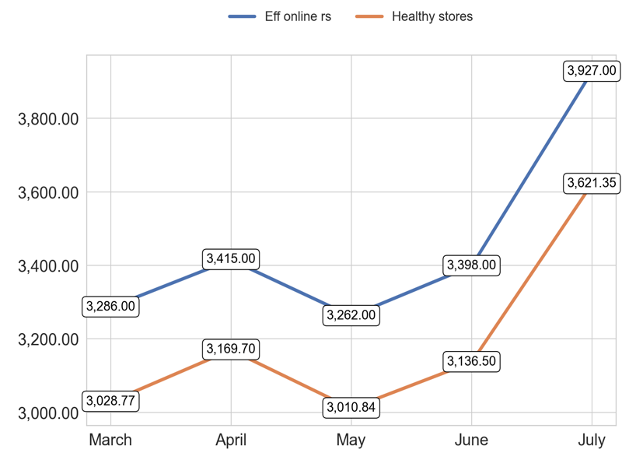
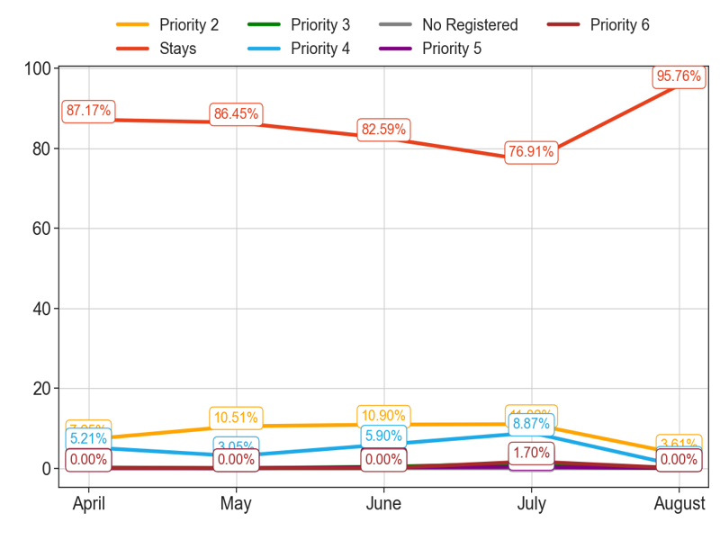
MIXED
Action Title
Priority 1 -
Insights
Example text
Example text
Example text

Slide 3
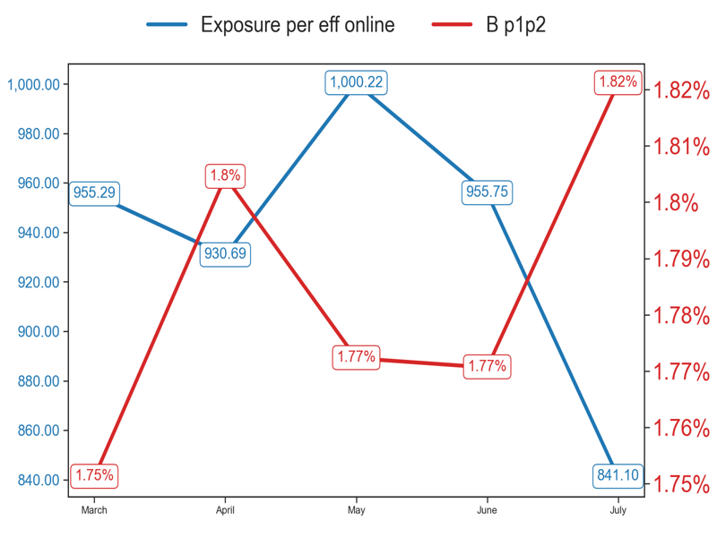
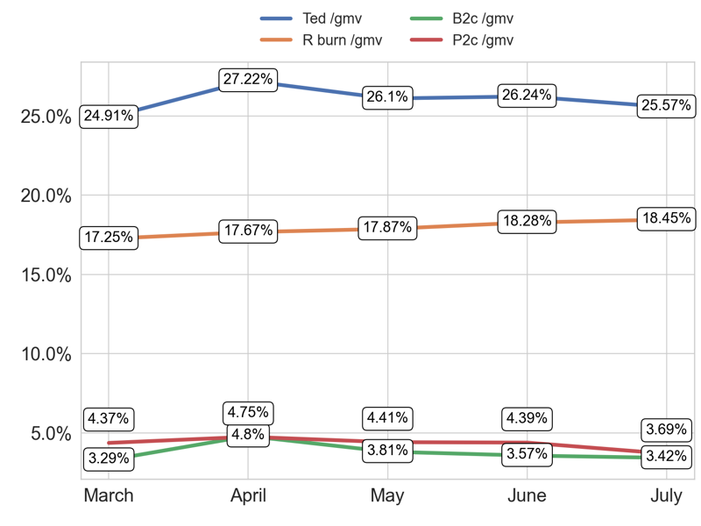
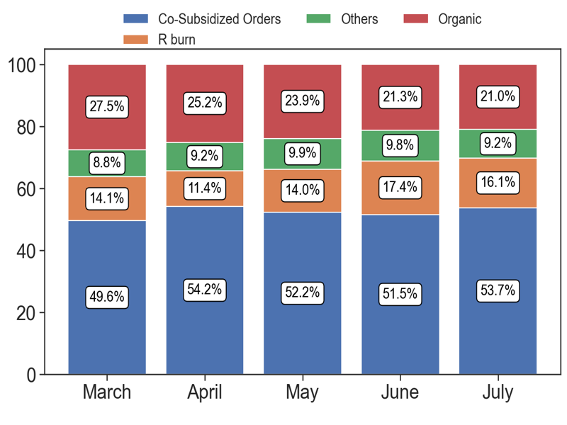
SERVICE
Action Title
Priority 1 -
Insights
Example text
Example text
Example text

Slide 4
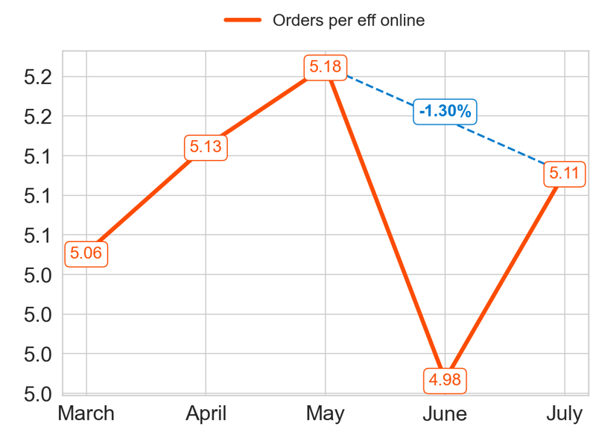
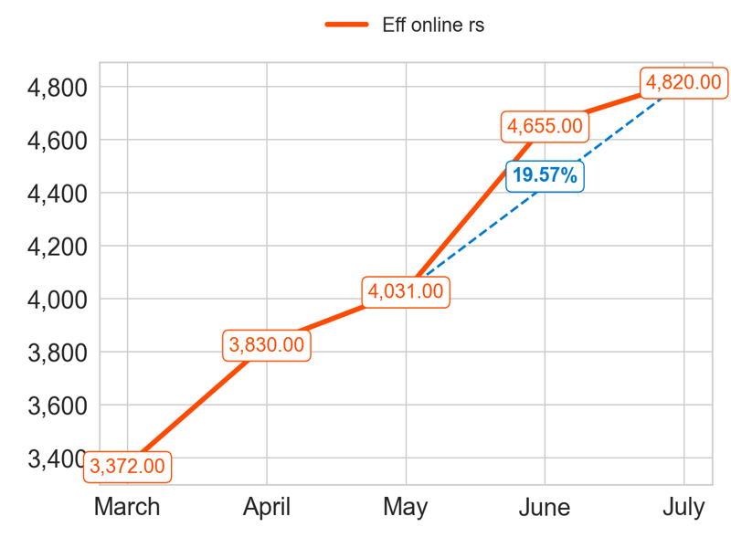
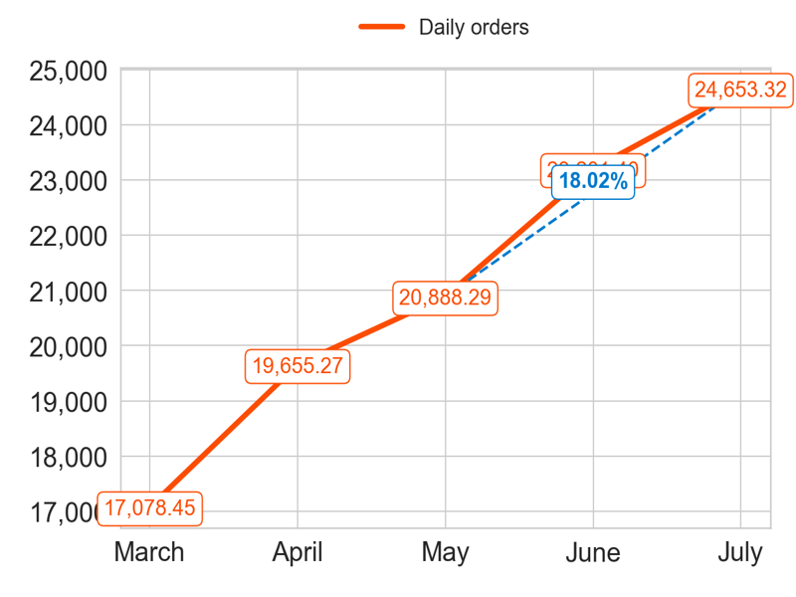
PERFORMANCE
Action Title
Priority 2 -
Insights
Mean over the last 4 months: 5.1
Mean over the last 4 months: 4334.0
Mean over the last 4 months: 22099.57

Slide 5
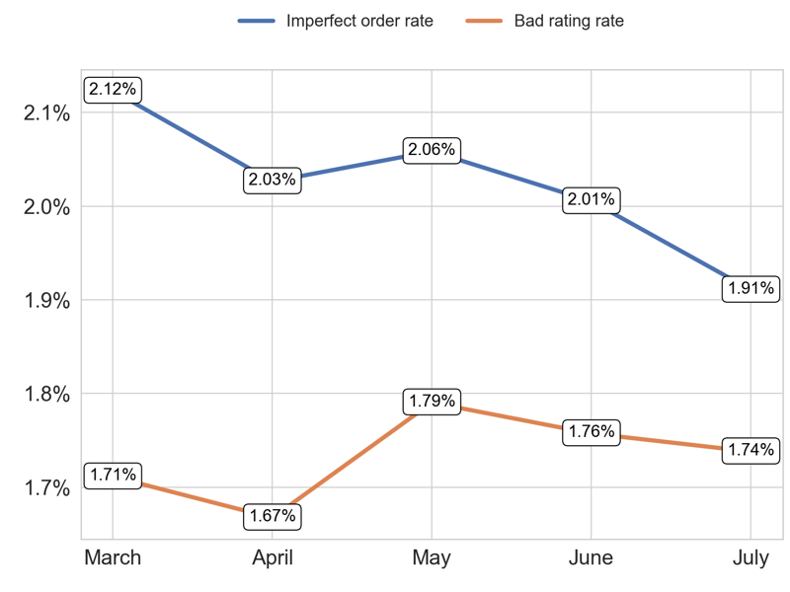
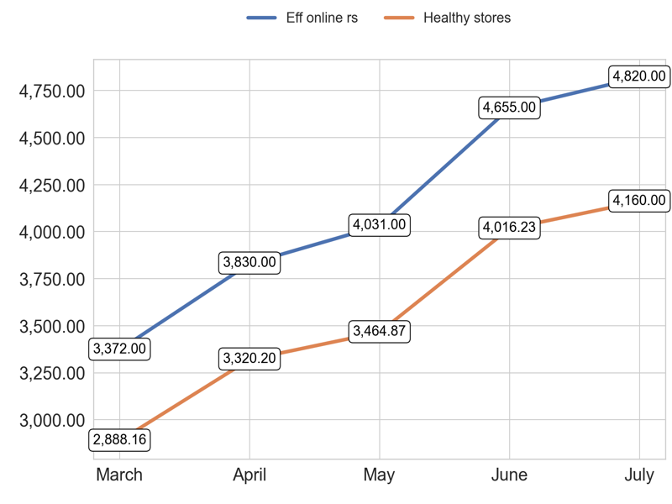
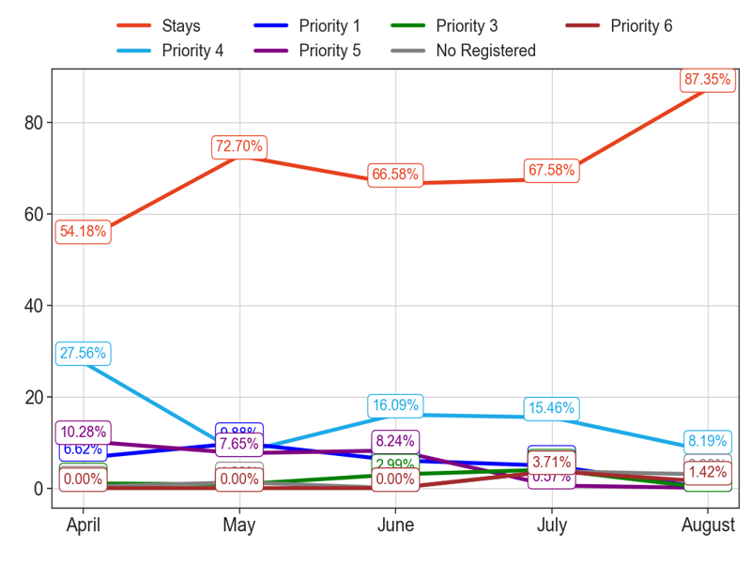
MIXED
Action Title
Priority 2 -
Insights
Example text
Example text
Example text

Slide 6
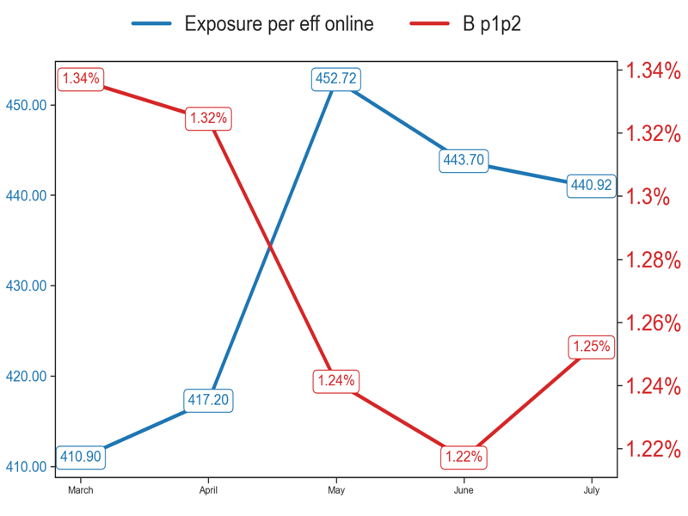
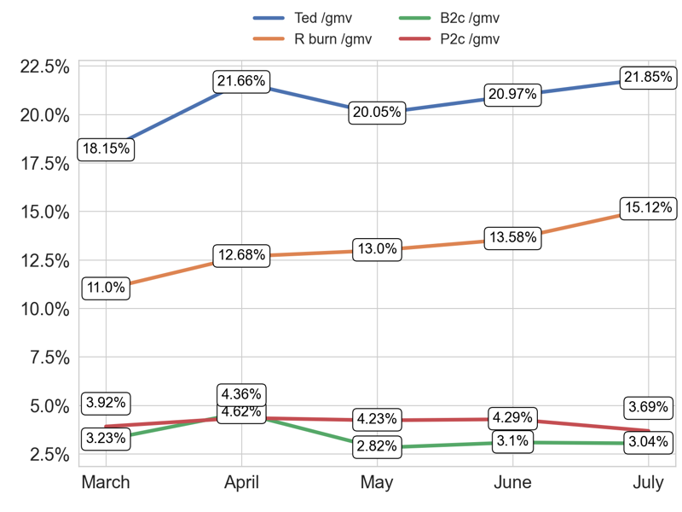
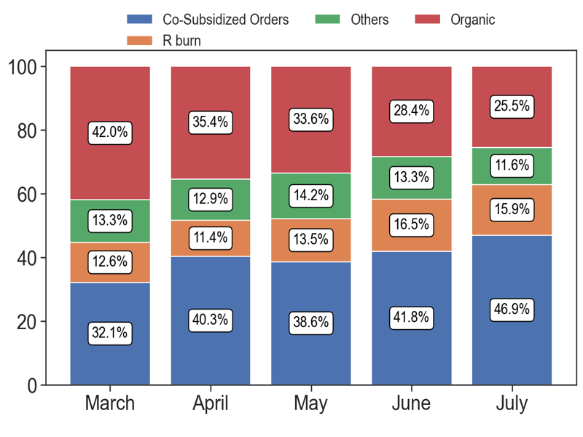
SERVICE
Action Title
Priority 2 -
Insights
Example text
Example text
Example text

Slide 7
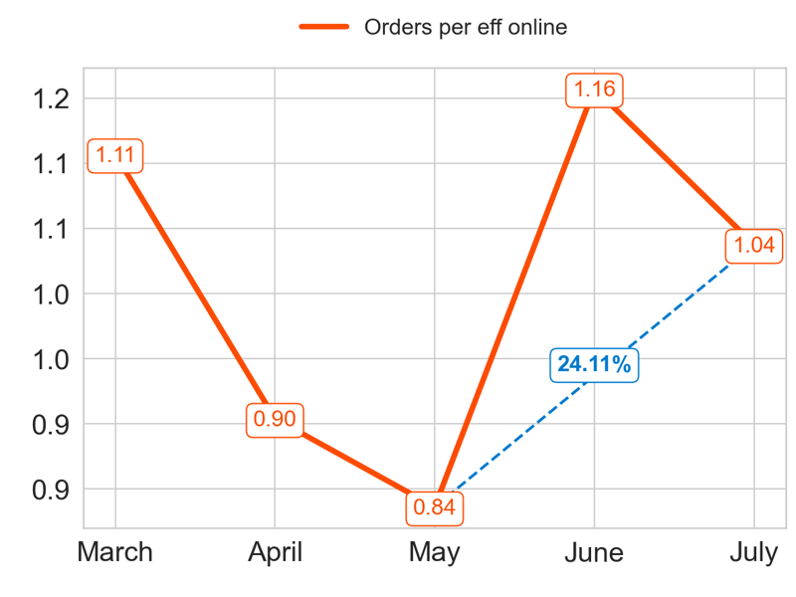
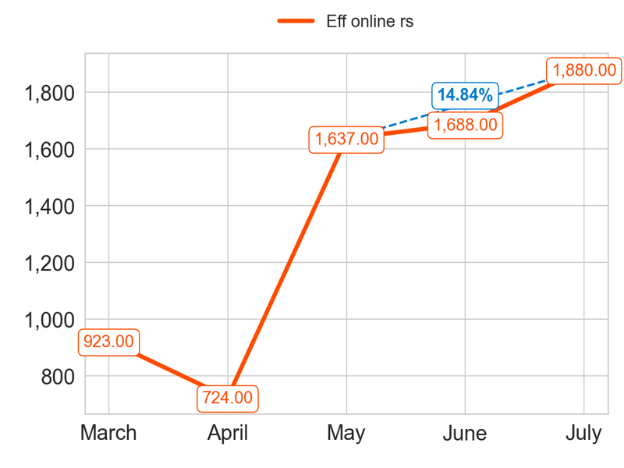
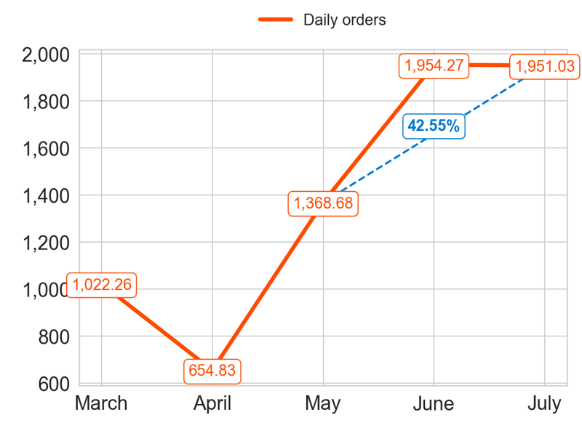
PERFORMANCE
Action Title
Priority 3 -
Insights
Mean over the last 4 months: 0.98
Mean over the last 4 months: 1482.25
Mean over the last 4 months: 1482.2

Slide 8
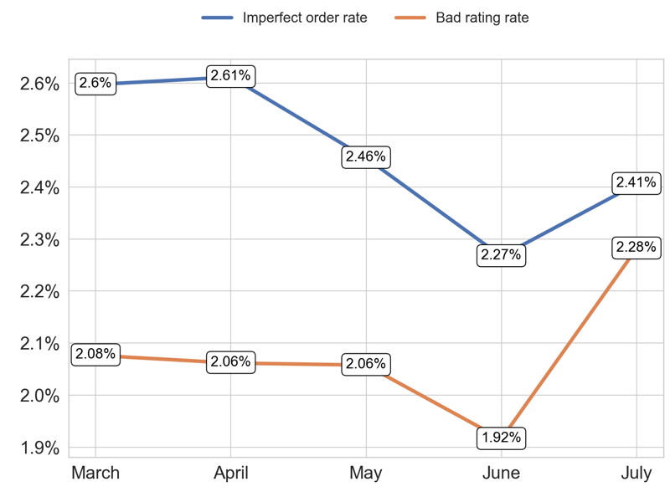
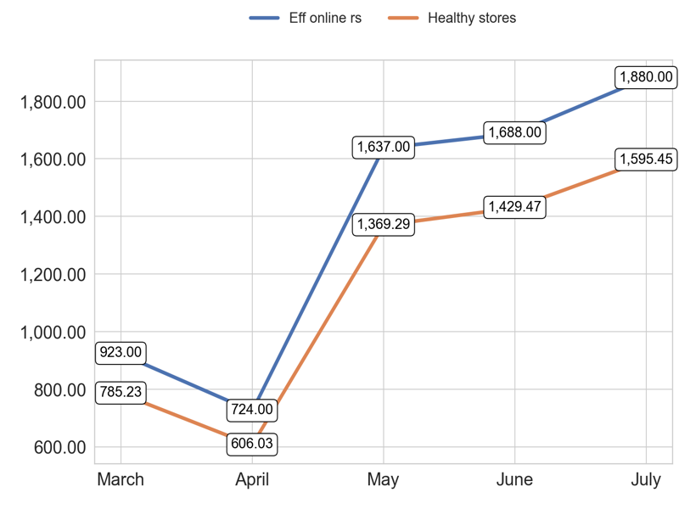
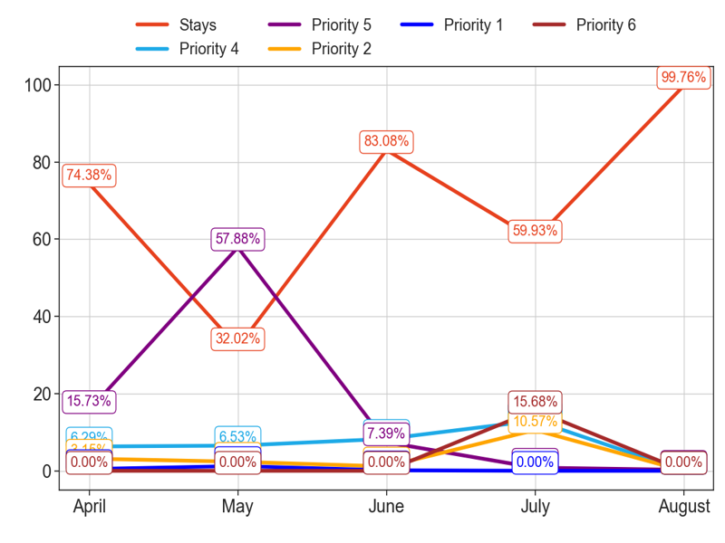
MIXED
Action Title
Priority 3 -
Insights
Example text
Example text
Example text

Slide 9
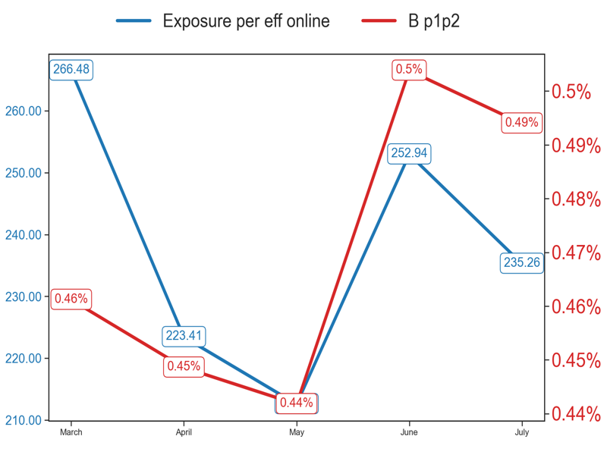
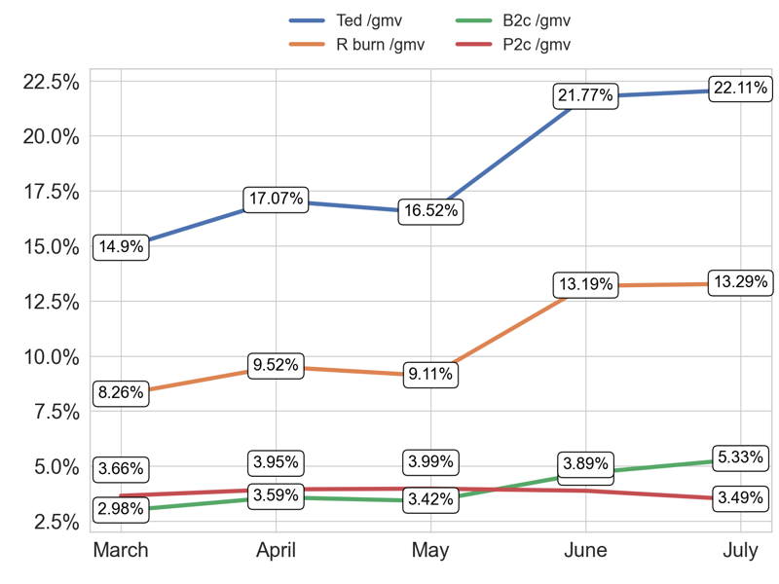
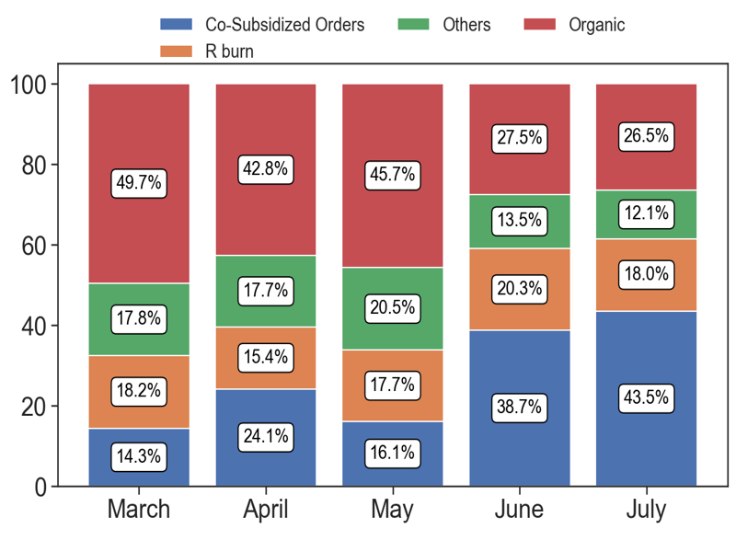
SERVICE
Action Title
Priority 3 -
Insights
Example text
Example text
Example text

Slide 10
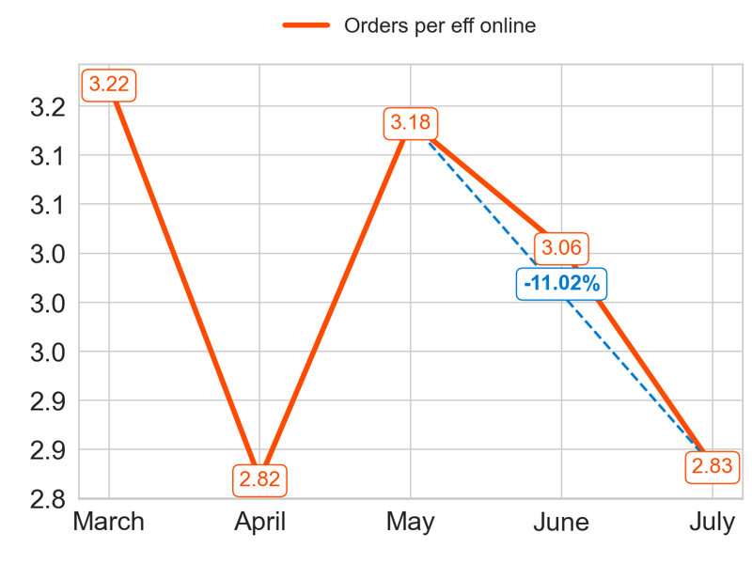
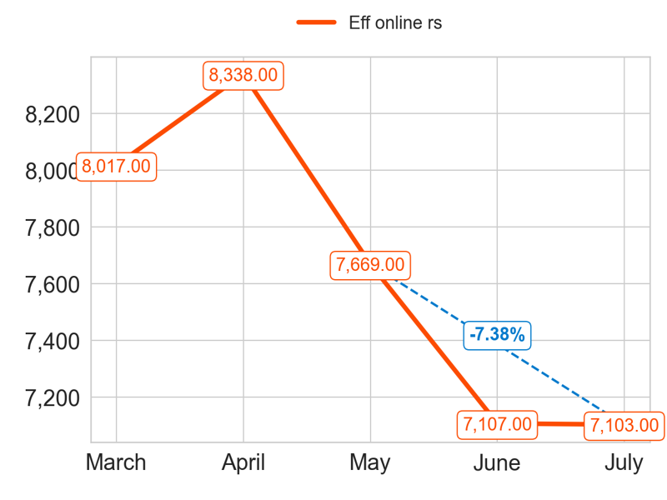
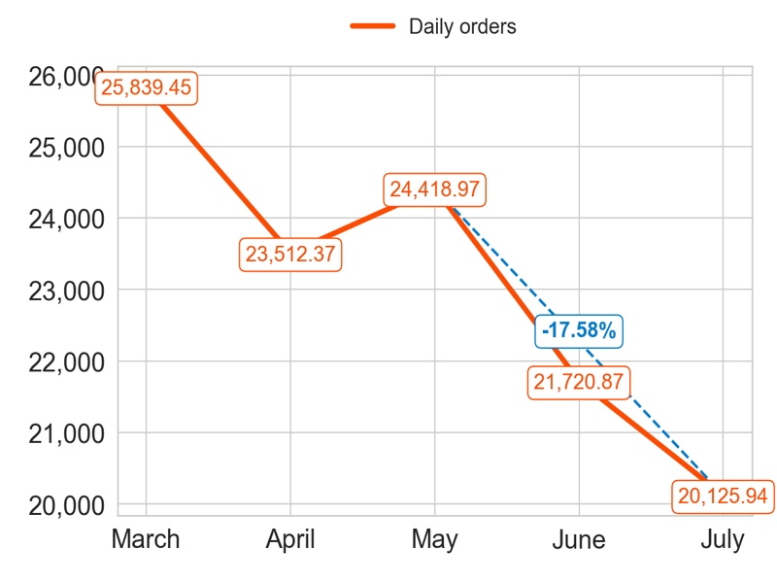
PERFORMANCE
Action Title
Priority 4 -
Insights
Mean over the last 4 months: 2.97
Mean over the last 4 months: 7554.25
Mean over the last 4 months: 22444.53

Slide 11
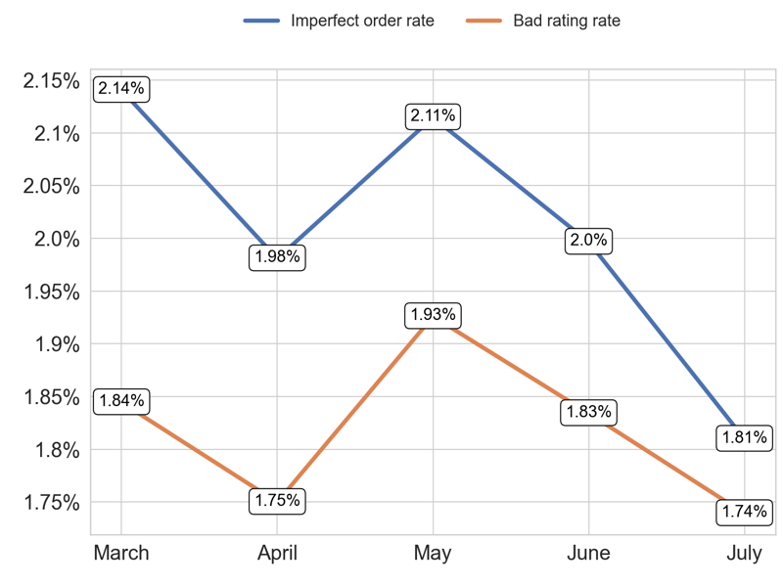
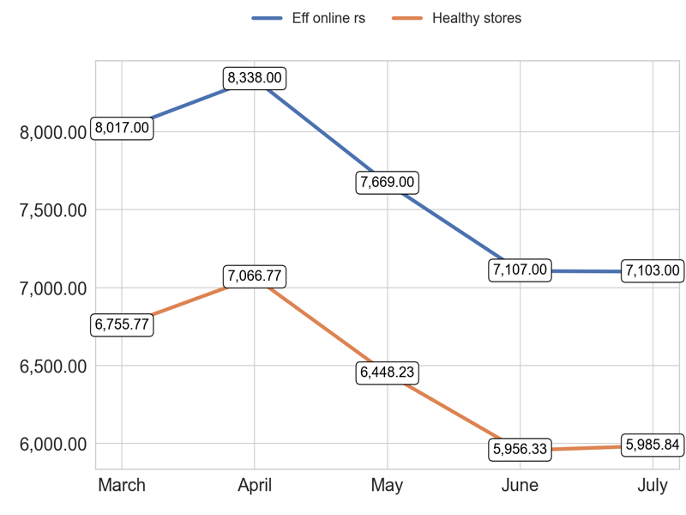
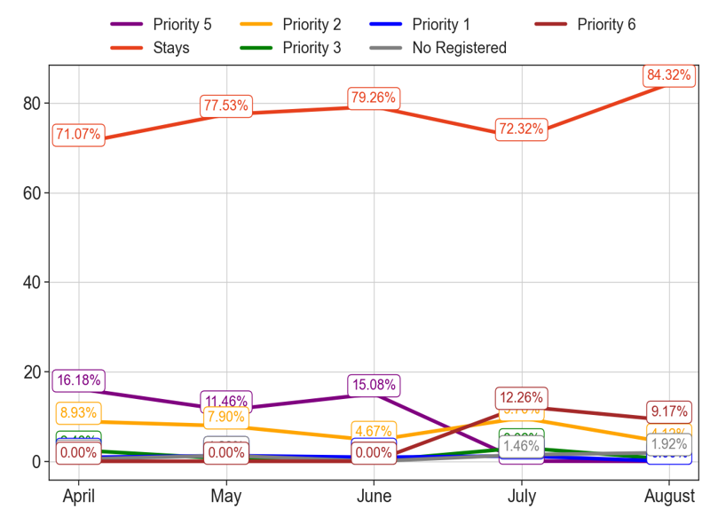
MIXED
Action Title
Priority 4 -
Insights
Example text
Example text
Example text

Slide 12
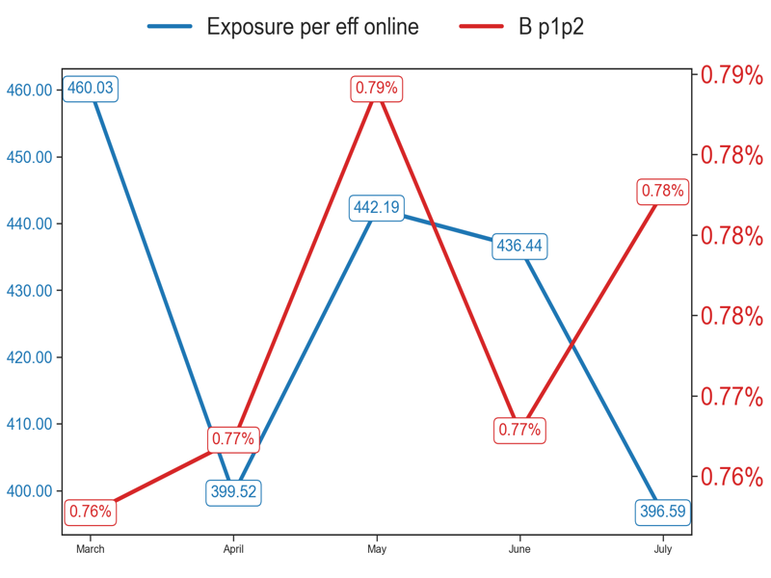
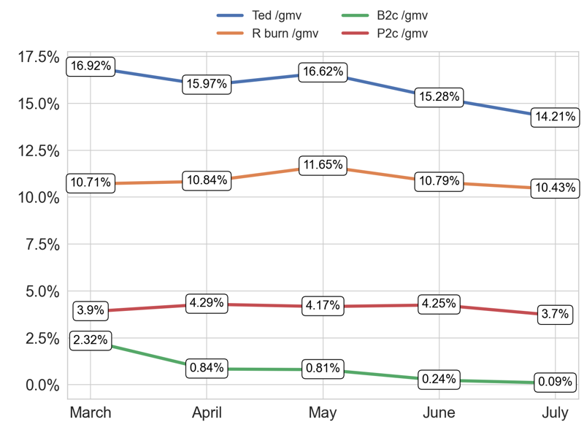
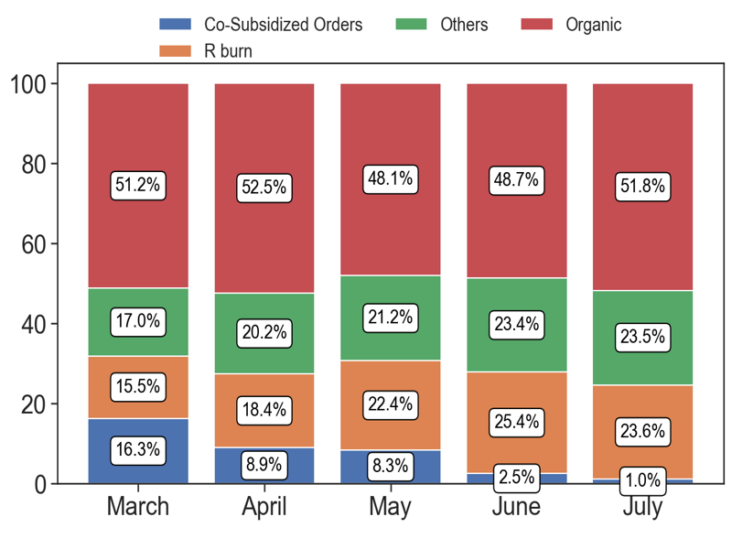
SERVICE
Action Title
Priority 4 -
Insights
Example text
Example text
Example text

Slide 13
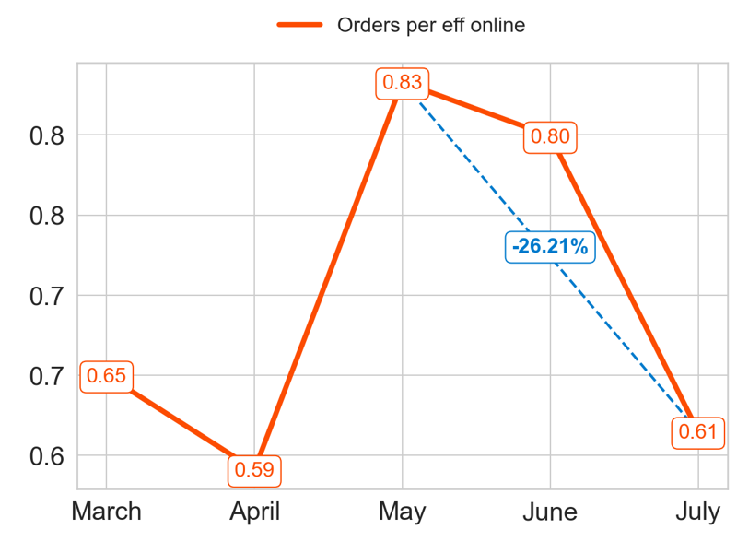
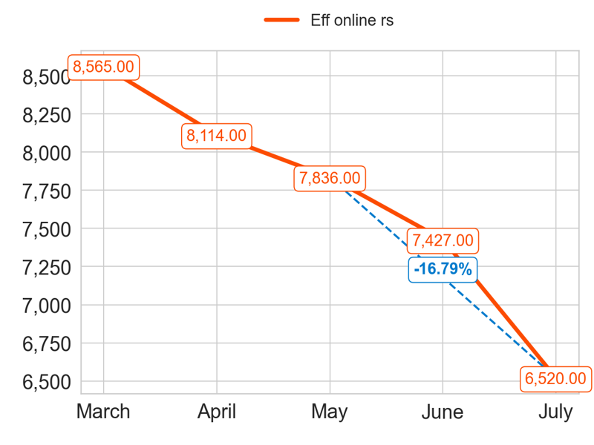
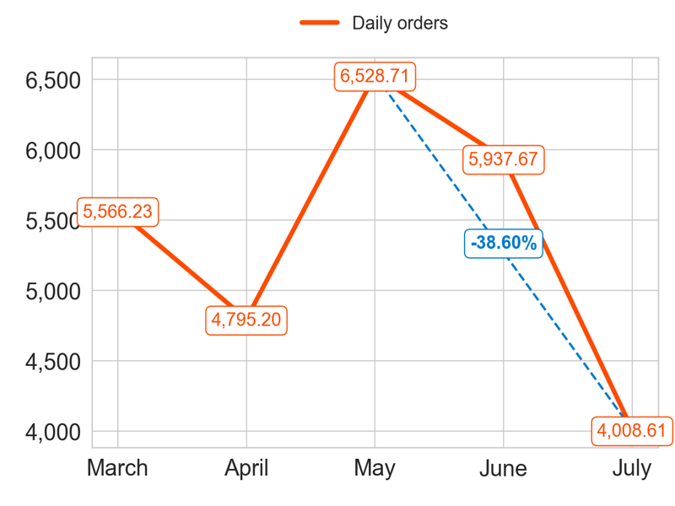
PERFORMANCE
Action Title
Priority 5 -
Insights
Mean over the last 4 months: 0.71
Mean over the last 4 months: 7474.25
Mean over the last 4 months: 5317.55

Slide 14
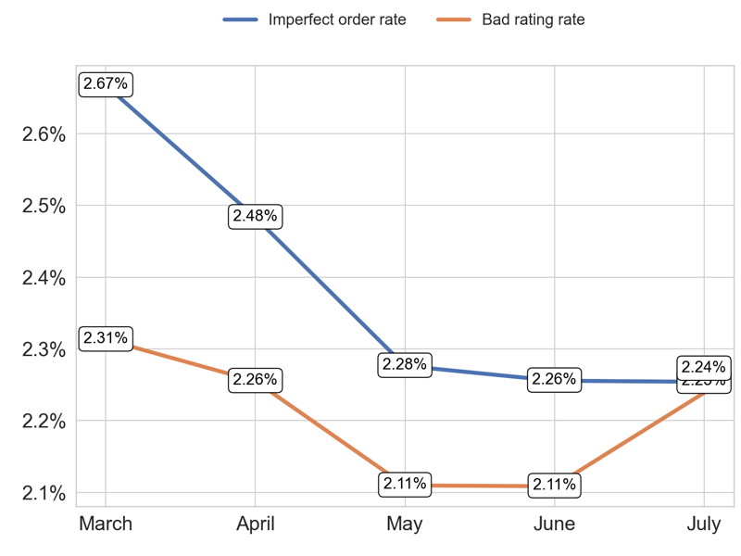
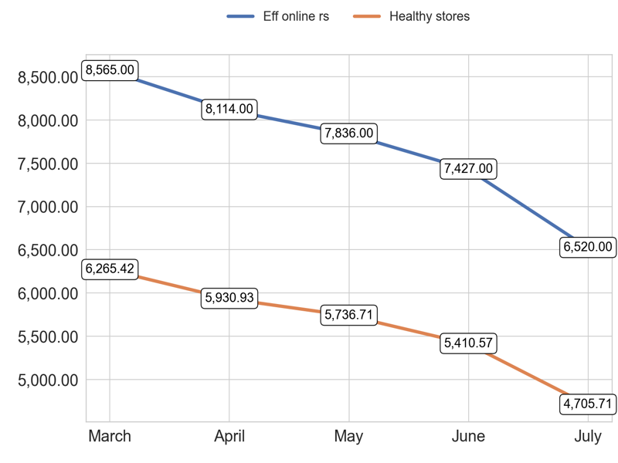
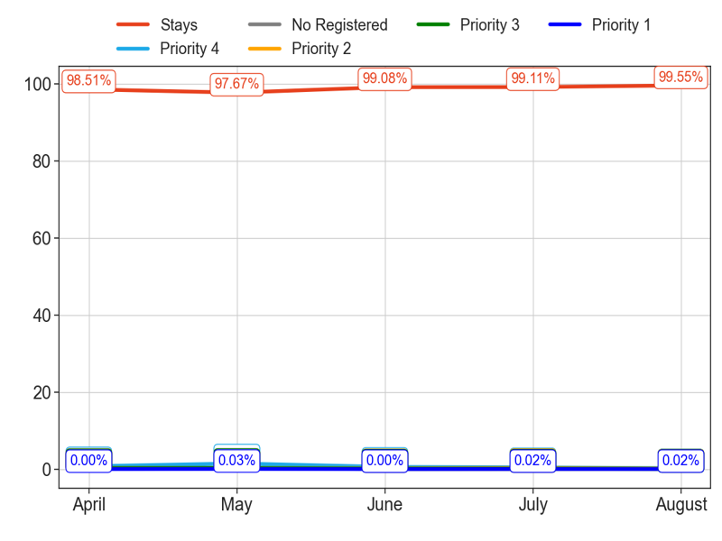
MIXED
Action Title
Priority 5 -
Insights
Example text
Example text
Example text

Slide 15
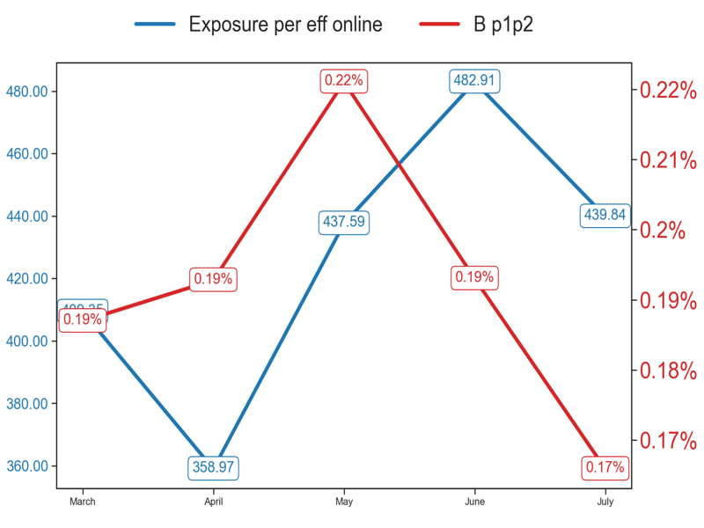
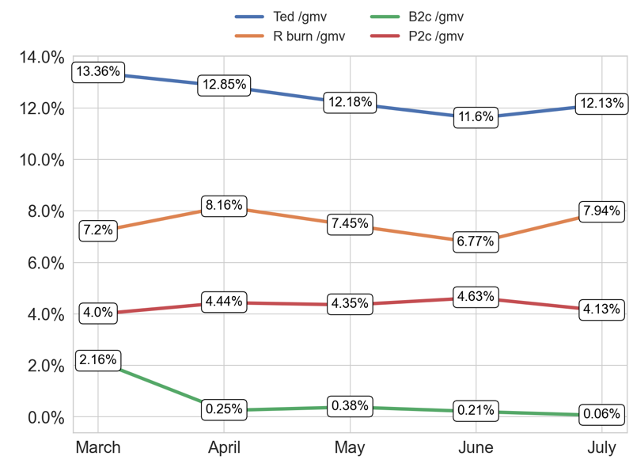
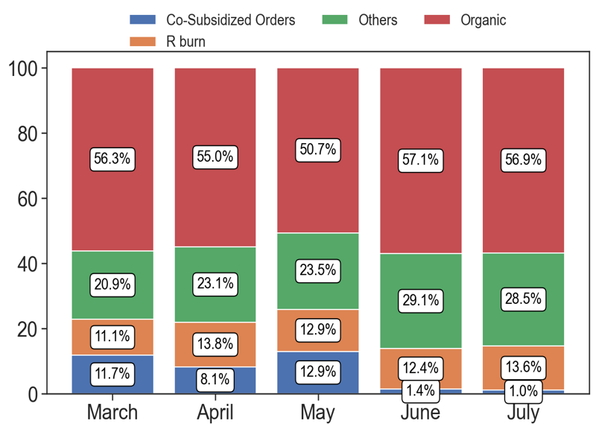
SERVICE
Action Title
Priority 5 -
Insights
Example text
Example text
Example text

Slide 16
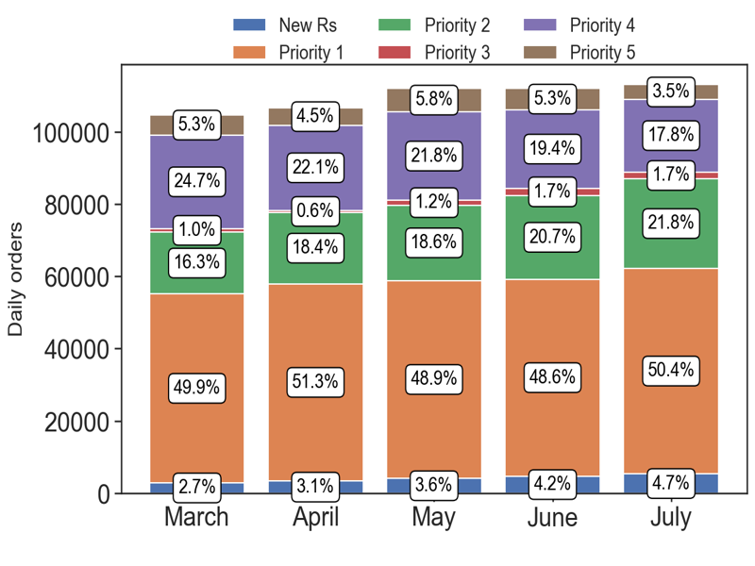
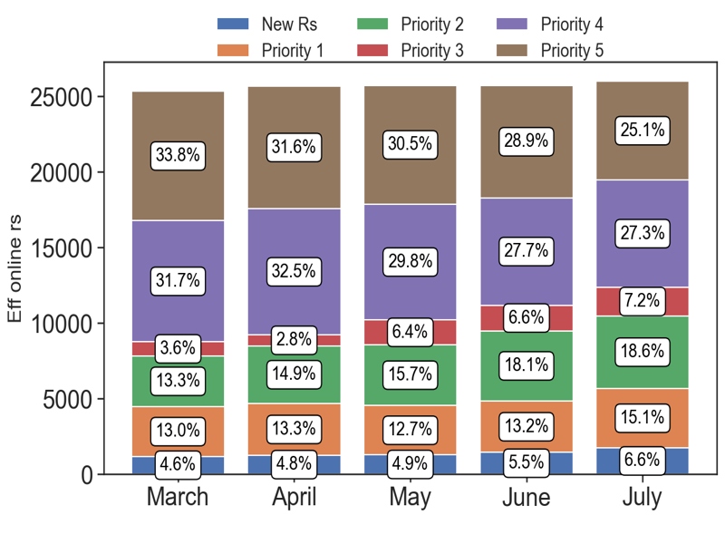
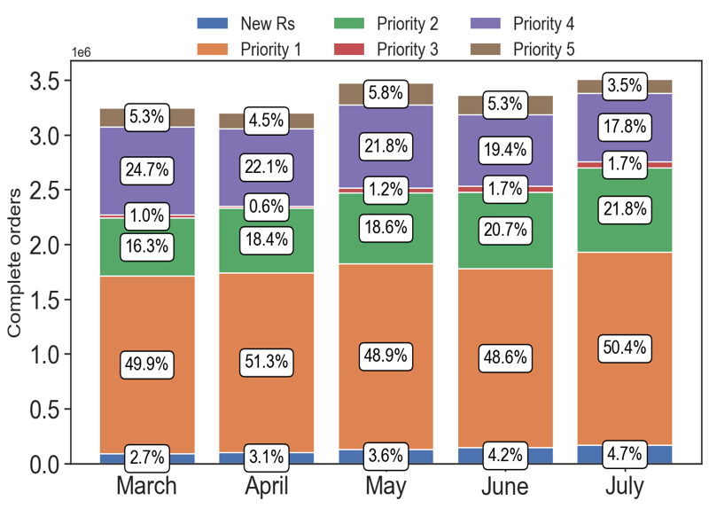
PERFORMANCE
Action Title
Country overview -
Insights
Example text
Example text
Example text

