Slide 1


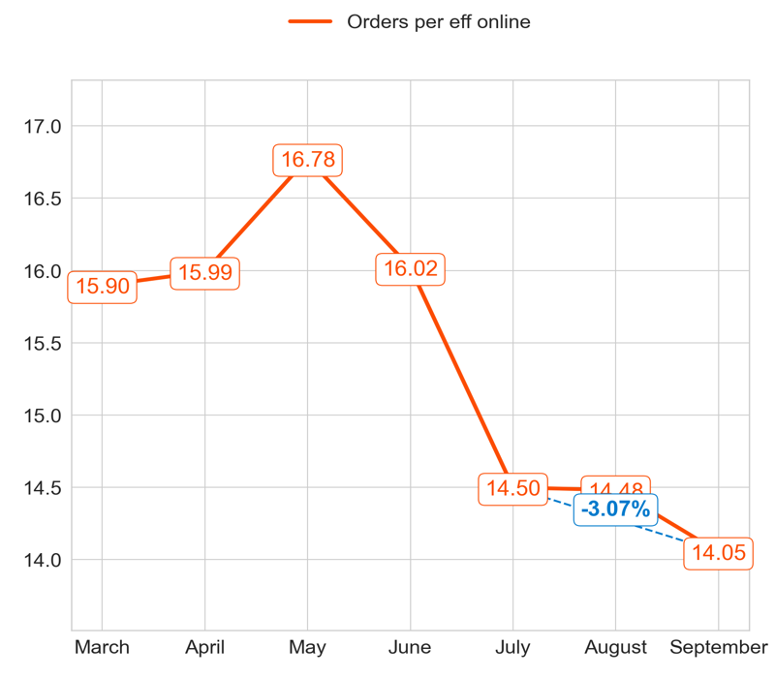
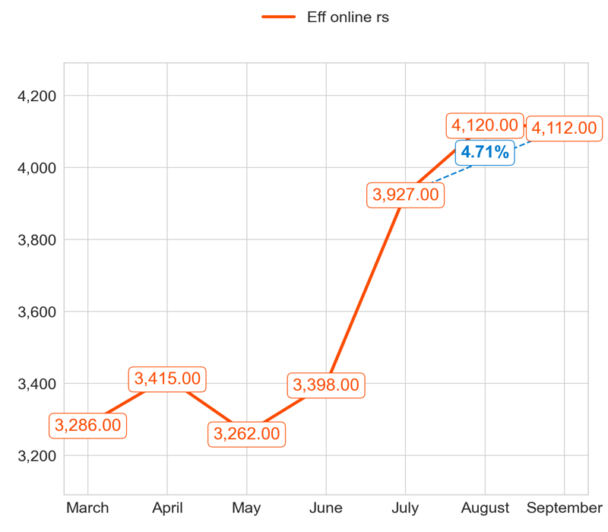
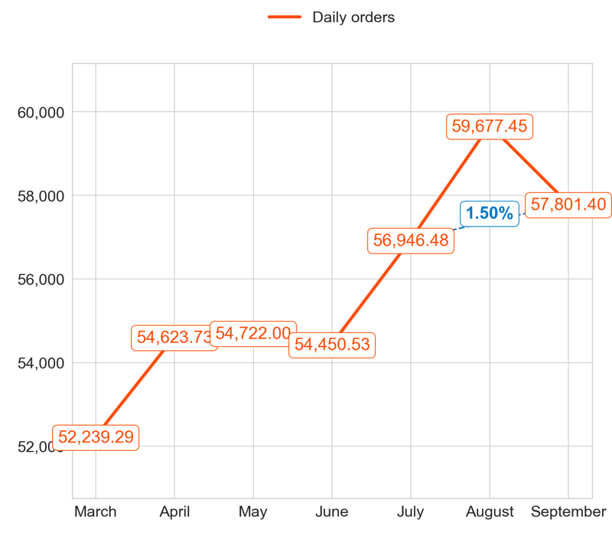
PERFORMANCE
Action Title
Priority 1 -
Comments
Highest: 16.78, Lowest: 14.05
Mean of the last 4 months: 15.30
Highest: 4,120.00, Lowest: 3,262.00
Mean of the last 4 months: 3,705.67
Highest: 59,677.45, Lowest: 52,239.29
Mean of the last 4 months: 56,370.27

Slide 2
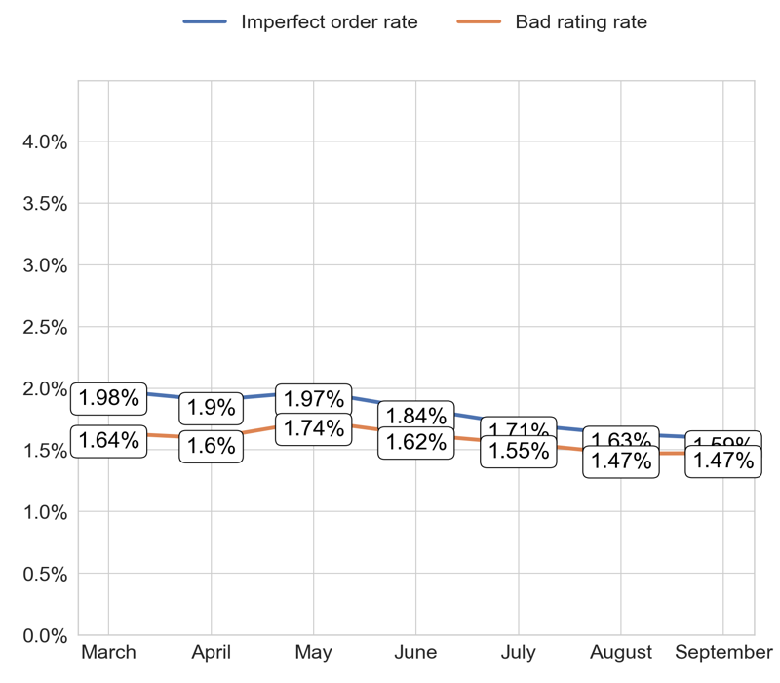
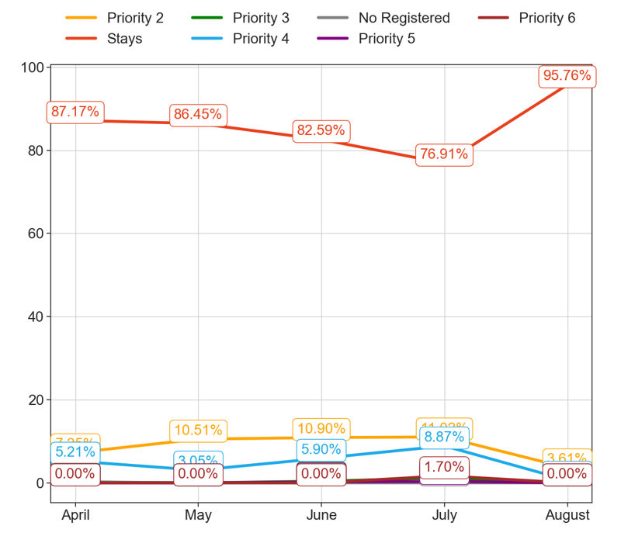
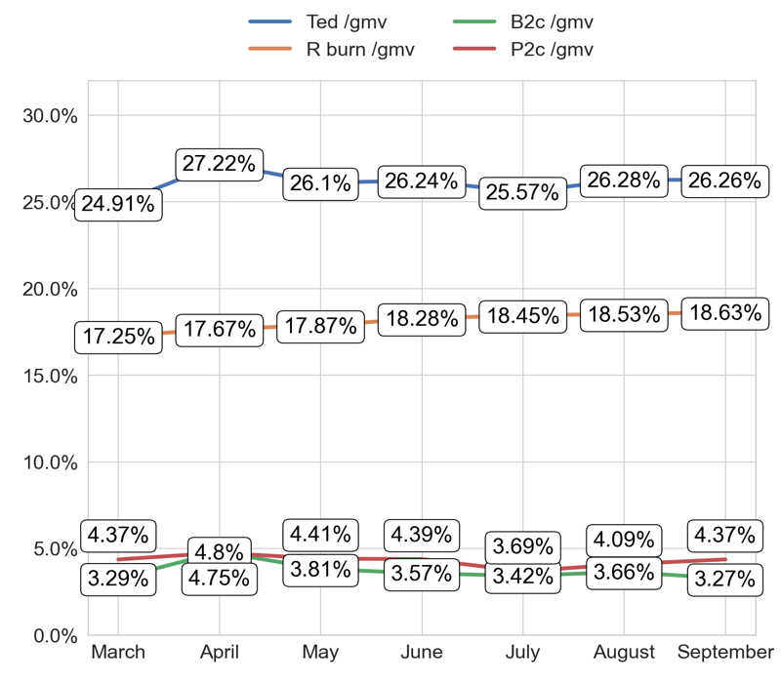
SERVICE
Action Title
Priority 1 -
Comments
Imperfect order rate average in the last 4 months: 1.8 % and the percentage change between the last 2 months: -2.18%.
Bad rating rate average in the last 4 months: 1.58 % and the percentage change between the last 2 months: 0.16%.
No comments
No comments

Slide 3
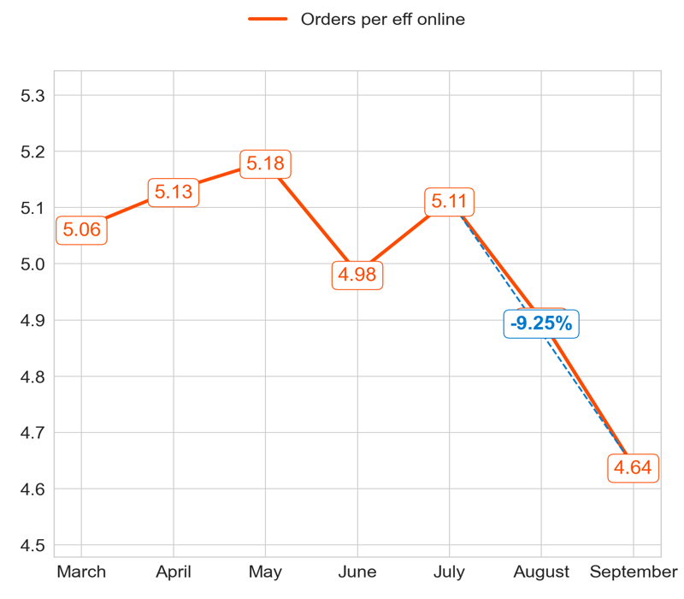
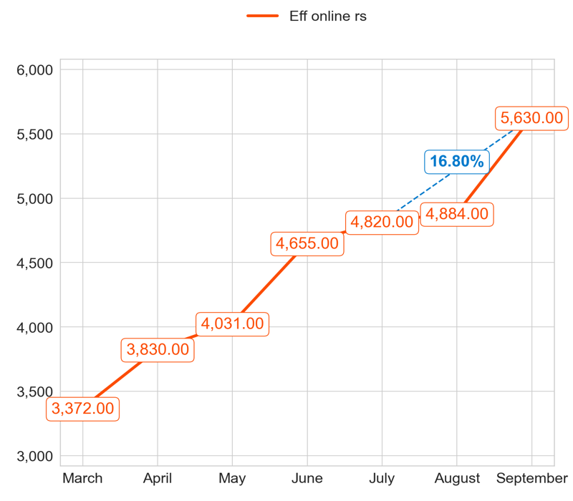
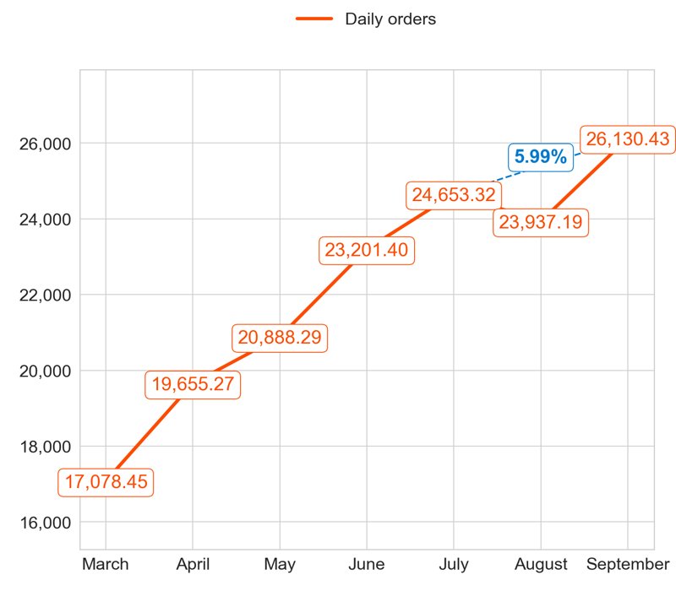
PERFORMANCE
Action Title
Priority 2 -
Comments
Highest: 5.18, Lowest: 4.64
Mean of the last 4 months: 4.99
Highest: 5,630.00, Lowest: 3,372.00
Mean of the last 4 months: 4,641.67
Highest: 26,130.43, Lowest: 17,078.45
Mean of the last 4 months: 23,077.65

Slide 4
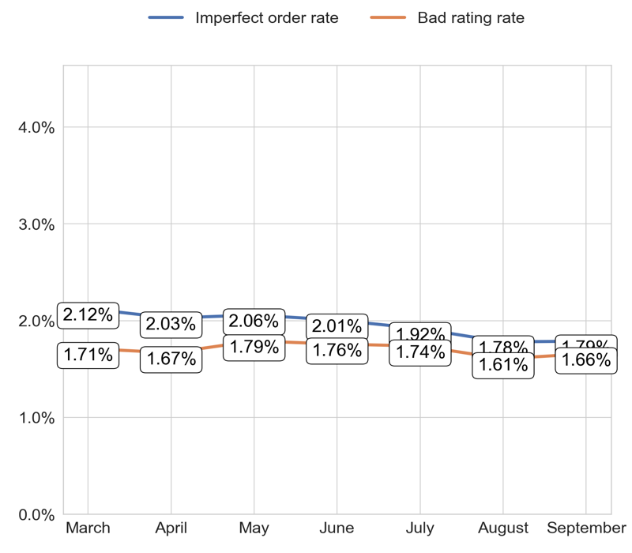
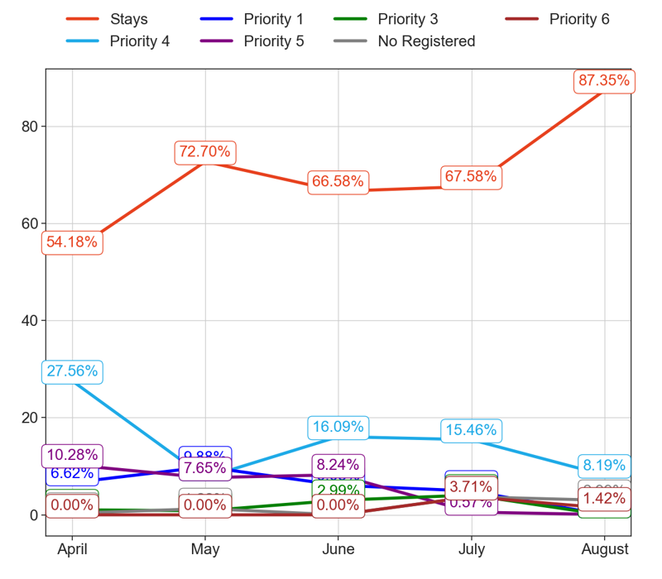
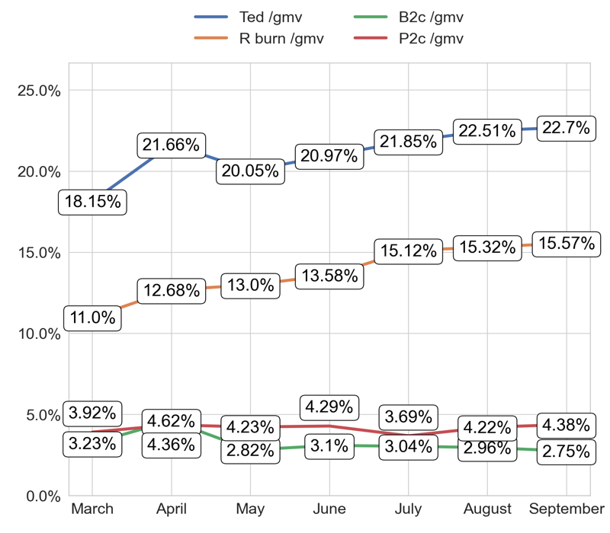
SERVICE
Action Title
Priority 2 -
Comments
Imperfect order rate average in the last 4 months: 1.96 % and the percentage change between the last 2 months: 0.44%.
Bad rating rate average in the last 4 months: 1.7 % and the percentage change between the last 2 months: 2.95%.
No comments
No comments

Slide 5
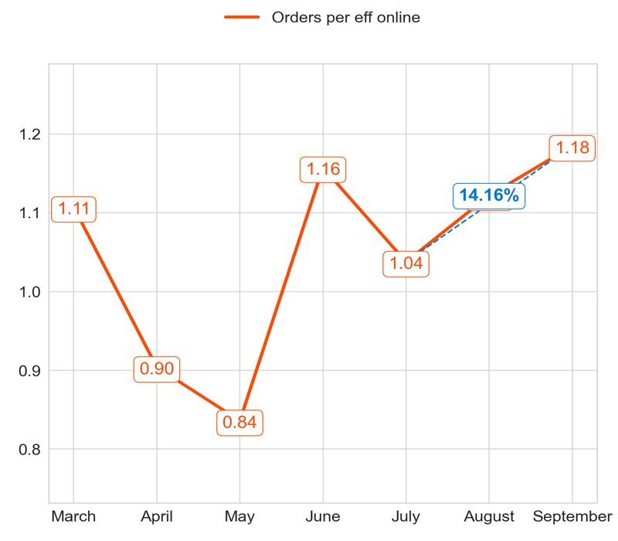
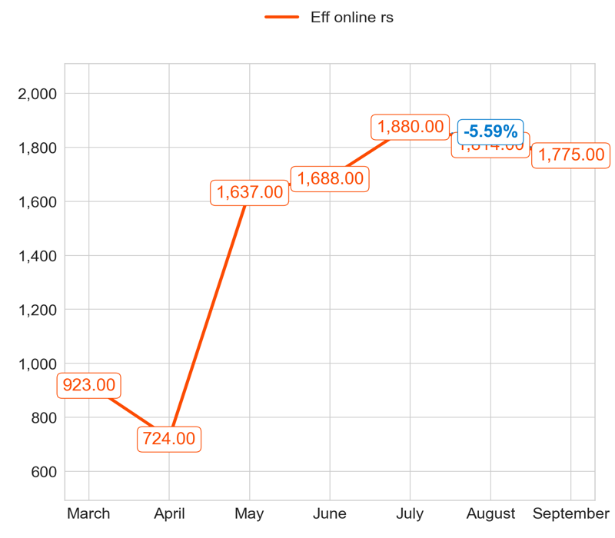
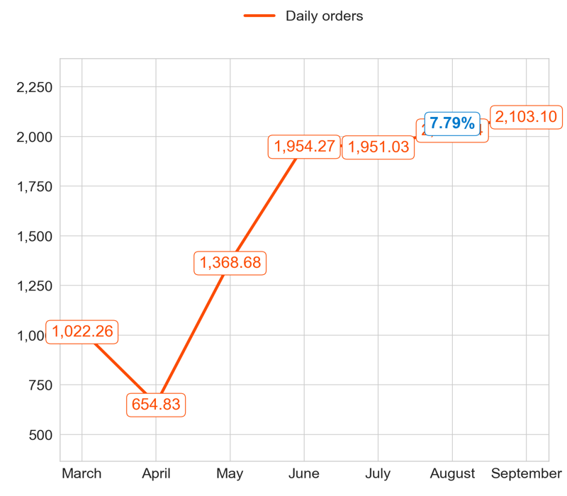
PERFORMANCE
Action Title
Priority 3 -
Comments
Highest: 1.18, Lowest: 0.84
Mean of the last 4 months: 1.04
Highest: 1,880.00, Lowest: 724.00
Mean of the last 4 months: 1,586.33
Highest: 2,103.10, Lowest: 654.83
Mean of the last 4 months: 1,677.97

Slide 6
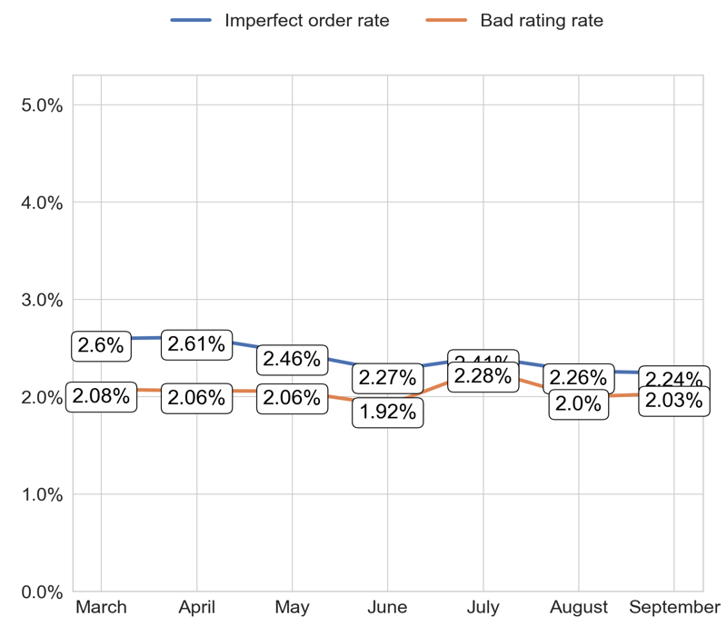
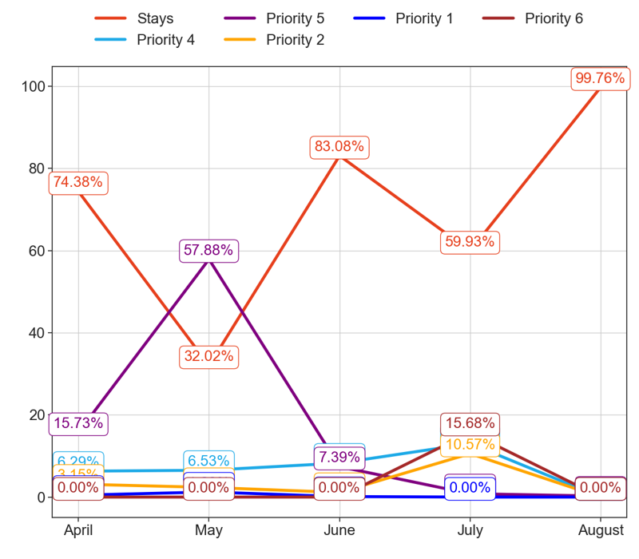
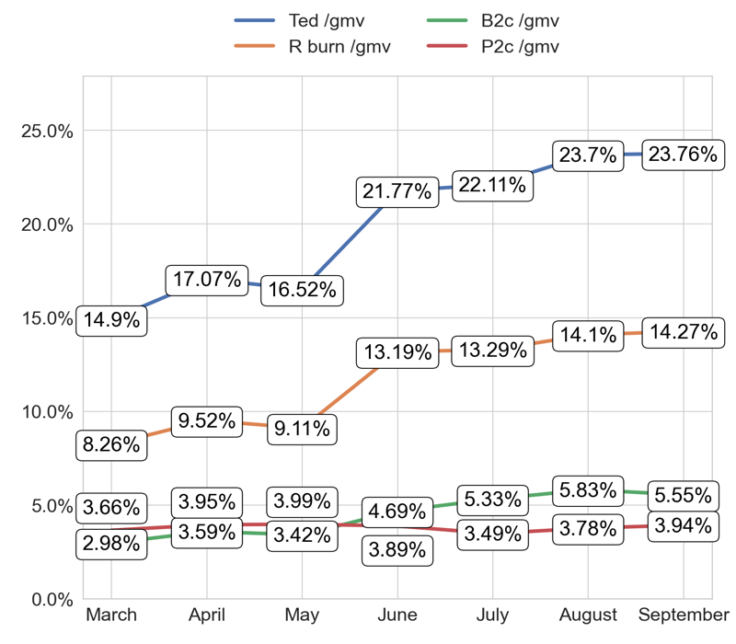
SERVICE
Action Title
Priority 3 -
Comments
Imperfect order rate average in the last 4 months: 2.41 % and the percentage change between the last 2 months: -0.89%.
Bad rating rate average in the last 4 months: 2.06 % and the percentage change between the last 2 months: 1.49%.
No comments
No comments

Slide 7
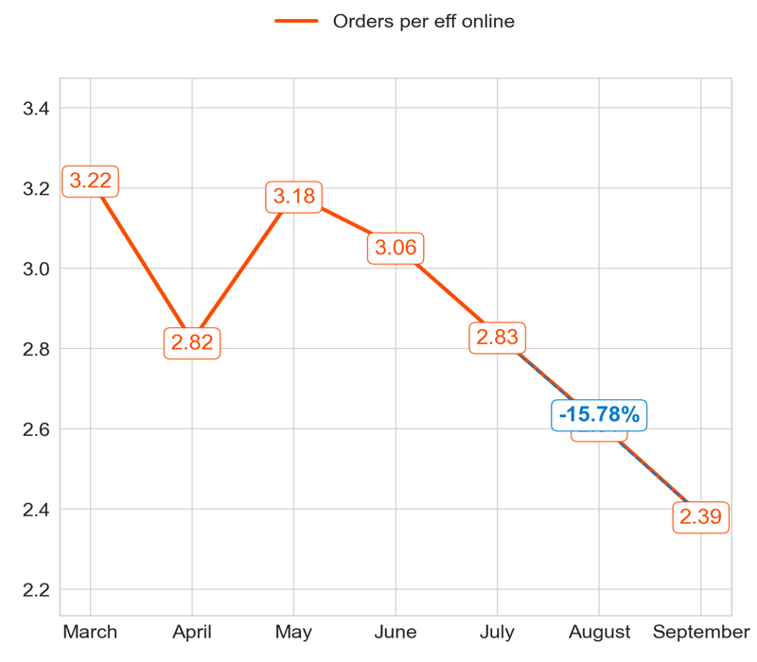
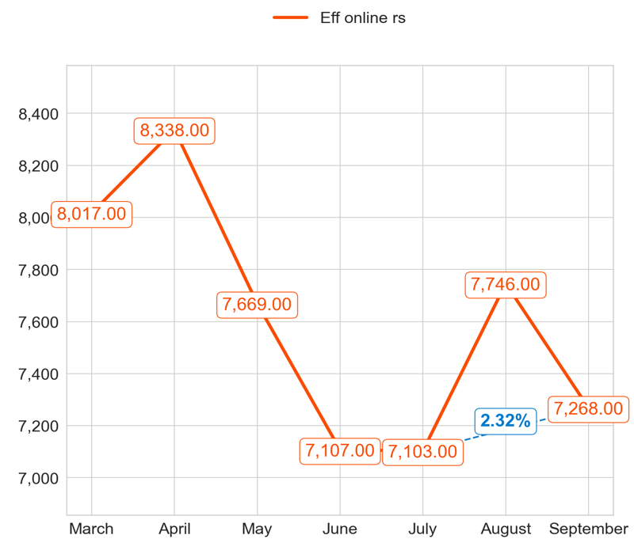
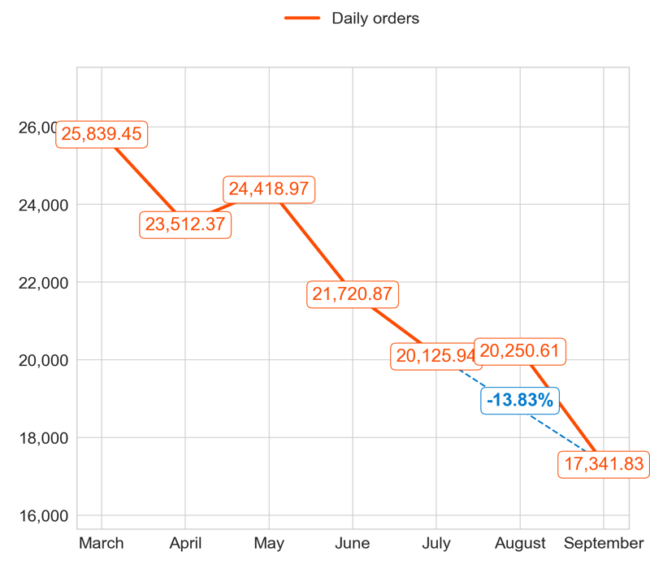
PERFORMANCE
Action Title
Priority 4 -
Comments
Highest: 3.22, Lowest: 2.39
Mean of the last 4 months: 2.82
Highest: 8,338.00, Lowest: 7,103.00
Mean of the last 4 months: 7,538.50
Highest: 25,839.45, Lowest: 17,341.83
Mean of the last 4 months: 21,228.43

Slide 8
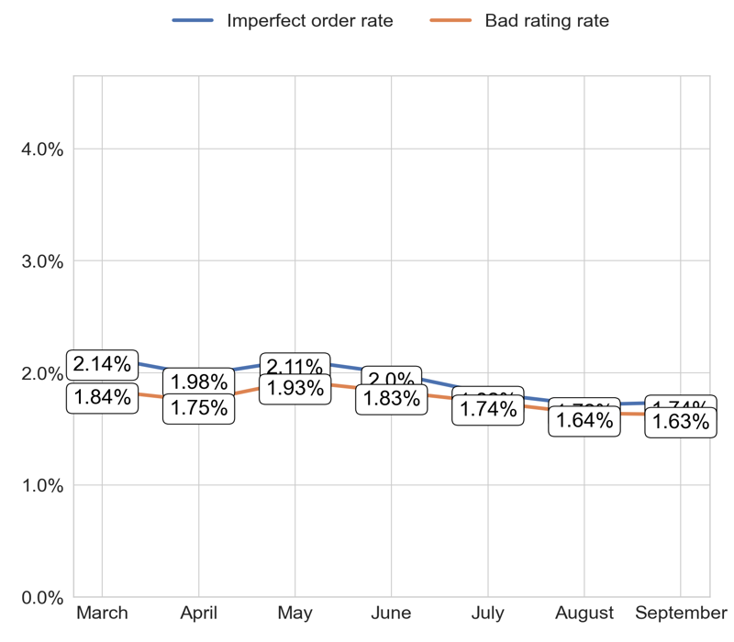
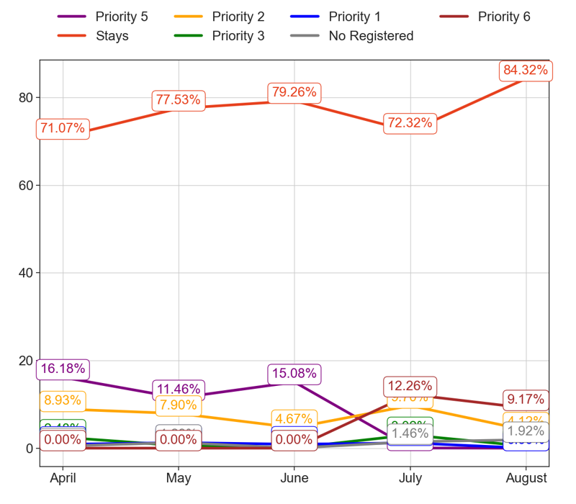
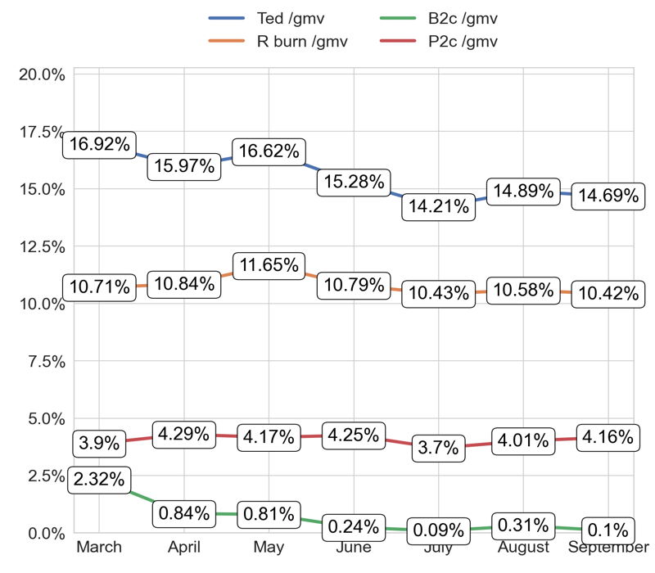
SERVICE
Action Title
Priority 4 -
Comments
Imperfect order rate average in the last 4 months: 1.93 % and the percentage change between the last 2 months: 1.26%.
Bad rating rate average in the last 4 months: 1.77 % and the percentage change between the last 2 months: -0.64%.
No comments
No comments

Slide 9
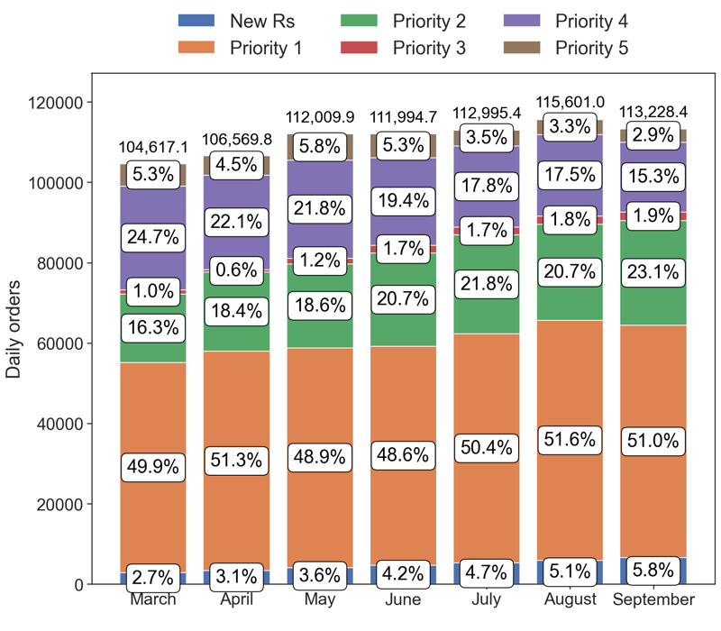
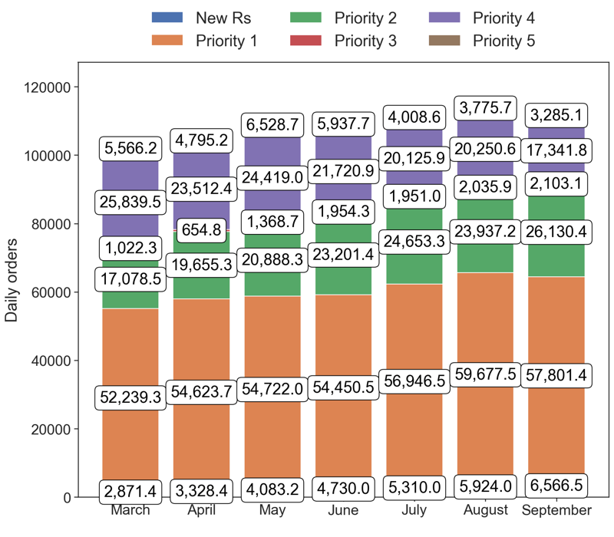
PERFORMANCE
Action Title
Country overview -
Comments
Last Month Data:
New Rs: 6,566.47, Priority 1: 57,801.40, Priority 2: 26,130.43, Priority 3: 2,103.10, Priority 4: 17,341.83, Priority 5: 3,285.13
Last Month percentages:
New Rs: 5.8%, Priority 1: 51.05%, Priority 2: 23.08%, Priority 3: 1.86%, Priority 4: 15.32%, Priority 5: 2.9%

Slide 10
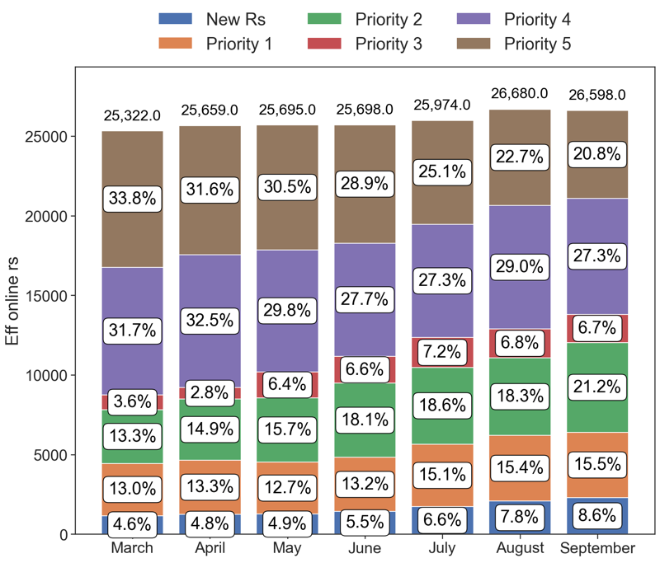
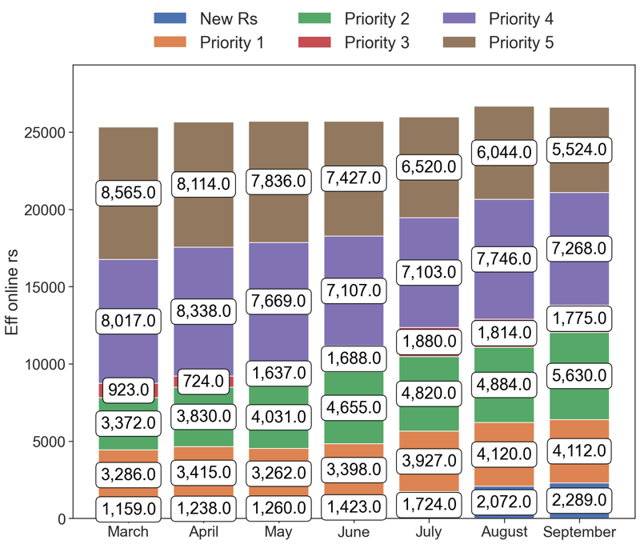
PERFORMANCE
Action Title
Country overview -
Comments
Last Month Data:
New Rs: 2,289.00, Priority 1: 4,112.00, Priority 2: 5,630.00, Priority 3: 1,775.00, Priority 4: 7,268.00, Priority 5: 5,524.00
Last Month percentages:
New Rs: 8.61%, Priority 1: 15.46%, Priority 2: 21.17%, Priority 3: 6.67%, Priority 4: 27.33%, Priority 5: 20.77%

