Slide 1


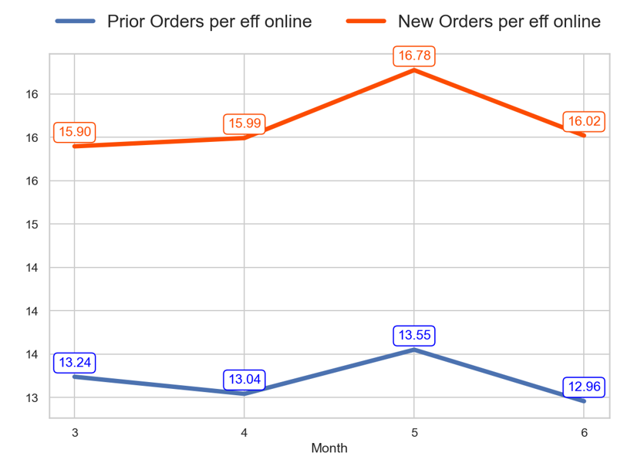
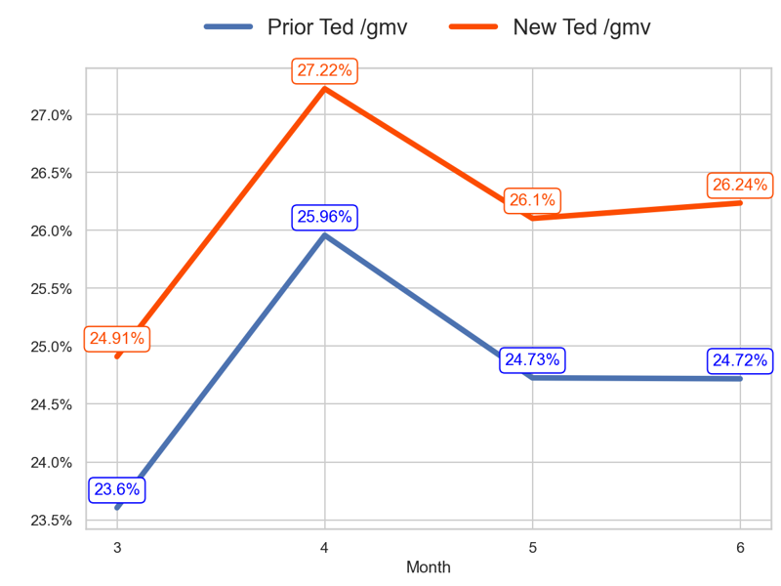
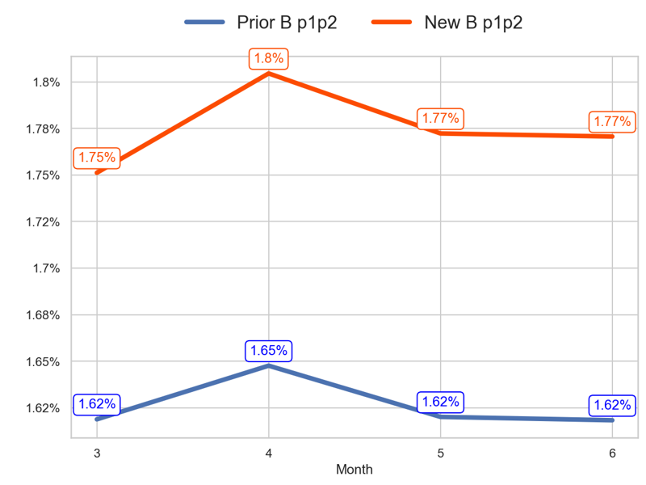
PERFORMANCE
Action Title
Prior P2 vs New P1 -
Insights
- The new priority has a better tendency than the old one over the last 3 months (0.78% > -2.13%) - The last 3 months mean of the old priority is 13.18 and the new priority is 16.26
- The new priority has a better tendency than the old one over the last 3 months (1.33 > 1.11 percentage points) - The last 3 months mean of the old priority is 25.13% and the new priority is 26.52%
- The new priority has a better tendency than the old one over the last 3 months (0.02 > -0.0 percentage points) - The last 3 months mean of the old priority is 1.63% and the new priority is 1.78%

Slide 2
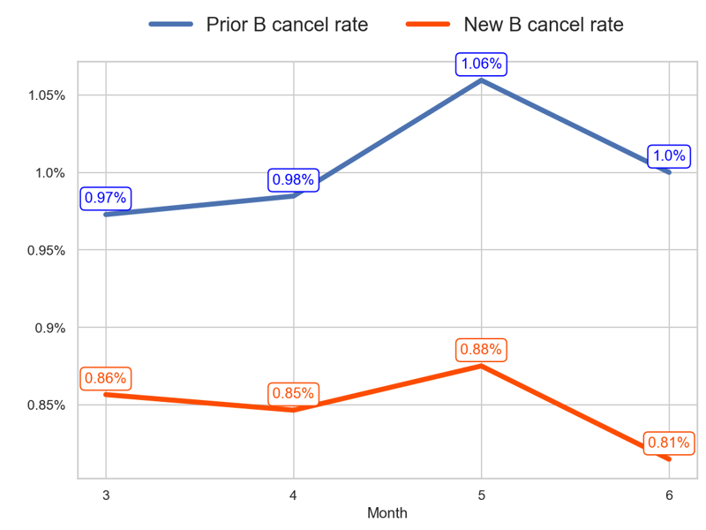
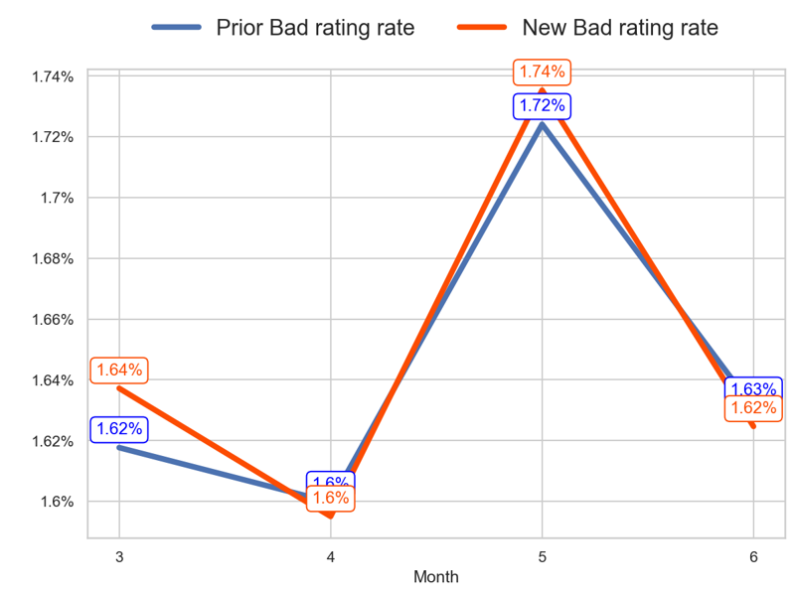
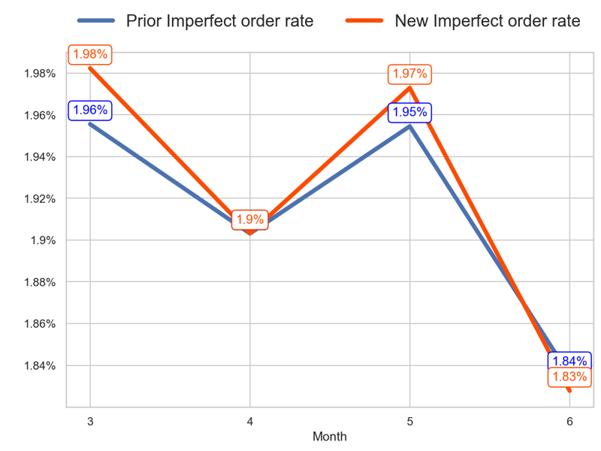
SERVICE
Action Title
Prior P2 vs New P1 -
Insights
- The new priority has a better tendency than the old one over the last 3 months (-0.04 < 0.03 percentage points) - The last 3 months mean of the old priority is 1.01% and the new priority is 0.85%
- The new priority has a better tendency than the old one over the last 3 months (-0.01 < 0.01 percentage points) - The last 3 months mean of the old priority is 1.65% and the new priority is 1.65%
- The new priority has a worse tendency than the old one over the last 3 months (-0.15 < -0.12 percentage points) - The last 3 months mean of the old priority is 1.9% and the new priority is 1.9%

Slide 3
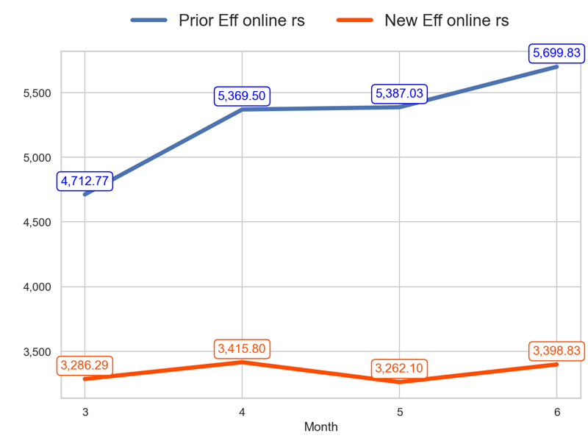
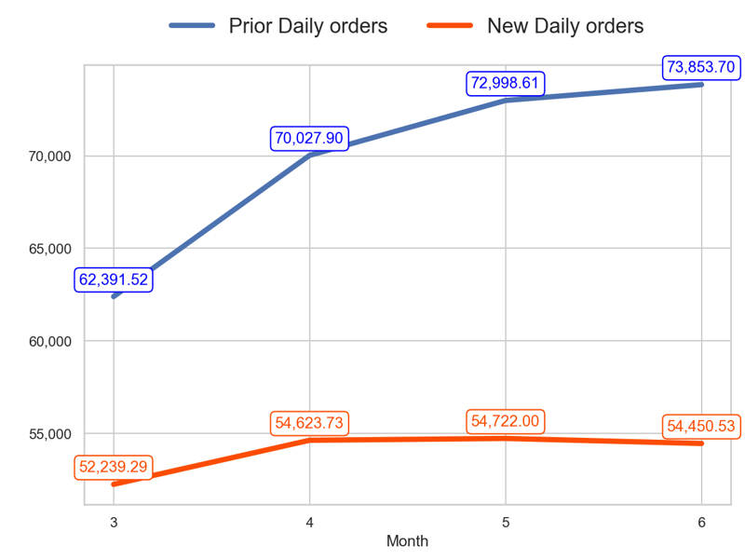
SERVICE
Action Title
Prior P2 vs New P1 -
- The new priority has a worse tendency than the old one over the last 3 months (3.42% < 20.94%) - The last 3 months mean of the old priority is 5485.46 and the new priority is 3358.91
- The new priority has a worse tendency than the old one over the last 3 months (4.23% < 18.37%) - The last 3 months mean of the old priority is 72293.4 and the new priority is 54598.76

Slide 4
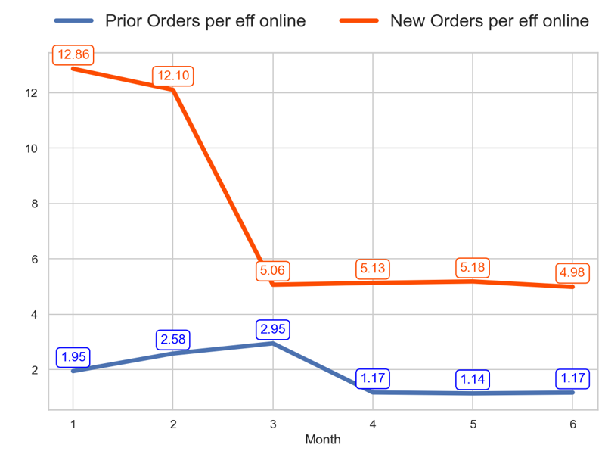
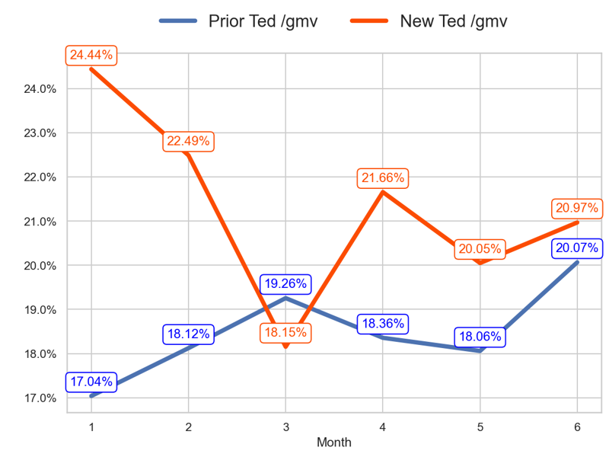
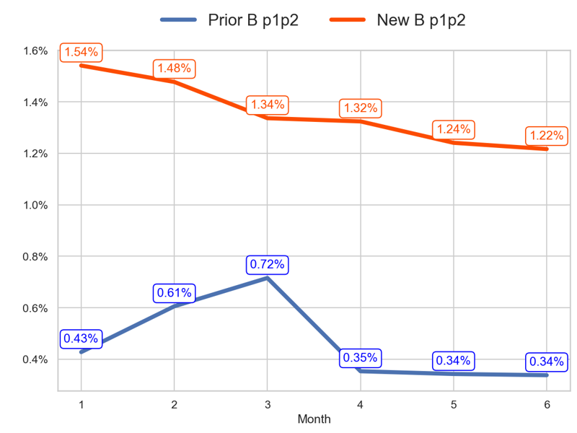
PERFORMANCE
Action Title
Prior P3 vs New P2 -
Insights
- The new priority has a better tendency than the old one over the last 3 months (-1.58% > -60.29%) - The last 3 months mean of the old priority is 1.16 and the new priority is 5.1
- The new priority has a better tendency than the old one over the last 3 months (2.81 > 0.81 percentage points) - The last 3 months mean of the old priority is 18.83% and the new priority is 20.89%
- The new priority has a better tendency than the old one over the last 3 months (-0.12 > -0.38 percentage points) - The last 3 months mean of the old priority is 0.34% and the new priority is 1.26%

Slide 5
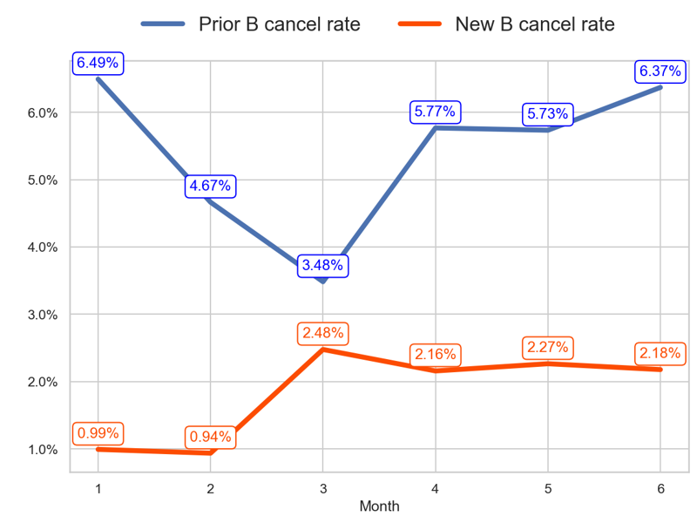
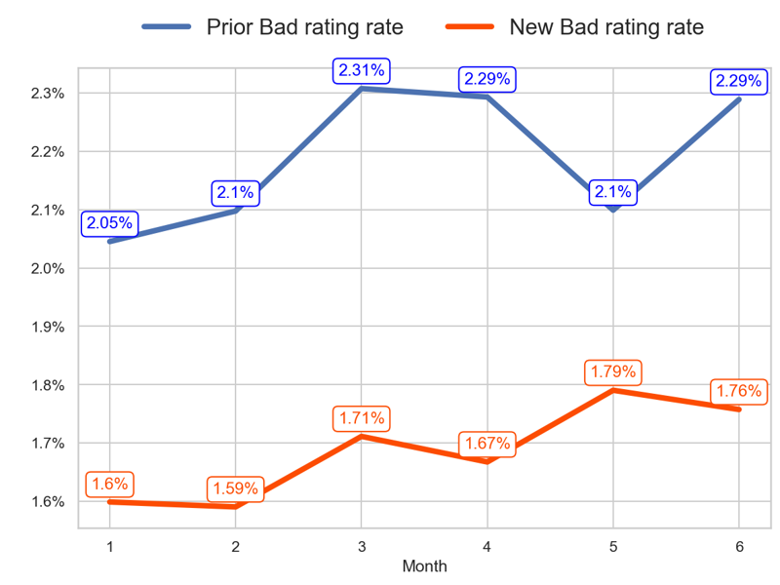
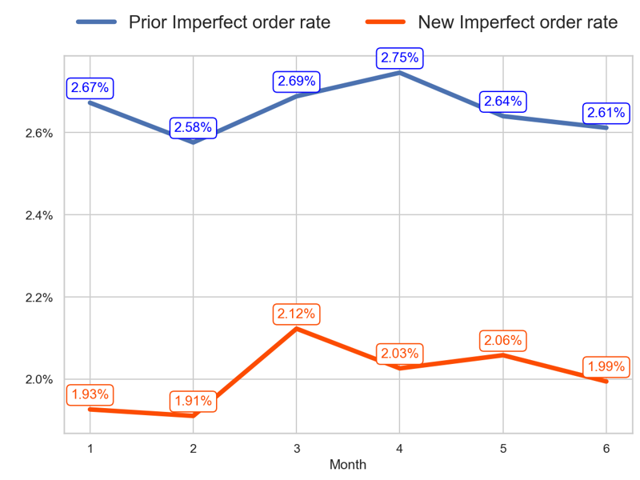
SERVICE
Action Title
Prior P3 vs New P2 -
Insights
- The new priority has a better tendency than the old one over the last 3 months (-0.3 < 2.89 percentage points) - The last 3 months mean of the old priority is 5.96% and the new priority is 2.2%
- The new priority has a worse tendency than the old one over the last 3 months (0.05 > -0.02 percentage points) - The last 3 months mean of the old priority is 2.23% and the new priority is 1.74%
- The new priority has a worse tendency than the old one over the last 3 months (-0.13 < -0.08 percentage points) - The last 3 months mean of the old priority is 2.67% and the new priority is 2.03%

Slide 6
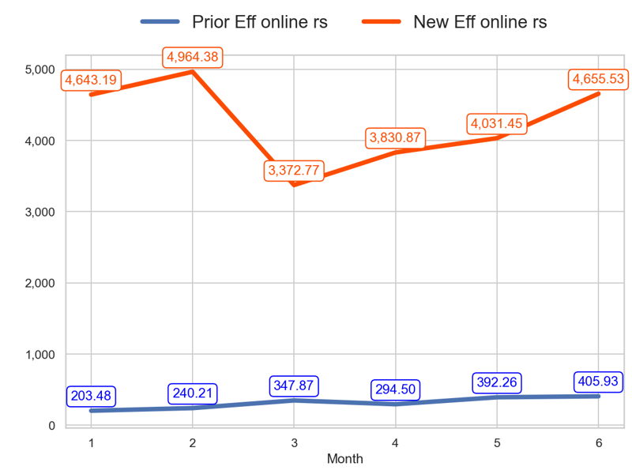
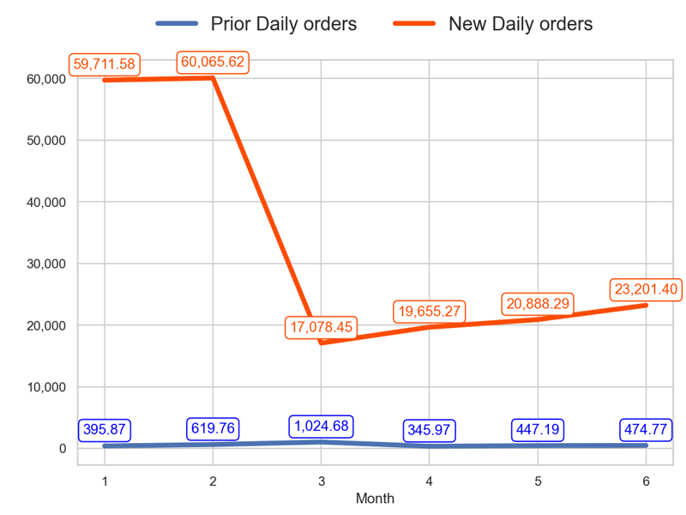
SERVICE
Action Title
Prior P3 vs New P2 -
- The new priority has a better tendency than the old one over the last 3 months (38.03% > 16.69%) - The last 3 months mean of the old priority is 364.23 and the new priority is 4172.62
- The new priority has a better tendency than the old one over the last 3 months (35.85% > -53.67%) - The last 3 months mean of the old priority is 422.64 and the new priority is 21248.32

Slide 7
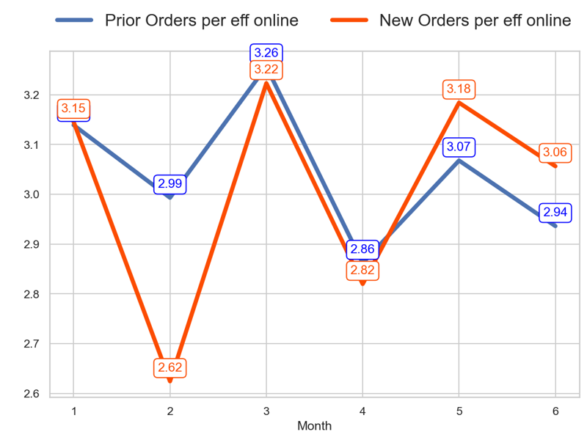
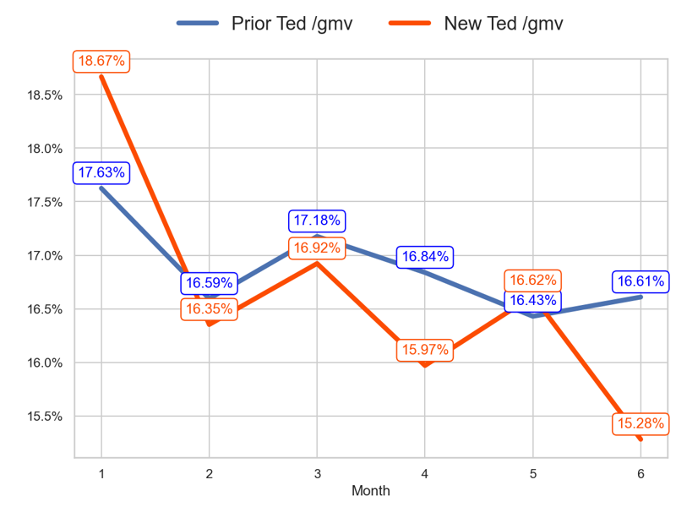
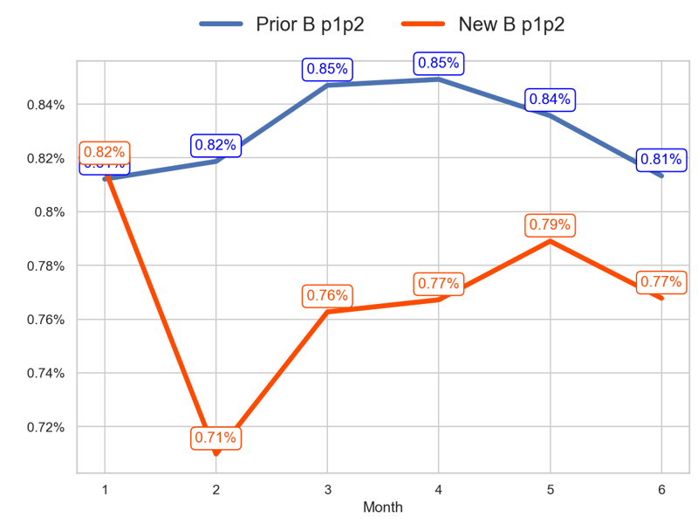
PERFORMANCE
Action Title
Prior P4 vs New P4 -
Insights
- The new priority has a better tendency than the old one over the last 3 months (-5.17% > -9.84%) - The last 3 months mean of the old priority is 2.96 and the new priority is 3.02
- The new priority has a worse tendency than the old one over the last 3 months (-1.64 < -0.57 percentage points) - The last 3 months mean of the old priority is 16.63% and the new priority is 15.96%
- The new priority has a better tendency than the old one over the last 3 months (0.01 > -0.03 percentage points) - The last 3 months mean of the old priority is 0.83% and the new priority is 0.77%

Slide 8
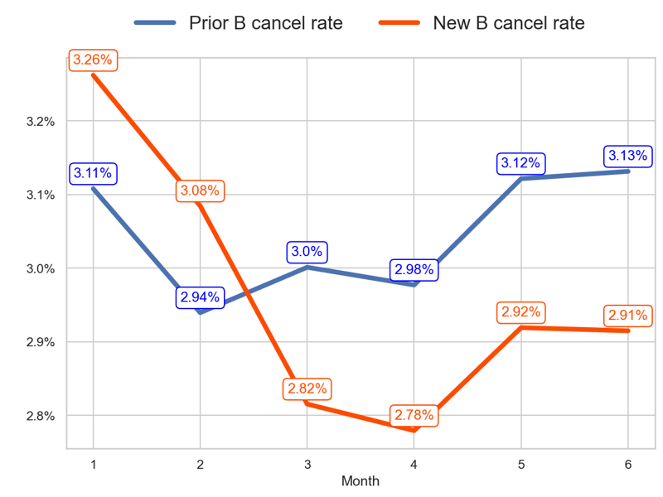
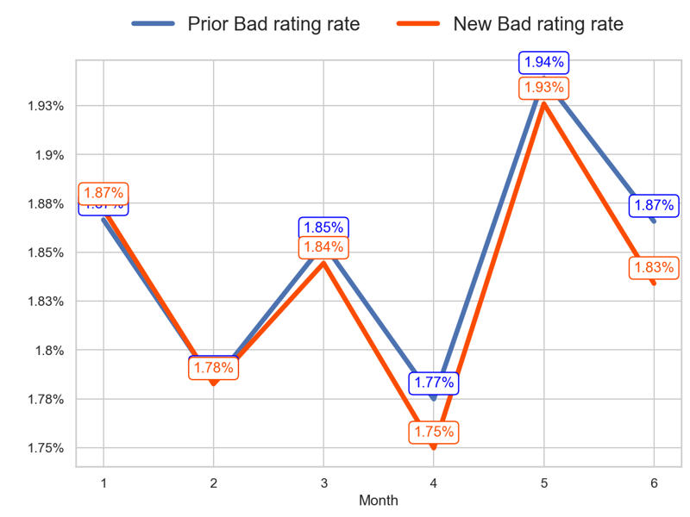
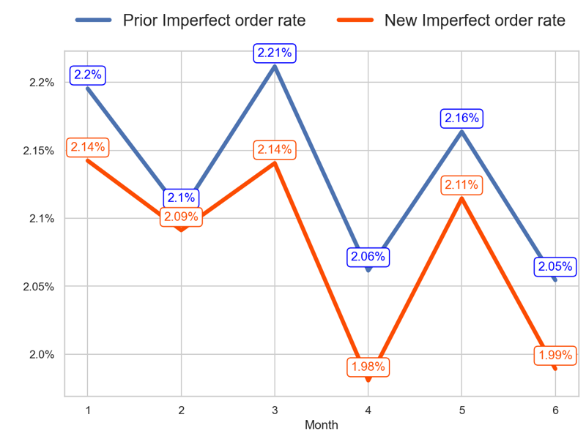
SERVICE
Action Title
Prior P4 vs New P4 -
Insights
- The new priority has a better tendency than the old one over the last 3 months (0.1 < 0.13 percentage points) - The last 3 months mean of the old priority is 3.08% and the new priority is 2.87%
- The new priority has a better tendency than the old one over the last 3 months (-0.01 < 0.01 percentage points) - The last 3 months mean of the old priority is 1.86% and the new priority is 1.84%
- The new priority has a better tendency than the old one over the last 3 months (-0.15 > -0.16 percentage points) - The last 3 months mean of the old priority is 2.09% and the new priority is 2.03%

Slide 9
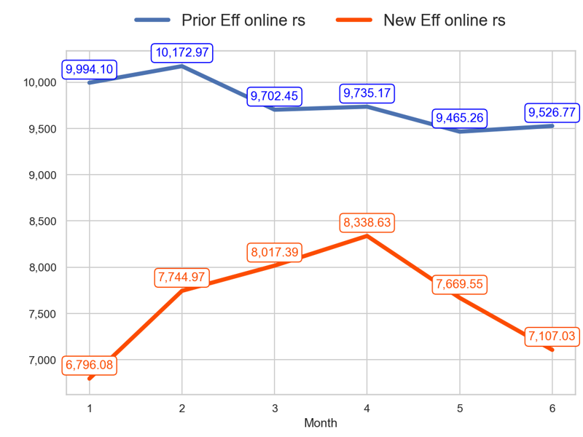
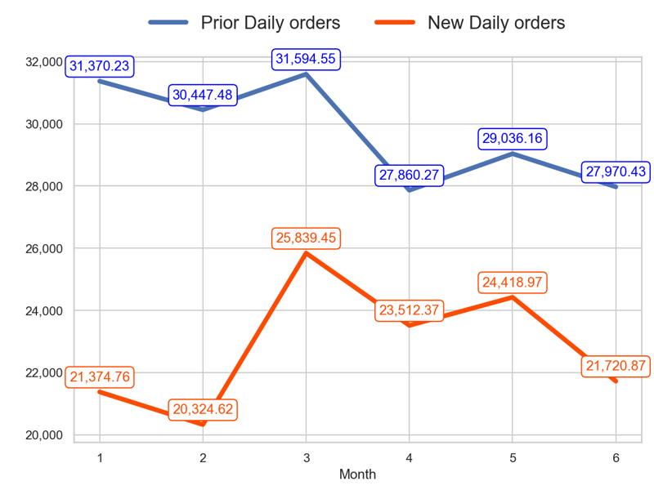
SERVICE
Action Title
Prior P4 vs New P4 -
- The new priority has a worse tendency than the old one over the last 3 months (-11.35% < -1.81%) - The last 3 months mean of the old priority is 9575.73 and the new priority is 7705.07
- The new priority has a worse tendency than the old one over the last 3 months (-15.94% < -11.47%) - The last 3 months mean of the old priority is 28288.95 and the new priority is 23217.4

Slide 10
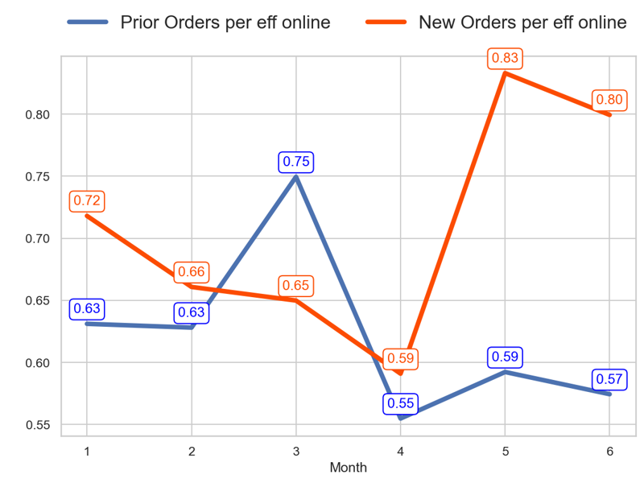
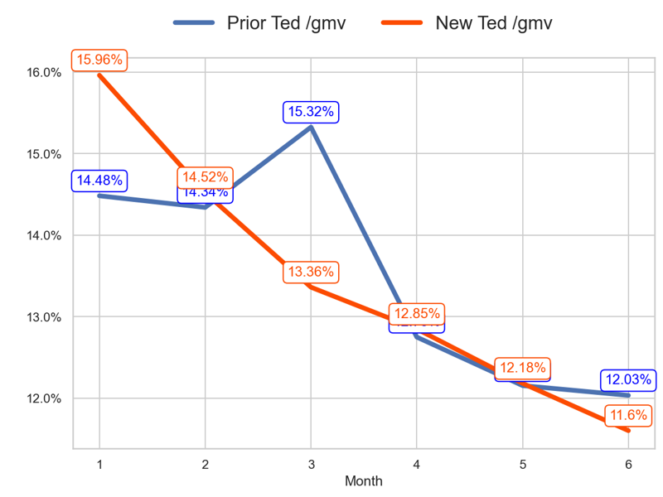
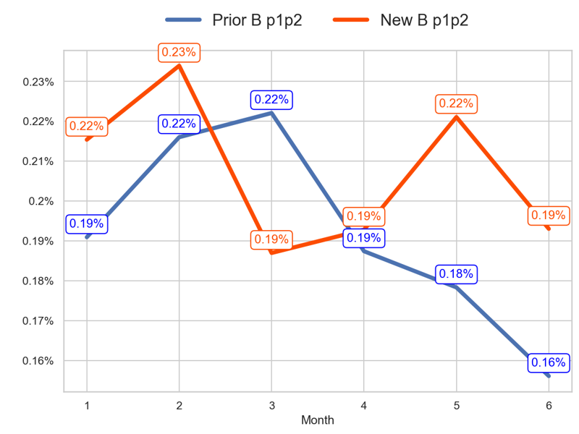
PERFORMANCE
Action Title
Prior P5 vs New P5 -
Insights
- The new priority has a better tendency than the old one over the last 3 months (23.01% > -23.36%) - The last 3 months mean of the old priority is 0.57 and the new priority is 0.74
- The new priority has a better tendency than the old one over the last 3 months (-1.76 > -3.29 percentage points) - The last 3 months mean of the old priority is 12.31% and the new priority is 12.21%
- The new priority has a better tendency than the old one over the last 3 months (0.01 > -0.07 percentage points) - The last 3 months mean of the old priority is 0.17% and the new priority is 0.2%

Slide 11
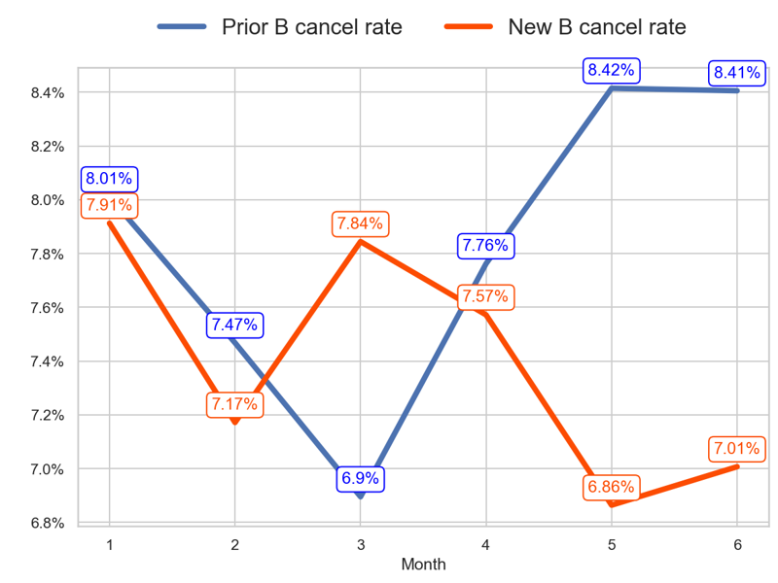
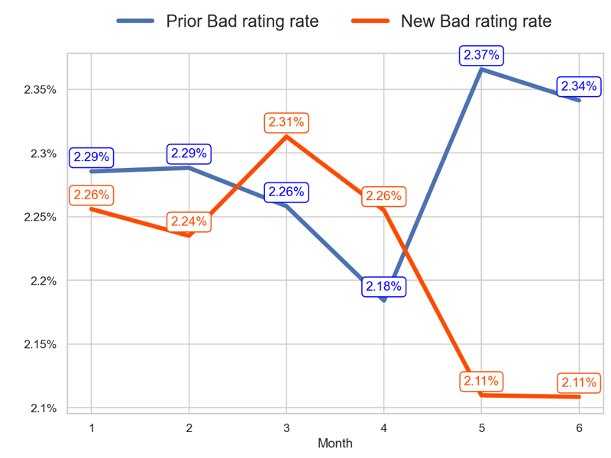
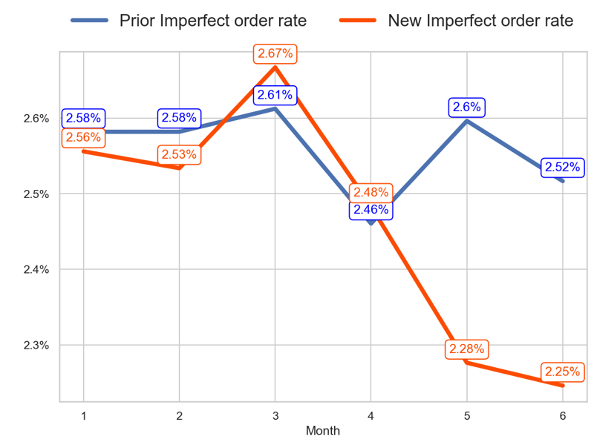
SERVICE
Action Title
Prior P5 vs New P5 -
Insights
- The new priority has a better tendency than the old one over the last 3 months (-0.84 < 1.51 percentage points) - The last 3 months mean of the old priority is 8.19% and the new priority is 7.15%
- The new priority has a better tendency than the old one over the last 3 months (-0.2 < 0.08 percentage points) - The last 3 months mean of the old priority is 2.3% and the new priority is 2.16%
- The new priority has a worse tendency than the old one over the last 3 months (-0.42 < -0.1 percentage points) - The last 3 months mean of the old priority is 2.52% and the new priority is 2.34%

Slide 12
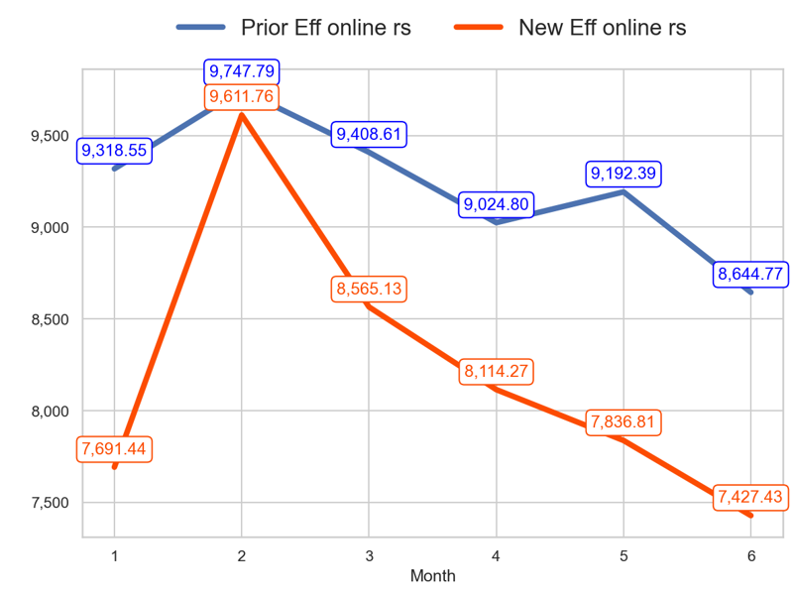
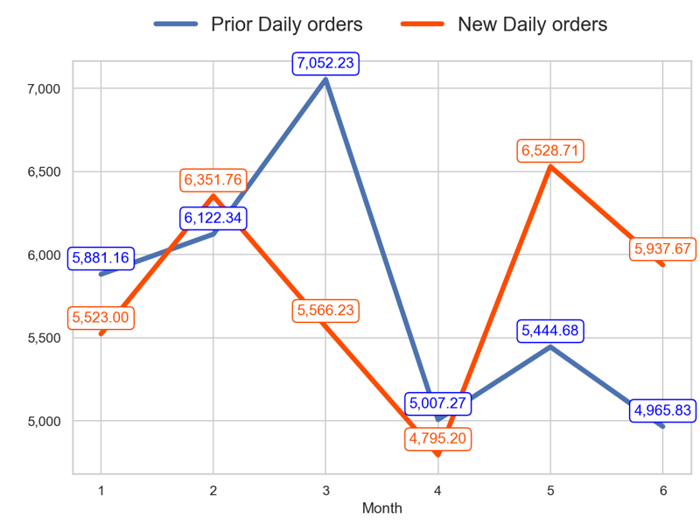
SERVICE
Action Title
Prior P5 vs New P5 -
- The new priority has a worse tendency than the old one over the last 3 months (-13.28% < -8.12%) - The last 3 months mean of the old priority is 8953.98 and the new priority is 7792.84
- The new priority has a better tendency than the old one over the last 3 months (6.67% > -29.58%) - The last 3 months mean of the old priority is 5139.26 and the new priority is 5753.86

