Slide 1


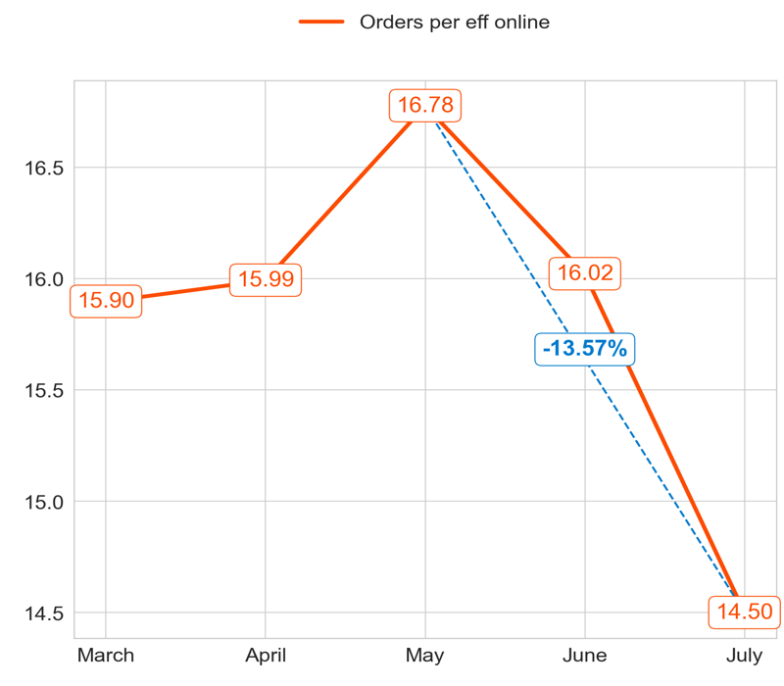
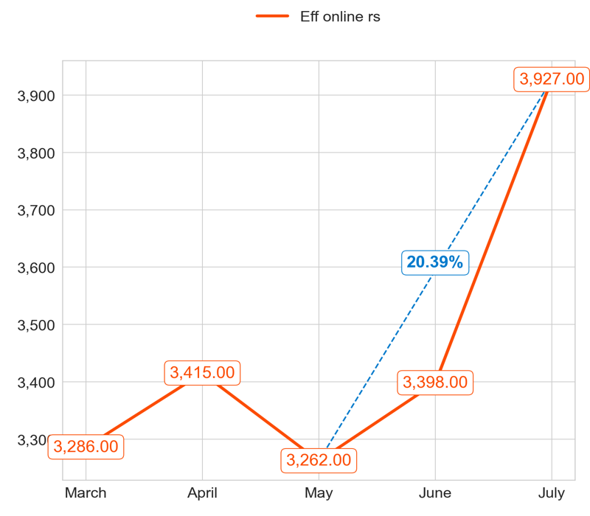
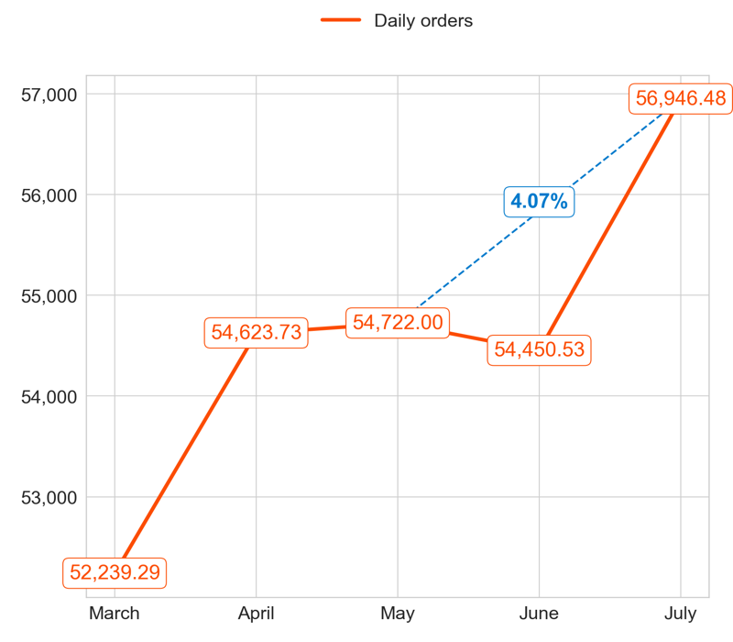
PERFORMANCE
Action Title
Priority 1 -
Comments
Highest: 16.78, Lowest: 14.50
Mean of the last 4 months: 15.82
Highest: 3,927.00, Lowest: 3,262.00
Mean of the last 4 months: 3,500.50
Highest: 56,946.48, Lowest: 52,239.29
Mean of the last 4 months: 55,185.69

Slide 2
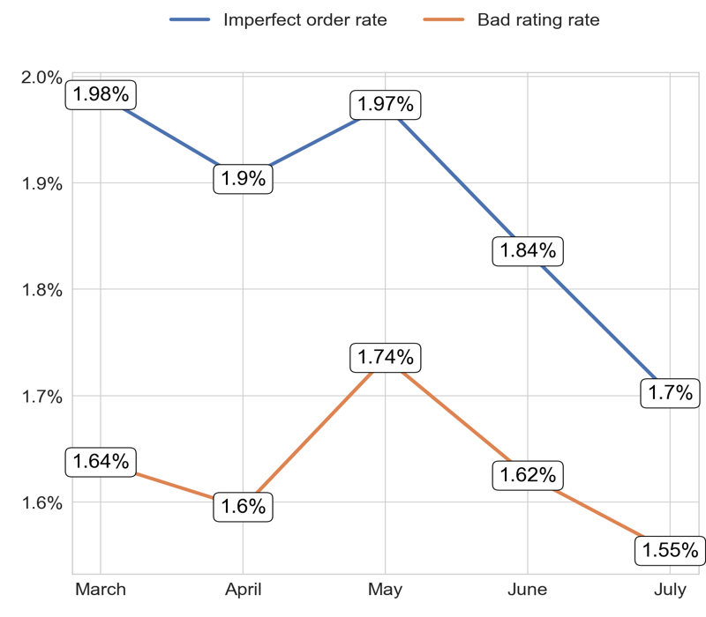
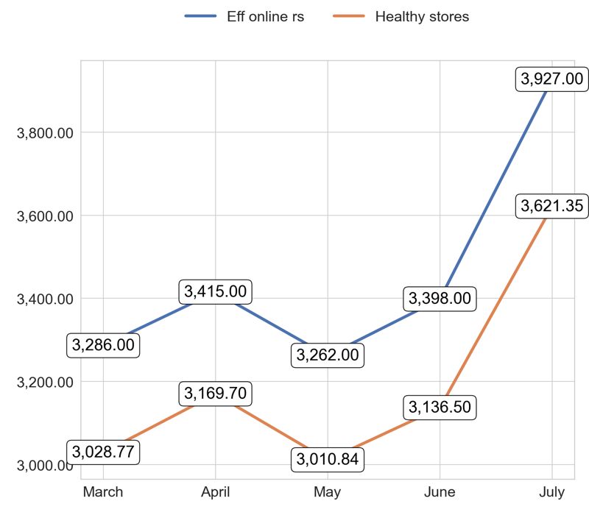
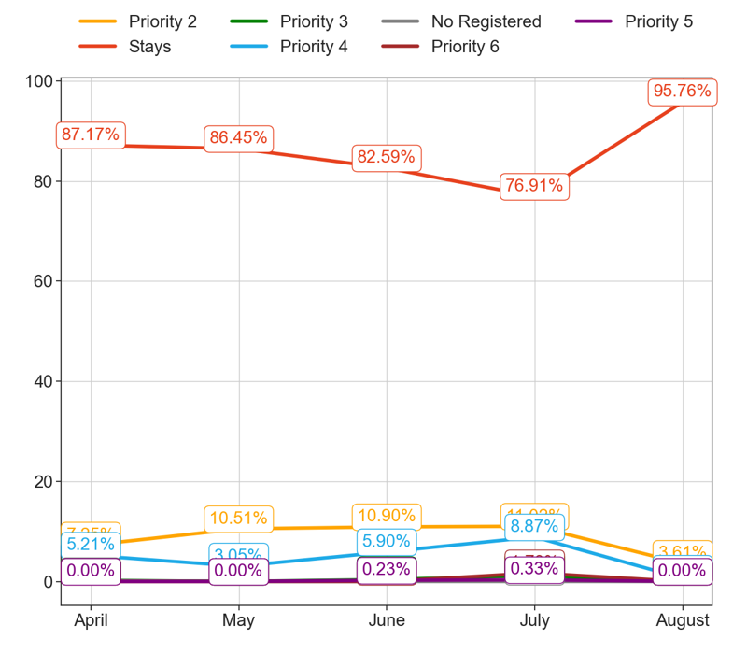
SERVICE
Action Title
Priority 1 -
Comments
Imperfect order rate average in the last 4 months: 1.88 % and the percentage change between the last 2 months: -6.76%.
Bad rating rate average in the last 4 months: 1.63 % and the percentage change between the last 2 months: -4.08%.
Eff online rs average in the last 4 months: 3,457.60 and the percentage change between the last 2 months: 16.22%.
Healthy stores average in the last 4 months: 3,193.43 and the percentage change between the last 2 months: 16.1%.
No comments

Slide 3
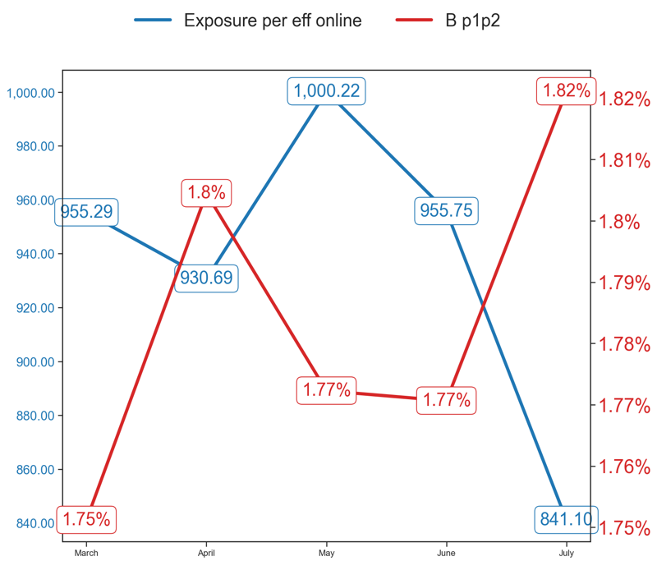
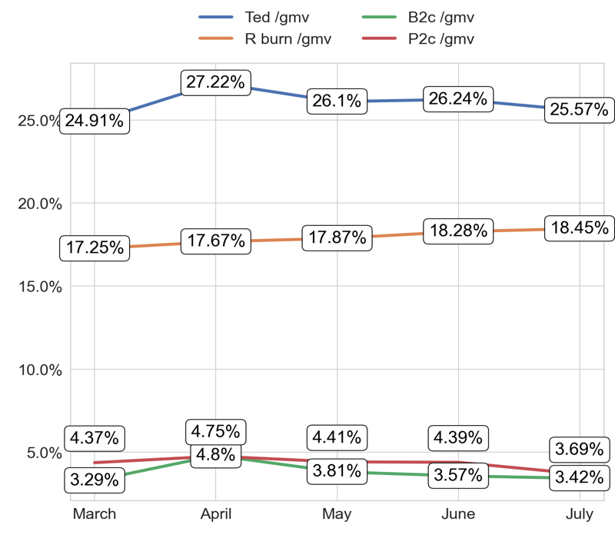
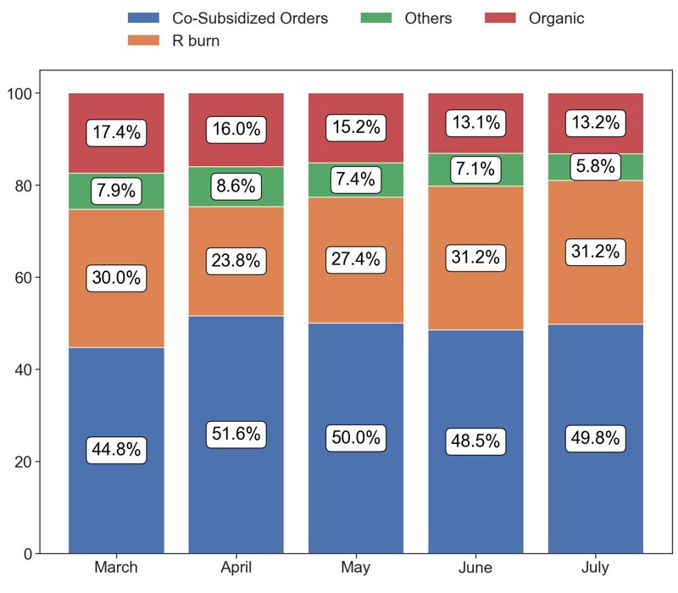
EXPOSURE AND BURN
Action Title
Priority 1 -
Comments
Exposure per eff online average in the last 4 months: 93660.71 % and the percentage change between the last 2 months: -11.46%.
B p1p2 average in the last 4 months: 1.78 % and the percentage change between the last 2 months: 2.85%.
No comments
Last Month Data:
Co-Subsidized Orders: 28,360
R burn: 17,782
Others: 3,313
Organic: 7,490

Slide 4
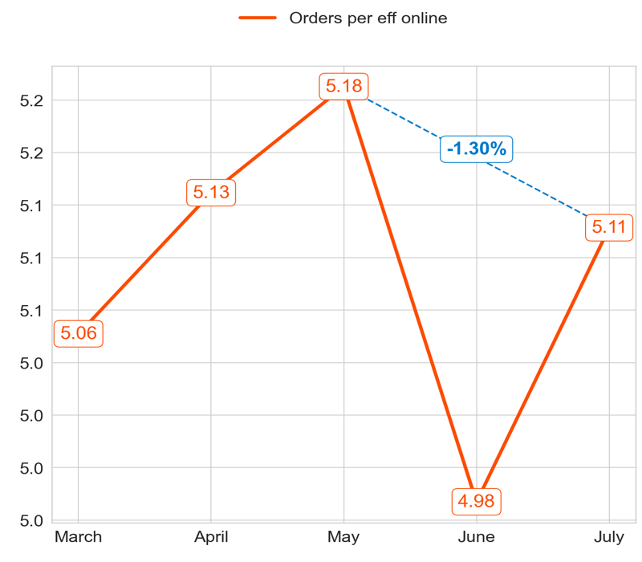
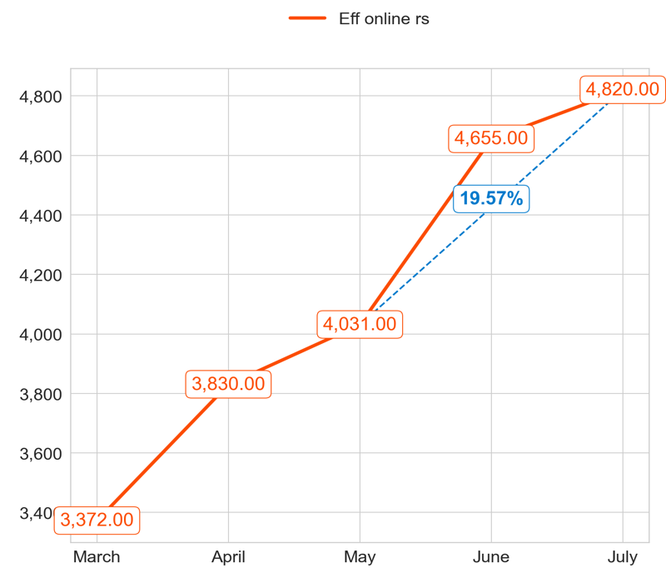
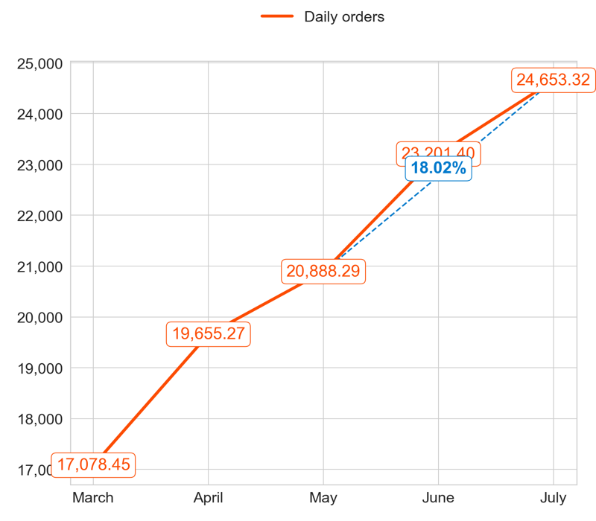
PERFORMANCE
Action Title
Priority 2 -
Comments
Highest: 5.18, Lowest: 4.98
Mean of the last 4 months: 5.10
Highest: 4,820.00, Lowest: 3,372.00
Mean of the last 4 months: 4,334.00
Highest: 24,653.32, Lowest: 17,078.45
Mean of the last 4 months: 22,099.57

Slide 5
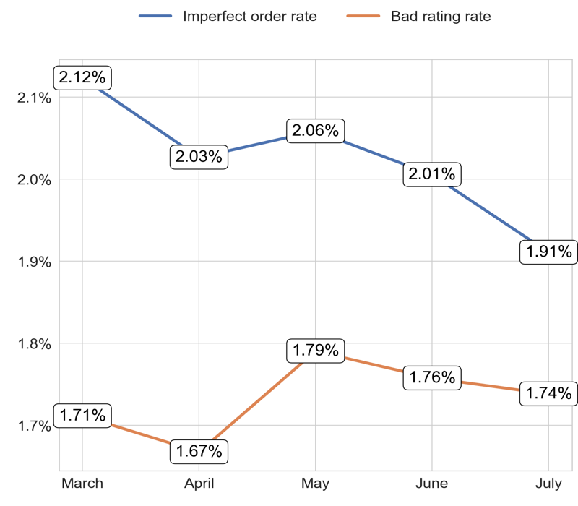
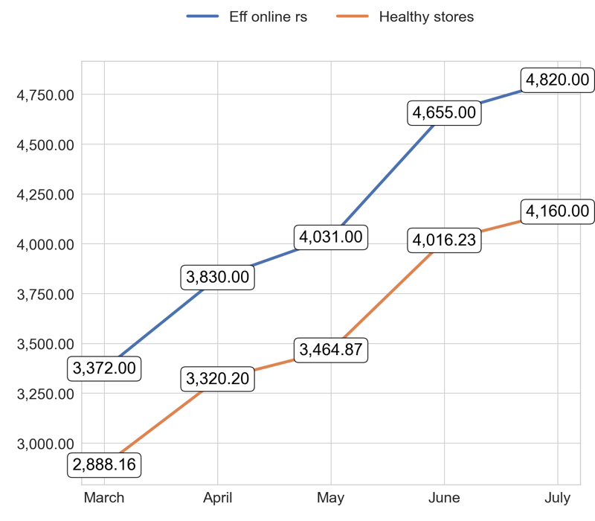
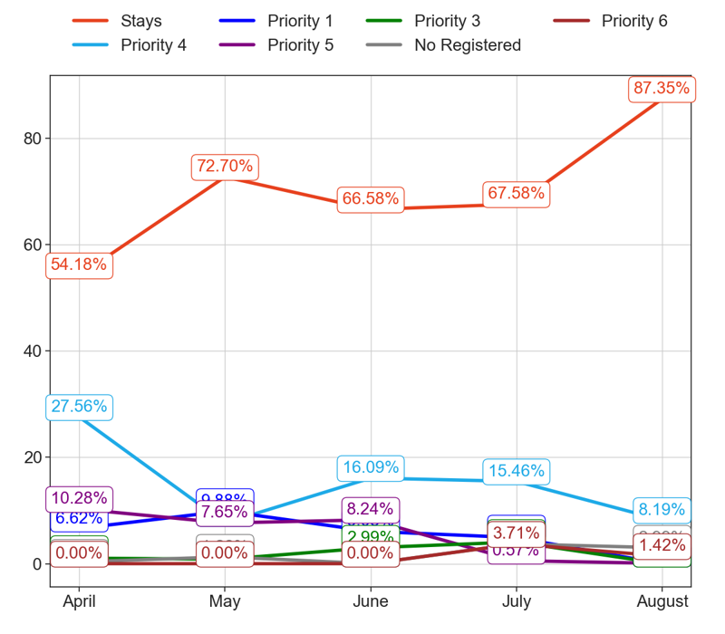
SERVICE
Action Title
Priority 2 -
Comments
Imperfect order rate average in the last 4 months: 2.02 % and the percentage change between the last 2 months: -4.59%.
Bad rating rate average in the last 4 months: 1.73 % and the percentage change between the last 2 months: -1.08%.
Eff online rs average in the last 4 months: 4,141.60 and the percentage change between the last 2 months: 4.09%.
Healthy stores average in the last 4 months: 3,569.89 and the percentage change between the last 2 months: 4.15%.
No comments

Slide 6
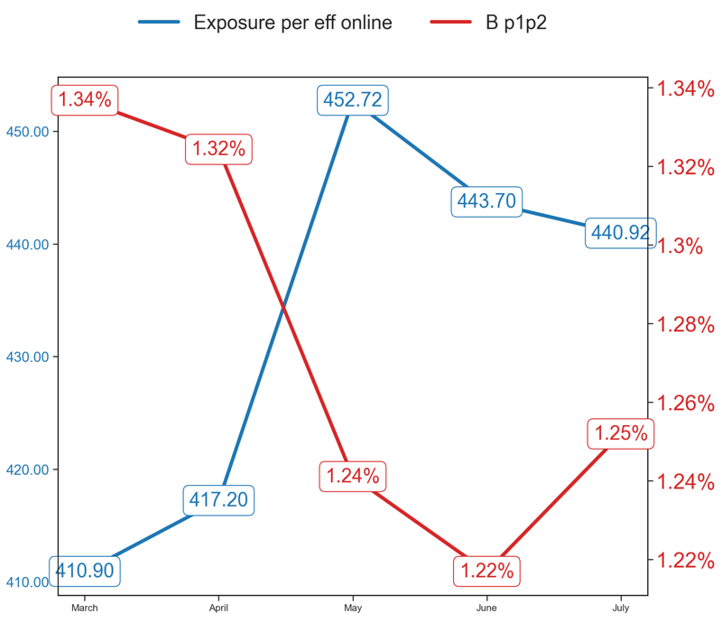
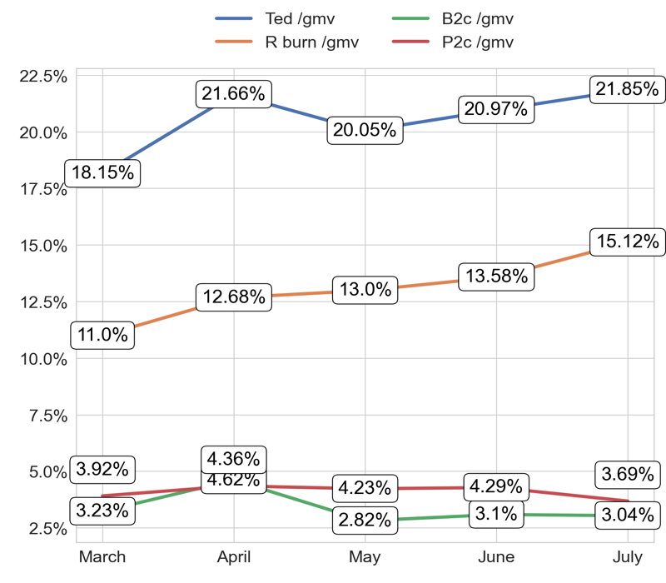
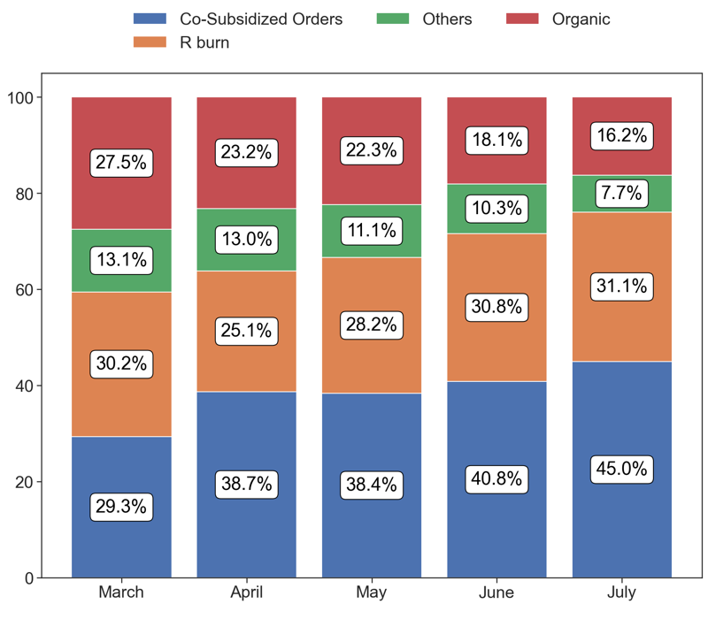
EXPOSURE AND BURN
Action Title
Priority 2 -
Comments
Exposure per eff online average in the last 4 months: 43308.79 % and the percentage change between the last 2 months: -0.61%.
B p1p2 average in the last 4 months: 1.27 % and the percentage change between the last 2 months: 2.82%.
No comments
Last Month Data:
Co-Subsidized Orders: 11,466
R burn: 7,927
Others: 1,960
Organic: 4,142

Slide 7
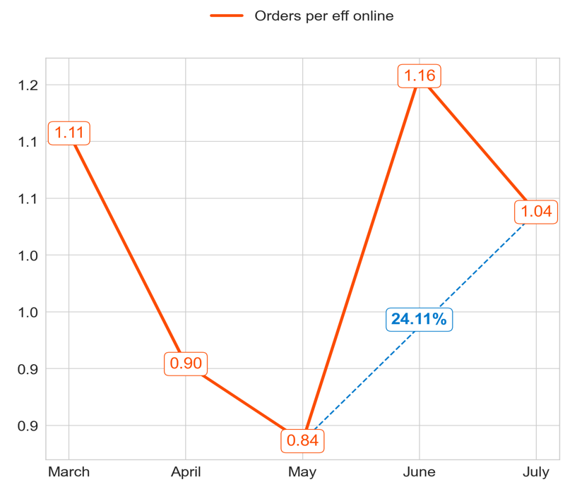
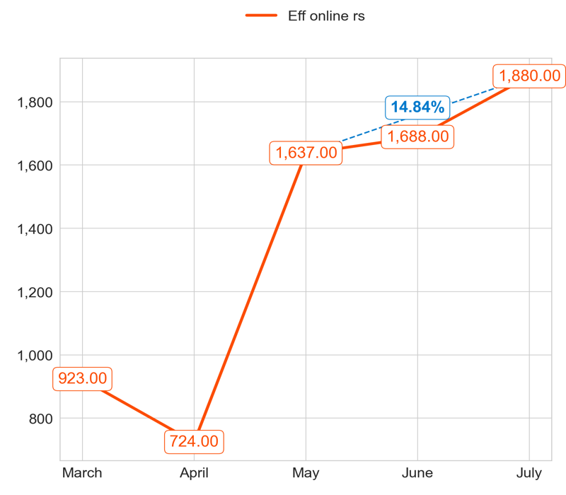
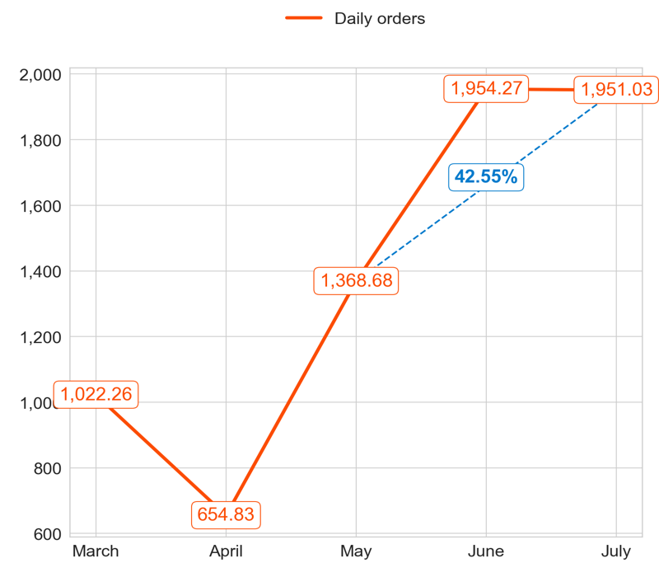
PERFORMANCE
Action Title
Priority 3 -
Comments
Highest: 1.16, Lowest: 0.84
Mean of the last 4 months: 0.98
Highest: 1,880.00, Lowest: 724.00
Mean of the last 4 months: 1,482.25
Highest: 1,954.27, Lowest: 654.83
Mean of the last 4 months: 1,482.20

Slide 8
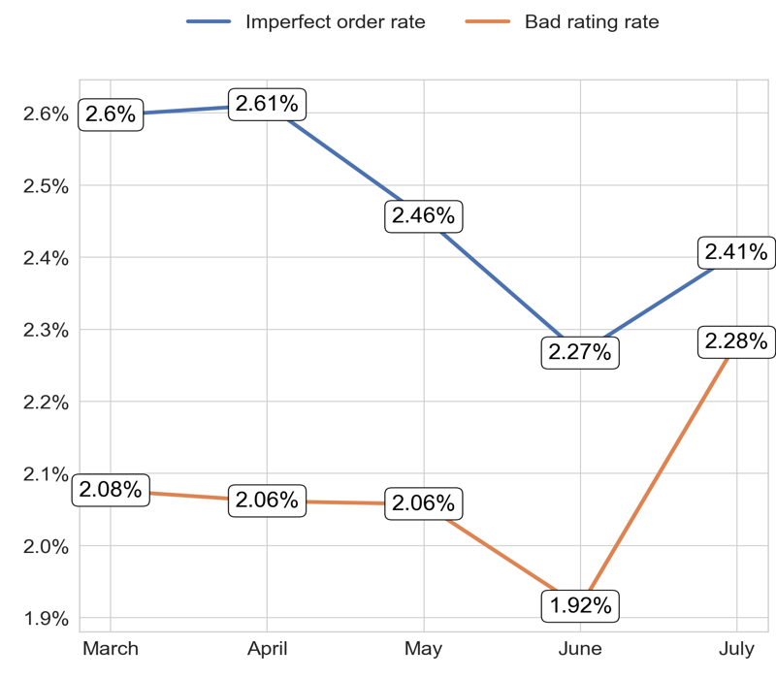
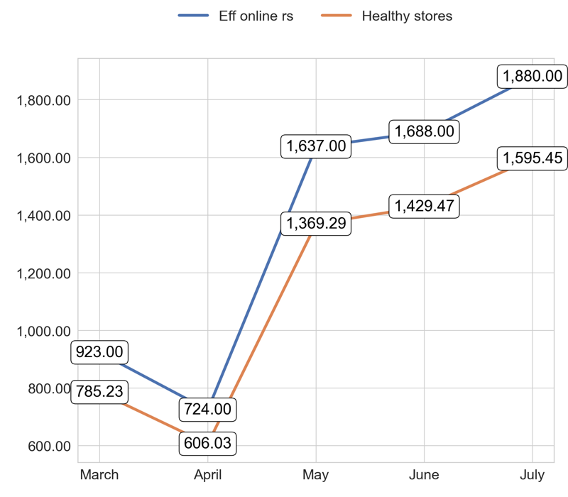
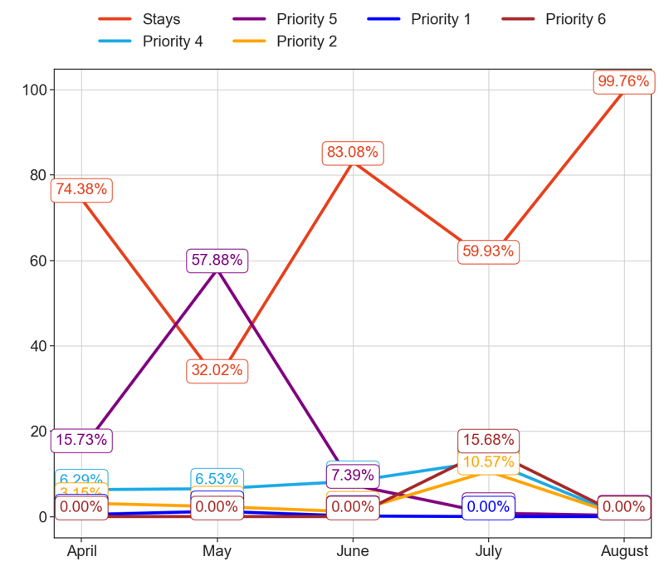
SERVICE
Action Title
Priority 3 -
Comments
Imperfect order rate average in the last 4 months: 2.47 % and the percentage change between the last 2 months: 5.65%.
Bad rating rate average in the last 4 months: 2.08 % and the percentage change between the last 2 months: 17.8%.
Eff online rs average in the last 4 months: 1,370.40 and the percentage change between the last 2 months: 11.73%.
Healthy stores average in the last 4 months: 1,157.09 and the percentage change between the last 2 months: 12.12%.
No comments

Slide 9
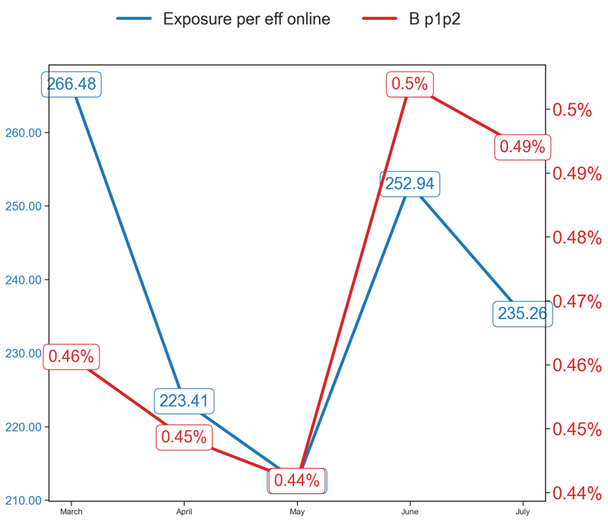
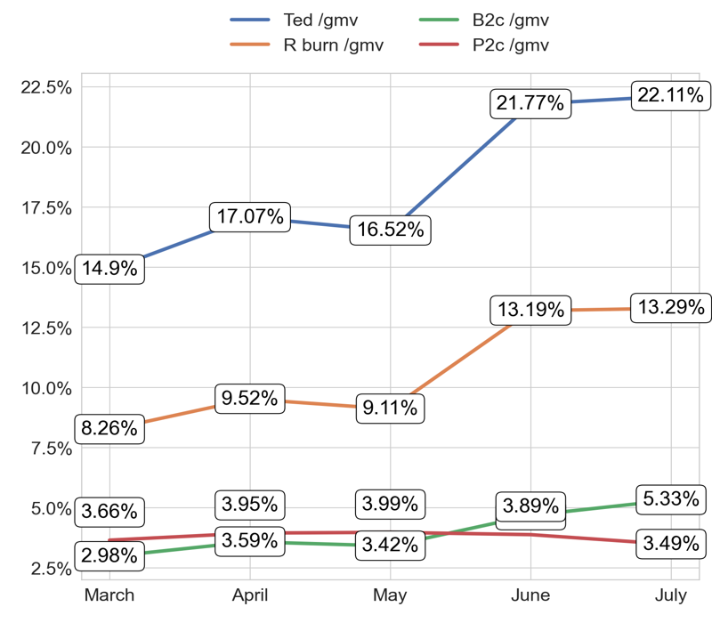
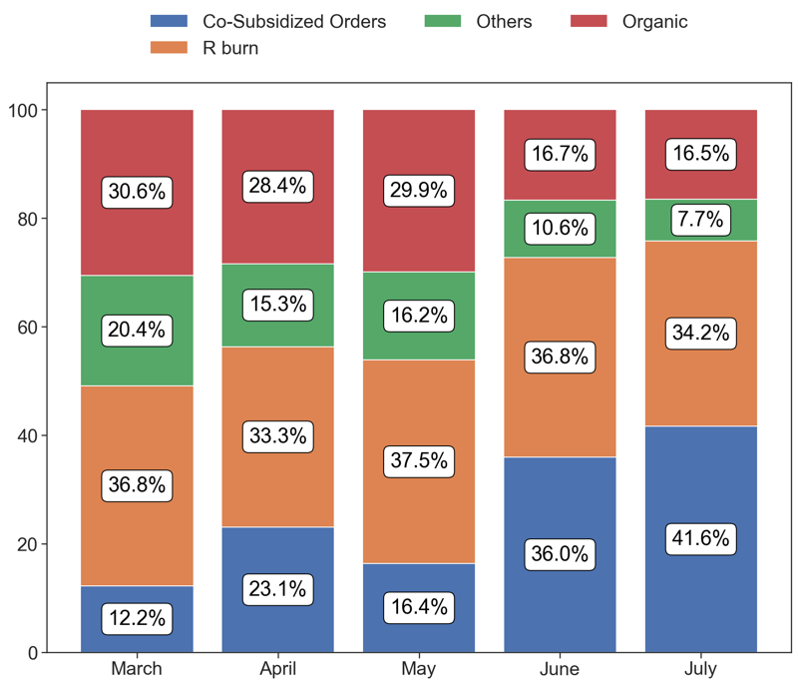
EXPOSURE AND BURN
Action Title
Priority 3 -
Comments
Exposure per eff online average in the last 4 months: 23813.45 % and the percentage change between the last 2 months: -8.32%.
B p1p2 average in the last 4 months: 0.47 % and the percentage change between the last 2 months: -2.23%.
No comments
Last Month Data:
Co-Subsidized Orders: 813
R burn: 667
Others: 150
Organic: 322

Slide 10
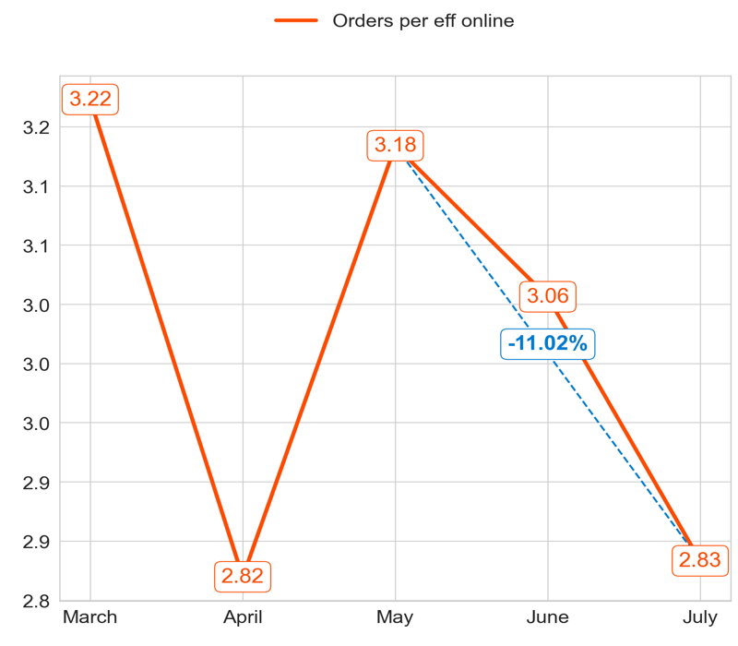
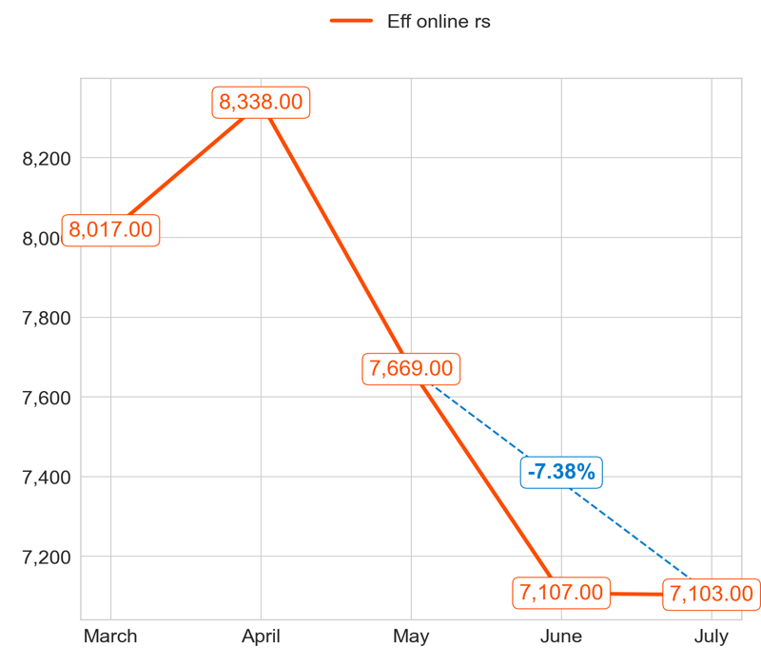
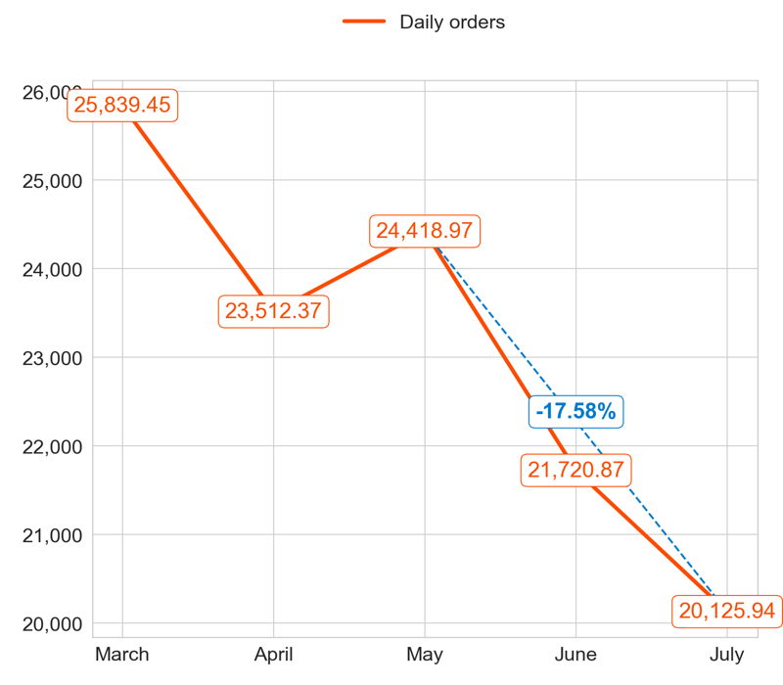
PERFORMANCE
Action Title
Priority 4 -
Comments
Highest: 3.22, Lowest: 2.82
Mean of the last 4 months: 2.97
Highest: 8,338.00, Lowest: 7,103.00
Mean of the last 4 months: 7,554.25
Highest: 25,839.45, Lowest: 20,125.94
Mean of the last 4 months: 22,444.53

Slide 11
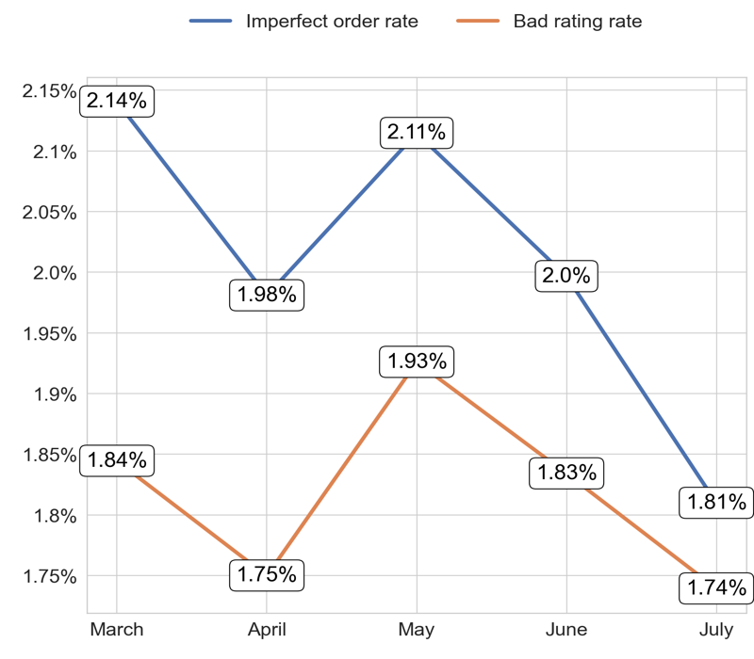
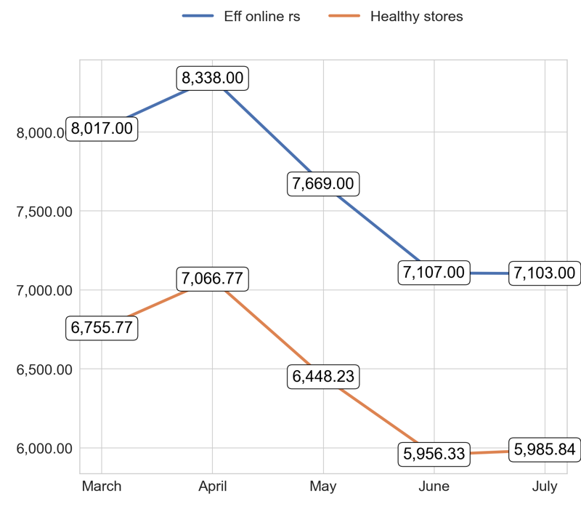
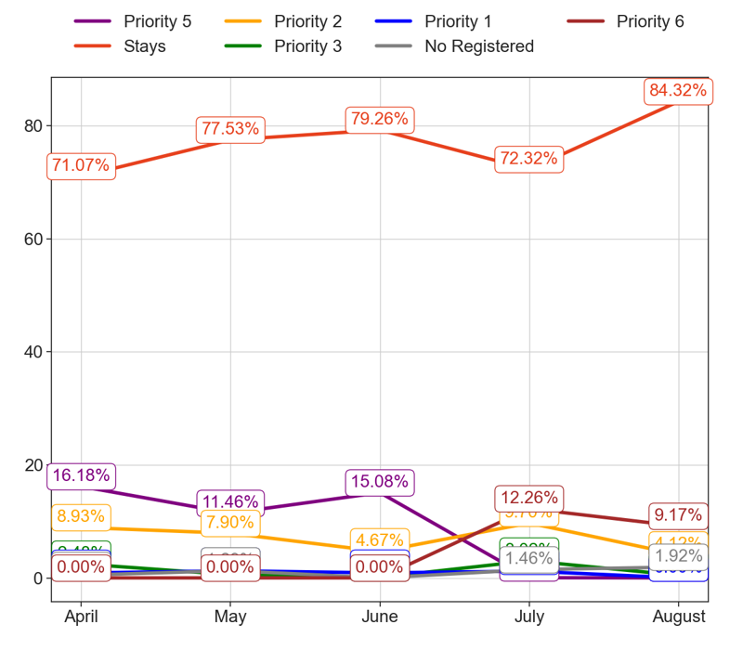
SERVICE
Action Title
Priority 4 -
Comments
Imperfect order rate average in the last 4 months: 2.01 % and the percentage change between the last 2 months: -8.83%.
Bad rating rate average in the last 4 months: 1.82 % and the percentage change between the last 2 months: -4.92%.
Eff online rs average in the last 4 months: 7,646.80 and the percentage change between the last 2 months: -0.05%.
Healthy stores average in the last 4 months: 6,442.59 and the percentage change between the last 2 months: 0.46%.
No comments

Slide 12
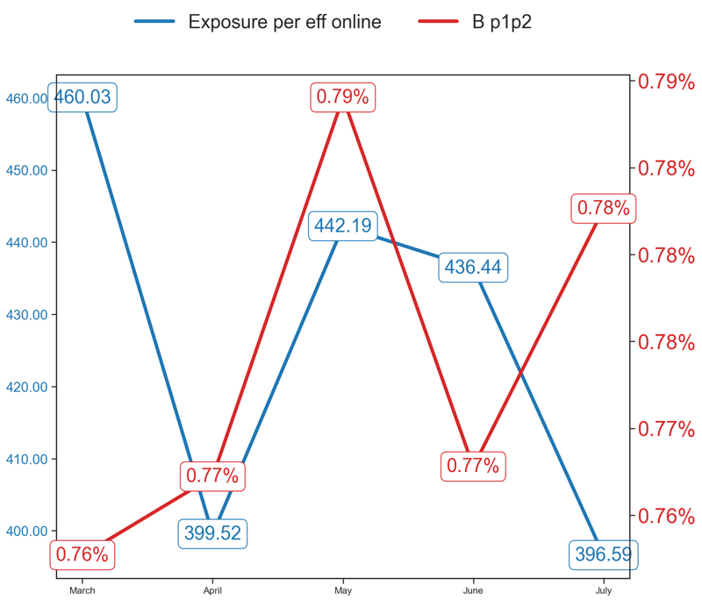
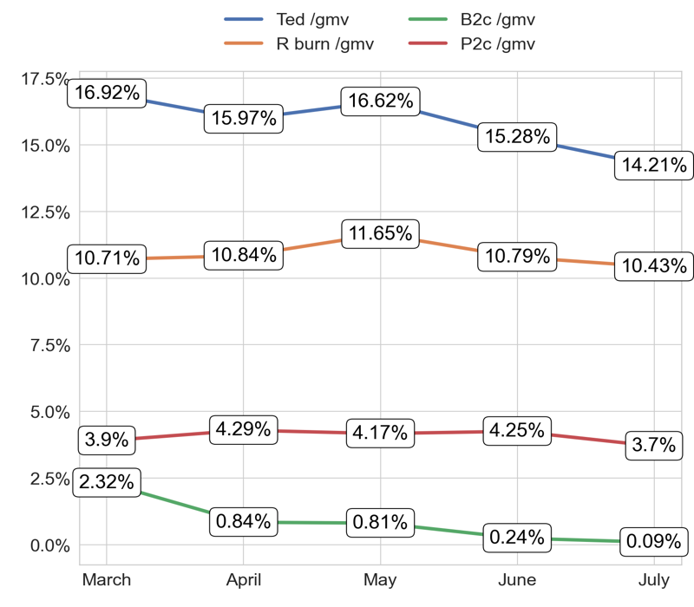
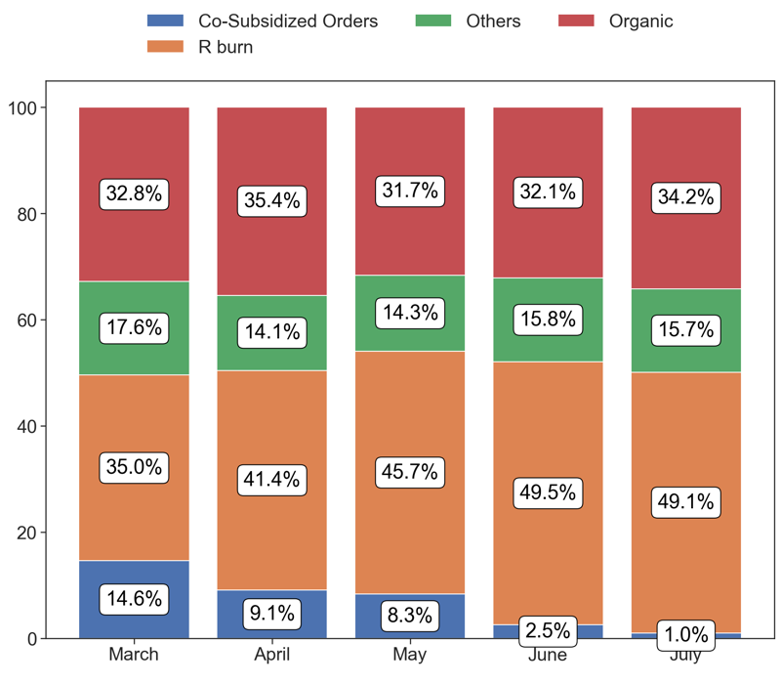
EXPOSURE AND BURN
Action Title
Priority 4 -
Comments
Exposure per eff online average in the last 4 months: 42695.3 % and the percentage change between the last 2 months: -9.01%.
B p1p2 average in the last 4 months: 0.77 % and the percentage change between the last 2 months: 1.88%.
No comments
Last Month Data:
Co-Subsidized Orders: 202
R burn: 9,913
Others: 3,164
Organic: 6,903

Slide 13
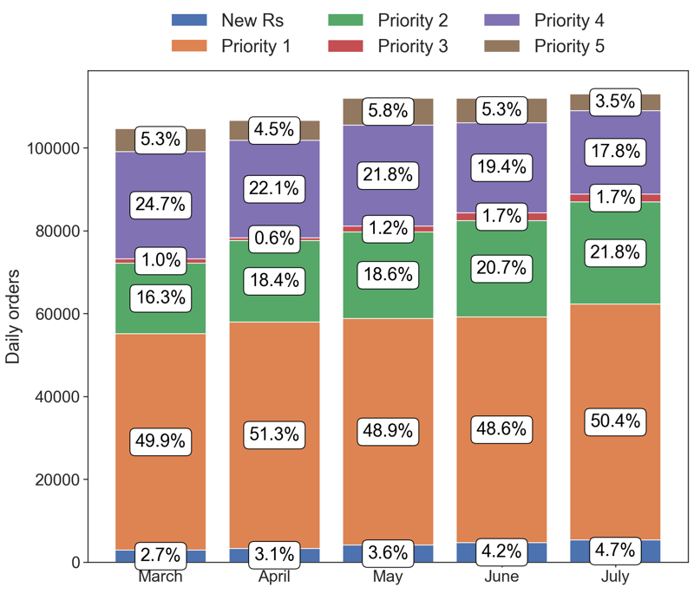
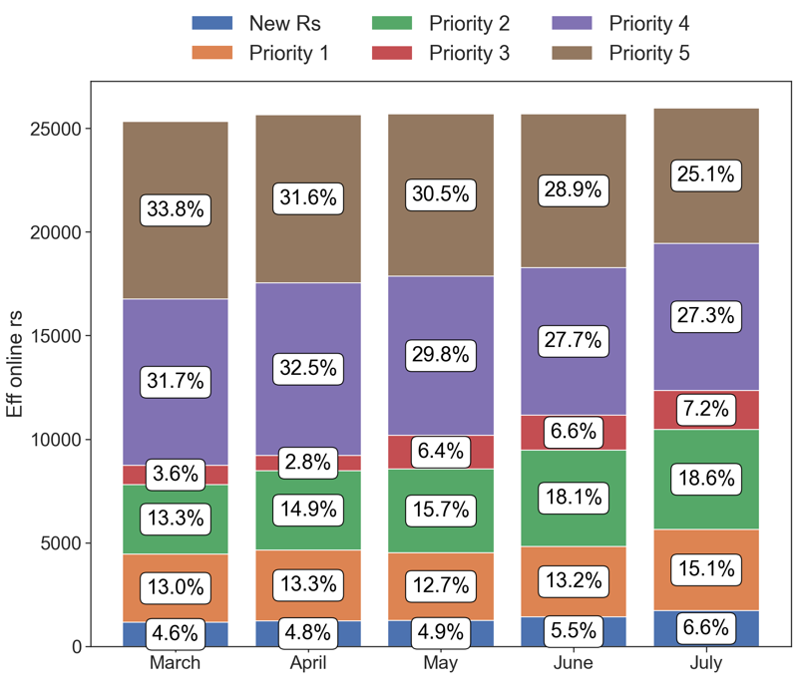
PERFORMANCE
Action Title
Country overview -
Comments
Last Month Data:
New Rs: 5,309.97, Priority 1: 56,946.48, Priority 2: 24,653.32, Priority 3: 1,951.03, Priority 4: 20,125.94, Priority 5: 4,008.61
Last Month Data:
New Rs: 1,724.00, Priority 1: 3,927.00, Priority 2: 4,820.00, Priority 3: 1,880.00, Priority 4: 7,103.00, Priority 5: 6,520.00

