Slide 1
Drug Classification
Merve Rana Kızıl – 150119825
Sueda Bilen – 150117044
Elif Gülay - 150119732

Slide 2


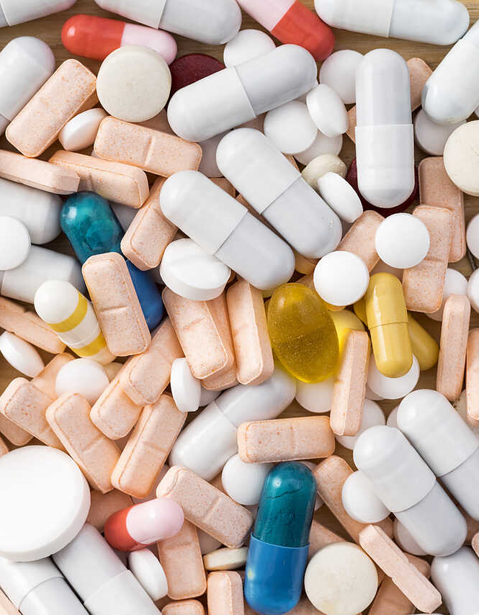
Goal
To predict the correct drugs for the patients by analyzing their gender, age, cholesterol, blood pressure levels, and sodium to potassium values in the dataset.

Slide 3

Subtasks
Examine and analysis of dataset
Implementation of different algorithms
a. k-NN
b. Naive Bayes
c. Decision Tree
d. Support Vector Machines
e. Random Forest
Visualization of classification results
Comparison of methods

Slide 4
Dataset
There are 6 types of variables in the dataset.
Variable Name | Description
Age | Age of the patient
Sex | Gender of the patient (male or female)
BP | Levels of blood pressure (high, normal, or low)
Cholesterol | Levels of cholesterol (high or normal)
Na-to-K | Sodium to potassium ratio in blood
Drug | Type of the drug
Age | Sex | BP | Cholesterol | Na-to-K | Drug
23 | F | HIGH | HIGH | 25.355 | DrugY
47 | M | LOW | HIGH | 13.093 | drugC
18 | F | NORMAL | NORMAL | 8.75 | drugX

Slide 5
Dataset Preparation
Data Bining
Data bining is the process of dividing a continuous variable into a set of discrete bins.
The age is divided into 7 categories.
The chemical ratio is divided into 4 categories.
Splitting the Dataset
70% training
30% testing

Slide 6
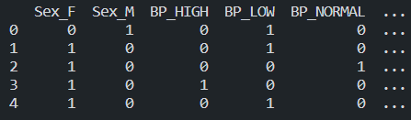
Feature Engineering
One-hot encoding is used as a feature engineering method to represent the categories as numerical data.
Each category is represented as a binary vector.

Slide 7
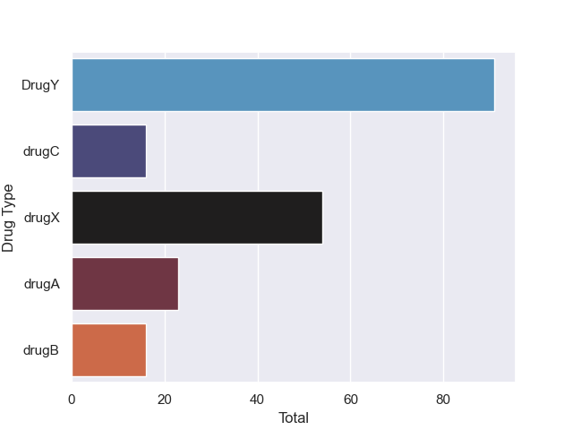
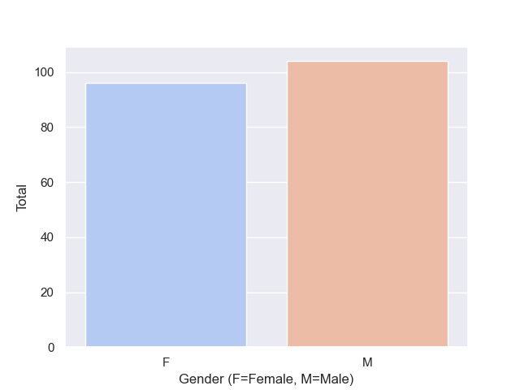
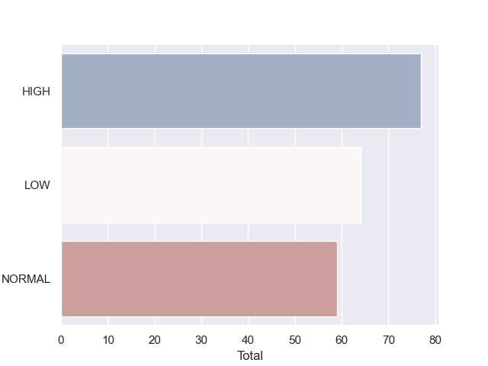
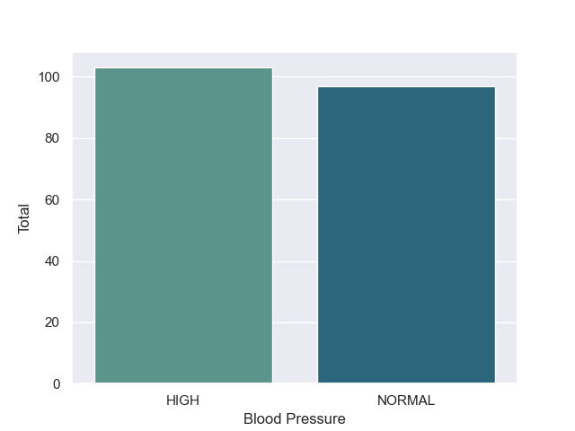
Feature Distributions

Slide 8
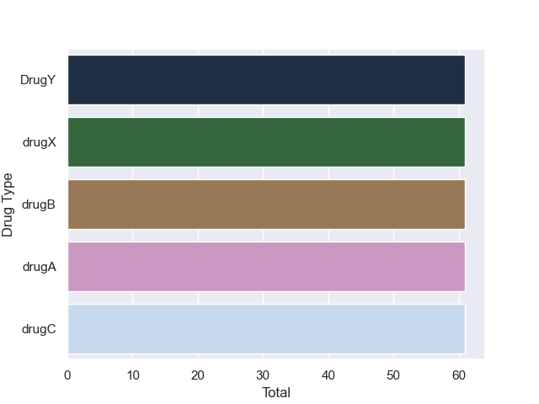
SMOTE Technique
Oversampling method is used to balance class distributions, i.e., drug types in the dataset.
before oversampling
after oversampling
The distribution of drug types is balanced.

Slide 9
Classification Report
Precision: Measures the proportion of positive predictions that are actually correct.
Recall: Measures the proportion of actual positive instances that were correctly predicted.
F1-score: a measure of the balance between precision and recall, with higher values indicating a better balance.
Support: The number of instances in the dataset for each class.

Slide 10
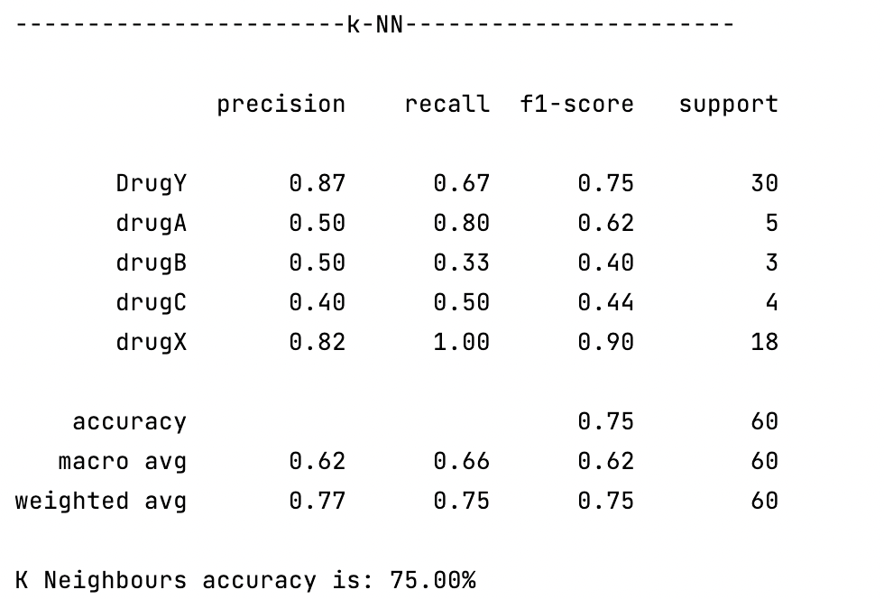
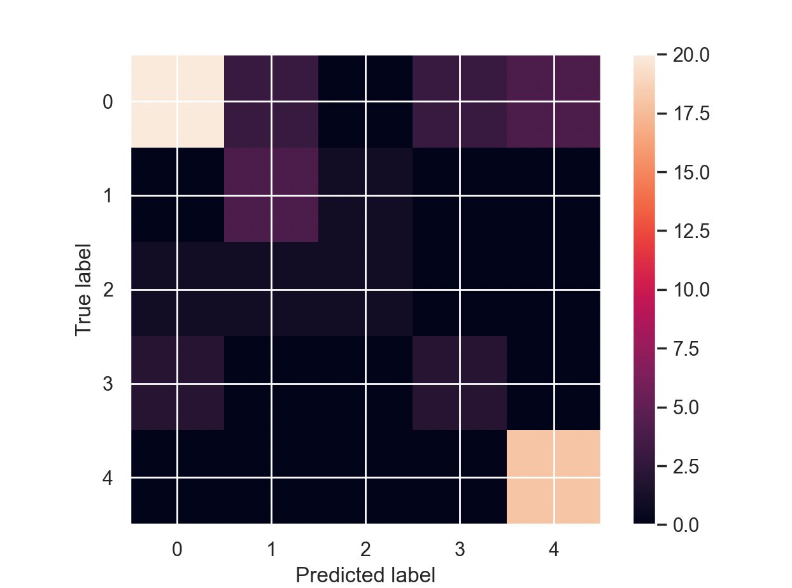
k-NN
The aim of k-NN (k-Nearest Neighbors) is to classify a given test point based on the majority class of its k nearest neighbors.

Slide 11
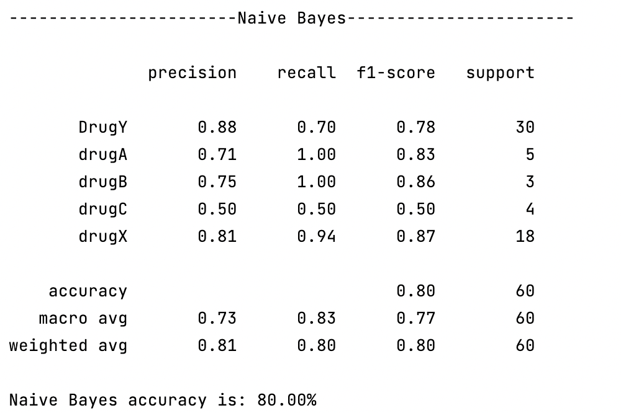
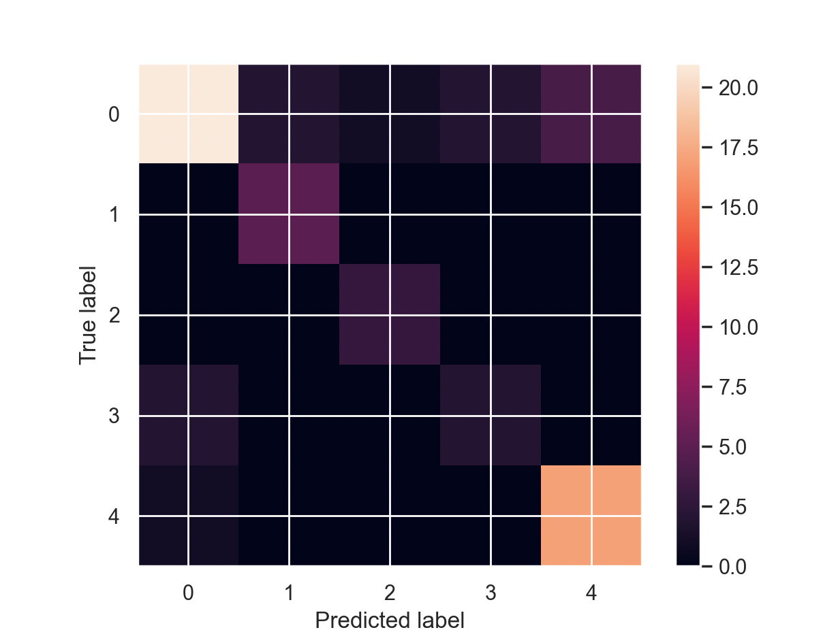
Naïve Bayes
The aim of Naive Bayes is to predict the class label of a given data point based on the probability of the data point belonging to each class, using Bayes' theorem and the assumption of independence among the features.

Slide 12
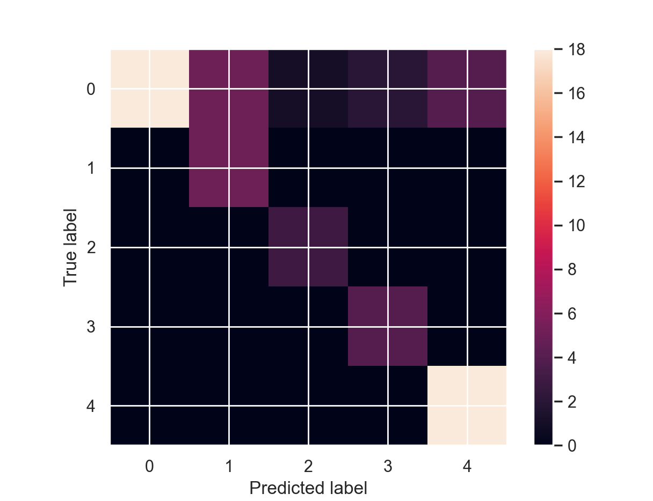
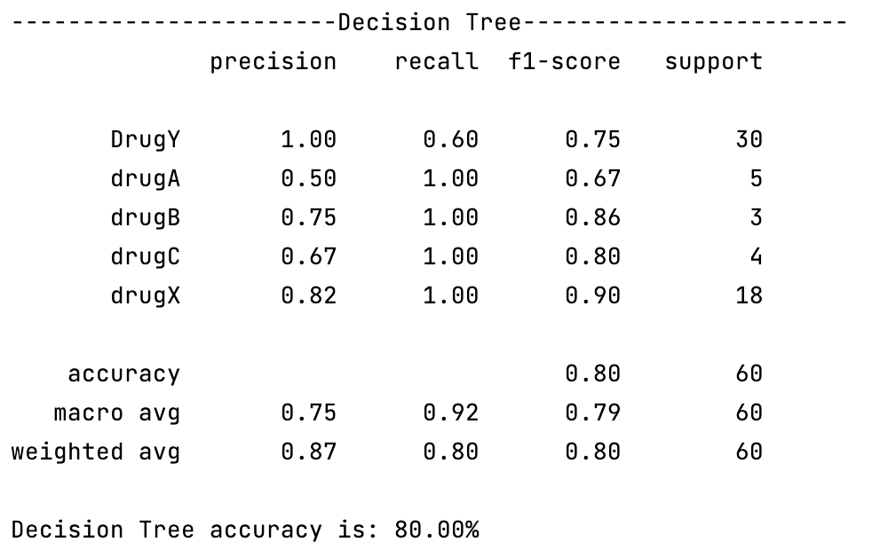
Decision Tree
The aim of Decision Tree is to make predictions by dividing the data into smaller and smaller groups based on the value of the features.

Slide 13
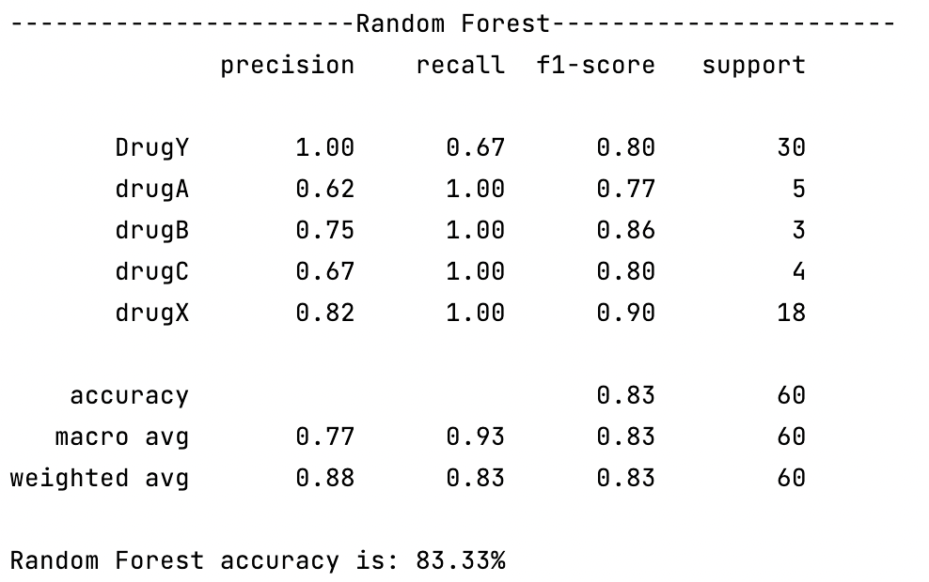
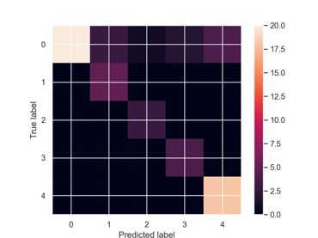
Random Forest
The aim of Random Forest is to make predictions using an ensemble of decision trees, where each tree is trained on a random subset of the data and features.

Slide 14
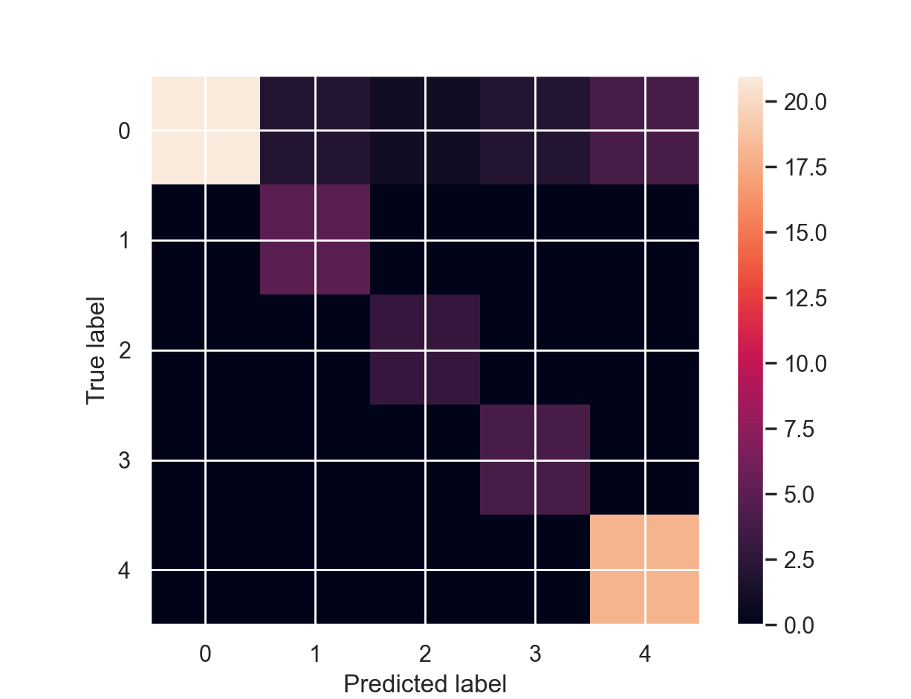
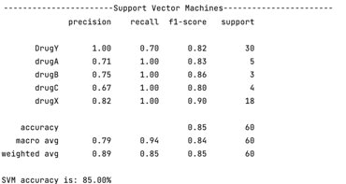
Support Vector Machines
The aim of Support Vector Machines is to find the best way to divide the data into groups based on their characteristics.

Slide 15
Comparison of the Algorithms
 | Model | Accuracy
1 | K-NN | 75.00%
2 | Naïve Bayes | 80.00%
3 | Decision Tree | 80.00%
4 | Random Forest | 83.33%
5 | SVM | 85.00%

Slide 16
References
https://www.kaggle.com/datasets/prathamtripathi/drug-classification

