Slide 1
Data Communication on Automated Systems
(a comparative approach)

Slide 2
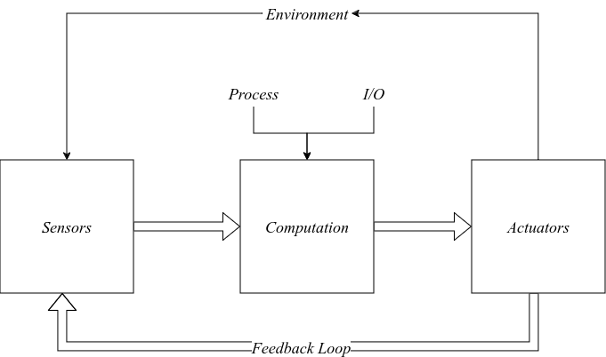
Automated Systems
Takes an input from its external environment (via sensors or other automated systems)
Processes the input via a computational system, usually a microcontroller
Acts on the environment based on that processing

Slide 3
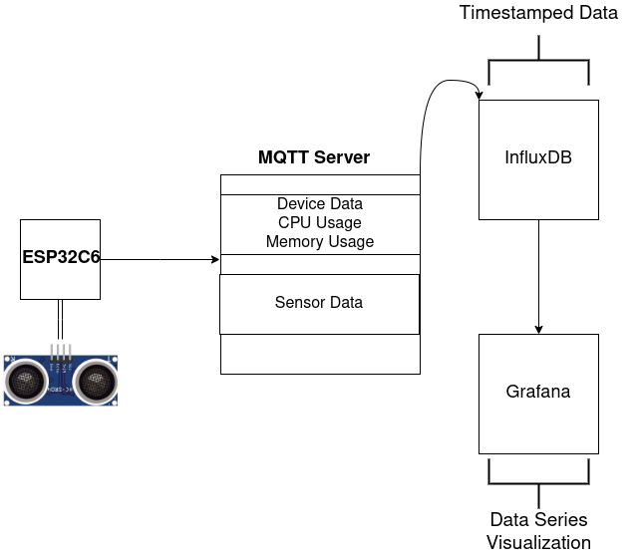
Same application, two different implementations:
Rust implementation with Embassy.
C implementation with FreeRTOS.

Slide 4
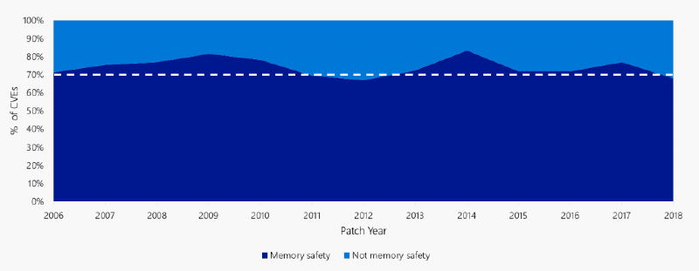
According to Microsofts Security Reseach & Defense department
70% of the vulnerabilities that have been assigned a CVE from
2006-2018 has been a memory safety issue.
In the same publication, Microsoft reccomends Rust!

Slide 5
C : ESP-IDF
1 #include <stdlib.h>
2 #include <stdio.h>
3 #include <string.h>
4
5 int main()
6 {
7 char file_name[100];
8 gets(file_name);
9 FILE* file = fopen(file_name, "r");
10 char *buffer = malloc(1024);
11 fread(buffer,1,1024,file);
12 fclose(file);
13 if (strcmp(buffer,"super_secret") == 0 ) {
14 printf("Access granted\n");
15 free(buffer);
16 return 0;
17 }
18 free(buffer);
19 return 1;
20 }

Slide 6
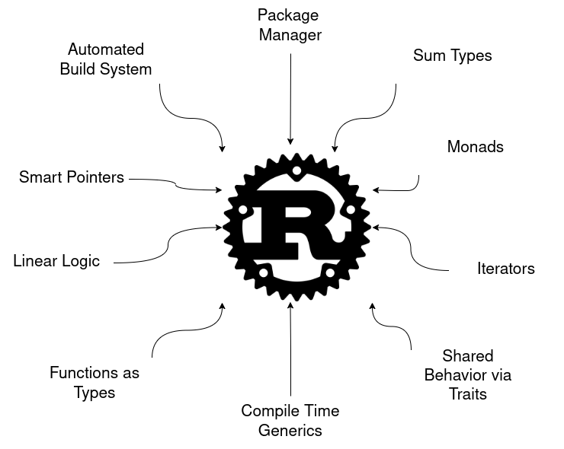

Slide 7
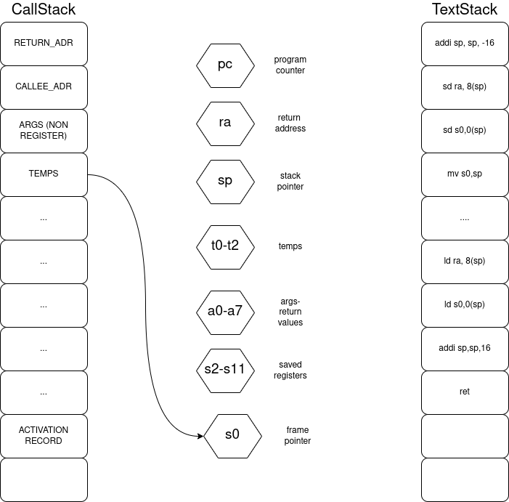
A program is just a list of
instructions that are executed sequentially.
The CPU itself can only execute intrustions this way.

Slide 8
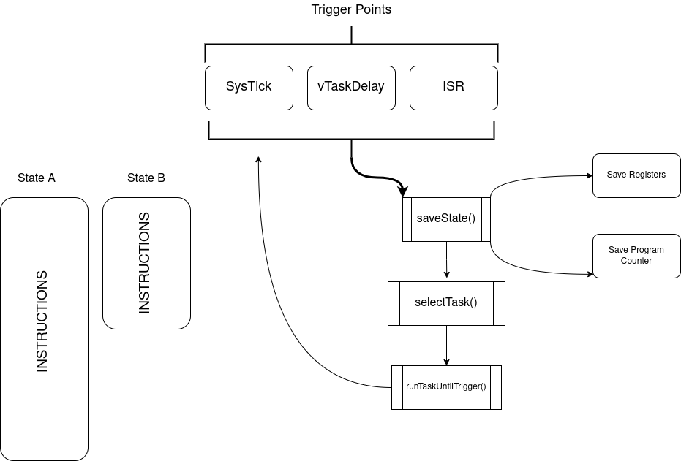
FreeRTOS Scheduler
Context Switching
When a task is created the
current state is saved, holding the values of its registers in its stack. The program counter register updates its value to point to the newly created task, a new state is created that uses the CPUs registers until another task is created and the process repeats itself.

Slide 9
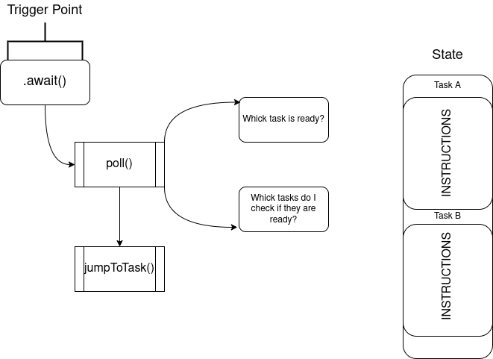
Embassy Scheduler
The Embassy Scheduler works like a Finite State Machine (FSM), performs no allocations for different states, everything lives on the same stack and every task is essentially a jump to another point of the program.

Slide 10
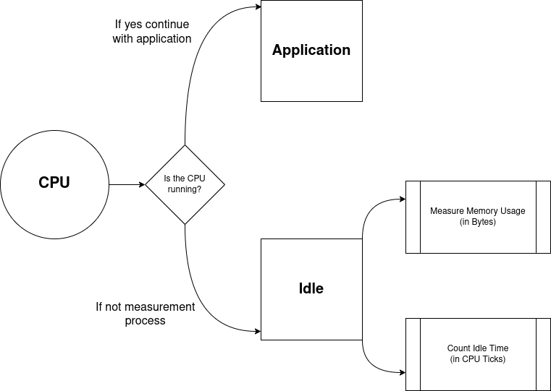
Measuring Device Data

Slide 11
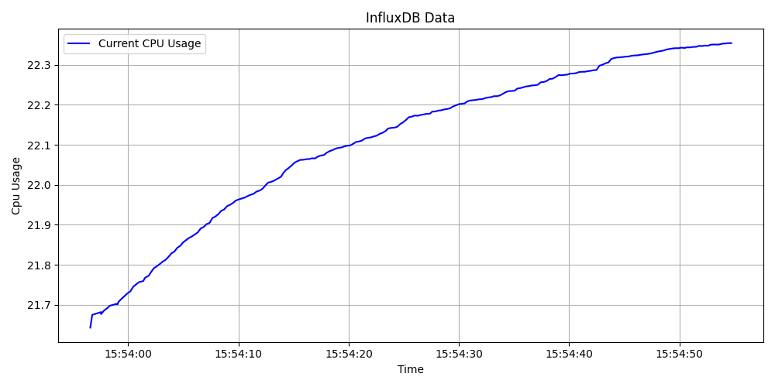
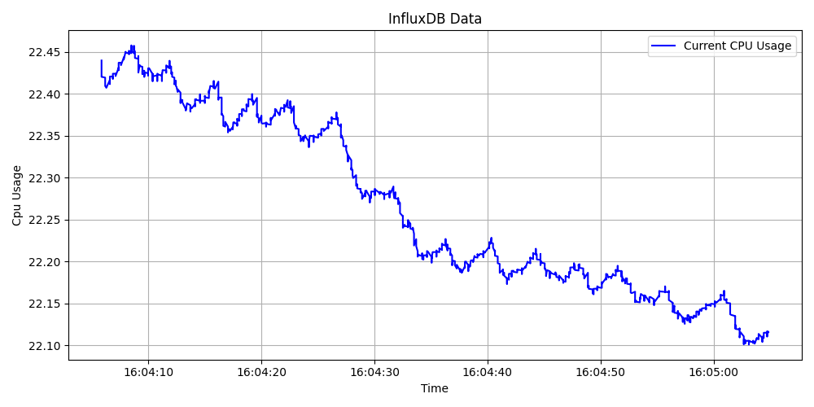
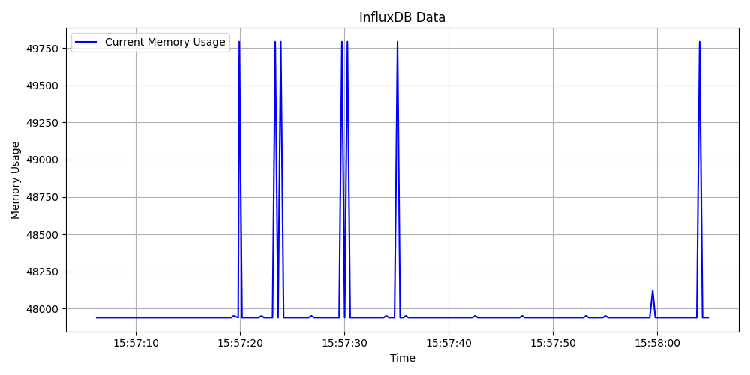
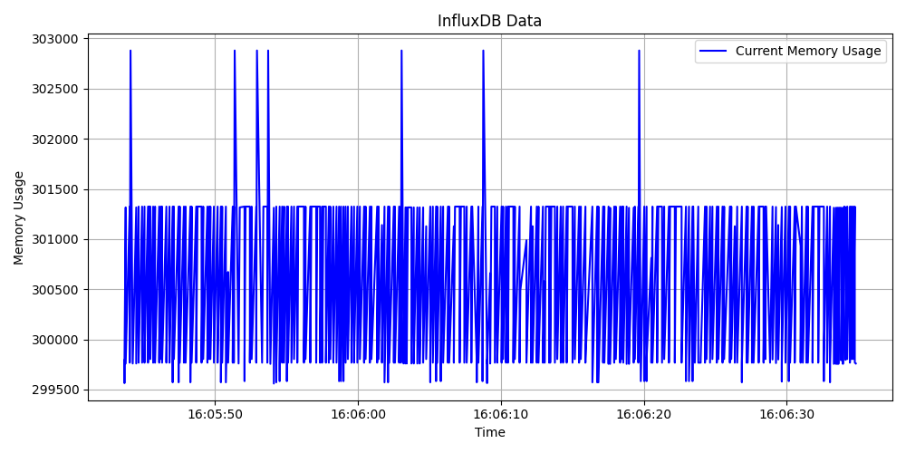
Rust && Embassy
C && FreeRTOS

