Slide 1
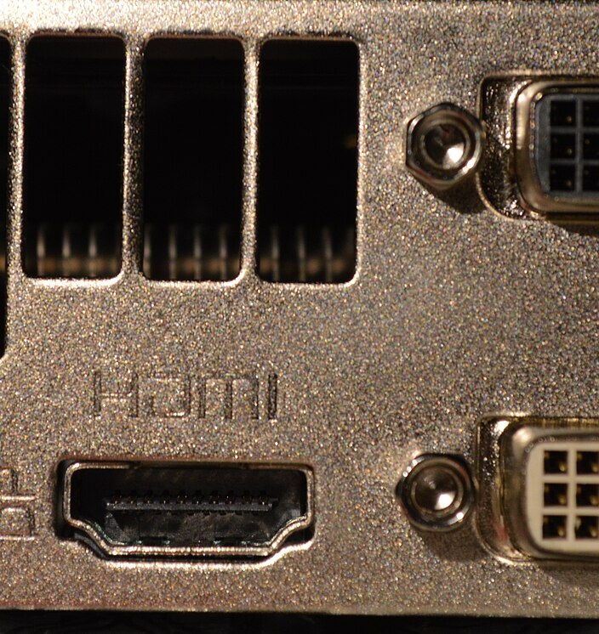
Monitors, Signals, Ports, and Cables
Recognize the port. Match the cable. Check the signal.
Computer Systems
Notes:
Open by asking students which connectors they already recognize.
Image sources and licences:
https://commons.wikimedia.org/wiki/File:GPU_Interface.jpg

Slide 2
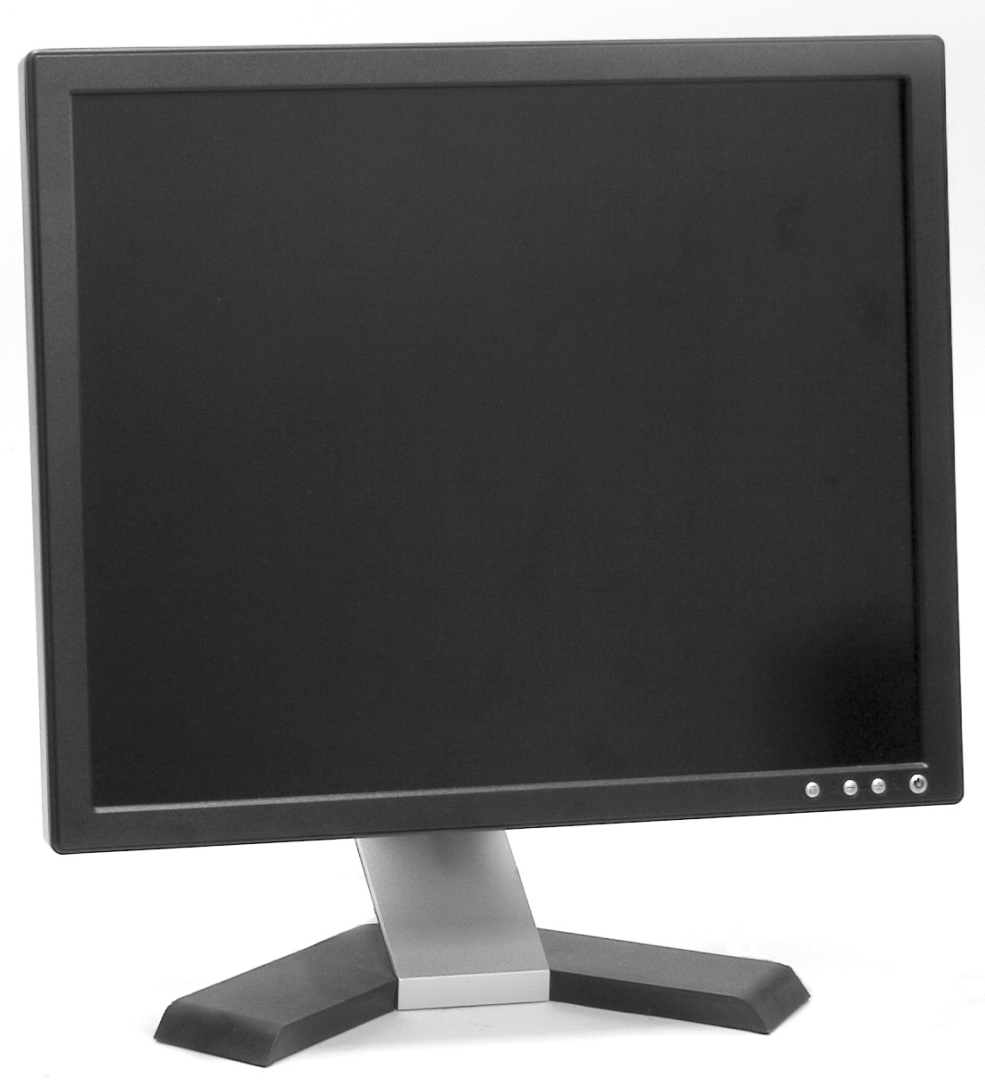
What a monitor does
A monitor displays the picture produced by the computer
Power
The monitor plugs into electrical power and turns on separately from the computer.
Picture signal
A video cable carries the computer's display signal to a matching monitor input.
The selected monitor input must match the connected cable.
Notes:
Point out that monitor power and the picture signal are separate connections.
Image sources and licences:
https://commons.wikimedia.org/wiki/File:Computer_monitor.jpg

Slide 3
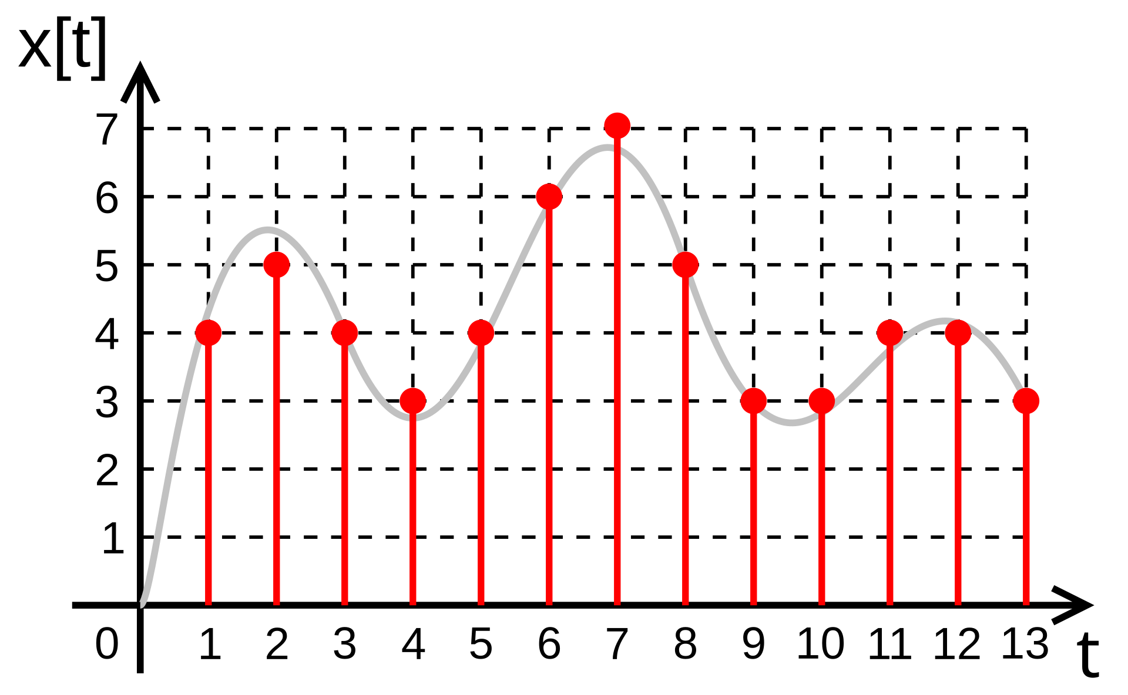
Analog and digital in three steps
The diagram shows one way a continuous signal becomes digital data
1
Continuous waveform
2
Sample
3
Digital values
The analog value can change at any moment
Measure the waveform at set intervals
Store each sample as a number
VGA carries analog video. HDMI and DisplayPort carry digital video.
Notes:
Use the grey curve for the continuous source and the red points for discrete samples. Keep the explanation at recognition level.
Image sources and licences:
https://commons.wikimedia.org/wiki/File:Digital.signal.discret.svg

Slide 4
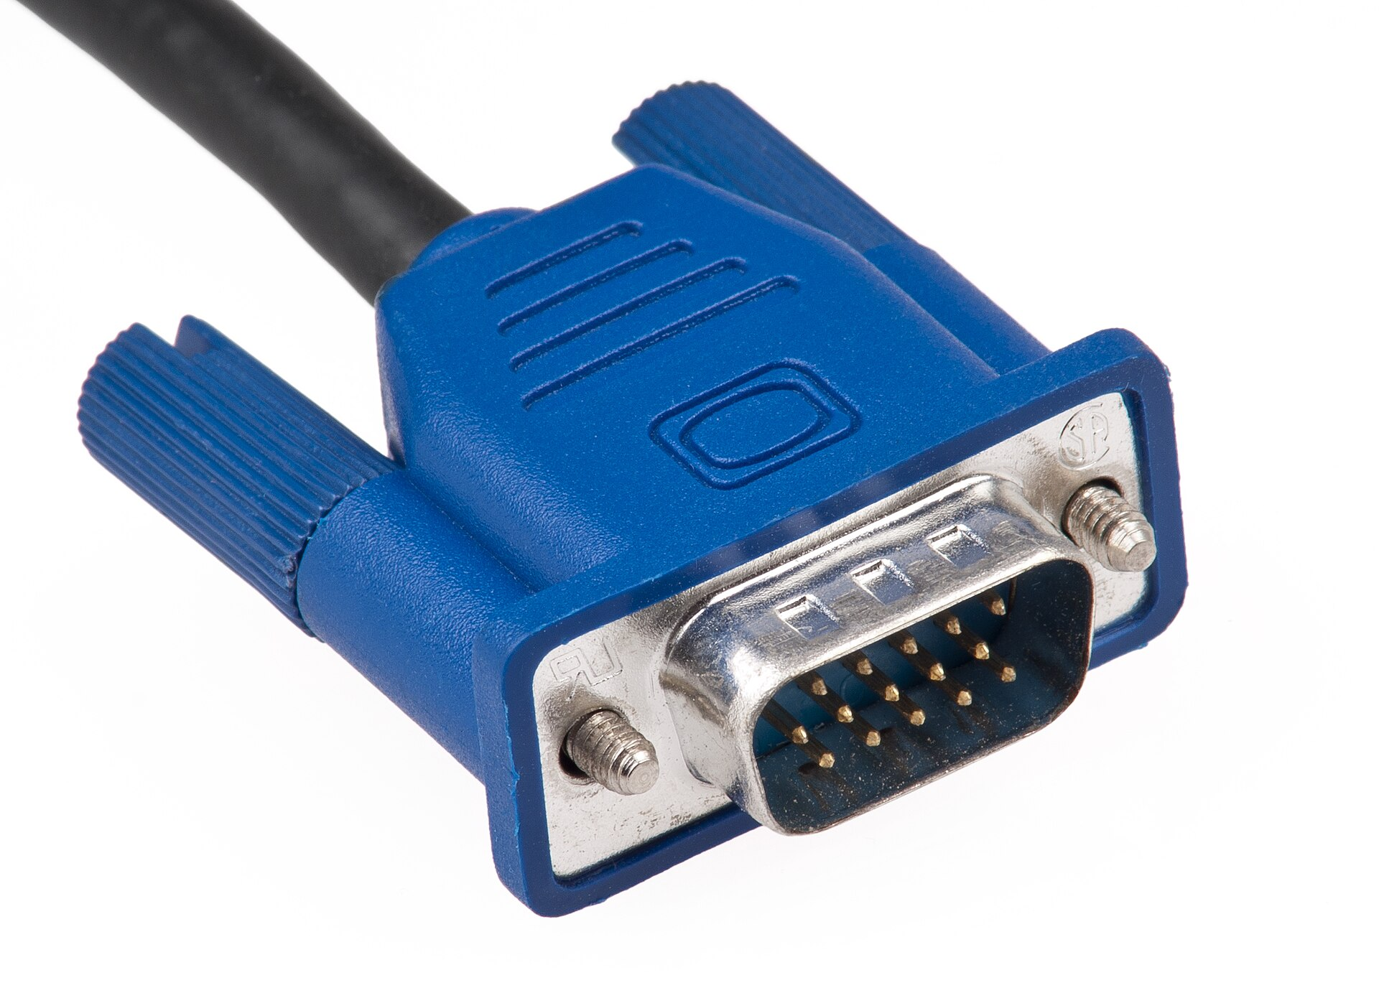
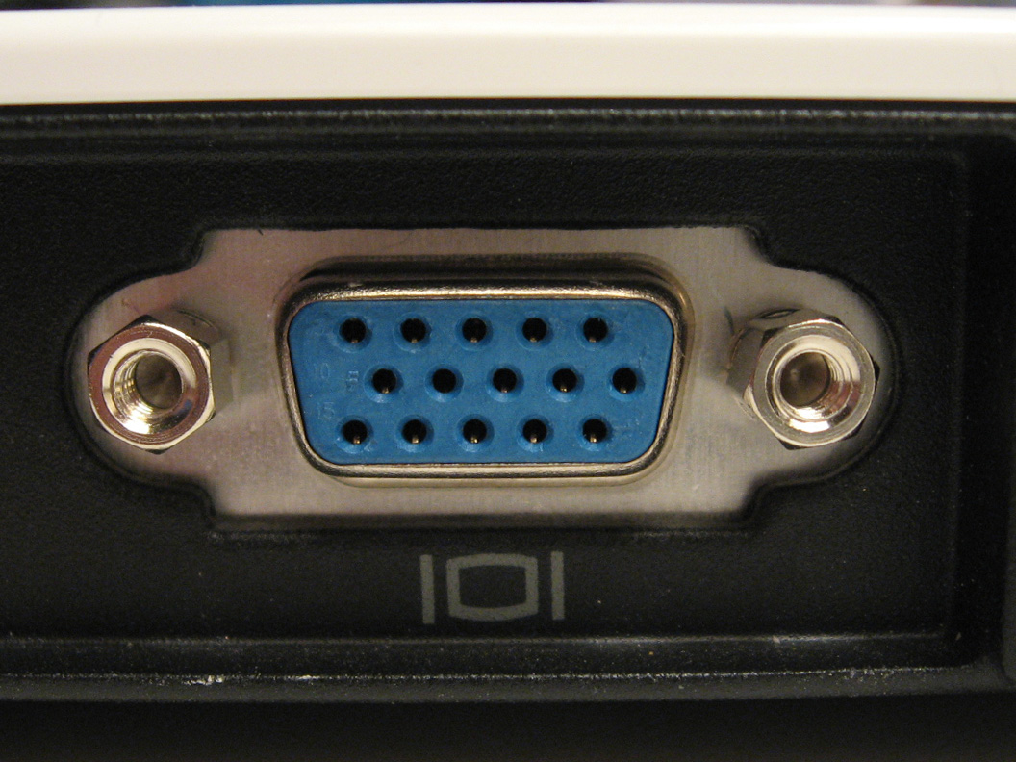
VGA
Analog video connection
CABLE PLUG
PORT
Usually video only. Tighten the two thumb screws gently.
Notes:
Students should identify the 15-pin pattern and the two thumb screws before connecting it.
Image sources and licences:
https://commons.wikimedia.org/wiki/File:Vga-cable.jpg
https://commons.wikimedia.org/wiki/File:VGA_port.jpg

Slide 5
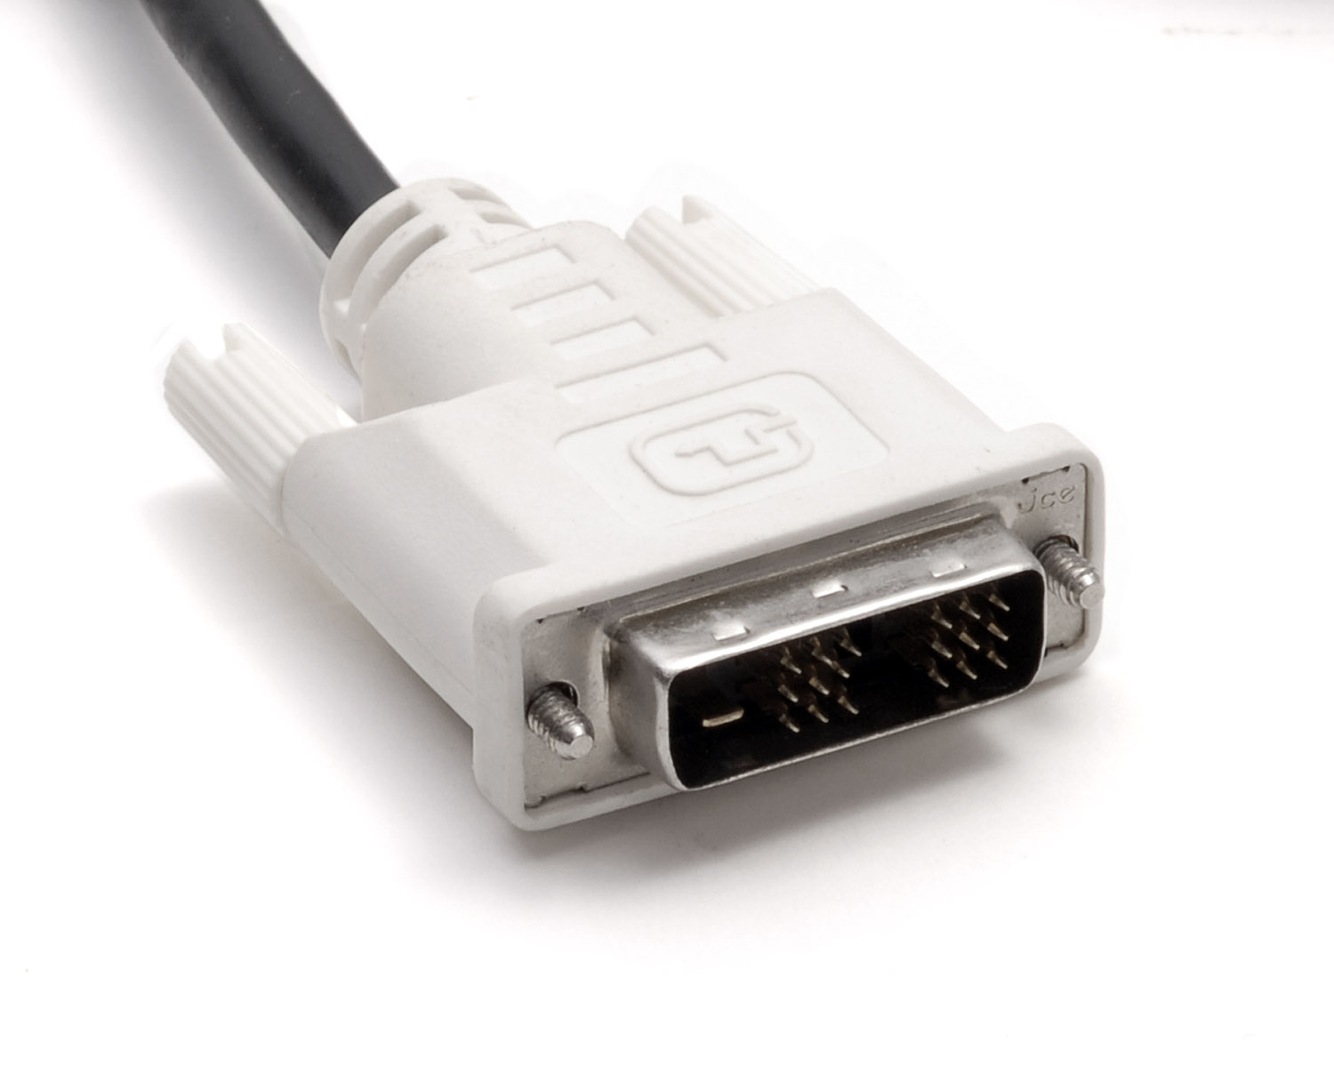
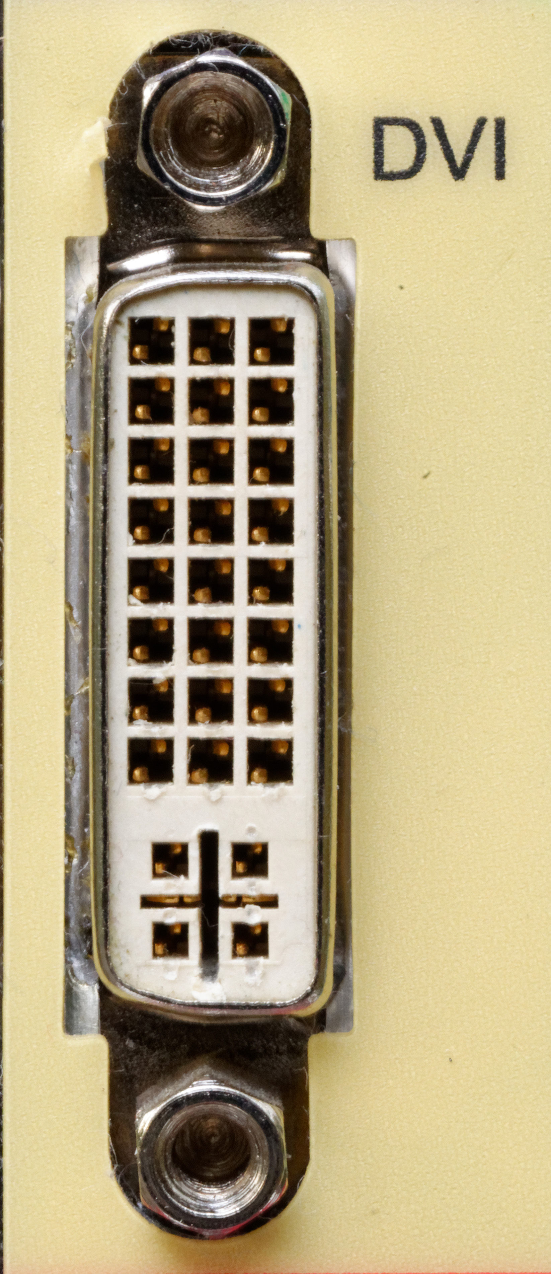
DVI
Check the pin pattern before connecting
CABLE PLUG
PORT
DVI-D is digital. DVI-A is analog. DVI-I supports both.
Notes:
Compare the flat blade and surrounding pins. Different DVI versions have different pin patterns.
Image sources and licences:
https://commons.wikimedia.org/wiki/File:Dvi-cable.jpg
https://commons.wikimedia.org/wiki/File:Computer_DVI_connector.jpg

Slide 6
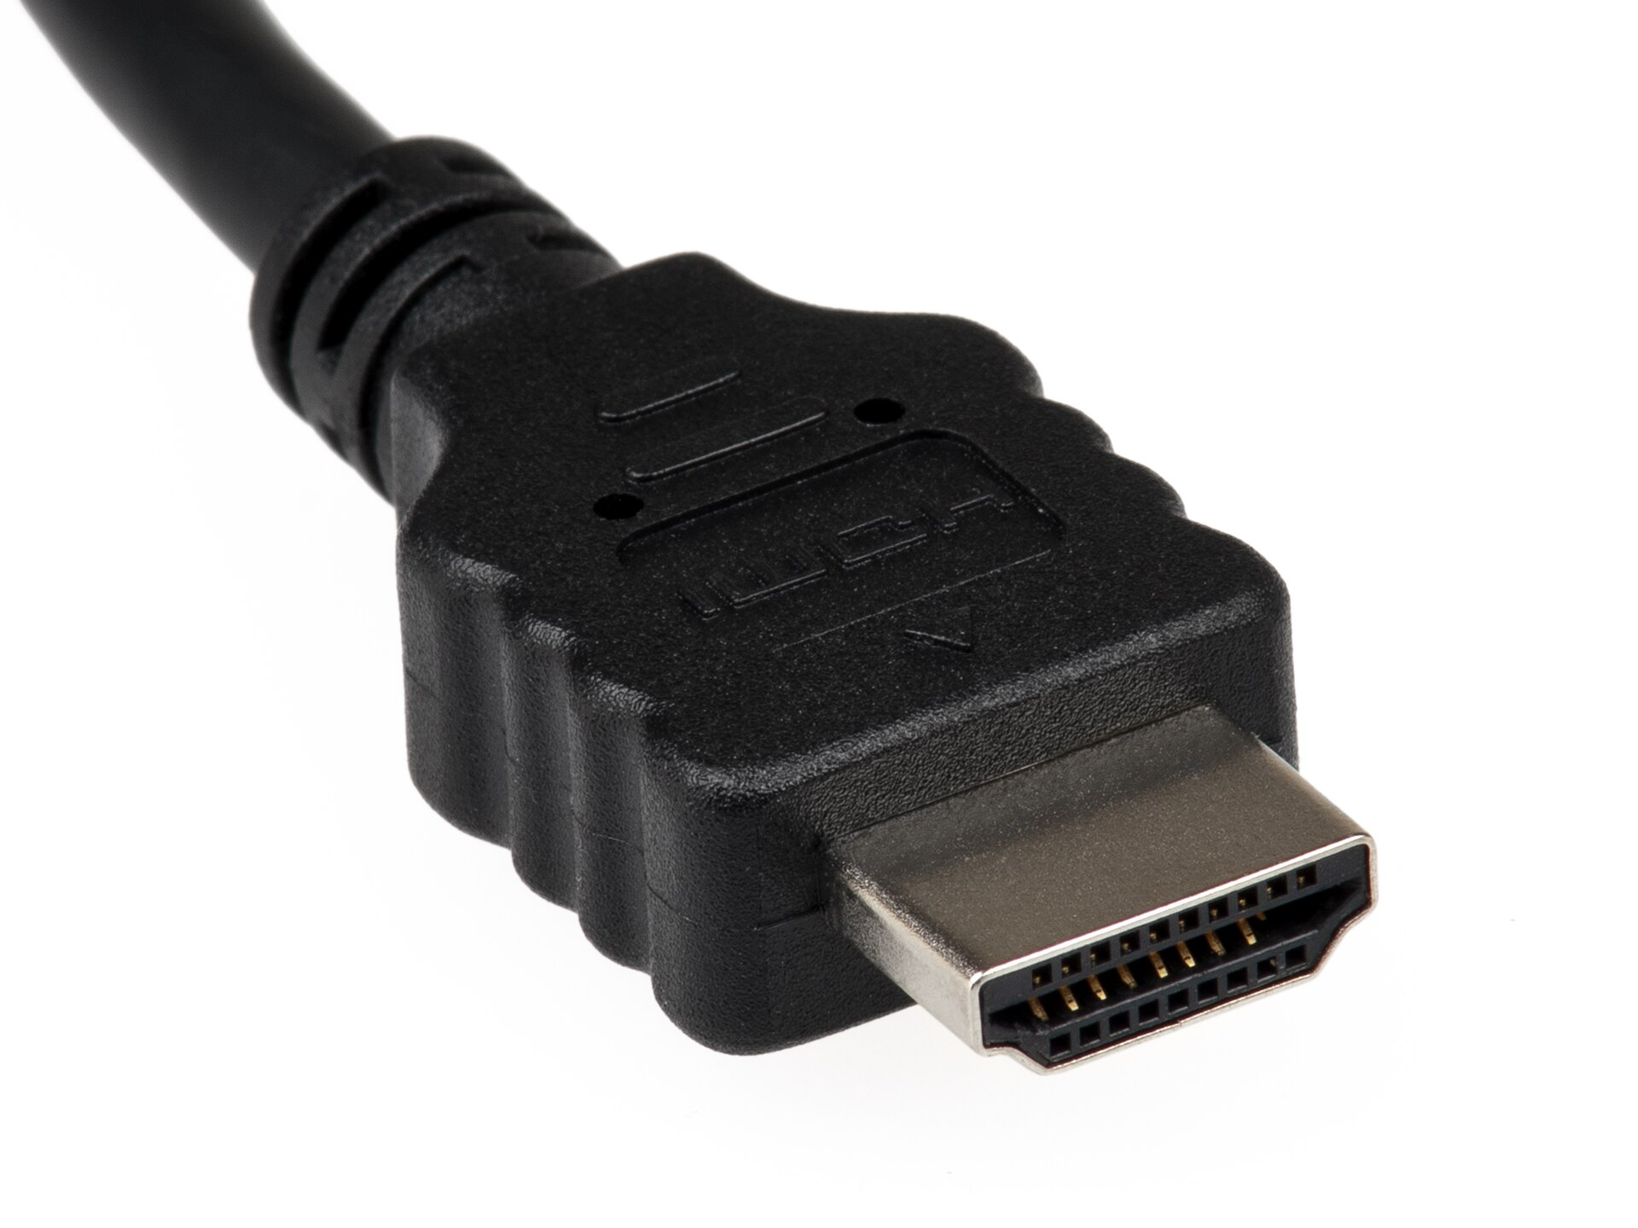
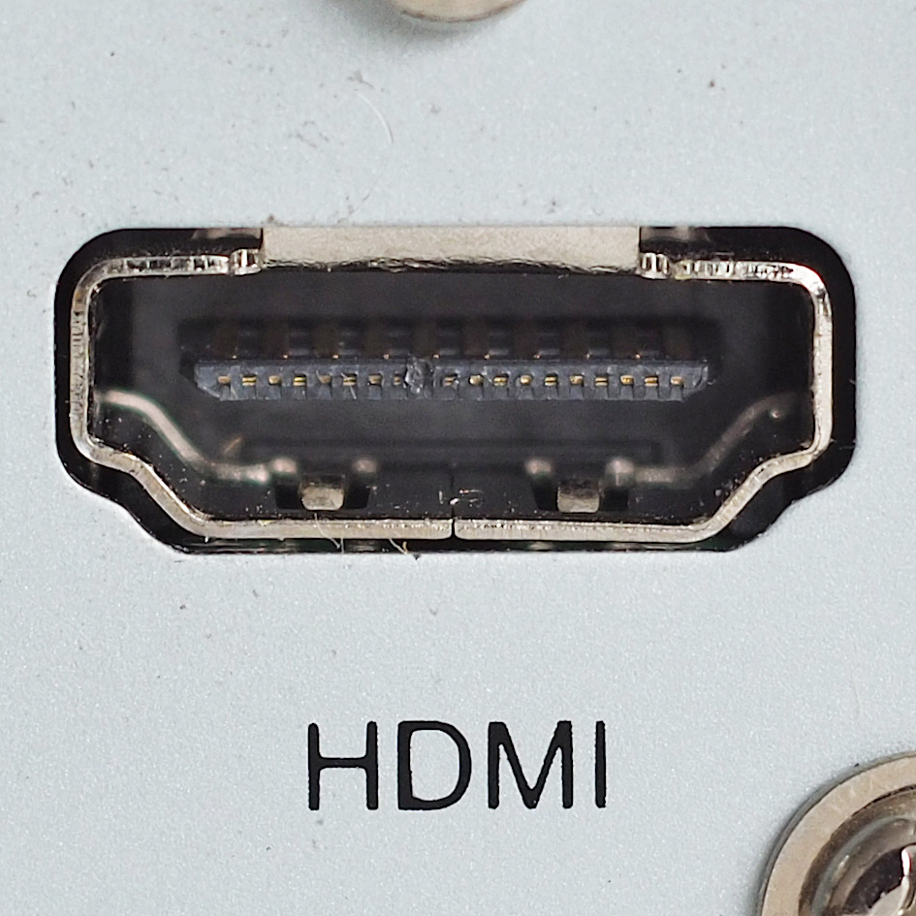
HDMI
Digital video and audio in one cable
CABLE PLUG
PORT
Common on monitors, televisions, laptops, and game consoles.
Notes:
Show the tapered connector shape and explain that HDMI usually carries both picture and sound.
Image sources and licences:
https://commons.wikimedia.org/wiki/File:HDMI-Connector.jpg
https://commons.wikimedia.org/wiki/File:HDMI_connector_female.jpg

Slide 7
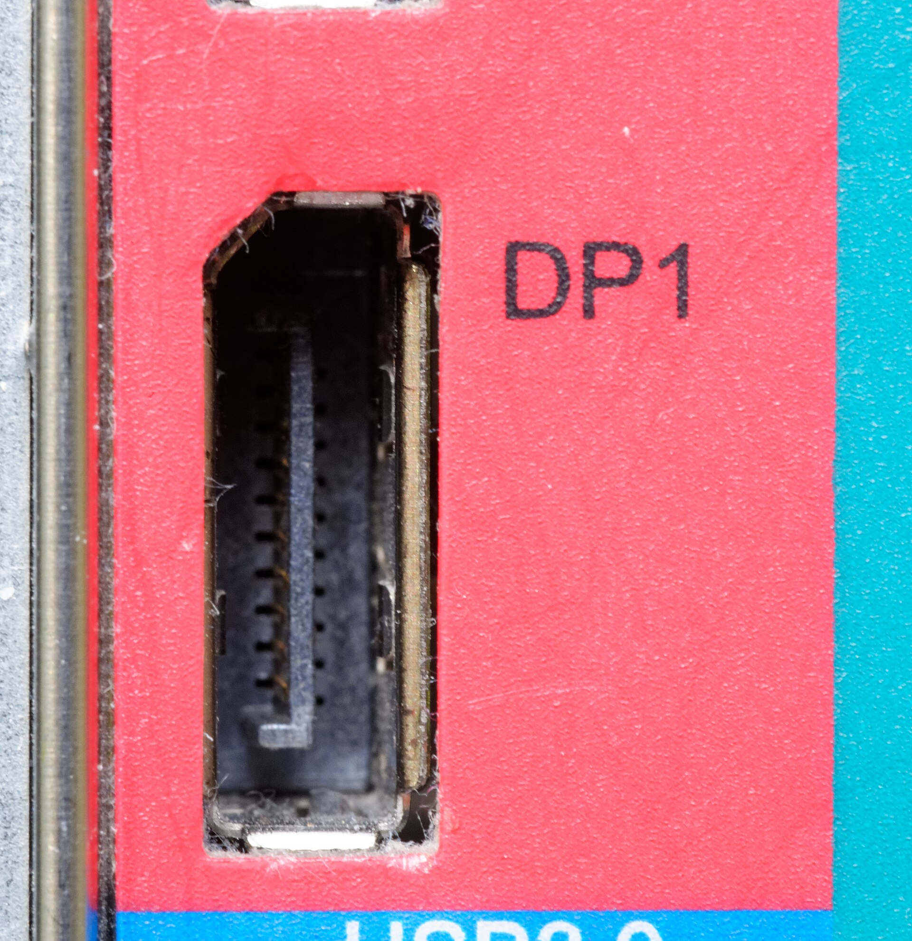
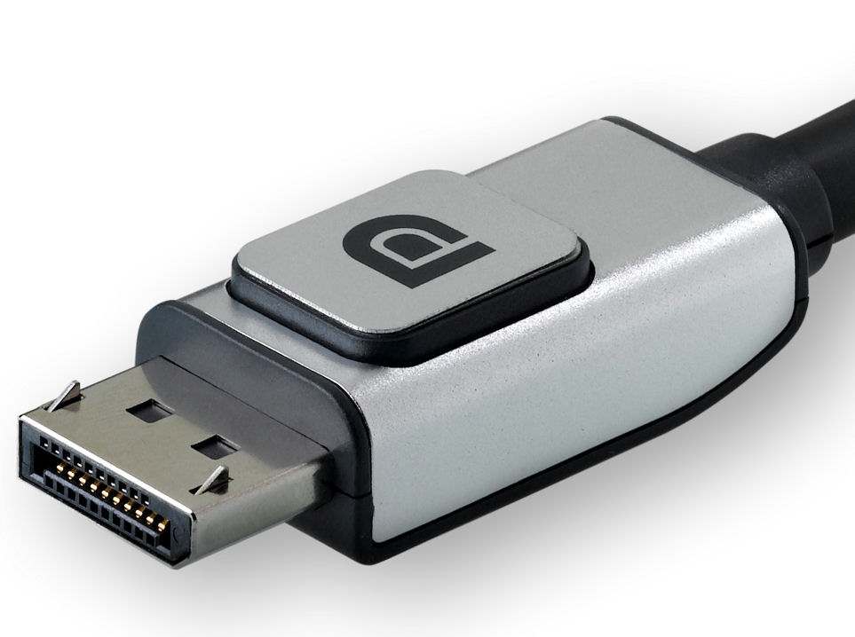
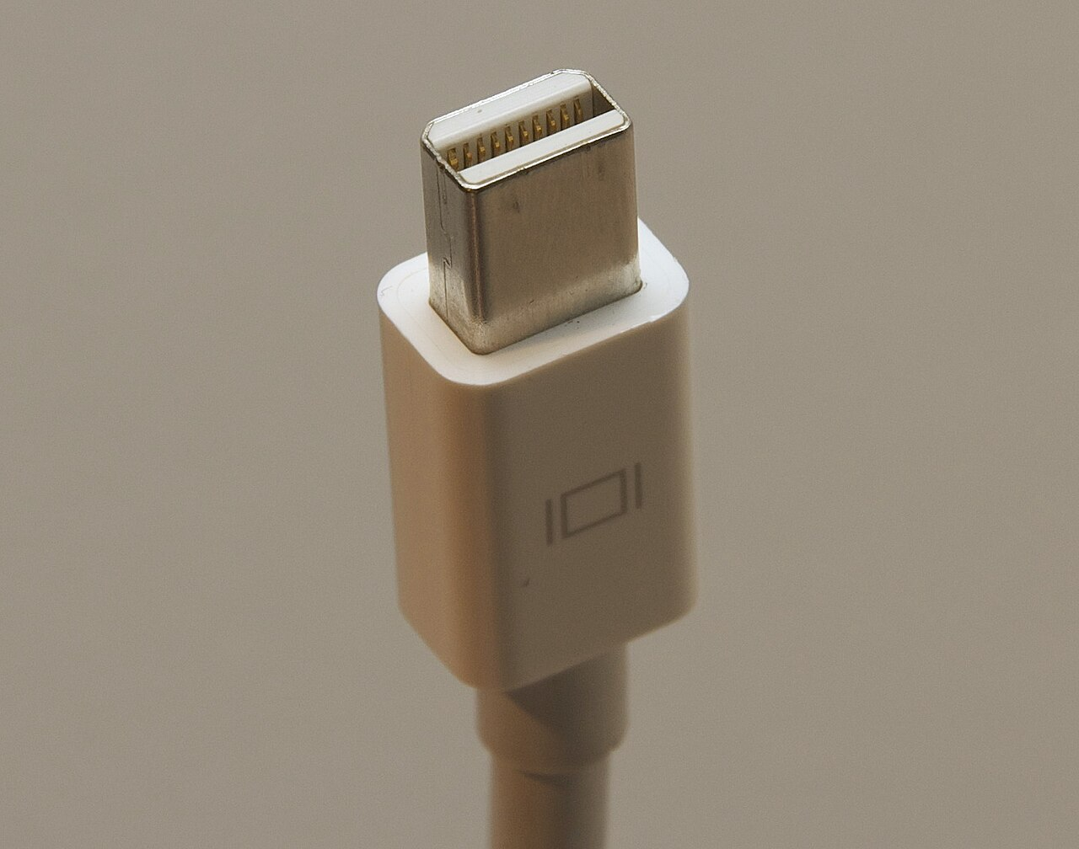
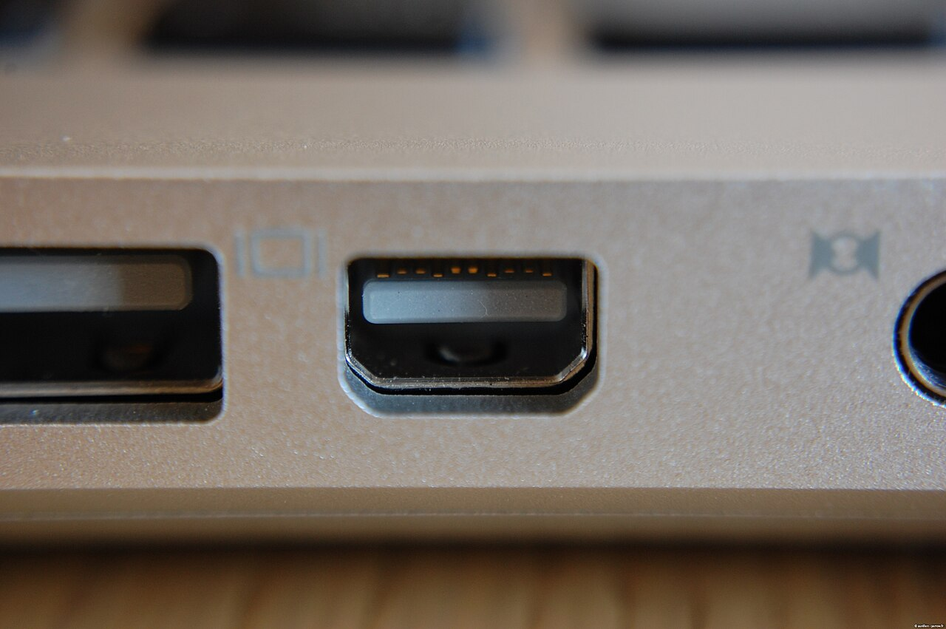
DisplayPort and Mini DisplayPort
Both carry digital video and audio
DISPLAYPORT
MINI DISPLAYPORT
One clipped corner identifies the full-size connector.
Thunderbolt 1 and 2 use the same connector shape. Check the symbol.
The cable plug and the device port must have the same shape.
Notes:
Compare the full-size clipped corner with the smaller Mini DisplayPort connector. The Thunderbolt symbol changes the capability, not the shape.
Image sources and licences:
https://commons.wikimedia.org/wiki/File:DisplayPort-rid.jpg
https://commons.wikimedia.org/wiki/File:DisplayPort_on_a_computer.jpg
https://commons.wikimedia.org/wiki/File:Mini_displayport.jpg
https://commons.wikimedia.org/wiki/File:Mini_DisplayPort_on_Apple_MacBook.jpg

Slide 8
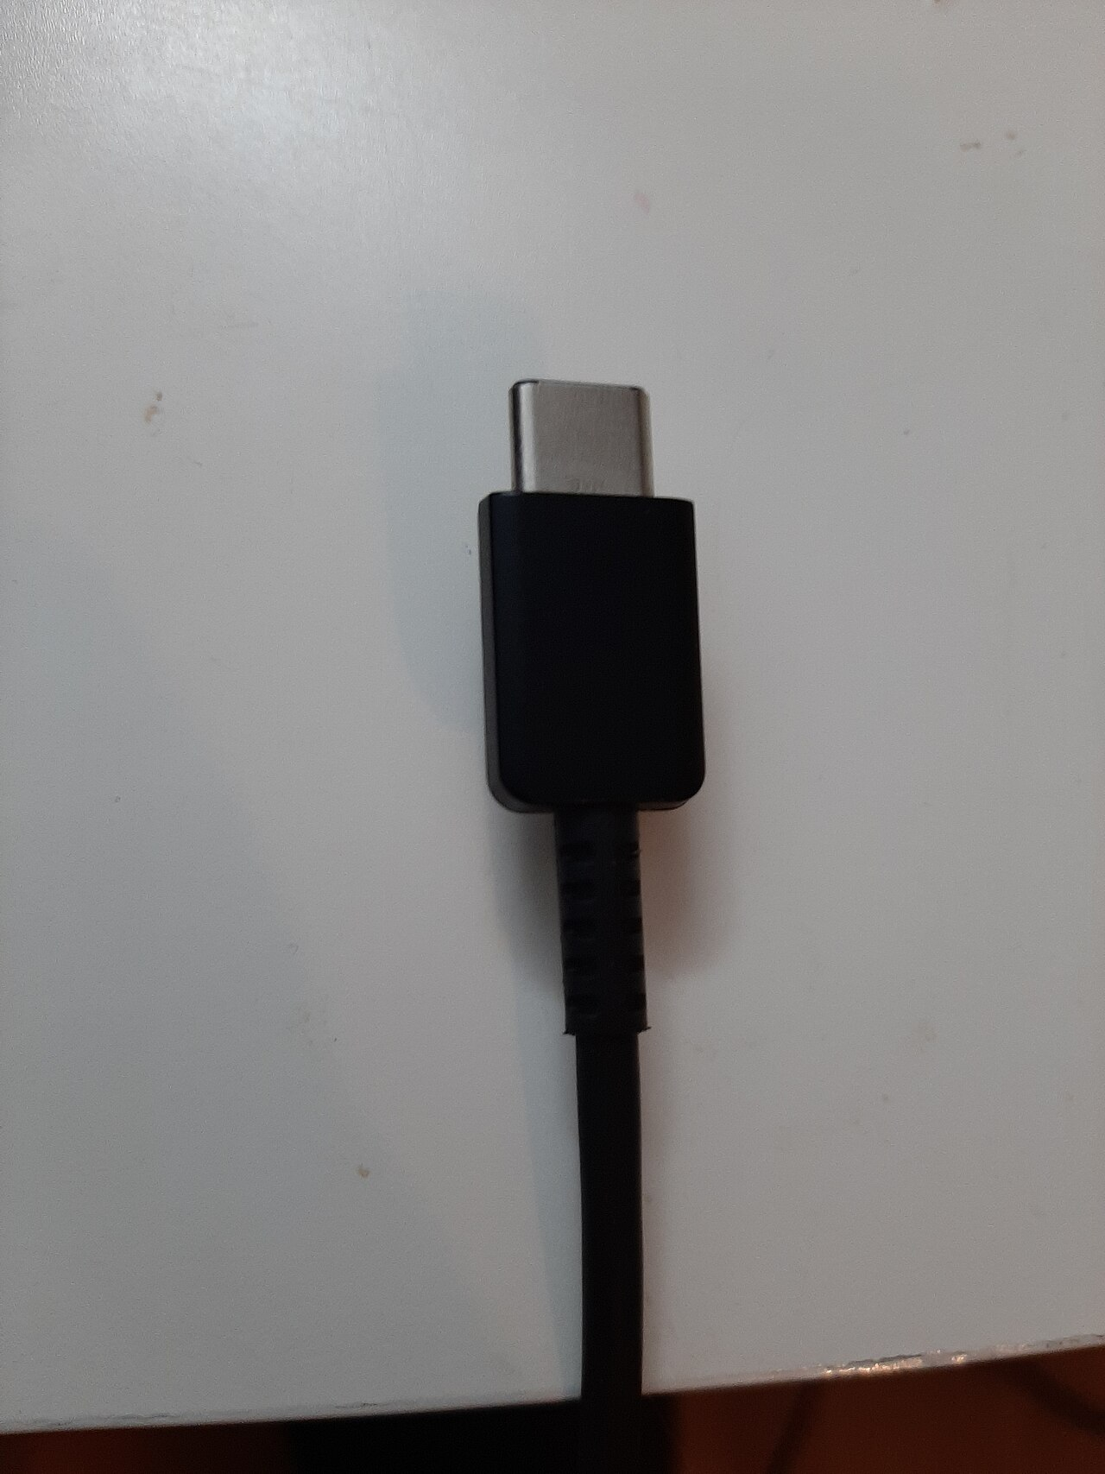
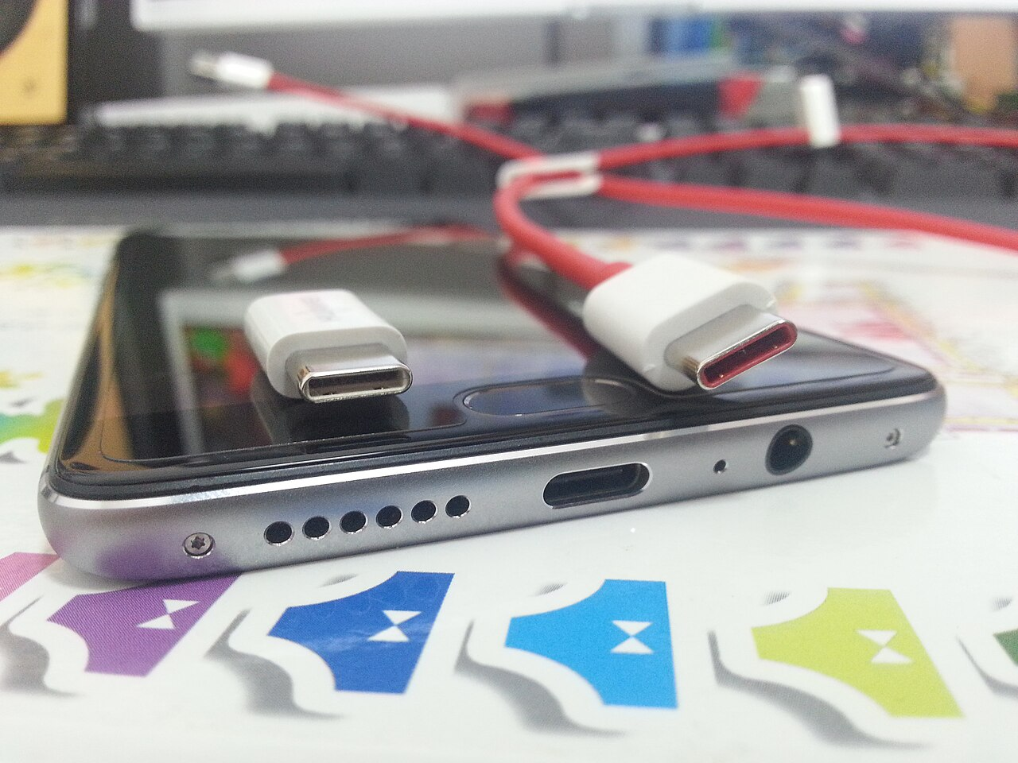
USB-C video
USB-C describes the connector shape, not every capability
CABLE PLUG
PORT
Video works only when the computer port, cable, adapter, and monitor support the same video path.
Notes:
The reversible shape does not guarantee DisplayPort Alt Mode, USB4, Thunderbolt, charging power, or data speed.
Image sources and licences:
https://commons.wikimedia.org/wiki/File:USB_Type-C.jpg
https://commons.wikimedia.org/wiki/File:OnePlus_3_USB_port_and_the_cable.jpg

Slide 9
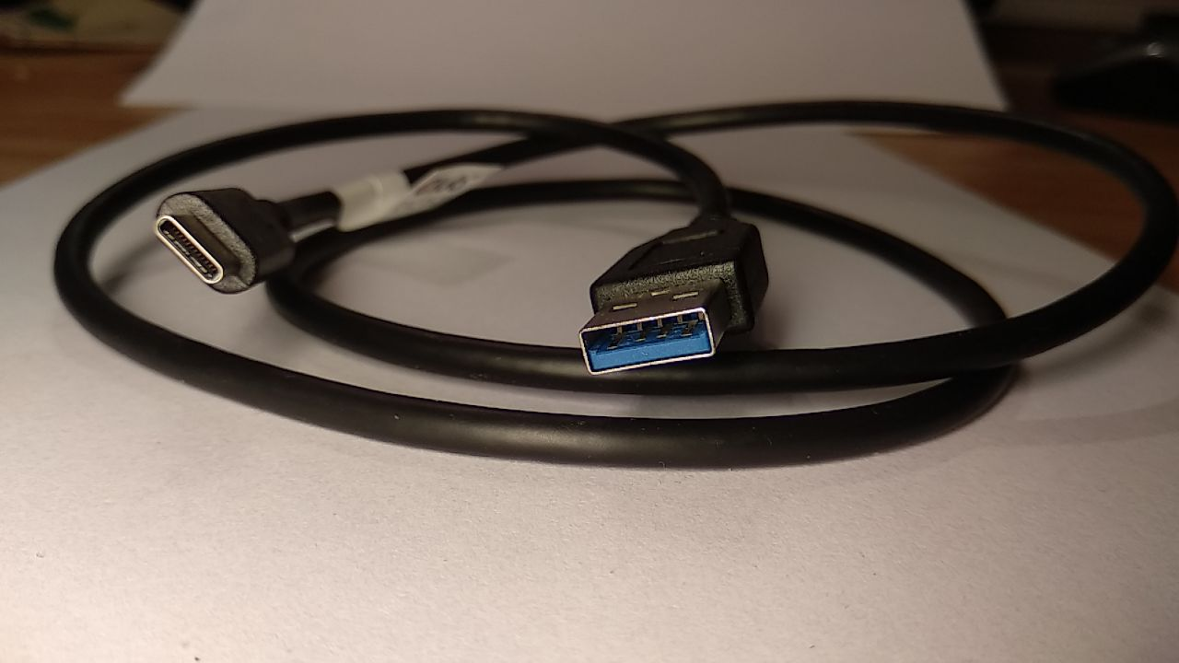
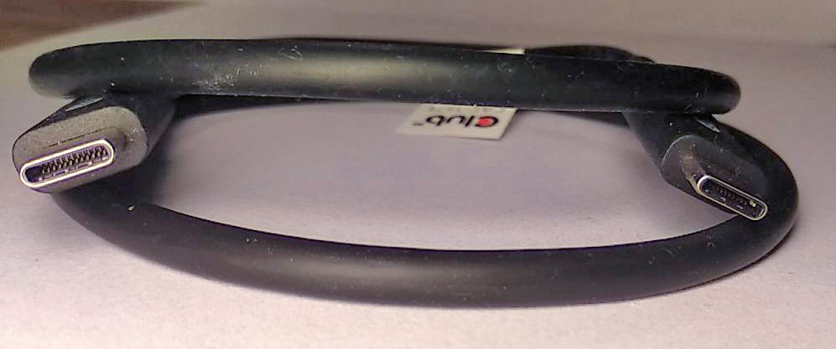
USB-C cables are different
Connector shape alone does not identify the cable's features
USB-A TO USB-C
USB-C TO USB-C
A passive A-to-C cable does not carry DisplayPort Alt Mode to a monitor.
Check for explicit video support and the required data speed and charging power.
An active USB graphics dock contains electronics and works differently from a passive cable.
Notes:
Students should not assume that a cable supports video because one end is USB-C. Read the device and cable specifications.
Image sources and licences:
https://commons.wikimedia.org/wiki/File:USB_3.1_Gen2_Typ-C_to_Typ-A_cable_10Gbps_PD_60W.jpg
https://commons.wikimedia.org/wiki/File:USB4_Type-C_Gen3x2_Bi-Directional_Cable_40Gbps_8K60Hz_100W_PowerDelivery.jpg

Slide 10
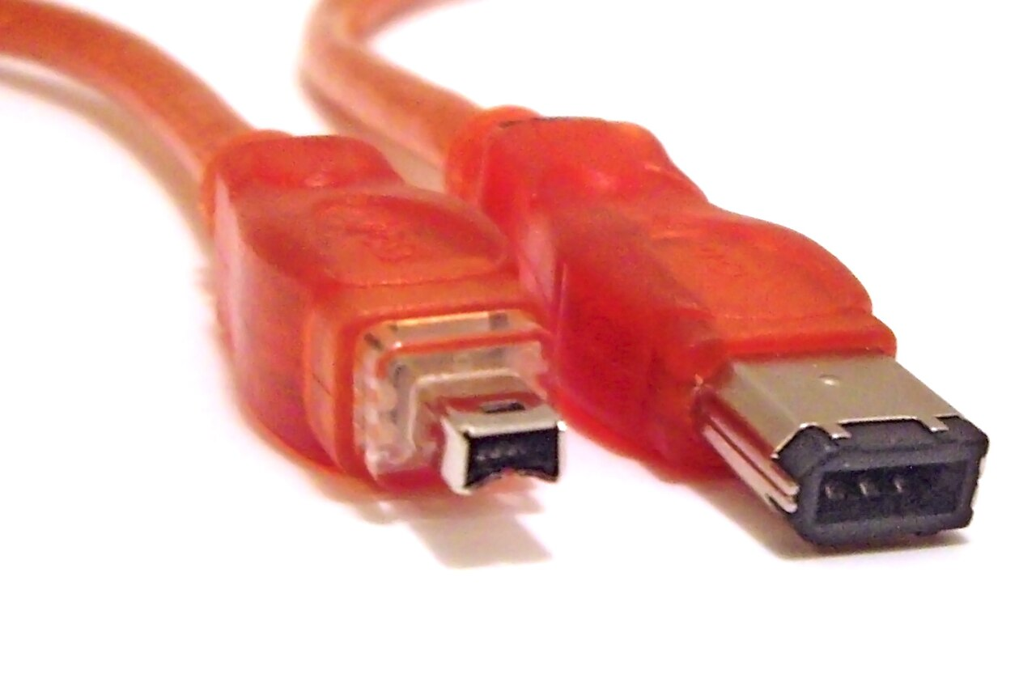
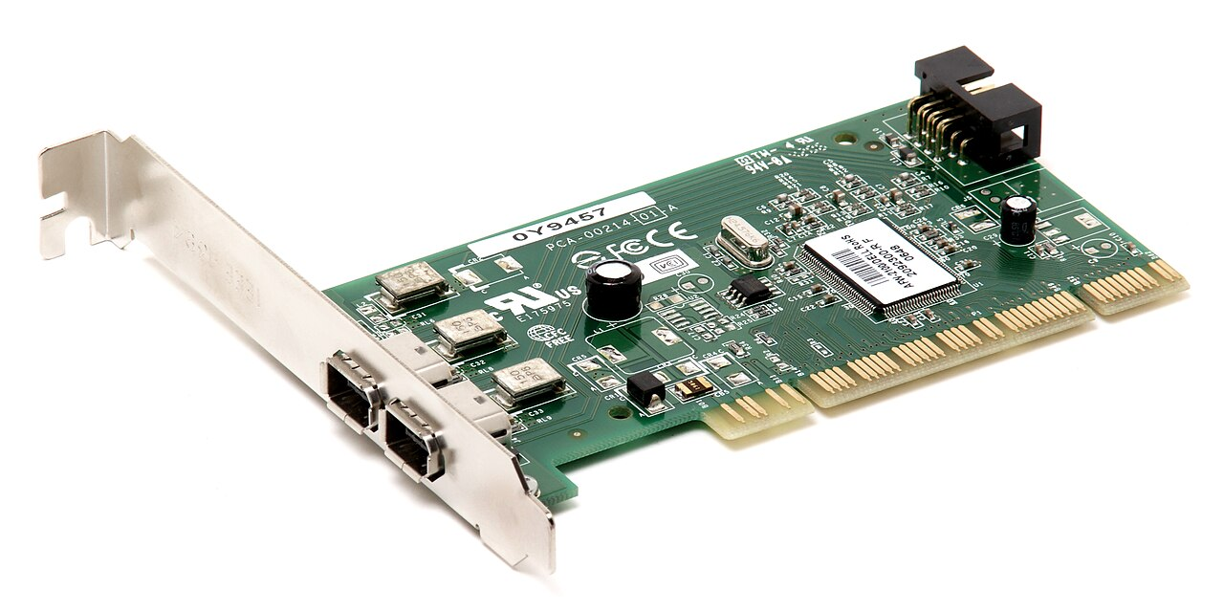
FireWire / IEEE 1394
A legacy digital peripheral connection
CABLE PLUG
PORT
Used for cameras, audio interfaces, and external drives. It is not a normal monitor connection.
Notes:
FireWire appears on older computers and media equipment. Do not confuse it with a display connector.
Image sources and licences:
https://commons.wikimedia.org/wiki/File:FireWire_cables.jpg
https://commons.wikimedia.org/wiki/File:FireWire-PCI-Card.jpg

Slide 11
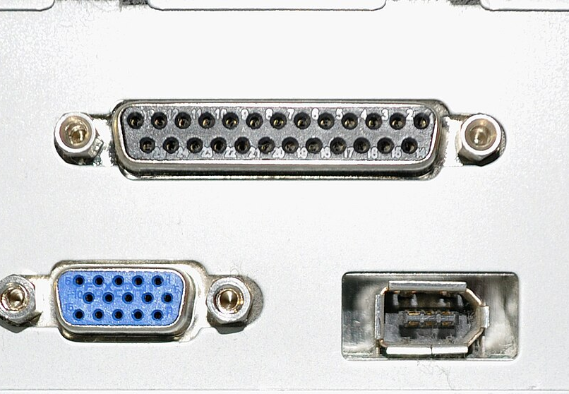
Connecting a monitor
Use the matching output, cable, and monitor input
1
Connect monitor power and turn it on
2
Connect a supported cable from computer output to monitor input
3
Select that input on the monitor
4
Check power, input, cable seating, adapter direction, and video support
Never force a connector. Stop and compare the shapes.
Notes:
Model the full connection sequence with a classroom computer and monitor before students try it.
Image sources and licences:
https://commons.wikimedia.org/wiki/File:Computer_ports.JPG

