Slide 1

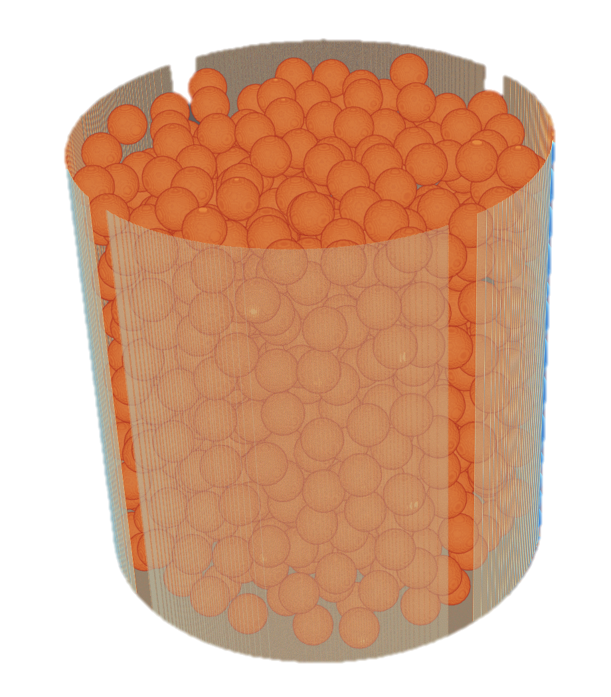
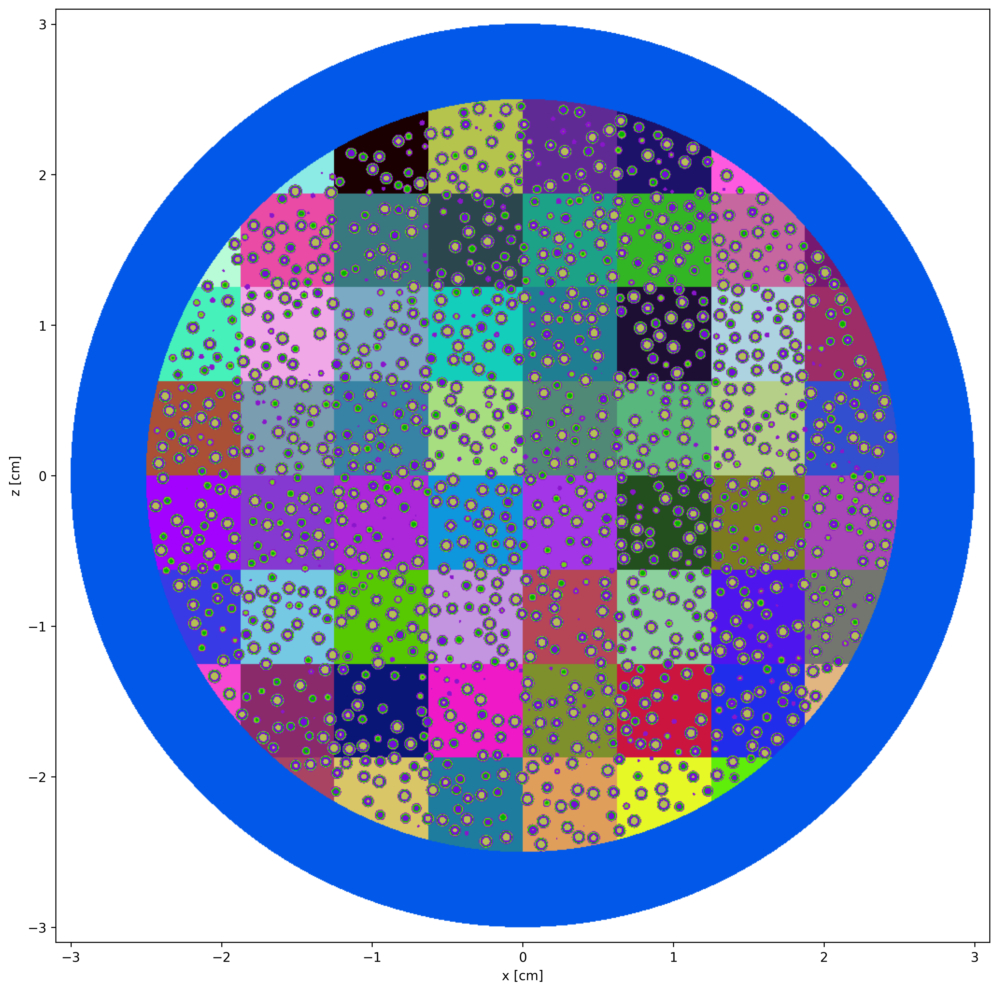
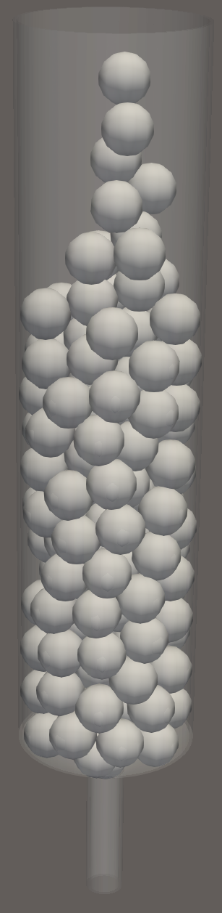
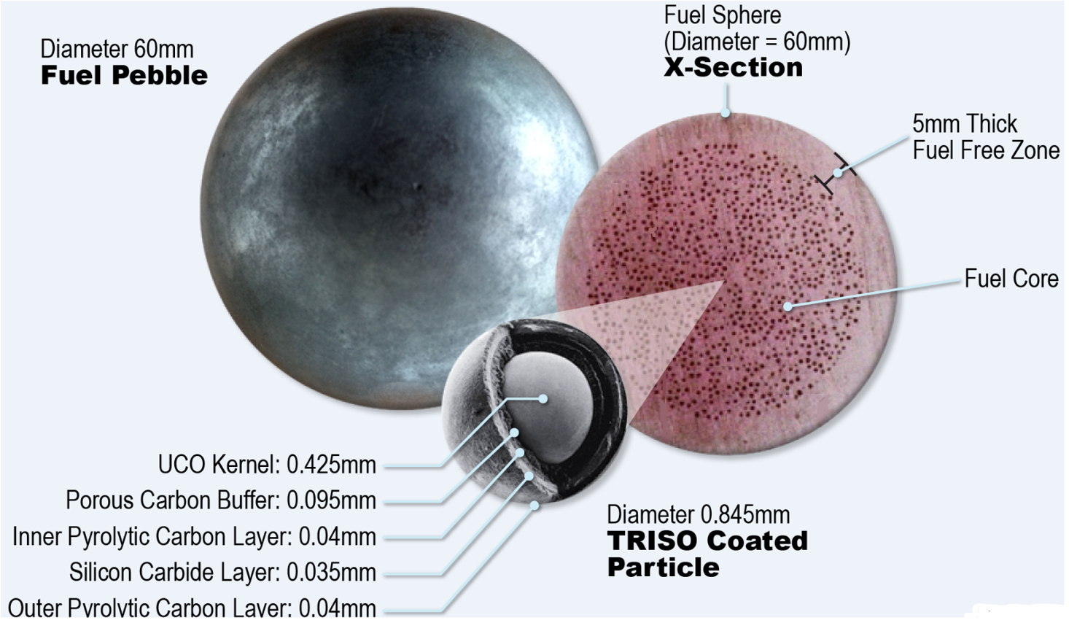
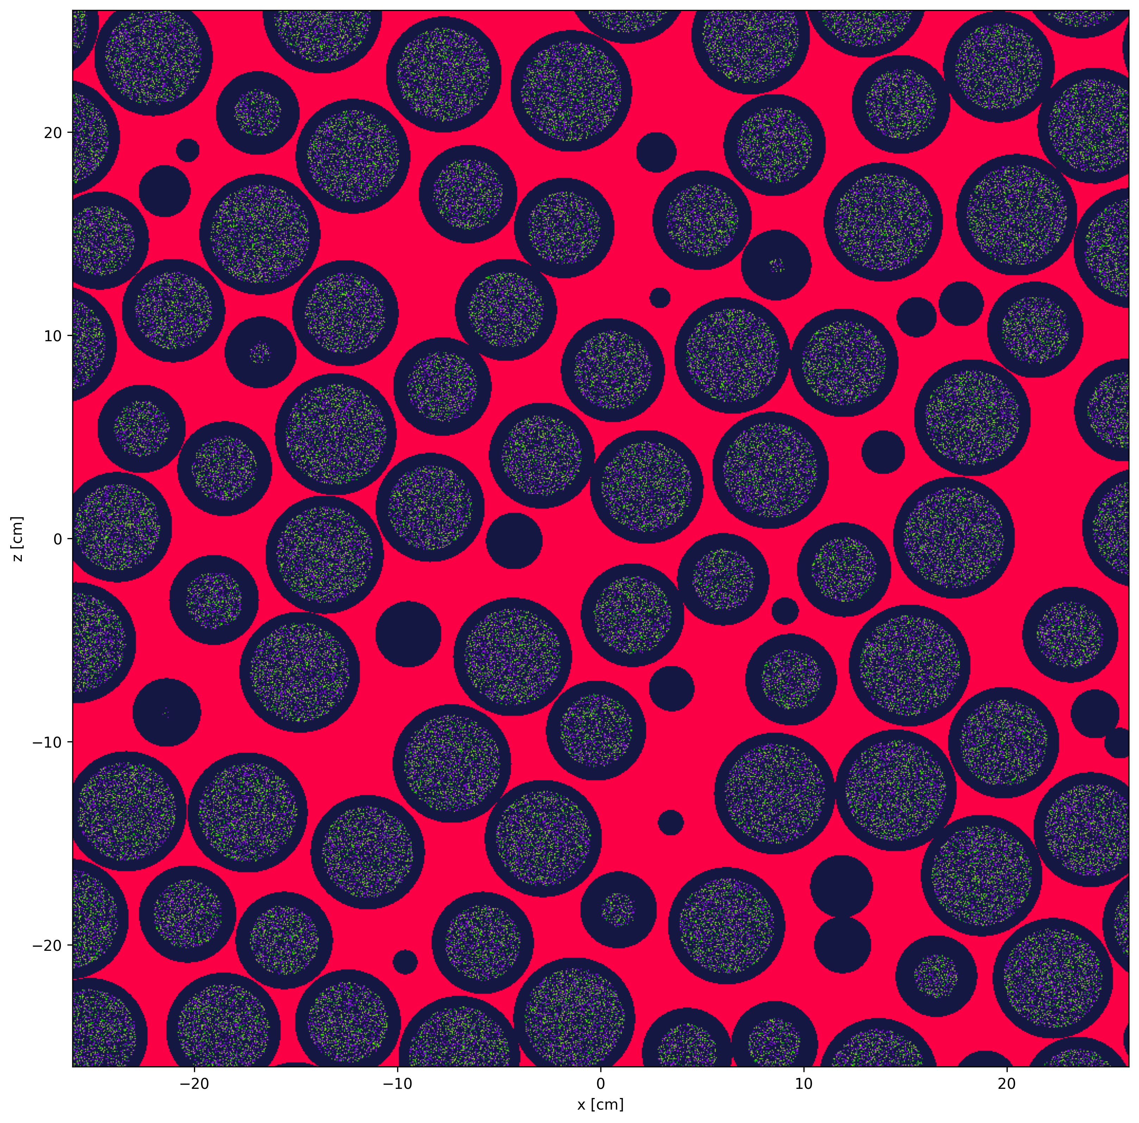
DEM–Monte Carlo Modeling of Burnup in a Pebble Bed Reactor
Richard Anderson, Department of Physics, The University of Texas at El Paso, El Paso, TX 79968
Odera Dim, Nonproliferation and National Security Department, Brookhaven National Laboratory, Upton, NY 11973-5000
Abstract
Introduction
This project, conducted within the Nonproliferation and National Security Department at Brookhaven National Laboratory (BNL), aims to leverage the open-source Monte-Carlo neutron transport code OpenMC to generate simulated neutron and gamma-ray spectra for individual pebbles or reactor fuel elements at various stages of burnup. In conjunction with OpenMC, the LIGGGHTS discrete element method (DEM) code can be used to model the motion and configuration of pebbles in a geometrically accurate model of a PBR, further reinforcing the fidelity of the model. A comprehensive dataset of spectral signatures corresponding to different burnup levels can be developed using depletion tools included in OpenMC. This dataset will serve as the foundation for training a machine learning model to predict the burnup of previously unseen pebbles based solely on their measured spectra. This approach offers a real-time, non-destructive method for burnup estimation, enhancing reactor monitoring, optimizing fuel cycle management, and improving safety assessments in pebble-bed reactor designs. This study aligns with BNL’s mission to address energy security and bolster our ability to implement safeguards safely and securely.
Pebble bed reactors are a type of high-temperature gas-cooled nuclear reactor that operate by continuously circulating spherical graphite pebbles embedded with fissile material throughout the reactor core. This dynamic fuel configuration offers unique advantages, particularly in the context of nuclear nonproliferation. The use of TRISO fuel particle, each encapsulating fissile material in multiple protective ceramic layers, provides inherent resistance to proliferation by making mechanical separation and chemical reprocessing of fissile material significantly more difficult than in conventional fuel designs. As the pebbles flow downward through the core, they are exposed to neutron flux and undergo burnup. After completing a certain number of passes, the fuel reaches a spent state and must be removed from the system. Over the course of reactor operation, various radioactive isotopes accumulate within the fuel, introducing additional challenges for safety, waste handling, and Materials Control and Accountability (MC&A). For these reasons, the development of accurate tools and methods to model burnup behavior in pebble bed reactors is critical to ensuring both operational safety and regulatory compliance.
Methods
This project utilizes OpenMC and LIGGGHTS in tandem to accurately model both the neutronics and the mechanical motion of pebbles within a pebble bed reactor core. The simulation begins with the generation of a reactor geometry accurate to a pebble bed reactor. Pebbles are then introduced from the top of a chute, simulating gravity-driven loading. As the simulation progresses, the motion and settling of each pebble are tracked, and their positions are recorded over time as they fill the reactor core. These time-dependent spatial configurations are exported and imported into OpenMC. Within OpenMC, each pebble is populated with a graphite lattice structure, and TRISO (TRi-structural ISOtropic) fuel particles are randomly distributed throughout the interior of each pebble. OpenMC performs neutron transport and depletion calculations using the recorded geometries, solving for the evolving isotopic composition of each pebble to determine burnup at each timestep derived from LIGGGHTS. As neutron interactions occur over time, the initial fissile isotopes undergo transmutation, producing a mix of fission products and actinides that evolve with each timestep. This isotopic composition can be used to determine burnup over time and can be used to produce simulated spectra for use in models for burnup prediction.
Discussion and Future Work
As opposed to some other Monte Carlo neutronics codes, OpenMC utilizes constructive solid geometry (CSG)-based domain decomposition rather than particle-specific region tracking to calculate neutron transport and interaction probabilities. This method defines surfaces and regions analytically through Boolean operations on quadratic surfaces, enabling precise and efficient spatial modeling without reliance on pre-meshed volumes. To simulate the microstructure of fuel within each pebble, OpenMC employs lattice universes, which allow for the structured placement of fuel particles in a repeated pattern. In this project, OpenMC is used to construct a 3D lattice inside each pebble, where TRISO fuel particles are distributed at predefined positions relative to the graphite matrix. This lattice serves as a discretized representation of the internal fuel structure, enabling OpenMC to calculate spatially resolved reaction rates, neutron fluxes, and isotopic changes within each TRISO.
Despite its effectiveness in modeling burnup behavior, this method introduces significant computational challenges, particularly in terms of memory usage. For realistic reactor geometries, memory requirements can exceed 192 GB (Liang et al.), posing a substantial barrier to full-scale simulation. Several mitigation strategies were explored during this project, including downsizing the geometry, simplifying the lattice, and experimenting with a virtual lattice approach, which reduces the number of explicitly constructed lattice elements. Even with these adjustments, the computational time required for burnup calculations remained a limiting factor throughout the project.
Future work will focus on implementing more memory and computationally efficient algorithms for lattice construction. Achieving this will make it possible to run full core simulations in a more practical timeframe, enabling the generation of simulated burnup spectra for use in burnup prediction models.
References
Paul K. Romano, Nicholas E. Horelik, Bryan R. Herman, Adam G. Nelson, Benoit Forget, and Kord Smith, “OpenMC: A State-of-the-Art Monte Carlo Code for Research and Development,” Annals of Nuclear Energy, Vol. 82, pp. 90–97, 2015. https://doi.org/10.1016/j.anucene.2014.07.048
Jingang Liang, Ruihan Li, Zhaoyuan Liu, “Virtual lattice method for efficient Monte Carlo transport simulation of dispersion nuclear fuels,” Computer Physics Communications, Vol. 295, 2024, Article 108985. ISSN: 0010-4655. https://doi.org/10.1016/j.cpc.2023.108985
Acknowledgements
This project was supported in part by the U.S. Department of Energy, Office of Science, Office of Workforce Development for Teachers and Scientists (WDTS) under the Science Undergraduate Laboratory Internships Program (SULI).
BNL – NN – 20250731 – 0000072 – POST
No Expert Control

