Slide 1
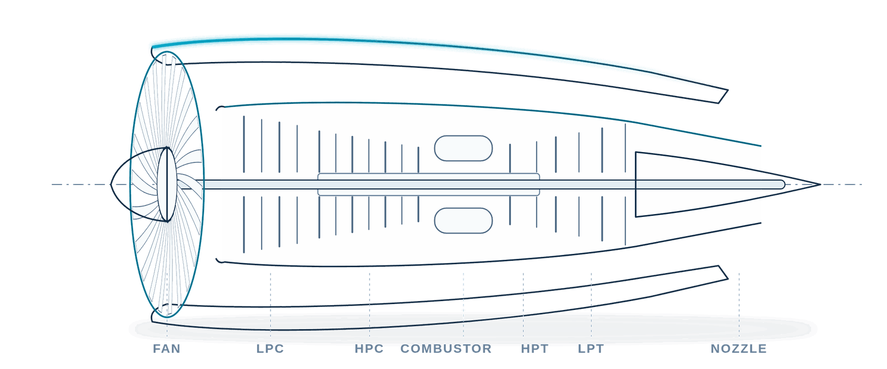
MSc DISSERTATION VIVA · M598 MASTER DISSERTATION
An Uncertainty-Aware, Explainable and Human-Reviewed Framework for Remaining-Useful-Life-Based Maintenance Prioritisation
Evidence from the NASA C-MAPSS FD001 Turbofan Dataset
Illustrative turbofan schematic — not a validated engine simulation
RESEARCH QUESTION
Can RUL evidence support maintenance prioritisation without hiding uncertainty or removing human authority?
Ranitabh Mallick · Student ID GH1047661
MSc Data Science, Artificial Intelligence and Digital Business
Supervisor: Dr Hiba Khalid
GISMA University of Applied Sciences · Berlin, September 2026
Applied quantitative research on secondary, simulated NASA C-MAPSS FD001 data
1 / 13
Notes:
SAY (≈ timed):
Good morning. My dissertation asks one question: can remaining-useful-life evidence support maintenance prioritisation without hiding uncertainty or taking authority away from the human reviewer? I answer it with NASA's simulated FD001 turbofan data.
POINT TO: The research question box.
EVIDENCE · DENOMINATOR · UNIT: Secondary, simulated data only; no real fleet.
MAIN LIMITATION: Everything that follows is conditional on one simulated dataset.
LIKELY EXAMINER QUESTION: Why FD001 and not real operator data?
ANSWER: FD001 has public run-to-failure labels, one operating condition and one fault mode, so the framework can be evaluated without confounding regimes. The price is external validity, which I state as the main limitation.

Slide 2
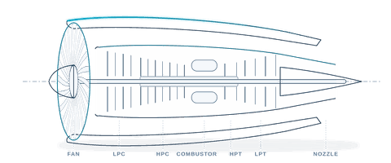
1 · INTRODUCTION
A point estimate can hide maintenance risk
Class thresholds are stipulated research assumptions (Table 4.4) — not approved aircraft-maintenance rules
CRITICAL ŷ ≤ 30
HIGH 30 < ŷ ≤ 60
MEDIUM 60 < ŷ ≤ 130
LOW
Predicted 64.5 cycles → MEDIUM
Observed 28 cycles → CRITICAL
0
30
60
RUL (cycles)
130
prediction − actual = +36.5 cycles (optimistic)
No interval
The reviewer cannot see how far 64.5 could be wrong.
No forced review
A MEDIUM label alone joins the routine queue — no mandatory human check.
Source: Engine 18, official endpoint (Table 5.9); classes (Table 4.4) Backup: triage classes ↗
2 / 13
Notes:
SAY (≈ timed):
Here is why a single number is not enough. For Engine 18 the model predicted 64.5 cycles of remaining life, which falls in the MEDIUM band. [click] The observed value was 28 cycles: CRITICAL under the study's thresholds. The estimate was 36.5 cycles too optimistic. [click] A reviewer who sees only 64.5 has no error range, and a MEDIUM call does not by itself trigger a human review. These bands are research assumptions, not approved maintenance rules.
POINT TO: Cyan dot (prediction), then coral dot (observed), then the +36.5 bracket.
EVIDENCE · DENOMINATOR · UNIT: One official endpoint, Engine 18; cycles; prediction minus actual = 64.5 − 28 = +36.5.
MAIN LIMITATION: One illustrative engine, chosen as an informative failure case — not typical error (MAE is 18.88).
LIKELY EXAMINER QUESTION: Isn't Engine 18 cherry-picked?
ANSWER: Yes, deliberately, as a failure case — the dissertation reports it in Table 5.9 alongside Engine 41. The average picture is on slide 7: MAE 18.88 cycles with +10.90 bias, so optimism is systematic, not unique to this engine.

Slide 3
2 · RELATED WORK
The gap is governed integration, not a new algorithm
Established components
Contribution: evaluated integration and governance
RUL prediction
Saxena et al. (2008a); Ramasso and Saxena (2014)
Engine-safe modelling
Predictive uncertainty
Angelopoulos and Bates (2023); Javanmardi and Hüllermeier (2023)
Explicit age-only baseline
Frozen model selection
Explainability
Lundberg and Lee (2017); Vollert, Atzmueller and Theissler (2021)
Whole-engine uncertainty
Checked SHAP interpretation
Maintenance prioritisation
Jardine, Lin and Banjevic (2006); ISO 17359 (ISO, 2018a)
Review-burden measurement
Traceable human authority
Human oversight
Parasuraman, Sheridan and Wickens (2000); Shneiderman (2020)
Claimed: a transparent, bounded combination and its measured limits — not state-of-the-art accuracy (§3.7)
Targeted narrative review (§3.1–3.7, Table 3.1) — not a systematic review Backup: references ↗
3 / 13
Notes:
SAY (≈ timed):
Each ingredient already exists: RUL models on C-MAPSS, conformal uncertainty, SHAP explanations, condition-based prioritisation and human-oversight principles. [click] What is missing is an evaluated, governed combination. So my contribution is not a new algorithm. It is engine-safe modelling with an explicit age-only baseline, frozen selection, whole-engine uncertainty, checked SHAP, a measured review burden and a traceable human decision.
POINT TO: Left column, then the arrow into the contribution panel.
EVIDENCE · DENOMINATOR · UNIT: Literature mapped in Table 3.1; contribution statement §1.4 and §3.7.
MAIN LIMITATION: Targeted narrative review, not a systematic search.
LIKELY EXAMINER QUESTION: If every component exists, what is actually new?
ANSWER: The evaluation of the combination under frozen rules: engine-level separation, an explicit naive baseline, whole-trajectory interval validity and width, checked SHAP, and the measured recall-versus-workload cost of human review. I claim that bounded combination, not state-of-the-art accuracy.

Slide 4
3 · APPROACH
Separation by engine, not by cycle row
Secondary, simulated NASA C-MAPSS FD001 · high-pressure-compressor degradation · one operating condition
60 modelling engines
12,310 rows · fit + grouped 5-fold CV
100 official test engines
20 validation engines
4,217 rows · compare and select
20 calibration engines
4,104 rows · one conformal score each
Grouped for display; roles came from a seed-42 engine-level shuffle
One last-observed endpoint each · opened once, after every policy froze
Primary target: uncapped RUL(i, t) = Tᵢ − t
Capped at 130 cycles: sensitivity analysis only
No engine contributes rows to more than one role — so no trajectory leaks across fitting, selection, calibration and test
Partitions: Table 4.1 (§4.5) · data: Saxena and Goebel (2008) Backup: partitions & leakage ↗
4 / 13
Notes:
SAY (≈ timed):
The data are secondary and simulated: NASA C-MAPSS FD001, one operating condition, one high-pressure-compressor fault. The key design choice is that I split by engine, not by cycle row. [click] Sixty engines, 12,310 rows, were used only for fitting and grouped cross-validation. [click] Twenty engines, 4,217 rows, only to choose the model. [click] Twenty more, 4,104 rows, only to calibrate uncertainty. [click] The 100 official test engines were opened once, one final endpoint each, after every policy was frozen. The primary target is uncapped RUL; capping at 130 cycles is only a sensitivity analysis.
POINT TO: Each block as it appears; finish on the cyan sentence in the target card.
EVIDENCE · DENOMINATOR · UNIT: Engines and rows: 60/12,310 · 20/4,217 · 20/4,104; test = 100 engines, 100 endpoints.
MAIN LIMITATION: A single seed-42 split; selection may depend on it (Table 6.1).
LIKELY EXAMINER QUESTION: Why not a row-random split — you'd have more data?
ANSWER: Consecutive cycles of one engine are strongly correlated; a row split puts neighbouring cycles of the same engine in train and test and inflates performance (Kaufman et al., 2012). Engine separation is what makes the held-out claim honest.

Slide 5
3 · APPROACH
Random Forest won a near tie through the frozen rule
Mean engine RMSE · validation · cycles (lower is better)
Tie-break: mean PHM penalty (lower is better)
Random Forest
29.479
Random Forest
83.67
Naive age-only
29.556
Naive age-only
156.44
XGBoost
31.156 outside band
Late (optimistic) error costs more: exp(e/10) − 1 if e ≥ 0, exp(−e/13) − 1 if e < 0
Ridge
31.516 outside band
Δ = 0.077 cycles
Both inside the predeclared 1% practical-equivalence band
Selected: Random Forest
by the asymmetric criterion — not by a large RMSE gain
Validation: 20 engines, 4,217 rows · rules frozen before the test · Table 5.1, §4.7 Backup: full comparison ↗ selection rules ↗
5 / 13
Notes:
SAY (≈ timed):
I compared four candidates: an age-only rule, Ridge, Random Forest and XGBoost. On validation, Random Forest's mean engine RMSE was 29.479 cycles; the age-only rule's was 29.556. [click] A difference of 0.077 cycles — both inside the 1% practical-equivalence band fixed in advance. [click] The predeclared tie-break was the asymmetric PHM penalty, which punishes late predictions harder: 83.67 for Random Forest against 156.44. [click] So Random Forest was selected, but honestly: it won a near tie through the frozen rule, not through a large accuracy gain. That is exactly why the age-only baseline is there.
POINT TO: The two near-identical top bars; then the PHM bars; then the selection card.
EVIDENCE · DENOMINATOR · UNIT: Mean engine RMSE over 20 validation engines (cycles); mean PHM penalty (unitless).
MAIN LIMITATION: Near tie on RMSE; the age rule's pooled RMSE was worse (41.135 vs 33.073, backup B4), but selection used the frozen criterion only.
LIKELY EXAMINER QUESTION: If age alone almost matches, do the sensors add anything?
ANSWER: On mean engine RMSE, barely. The sensors matter through the asymmetric penalty and on the truncated test endpoints, where a post-closure comparison gave the age rule MAE 30.88 versus 18.88 — but that comparison reuses opened outcomes, so I report it as descriptive, not as selection evidence.

Slide 6
3 · APPROACH
One score per engine sets a deliberately wide radius
Score for each calibration engine i
Nominal coverage 90% · interval ŷ ± q̂
Lower bound clipped at 0 cycles
Validity is marginal: it assumes exchangeable engines and a prespecified score
sᵢ = maxₜ | ŷ(i, t) − y(i, t) |
largest absolute residual over the whole trajectory · n = 20
20 engine scores, sorted ascending (rank positions only; values in Figure 4.5)
1
2
3
4
5
6
7
8
9
10
11
12
13
14
15
16
17
18
19
19
20
19th of 20 → q̂ = 107.90 cycles
Example — Engine 18 (derived): 64.5 ± 107.90 → [0, 172.40] cycles
clipped at 0
ŷ = 64.5
172.40
0
50
100
150
200
Engine-block split conformal (§4.8; Lei et al., 2018a; Angelopoulos and Bates, 2023) Backup: rank and assumptions ↗
6 / 13
Notes:
SAY (≈ timed):
For uncertainty the unit is again the engine. Each of the 20 calibration engines contributes one score: its largest absolute error anywhere along its trajectory. [click] I sort those 20 scores. [click] For 90% nominal coverage the finite-sample rule picks the 19th of 20, giving a radius of 107.90 cycles. [click] Take Engine 18's prediction of 64.5. [click] The interval is plus or minus 107.90, and the lower bound clips at zero. Because it protects whole trajectories rather than single rows, it is deliberately conservative. Its validity is marginal and rests on exchangeable engines and a score fixed in advance — which it was.
POINT TO: The formula, the rank strip, the highlighted 19th slot, then the example interval.
EVIDENCE · DENOMINATOR · UNIT: n = 20 calibration engines; rank 19 of 20; q̂ = 107.90 cycles (107.8965).
MAIN LIMITATION: Twenty engines give a coarse order statistic; q̂ is sensitive to one engine (Table 6.1).
LIKELY EXAMINER QUESTION: Why the maximum residual instead of row residuals?
ANSWER: Rows of one engine are not independent; calibrating them as if they were inflates the effective sample size. One maximum per engine targets coverage of the complete trajectory. The cost is width — and slide 8 shows that cost explicitly.

Slide 7
4 · EVALUATION AND RESULTS
Endpoint error is moderate, but the bias is optimistic
MAE
RMSE
Bias (prediction − actual)
18.88 cycles
25.73 cycles
+10.90 cycles
0
10
20
30
0
10
20
30
0
10
20
30
95% CI 15.56–22.48
95% CI 21.33–30.15
95% CI 6.47–15.57
Positive bias = optimistic
The model usually predicts more remaining life than actually remains — 69% of endpoints were over-estimated.
Why it matters
Optimistic estimates can delay review. The bias CI (6.47–15.57) lies entirely above zero, so the optimism is systematic.
Official test: 100 engines, one endpoint each, evaluated once · bootstrap: 5,000 engine resamples · Table 5.2 Backup: bootstrap ↗
7 / 13
Notes:
SAY (≈ timed):
Now the once-only official test on 100 engine endpoints. [click] Mean absolute error was 18.88 cycles, bootstrap interval 15.56 to 22.48. [click] RMSE was 25.73, interval 21.33 to 30.15 — larger than MAE because a minority of errors are large. [click] The most important number is the bias: plus 10.90 cycles, interval 6.47 to 15.57. [click] Bias is prediction minus actual, so positive means the model usually predicts more life than remains; 69% of endpoints were overestimated. The whole interval sits above zero, so this is systematic, and it is the risky direction: optimism can delay review. The bootstrap reflects resampling these 100 engines, not new fleets.
POINT TO: Each tile's dot and interval bar; end on the coral bias tile.
EVIDENCE · DENOMINATOR · UNIT: n = 100 official engine endpoints; cycles; 95% bootstrap CIs from 5,000 engine resamples.
MAIN LIMITATION: Single test snapshot per engine; CIs describe sampling over these engines only.
LIKELY EXAMINER QUESTION: With a +10.90 bias, why not simply subtract it?
ANSWER: Because estimating the correction on the already-opened test set would leak test information. A bias correction must be prespecified and tested on new engines — that is listed as future work, and it is why the interval and the review guard exist.

Slide 8
4 · EVALUATION AND RESULTS
Full coverage came with intervals too wide to schedule
Conformal score
Mean interval width · cycles · 100 endpoints
Endpoints covered
Validation trajectories fully covered (of 20)
Engine maximum
FROZEN · PRIMARY
182.46
100/100
Wilson 95% CI 96.30–100% · median width 193.64 · 63% of lower bounds clipped at 0
Row-level score
POST-CLOSURE · EXPLORATORY
106.34
96/100
Engine-mean score
POST-CLOSURE · EXPLORATORY
100.72
96/100
Narrower scores cut mean width by 42–45% but fully covered only 8 of 20 validation trajectories.
Exploratory comparisons — not replacements for the frozen analysis. 100/100 is observed coverage, not a guarantee.
Tables 5.2 and 5.7 (§5.4, §5.7) · coverage counts are observed, not guaranteed Backup: conformal ablation ↗
8 / 13
Notes:
SAY (≈ timed):
Coverage and width must be read together. The frozen interval covered all 100 endpoints, Wilson interval 96.3 to 100 percent — but its mean width was 182.46 cycles, and 63% of lower bounds hit zero. [click] After closure I tried narrower scores: about 101 to 106 cycles wide, still 96 of 100 endpoints covered, but only 8 of 20 validation trajectories fully covered. [click] These are exploratory comparisons, not replacements, and 100 of 100 is observed coverage, not a guarantee.
POINT TO: Top amber bar and its 20 filled dots; then the two shorter bars with 8 dots.
EVIDENCE · DENOMINATOR · UNIT: Widths over 100 endpoints (cycles); trajectories = 20 validation engines; post-closure rows labelled.
MAIN LIMITATION: Selecting a narrower score now would use already-opened test knowledge.
LIKELY EXAMINER QUESTION: Why not just adopt the narrower row-level interval?
ANSWER: It loses whole-trajectory protection — 8 of 20 engines were not fully covered — and choosing it after seeing these results would import test knowledge. Replacing the score needs fresh engines and a prespecified comparison.

Slide 9
4 · EVALUATION AND RESULTS
SHAP traces how the model overestimated Engine 18
TreeSHAP contributions · Engine 18 · cycles
TreeSHAP checks
100 endpoints × 18 predictors
Additivity error < 10⁻¹² cycles
Baseline 107.84 cycles
Age ranked 1st globally (mean |SHAP| 24.76)
Model baseline
107.84
Age (cycles)
−28.1
Ps30 (s11)
−12.2
T50 (s4)
−11.4
Explains the fitted model's output — not mechanical or physical causation.
Nc core speed (s9)
+5.6
NRc (s14)
+4.6
Other 13 features
≈ −1.8
Prediction
64.5
true RUL 28
Local: Table 5.9 · global: Table 5.8 (§5.8; Lundberg and Lee, 2017) · ‘other 13’ = derived remainder Backup: global SHAP ↗ failure cases ↗
9 / 13
Notes:
SAY (≈ timed):
TreeSHAP reconstructs every endpoint prediction exactly, to below 10 to the minus 12 cycles. For Engine 18, start from the model baseline of 107.84. [click] Age removes 28.1 cycles, Ps30 12.2 and T50 11.4. [click] But the two core-speed channels push it back up, by 5.6 and 4.6. [click] The rest nets about minus 1.8, giving 64.5 — [click] against a true value of 28. So SHAP shows how the fitted model reached an optimistic answer. It does not show what physically happened in the engine.
POINT TO: Baseline bar, the three cyan reductions, the two coral increases, then the dashed true-RUL line.
EVIDENCE · DENOMINATOR · UNIT: Contributions in cycles from Table 5.9 (rounded); ‘other 13’ is 64.5 minus the listed terms, derived.
MAIN LIMITATION: Correlated channels can exchange credit; SHAP is non-causal.
LIKELY EXAMINER QUESTION: Does this show core-speed sensors cause the error — should you drop them?
ANSWER: No causal claim. The post-closure ablation without sensors 9 and 14 lowered validation pooled RMSE from 33.07 to 31.76, about 4%, but on reused validation engines; it is a hypothesis to test on new engines, not a change to the frozen model.

Slide 10
4 · EVALUATION AND RESULTS
High recall came with a heavy review burden
Point-only triage · 100 official endpoints
Offline lower-bound guard · same 100 endpoints
39/39
truly CRITICAL-or-HIGH sent to review
81/100
endpoints sent to review
62 correct
34 under-triaged
34/100 under-triaged
including 9 of 25 truly CRITICAL engines not labelled CRITICAL
39 truly high-risk
42 other reviewed
19 not
47 of the 81 entered through the interval rule alone
Validation rows — repeated observations of 20 engines, not independent engines: 2,578/4,217 referred · 2/1,220 truly CRITICAL-or-HIGH rows missed.
Never pooled with endpoints. Offline and retrospective, not n8n routing. 39/39 is an observed count, not a measured safety rate.
Table 5.10, Figure 5.10 (§5.9) · offline, post-closure · classes from stipulated thresholds Backup: denominators ↗ row warning ↗
10 / 13
Notes:
SAY (≈ timed):
This is the central trade-off. [click] With point predictions alone, triage was correct for 62 of 100 endpoints and 34 were under-triaged — including 9 of the 25 truly critical engines not labelled critical. [click] After closure I tested an offline guard: review an engine if its point class is critical or high, or if its interval's lower bound is 30 cycles or less. It caught all 39 truly critical-or-high endpoints — but sent 81 of 100 engines to review. [click] Of those 81, 39 were truly high-risk, and 47 entered only through the interval rule. Recall improved; workload became heavy. [click] On validation rows it referred 2,578 of 4,217 and missed 2 of 1,220 high-risk rows — but those are repeated observations of 20 engines, so I never pool them with endpoints. And 39 of 39 is an observed count under simulated labels, not a safety rate.
POINT TO: Coral segment; then the 39/39 and 81/100 tiles side by side; then the workload bar; then the warning box.
EVIDENCE · DENOMINATOR · UNIT: Endpoints n = 100 (39 truly CRITICAL-or-HIGH, 25 truly CRITICAL); validation rows n = 4,217 (1,220 truly CRITICAL-or-HIGH).
MAIN LIMITATION: Post-closure, offline; thresholds stipulated; review capacity unknown.
LIKELY EXAMINER QUESTION: Isn't 81% review just ‘review everything’? What did the guard add?
ANSWER: It is close, and I say so: only 48.1% of reviewed endpoints were truly high-risk. The value is that the cost is now measured instead of hidden. Whether 81% is acceptable depends on real inspection capacity, which needs qualified users and stakeholder thresholds.

Slide 11
4 · EVALUATION — SEPARATE PROTOTYPE
Policy stays deterministic; the human decides
TRACK A · EVALUATED ANALYTICAL PIPELINE (offline notebook)
FD001 data
Engine-safe split
Frozen Random Forest
Conformal interval
SHAP explanation
Offline review-policy audit
No live connection implemented · Track B runs on a fixed illustrative payload
TRACK B · SEPARATELY TESTED n8n PROTOTYPE (22 nodes)
Fixed illustrative payload
Provenance validation
DEMO_POLICY_V1
deterministic policy
Qwen3 1.7B narration
Human review form
PostgreSQL + JSON audit
Qwen3 1.7B · temperature 0
Narrates the supplied evidence only
Cannot change values
Cannot assign the priority
Cannot choose the decision
APPROVE
2 exported records
REJECT
1 exported record
MODIFY (valid)
1 exported record
MODIFY (invalid)
route trace only
Deterministic policy fixes priority and proposed action before narration; the reviewer has final authority.
§4.10, §5.10, Tables 5.11 and A.1 · fixed payload: no notebook, live model, sensor feed or dynamic SHAP Backup: topology ↗ routes ↗ invalid MODIFY ↗
11 / 13
Notes:
SAY (≈ timed):
The workflow is a separate prototype, and the boundary matters. [click ×3] Track A is the evaluated analysis: data, engine-safe split, frozen forest, conformal interval, SHAP and the offline review audit. [click] There is no live connection to Track B. [click ×2] Track B is a 22-node n8n workflow driven by a fixed illustrative payload. It validates provenance and applies a deterministic policy, DEMO_POLICY_V1, which fixes priority and proposed action. Only then does a local Qwen3 1.7B model, at temperature zero, narrate the supplied evidence. [click] A human approves, rejects or modifies. The exported records show two approvals, one rejection and one valid modification; an invalid modification has an editor trace but no exported record of its final state. [click] The model cannot change values, assign priority or decide. The prototype does not call the notebook, a live model or sensors, compute SHAP, or route the offline guard. Authority stays with the policy and the reviewer.
POINT TO: Track A left to right; the coral boundary; Track B; the four route boxes; the model-constraint card.
EVIDENCE · DENOMINATOR · UNIT: 4 exported audit records (2 APPROVE, 1 REJECT, 1 valid MODIFY); invalid MODIFY = editor trace only.
MAIN LIMITATION: Manually seeded local runs; no user study, security, concurrency or reliability evaluation.
LIKELY EXAMINER QUESTION: What does the language model contribute if it can't decide anything?
ANSWER: Readability: it turns supplied numbers and drivers into a short narrative for the reviewer. It is deliberately subordinate — values, priority and action are fixed upstream. I observed it preserving the policy values, though it sometimes exceeded the requested two-sentence format.

Slide 12
5 · CONCLUSION
Three conclusions, bounded by clear limits
1 · ACCURACY
2 · UNCERTAINTY
3 · HUMAN REVIEW
18.88 cycles MAE
182.46 cycles wide
39/39 at 81/100 reviewed
Selected by a frozen PHM tie-break after a near tie; bias +10.90 cycles is optimistic.
Whole-engine intervals protected trajectories but were too wide; 63% of lower bounds clipped.
All observed high-risk endpoints reviewed, at heavy workload; the prototype kept policy deterministic and the human in charge.
Limits
Secondary simulated FD001 · one regime, one fault mode · 20 calibration engines · stipulated thresholds · no qualified-technician study · no live model-to-workflow link · historical provenance gaps
Not claimed: field effectiveness · validated operational safety · production readiness · aircraft-maintenance certification
Next test
Fresh engine regimes · conditional or group-aware uncertainty · bias correction on new engines · live authenticated interface · qualified reviewers with workload and automation-bias study · immutable provenance
§6.6, §7.1–7.4, Table 6.1 Backup: provenance ↗ claims boundary ↗
12 / 13
Notes:
SAY (≈ timed):
Three conclusions. [click] Accuracy: Random Forest was chosen by a frozen tie-break after a near tie, with endpoint MAE of 18.88 cycles but an optimistic bias of 10.90. [click] Uncertainty: whole-engine intervals protected complete trajectories but averaged 182 cycles wide. [click] Human review: the offline guard caught all 39 observed high-risk endpoints but sent 81 of 100 to review, and the prototype kept policy deterministic and the human in charge. [click] The limits are clear — simulated FD001, one regime, stipulated thresholds, no technician study, no live connection — so no safety, production or certification claim. The next test is fresh engines with qualified reviewers. Thank you; I'm happy to take questions.
POINT TO: The three cards in turn; then the limits and next-test panels.
EVIDENCE · DENOMINATOR · UNIT: MAE 18.88 cycles (n = 100 endpoints); width 182.46 cycles; 39/39 and 81/100 endpoints.
MAIN LIMITATION: All conclusions are conditional on simulated FD001 labels and stipulated thresholds.
LIKELY EXAMINER QUESTION: What is the single most important finding?
ANSWER: That making uncertainty visible changes the decision problem: interval-aware review caught every observed high-risk endpoint the point estimate missed, but at a measured and heavy workload. Reporting that cost honestly, rather than a headline accuracy, is the contribution.

Slide 13
Illustrative turbofan schematic — not a validated engine simulation
Thank you — Questions
Ranitabh Mallick · Supervisor: Dr Hiba Khalid · GISMA University of Applied Sciences
Backup slides: index ↗
13 / 13
Notes:
Stay on this slide during questions. Use the backup index (link on this slide) to open evidence slides; each backup slide links back to the index.

Slide 14
BACKUP SLIDES
Evidence for questions — select a topic
B1 Research questions and answers
B10 Feature ablation
B19 Invalid-MODIFY limitation
B2 Objectives → evidence
B11 Conformal-score ablation
B20 Reproducibility environment
B3 Partitions and leakage controls
B12 Global SHAP and additivity
B21 Provenance limitations
B4 Full model comparison
B13 Local SHAP failure cases
B22 Standards as design references
B5 RF and XGBoost configurations
B14 Triage classes and denominators
B23 Scope and claims boundary
B6 Equivalence band and PHM tie-break
B15 Endpoints vs validation rows
B24 Verified references
B7 Conformal score and rank
B16 n8n topology
B25 Repository
B8 Bootstrap and confidence intervals
B17 Decision-route evidence
B9 Uncapped target vs capped sensitivity
B18 Audit-record fields
↩ Conclusions (slide 12) ↩ Questions (slide 13)
Notes:
Backup index. Click a topic to open it; every backup slide links back here.

Slide 15
BACKUP B1 · RESEARCH QUESTIONS AND ANSWERS
Four research questions and their bounded answers
RQ | Question | Answer (§7.2)
RQ1 | How accurately can lightweight ML models estimate RUL for FD001 under an engine-level, leakage-controlled design, relative to a naive age-only baseline, and which feature groups drive that accuracy? | Test MAE 18.88, RMSE 25.73, bias +10.90 cycles; PHM tie-break selected RF despite near-equal validation RMSE vs age alone
RQ2 | How can engine-block conformal prediction provide RUL intervals with a transparent finite-sample rule, and what coverage–precision trade-off does it create? | q̂ 107.90 covered 100/100 endpoints, mean width 182.46; narrower scores covered only 8/20 validation trajectories
RQ3 | What do SHAP explanations reveal about the selected model, and how can they be read against turbofan physics without being mistaken for causal evidence? | Exact reconstruction; age dominant; local core-speed contributions — not physical causes
RQ4 | How can prediction, uncertainty and explanation be translated into CRITICAL/HIGH/MEDIUM/LOW triage with mandatory human review, and how safe and burdensome is it? | Point triage under-triaged 34/100; offline guard caught 39/39 with 81/100 reviews; prototype records three decision types
Table 1.2 (§1.3); answers §7.2 ↩ Backup index
B1
Notes:
Backup B1: Research questions and answers. Source: Table 1.2 (§1.3); answers §7.2

Slide 16
BACKUP B2 · OBJECTIVES → EVIDENCE
Six objectives map to specific evidence
ID | Objective | Evidence
O1 | Leakage-controlled, engine-level partitions and an auditable RUL target | Frozen 60/20/20 engine partitions, target checks, SHA-256 manifests (§4.3–4.5)
O2 | Compare regression models against a clear baseline under a pre-declared policy; test feature groups | Naive, Ridge, RF, XGBoost comparison; feature ablation (§5.2, §5.6)
O3 | Quantify uncertainty with a transparent, engine-aware conformal rule | Engine-block calibration, q̂ = 107.90; conformal ablation (§4.8, §5.4, §5.7)
O4 | Evaluate the frozen model once on the official test endpoints | Point, interval, lifecycle and bootstrap results, 100 engines (§5.3–5.5)
O5 | Explain predictions without causal overclaiming; relate to engine physics | 100 × 18 TreeSHAP matrix; local failure cases (§5.8)
O6 | Specify and audit a CRITICAL/HIGH/MEDIUM/LOW triage policy for an n8n review workflow | Triage policy, classification audit, review-burden analysis (§4.10, §5.9)
Table 1.1 (§1.3) ↩ Backup index
B2
Notes:
Backup B2: Objectives → evidence. Source: Table 1.1 (§1.3)

Slide 17
BACKUP B3 · PARTITIONS AND LEAKAGE CONTROLS
Each engine had exactly one role
Partition | Engines | Rows | Role | Prohibited use
Model training | 60 | 12,310 | Fit scaler and models; grouped CV for tuning | Any claim of held-out performance
Validation | 20 | 4,217 | Compare frozen candidates; select point model | Calibration; retuning after selection
Conformal calibration | 20 | 4,104 | One nonconformity score per engine | Model selection; method shopping
Official test | 100 | 13,096 (100 endpoints) | Once-only final evaluation | Reselection, retraining, recalibration
Controls: fixed seed-42 engine shuffle without rerolling or stratification · scaler fitted on training engines only · Phase 6 policy froze model hash, feature order, q̂, metrics, lifecycle groups and the last-observed-row rule before the 100 official RUL values were read.
Table 4.1 (§4.5); leakage: Kaufman et al. (2012) ↩ Backup index
B3
Notes:
Backup B3: Partitions and leakage controls. Source: Table 4.1 (§4.5); leakage: Kaufman et al. (2012)

Slide 18
BACKUP B4 · FULL MODEL COMPARISON
Full validation comparison: a near tie on mean engine RMSE
Model | Mean engine RMSE | Median engine RMSE | Pooled RMSE | Pooled MAE | Bias | Over-estimation | Mean PHM
Random Forest | 29.479 | 26.458 | 33.073 | 25.324 | +0.96 | 54.2% | 83.67
Naive age-only | 29.556 | 21.109 | 41.135 | 31.106 | −19.33 | 33.3% | 156.44
XGBoost | 31.156 | 29.471 | 34.348 | 26.664 | +1.03 | 53.5% | 101.15
Ridge | 31.516 | 26.076 | 34.295 | 26.251 | +0.44 | 54.1% | 157.53
Selection used mean engine RMSE with a 1% practical-equivalence band, then the mean PHM penalty. Other columns are descriptive. The age rule's much lower median engine RMSE and strongly negative bias show it errs pessimistically.
Table 5.1 (§5.2) · 20 validation engines, 4,217 rows ↩ Backup index
B4
Notes:
Backup B4: Full model comparison. Source: Table 5.1 (§5.2) · 20 validation engines, 4,217 rows

Slide 19
BACKUP B5 · RF AND XGBOOST CONFIGURATIONS
Frozen configurations from grouped cross-validation
Model | Role | Training-only selection | Frozen configuration
Naive age-only | Non-sensor baseline | Median training lifetime (195 cycles) | ŷ = max(195 − time_in_cycles, 0)
Ridge | Regularised linear comparator | 11 α values, grouped 5-fold CV | α = 0.0001 (grid boundary)
Random Forest | Non-linear bagged trees | 18 candidates, grouped 5-fold CV, 150 trees per fold | depth 8, min. leaf 10, max_features 0.5, 500 trees, seed 42
XGBoost | Regularised boosted trees | 18 candidates, grouped 5-fold CV | depth 3, learning rate 0.03, min. child weight 5, 400 rounds, subsample 0.8, colsample 0.8, λ = 5
Ridge standardisation fitted on training engines only; tree models used raw inputs; outputs clipped at 0; no retuning after configurations were fixed.
Table 4.3 (§4.7) ↩ Backup index
B5
Notes:
Backup B5: RF and XGBoost configurations. Source: Table 4.3 (§4.7)

Slide 20
BACKUP B6 · EQUIVALENCE BAND AND PHM TIE-BREAK
Selection: equivalence band first, asymmetric penalty second
Rule 1 — practical equivalence
Candidates whose mean engine RMSE lies within 1% of the best are treated as equivalent.
RF 29.479 vs naive 29.556: ratio 1.0026 → within 1%
XGBoost 31.156 and Ridge 31.516: outside the band
Rule 2 — tie-break
Lowest mean PHM penalty among equivalent candidates: RF 83.67 vs naive 156.44.
PHM 2008 penalty, e = predicted − actual
e ≥ 0 (late): exp(e / 10) − 1
e < 0 (early): exp(−e / 13) − 1
Late, optimistic errors are penalised more steeply than early ones.
Ratio 29.556 / 29.479 is derived from Table 5.1. Both rules were fixed before validation results were read.
§2.4.2, §4.7, §5.2; PHM score after Saxena et al. (2008a) ↩ Backup index
B6
Notes:
Backup B6: Equivalence band and PHM tie-break. Source: §2.4.2, §4.7, §5.2; PHM score after Saxena et al. (2008a)

Slide 21
BACKUP B7 · CONFORMAL SCORE AND RANK
Conformal score: definition, rank and assumptions
Score
sᵢ = maxₜ |ŷ(i, t) − y(i, t)| for each of n = 20 calibration engines
Rank
Finite-sample rank ⌈(n + 1)(1 − α)⌉ = ⌈21 × 0.90⌉ = 19 → 19th of 20
q̂ = 107.8965 cycles (reported 107.90)
Interval
[max(ŷ − q̂, 0), ŷ + q̂]; clipping changes reported width
Assumptions and caveats
Coverage is marginal under exchangeable calibration and future engines
Not guaranteed per engine, under distribution shift, or as a safety certificate
Calibration covered 19/20 engines by construction — not independent validation
20 engines → coarse order statistic; q̂ sensitive to one engine
§2.5.1, §4.8; Vovk, Gammerman and Shafer (2005); Lei et al. (2018a); Barber et al. (2023) ↩ Backup index
B7
Notes:
Backup B7: Conformal score and rank. Source: §2.5.1, §4.8; Vovk, Gammerman and Shafer (2005); Lei et al. (2018a); Barber et al. (2023)

Slide 22
BACKUP B8 · BOOTSTRAP AND CONFIDENCE INTERVALS
Official endpoint results with bootstrap intervals
Measure | Value | Interpretation
MAE | 18.88 (95% CI 15.56–22.48) | Average absolute endpoint error
RMSE | 25.73 (CI 21.33–30.15) | Larger than MAE: a minority of large errors
R² | 0.617 (CI 0.42–0.75) | Meaningful but incomplete variance explained
Bias | +10.90 (CI 6.47–15.57) | Systematic overestimation; interval excludes zero
Median absolute error | 14.19 | Half of engines within about 14 cycles
Over- / underestimation | 69% / 31% | Overestimation dominates
Within 10 / 20 / 30 cycles | 43% / 62% / 75% | Descriptive accuracy bands
PHM penalty, total / mean | 10,108.02 / 101.08 | Inflated by late predictions
The bootstrap quantifies sampling uncertainty of these same 100 predictions — not performance on new engines or fleets.
Table 5.2 (§5.3) · 100 engines · 5,000 engine resamples of the single evaluation ↩ Backup index
B8
Notes:
Backup B8: Bootstrap and confidence intervals. Source: Table 5.2 (§5.3) · 100 engines · 5,000 engine resamples of the single evaluation

Slide 23
BACKUP B9 · UNCAPPED TARGET VS CAPPED SENSITIVITY
Capping changes the question, not just the score
Lifecycle stage | MAE uncapped | MAE capped | Bias uncapped | Bias capped
Critical, 0–30 | 7.48 | 7.32 | +4.87 | +4.68
Near-term, 31–60 | 19.96 | 18.91 | +13.09 | +11.95
Mid-life, 61–130 | 29.02 | 17.73 | +13.72 | −0.81
Early life, > 130 | 31.03 | 58.01 | −16.29 | −58.01
Against actual cycles
Capped-130 validation RMSE 44.04 vs 33.07 uncapped
Capped bias −19.85; mean PHM penalty 1,440.27
Uncapped RUL is primary; capped is sensitivity only.
Table 5.5 (§5.5) · validation rows, actual-RUL scale ↩ Backup index
B9
Notes:
Backup B9: Uncapped target vs capped sensitivity. Source: Table 5.5 (§5.5) · validation rows, actual-RUL scale

Slide 24
BACKUP B10 · FEATURE ABLATION
Age dominates; dropping s9/s14 is only a hypothesis
Variant | N features | Val. MAE | Pooled RMSE | Bias | Mean PHM | Engine MAE
A0 Full model | 18 | 25.32 | 33.07 | +0.96 | 83.7 | 24.93
A1 Without time_in_cycles | 17 | 31.03 | 41.16 | +1.77 | 1,436.3 | 30.18
A2 Sensors only | 15 | 31.02 | 41.14 | +1.72 | 1,389.4 | 30.17
A3 Age only (Random Forest) | 1 | 28.79 | 36.72 | −1.80 | 93.0 | 28.28
A4 Without operational settings | 16 | 25.40 | 33.14 | +0.99 | 84.7 | 25.00
A5 Without sensor_9 and sensor_14 | 16 | 24.03 | 31.76 | −1.44 | 60.1 | 23.79
B0 Naive age-only rule | 1 | 31.11 | 41.14 | −19.33 | 156.4 | 28.73
A5 lowered pooled RMSE about 4.0% in a single exploratory comparison on reused validation engines — it does not change the frozen model or establish general harm.
Table 5.6 (§5.6) · post-closure · 60 modelling, 20 reused validation engines, no retuning ↩ Backup index
B10
Notes:
Backup B10: Feature ablation. Source: Table 5.6 (§5.6) · post-closure · 60 modelling, 20 reused validation engines, no retuning

Slide 25
BACKUP B11 · CONFORMAL-SCORE ABLATION
Narrower conformal scores lose whole-trajectory coverage
Score | q̂ | Val. row coverage | Val. engines fully covered | Test endpoint coverage | Test mean width | Test misses below lower bound
C0 Engine maximum (frozen) | 107.90 | 100% | 20/20 | 100% | 182.46 | 0
C1 Row-level | 57.70 | 89.7% | 8/20 | 96% | 106.34 | 4
C2 Engine mean | 54.32 | 88.2% | 8/20 | 96% | 100.72 | 4
Selecting C1 or C2 on these already examined engines would import post-closure test knowledge. Replacement needs fresh engine groups and a prespecified comparison.
Table 5.7 (§5.7) · post-closure · original 20 calibration and 20 validation engines ↩ Backup index
B11
Notes:
Backup B11: Conformal-score ablation. Source: Table 5.7 (§5.7) · post-closure · original 20 calibration and 20 validation engines

Slide 26
BACKUP B12 · GLOBAL SHAP AND ADDITIVITY
Global SHAP ranks age first, then HPC pressure
Rank | Feature | Physical meaning | Mean |SHAP| | Mean signed
1 | time_in_cycles | Engine age | 24.76 | −16.57
2 | sensor_11 | Ps30, HPC outlet static pressure | 12.87 | −1.78
3 | sensor_4 | T50, LPT outlet temperature | 7.45 | −0.68
4 | sensor_9 | Nc, core speed | 6.05 | +0.40
5 | sensor_14 | NRc, corrected core speed | 5.30 | +0.55
6 | sensor_12 | phi, fuel flow / Ps30 | 4.39 | −0.45
7 | sensor_7 | P30, HPC outlet pressure | 3.59 | −0.77
8 | sensor_15 | BPR, bypass ratio | 2.05 | −0.61
9 | sensor_13 | NRf, corrected fan speed | 1.03 | −0.45
10 | sensor_8 | Nf, fan speed | 0.85 | −0.48
Checks
Additivity / fidelity: max discrepancy < 10⁻¹² cycles
Units: cycles of predicted RUL
Correlated channels can exchange credit; sensor names follow the literature mapping
Non-causal
Table 5.8 (§5.8) · 100 official endpoints × 18 predictors · baseline 107.84 cycles ↩ Backup index
B12
Notes:
Backup B12: Global SHAP and additivity. Source: Table 5.8 (§5.8) · 100 official endpoints × 18 predictors · baseline 107.84 cycles

Slide 27
BACKUP B13 · LOCAL SHAP FAILURE CASES
Four local cases: two under-triaged, two large errors
Engine | Age | True RUL | Predicted | Largest contributions (cycles)
41 | 123 | 18 | 60.0 | age −29.2; T50 (s4) −11.5; phi (s12) −7.9; Nc (s9) +4.3; NRf (s13) −3.0
18 | 133 | 28 | 64.5 | age −28.1; Ps30 (s11) −12.2; T50 (s4) −11.4; Nc (s9) +5.6; NRc (s14) +4.6
15 | 76 | 83 | 170.5 | Ps30 (s11) +18.3; NRc (s14) +9.5; T50 (s4) +8.2; Nc (s9) +7.8; phi (s12) +7.5
1 | 31 | 112 | 184.2 | age +34.7; Ps30 (s11) +14.3; T50 (s4) +7.0; NRc (s14) +6.0; Nc (s9) +5.2
Engines 41 and 18 (truly CRITICAL, point class MEDIUM): core-speed inputs partly counteracted degradation-related negative contributions. Engine 15's measured sensors looked healthy with 83 cycles left. These describe model behaviour, not a diagnosed physical cause.
Table 5.9 (§5.8.2) · baseline 107.84 cycles · contributions in cycles ↩ Backup index
B13
Notes:
Backup B13: Local SHAP failure cases. Source: Table 5.9 (§5.8.2) · baseline 107.84 cycles · contributions in cycles

Slide 28
BACKUP B14 · TRIAGE CLASSES AND DENOMINATORS
Triage classes are stipulated; Rule 2 is offline only
Class | Rule 1 on predicted ŷ | Proposed action (for reviewer approval) | Review requirement
CRITICAL | ŷ ≤ 30 cycles | Immediate inspection planning; consider removal from service | Mandatory human review
HIGH | 30 < ŷ ≤ 60 | Schedule inspection and parts within the planning horizon | Mandatory human review
MEDIUM | 60 < ŷ ≤ 130 | Increased monitoring; plan at the next maintenance opportunity | Routine queue unless Rule 2
LOW | ŷ > 130 | Continue routine monitoring | Routine queue unless Rule 2
Rule 2 (post-closure, offline): refer when the conformal lower bound is ≤ 30 cycles. Not implemented as n8n routing. Denominators: 100 endpoints — 25 truly CRITICAL, 39 truly CRITICAL-or-HIGH; point-only CRITICAL recall 64%.
Table 4.4 (§4.10.2) · thresholds are research assumptions, not maintenance-approved limits ↩ Backup index
B14
Notes:
Backup B14: Triage classes and denominators. Source: Table 4.4 (§4.10.2) · thresholds are research assumptions, not maintenance-approved limits

Slide 29
BACKUP B15 · ENDPOINTS VS VALIDATION ROWS
Endpoints and validation rows answer different questions
Measure | Endpoints (n = 100 engines) | Validation rows (n = 4,217, 20 engines)
Point-only: CRITICAL recall | 64% | 80.5%
Point-only: CRITICAL or HIGH recall | 82% | 77.6%
Point-only: under-triage rate | 34% | 19.8%
Two rules: truly CRITICAL routed to review | 100% | 100%
Two rules: truly CRITICAL or HIGH routed | 100% (39/39) | 99.8% (1,218/1,220)
Two rules: share of all cases reviewed | 81% | 61.1%
Reviewed cases truly CRITICAL or HIGH | 48.1% | 47.2%
Routed by Rule 2 only | 47% | 35.6%
Validation rows are repeated cycle observations of the same 20 engines — not independent. Both columns are retrospective under simulated labels; neither is a field safety rate.
Table 5.10 (§5.9) · never pool the two columns into one safety statistic ↩ Backup index
B15
Notes:
Backup B15: Endpoints vs validation rows. Source: Table 5.10 (§5.9) · never pool the two columns into one safety statistic

Slide 30
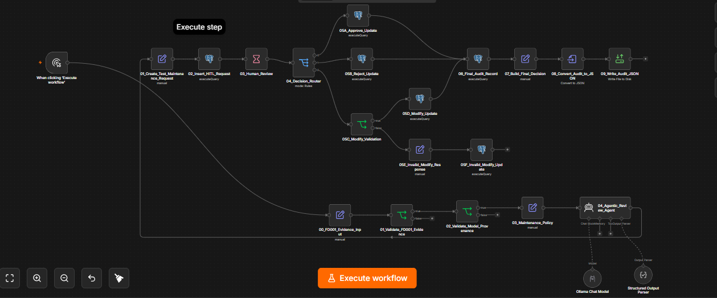
BACKUP B16 · N8N TOPOLOGY
Exported 22-node n8n workflow (THESIS_HITL_AGENTIC_V2)
Groups
Fixed PROTOTYPE_TEST input
Evidence and provenance checks
DEMO_POLICY_V1 (STIPULATED_RESEARCH_ASSUMPTION)
Bounded local narration (Ollama, Qwen3 1.7B, temperature 0)
Human form → APPROVE / REJECT / MODIFY
PostgreSQL status + JSON audit export
Connections show available routes; exported audit records show saved decisions. Neither establishes a live notebook feed, offline interval-guard routing or field reliability.
Figure 4.7 (§4.10.4) · author's n8n editor screenshot — topology, not a deployment ↩ Backup index
B16
Notes:
Backup B16: n8n topology. Source: Figure 4.7 (§4.10.4) · author's n8n editor screenshot — topology, not a deployment

Slide 31
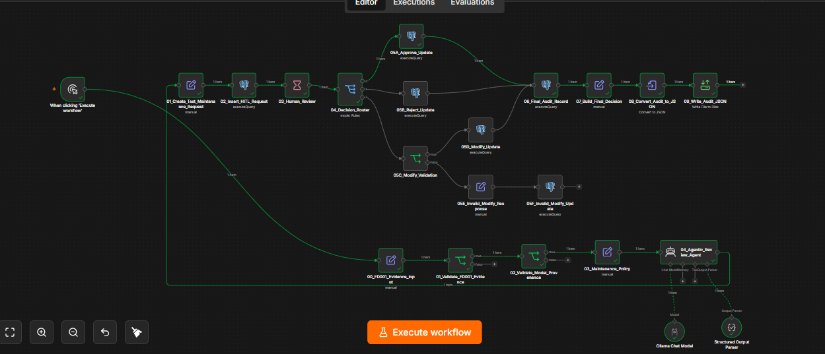
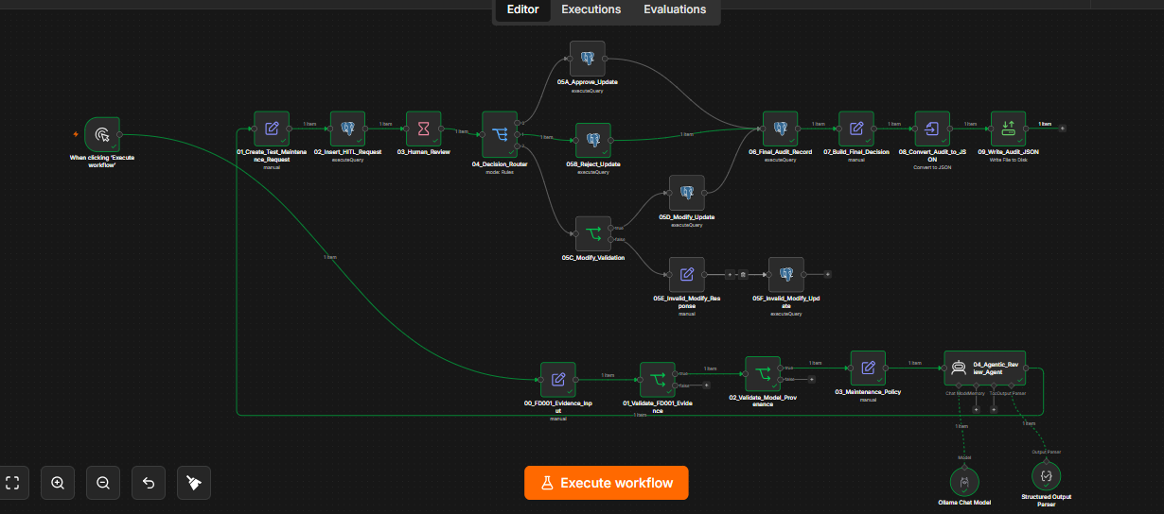
BACKUP B17 · DECISION-ROUTE EVIDENCE
Three human decision types were executed and exported
Branch | Observed result | Evidence
APPROVE | Executed twice; APPROVED, override NO | Two audit records
REJECT | Executed; REJECTED, override YES, final recommendation empty | Audit record
MODIFY (valid) | Executed; MODIFIED, override YES, revised recommendation stored | Audit record
MODIFY (invalid) | Editor trace reaches invalid response and update nodes | Trace only; no audit JSON
APPROVE route highlighted (editor execution)
REJECT route (editor execution)
Table 5.11 (§5.10) · Figure 5.11a ↩ Backup index
B17
Notes:
Backup B17: Decision-route evidence. Source: Table 5.11 (§5.10) · Figure 5.11a

Slide 32
BACKUP B18 · AUDIT-RECORD FIELDS
Audit records link policy, explanation and decision
Field group | Recorded content (MODIFY example)
Request | Request id; asset id; predicted RUL 18 cycles; priority CRITICAL
Policy | DEMO_POLICY_V1; STIPULATED_RESEARCH_ASSUMPTION; stage critical_0_to_30; flag LOWER_BOUND_CLIPPED; rule reason
Explanation | SHAP drivers + constrained agent summary, evidence list, limitations, ‘human review required’
Human decision | MODIFY; comment; revised recommendation; status MODIFIED; override YES
Timestamps | Creation, review and completion
Record | Decision | Override
HITL-1790096772107 | APPROVE | NO
HITL-1790108329010 | APPROVE | NO
HITL-1790097014976 | REJECT | YES
HITL-1790094775152 | MODIFY | YES
A fifth, earlier placeholder APPROVE run (HITL-20260909-214406-369) is kept separate from these four agent-assisted records.
Tables A.1 and A.2 (Appendix A) · sanitised prototype records ↩ Backup index
B18
Notes:
Backup B18: Audit-record fields. Source: Tables A.1 and A.2 (Appendix A) · sanitised prototype records

Slide 33
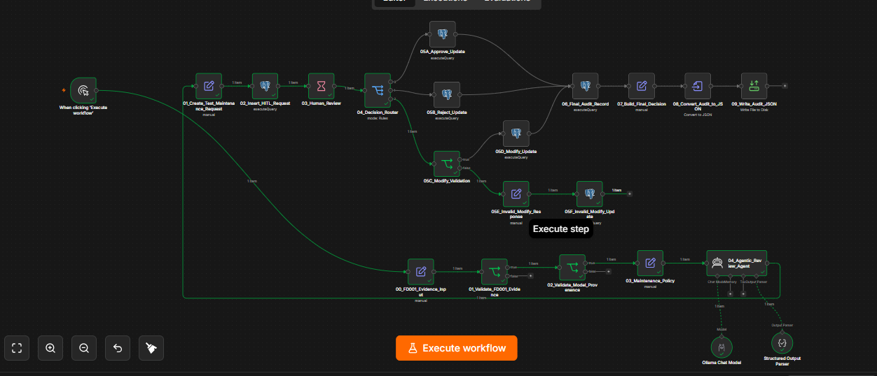
BACKUP B19 · INVALID-MODIFY LIMITATION
Invalid MODIFY: a route trace, not a persisted-state proof
What is and is not shown
Expected: fail closed when no revised recommendation is supplied
Shown: the editor trace reaches the invalid response and update nodes
Not shown: a returned database row or exported audit JSON of the final state
Invalid-MODIFY response and update nodes highlighted (editor execution)
Figure 5.11b, Table 5.11 (§5.10) ↩ Backup index
B19
Notes:
Backup B19: Invalid-MODIFY limitation. Source: Figure 5.11b, Table 5.11 (§5.10)

Slide 34
BACKUP B20 · REPRODUCIBILITY ENVIRONMENT
Executed environment and independent reproduction
Component | Version / platform
Python (original) | 3.13.15 (Google Colab, Linux)
Python (Phase 8 reproduction) | 3.12
NumPy / pandas | 2.1.3 / 2.2.3
scikit-learn | 1.6.1
XGBoost | 3.4.1
SHAP | 0.52.0
Matplotlib / seaborn | 3.10.0 / 0.13.2
Workflow layer | n8n + PostgreSQL + local Ollama chat model; fixed evidence payload
The Phase 8 reproduction restored the 60/20/20 partition with the same library versions and matched the recorded validation, calibration, test and SHAP values exactly. The two Python environments are reported separately.
Table 4.6 (§4.12) ↩ Backup index
B20
Notes:
Backup B20: Reproducibility environment. Source: Table 4.6 (§4.12)

Slide 35
BACKUP B21 · PROVENANCE LIMITATIONS
Numbers reproduce; earlier history cannot
Reproduced
Independent Phase 8 run restored the partition and matched q̂ and the principal validation, calibration and test metrics. The selected model hash stayed stable.
Not reconstructable
Five legacy Phase 5–6 artefact hashes differ from current archive bytes. The number of historical test executions is not fully verifiable, so post-closure analyses are treated as descriptive characterisation.
Required response
Version control with signed, immutable releases from ingestion onward; fresh data for confirmation.
§6.6, Table 6.1, declaration ↩ Backup index
B21
Notes:
Backup B21: Provenance limitations. Source: §6.6, Table 6.1, declaration

Slide 36
BACKUP B22 · STANDARDS AS DESIGN REFERENCES
Standards informed the design — no compliance is claimed
Standard or framework | Application in this dissertation
EN 13306:2017 | Definitions of fault, failure, condition-based and predictive maintenance
ISO 17359:2018 | Monitored parameters and alert criteria that trigger review
ISO 13374-1:2003 | Pipeline blocks: acquisition → state detection → health → prognosis → advisory
ISO 13381-1:2015 | RUL definition; confidence stated alongside a prognosis
IEEE Std 1856-2017 | Sensing, health assessment, prognostics and decision support as distinct capabilities
ISO 55000:2014; ISO 31000:2018 | Risk-based prioritisation behind the four classes
NIST AI RMF 1.0; ISO/IEC 42001:2023 | Governance via frozen policies, documented limitations, version fingerprints
EU AI Act, Art. 14 (2024) | Reviewer authority to approve, reject, modify or defer; no autonomous approval
Table 2.3 (§2.6) ↩ Backup index
B22
Notes:
Backup B22: Standards as design references. Source: Table 2.3 (§2.6)

Slide 37
BACKUP B23 · SCOPE AND CLAIMS BOUNDARY
What the framework can and cannot do
The framework CAN | The framework CANNOT
Estimate RUL for FD001-like engines from 18 cycle-level inputs | Transfer to other conditions, fault modes (FD002–FD004), engine types or real fleets without new validation
Attach a 90% interval calibrated on whole engine trajectories | Guarantee coverage for an individual engine, under distribution shift, or as a safety certificate
Show which inputs moved a prediction, and by how much | Identify the physical cause of degradation or the failing component
Assign stipulated classes; evaluate an offline uncertainty-based review rule | Define an approved maintenance window, cost-optimal action or airworthiness decision
Record proposals, reviewer decisions and versions for audit | Provide tamper-proof logging, access control, uptime or cybersecurity guarantees
Support a qualified human reviewer | Replace the reviewer or approve maintenance autonomously
Table 4.5 (§4.11) ↩ Backup index
B23
Notes:
Backup B23: Scope and claims boundary. Source: Table 4.5 (§4.11)

Slide 38
BACKUP B24 · VERIFIED REFERENCES
Key references (Harvard)
Angelopoulos, A.N. and Bates, S. (2023) 'Conformal prediction: a gentle introduction', Found. Trends Mach. Learn., 16(4), pp. 494–591.
Breiman, L. (2001) 'Random forests', Machine Learning, 45(1), pp. 5–32.
Jardine, A.K.S., Lin, D. and Banjevic, D. (2006) 'A review on machinery diagnostics and prognostics implementing CBM', MSSP, 20(7), pp. 1483–1510.
Javanmardi, A. and Hüllermeier, E. (2023) 'Conformal prediction intervals for remaining useful lifetime estimation', IJPHM, 14(2).
Kaufman, S. et al. (2012) 'Leakage in data mining: formulation, detection, and avoidance', ACM TKDD, 6(4), Article 15.
Lei, J. et al. (2018a) 'Distribution-free predictive inference for regression', JASA, 113(523), pp. 1094–1111.
Lundberg, S.M. and Lee, S.-I. (2017) 'A unified approach to interpreting model predictions', NeurIPS 30, pp. 4765–4774.
Lundberg, S.M. et al. (2020) 'From local explanations to global understanding with explainable AI for trees', Nat. Mach. Intell., 2(1).
Parasuraman, R., Sheridan, T.B. and Wickens, C.D. (2000) 'A model for types and levels of human interaction with automation', IEEE TSMC-A, 30(3), pp. 286–297.
Ramasso, E. and Saxena, A. (2014) 'Performance benchmarking and analysis of prognostic methods for CMAPSS datasets', IJPHM, 5(2).
Saxena, A. et al. (2008a) 'Damage propagation modeling for aircraft engine run-to-failure simulation', PHM 2008, pp. 1–9.
Saxena, A. and Goebel, K. (2008) Turbofan Engine Degradation Simulation Data Set. NASA Ames Prognostics Data Repository.
Shneiderman, B. (2020) 'Human-centered artificial intelligence: reliable, safe & trustworthy', IJHCI, 36(6), pp. 495–504.
Vollert, S., Atzmueller, M. and Theissler, A. (2021) 'Interpretable machine learning: a brief survey from the predictive maintenance perspective', ETFA 2021.
Full list: dissertation References ↩ Backup index
B24
Notes:
Backup B24: Verified references. Source: Full list: dissertation References

Slide 39
BACKUP B25 · REPOSITORY
Dissertation repository (private)
github.com/mranitabh/GISMA-hitl-dissertation-predictive-maintenance
Private dissertation repository — examiners may need to request access.
Contents relevant to the viva
executed_notebook/ — executed implementation notebook (HTML export)
workflow/ — n8n workflow exports
audit_examples/ — sanitised HITL audit JSON records
screenshots/ — workflow canvas, form and route traces
schemas/, config/ — request/response schemas and threshold policy
presentation/ — this deck, its source, script and verification report
Repository stated in the dissertation; property of GISMA University — access must be requested ↩ Backup index
B25
Notes:
Backup B25: Repository. Source: Repository stated in the dissertation; property of GISMA University — access must be requested

