Slide 1
client side And server side scripting languages

Slide 2
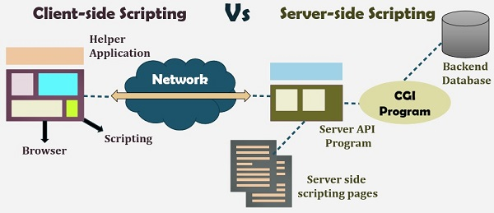

Slide 3
Server-side Programming :
It is the program that runs on server dealing with the generation of content of web page. 1) Querying the database 2) Operations over databases 3) Access/Write a file on server. 4) Interact with other servers. 5) Structure web applications. 6) Process user input. For example if user input is a text in search box, run a search algorithm on data stored on server and send the results.

Slide 4
The Programming languages for server-side programming are : 1) PHP 2) C++ 3) Java and JSP 4) Python 5) Ruby on Rails
Refer PHP articles for example server side codes.

Slide 5
Client-side scripting language
Client-side scripting is performed to generate a code that can run on the client end (browser) without needing the server side processing. Basically, these types of scripts are placed inside an HTML document. The client-side scripting can be used to examine the user’s form for the errors before submitting it and for changing the content according to the user input. As I mentioned before, the web requires three elements for its functioning which are, client, database and server.

Slide 6
The effective client-side scripting can significantly reduce the server load. It is designed to run as a scripting language utilizing a web browser as a host program. For example, when a user makes a request via browser for a webpage to the server, it just sent the HTML and CSS as plain text, and the browser interprets and renders the web content in the client end.

Slide 7
Client-side scripting languages:
HTML: It is the fundamental building blocks of web programming which provides the frame to the website. It describes the arrangement of the content.
CSS: CSS provides the way to design the graphic elements which help in making the appearance of the web application more attractive.
JavaScript: It is also a client-side scripting language which essentially devised for the specific purpose, but currently there are various JavaScript frameworks used as server-side scripting technology.

Slide 8
Key Differences Between Server-side Scripting and Client-side Scripting
Server-side scripting is used at the backend, where the source code is not viewable or hidden at the client side (browser). On the other hand, client-side scripting is used at the front end which users can see from the browser.
When a server-side script is processed it communicates to the server. As against, client-side scripting does not need any server interaction.
The client-side scripting language involves languages such as HTML, CSS and JavaScript. In contrast, programming languages such as PHP, ASP.net, Ruby, ColdFusion, Python, C#, Java, C++, etc.
Server-side scripting is useful in customizing the web pages and implement the dynamic changes in the websites. Conversely, the client-side script can effectively minimize the load to the server.
Server-side scripting is more secure than client-side scripting as the server side scripts are usually hidden from the client end, while a client-side script is visible to the users.

Slide 9
BASIS FOR COMPARISON | SERVER-SIDE SCRIPTING | CLIENT-SIDE SCRIPTING
Basic | Works in the back end which could not be visible at the client end. | Works at the front end and script are visible among the users.
Processing | Requires server interaction. | Does not need interaction with the server.
Languages involved | PHP, ASP.net, Ruby on Rails, ColdFusion, Python, etcetera. | HTML, CSS, JavaScript, etc.
Affect | Could effectively customize the web pages and provide dynamic websites. | Can reduce the load to the server.
Security | Relatively secure. | Insecure

