Slide 1
WDIO
Overview

Slide 2

What is WDIO
It is a full test framework with numerous additional features and utilities
It supports Browser, Mobile and Desktop App Automation, and allows integration of API testing (using 3rd party libraries like SuperTest) for Node.js
WebDriverIO is a better implementation of the WebDriver bindings and supports 50+ types of interactions
WebDriver is W3C compliant and is the official standard for browser automation
WebDriver is a remote control interface that enables introspection and control of user agents

Slide 3
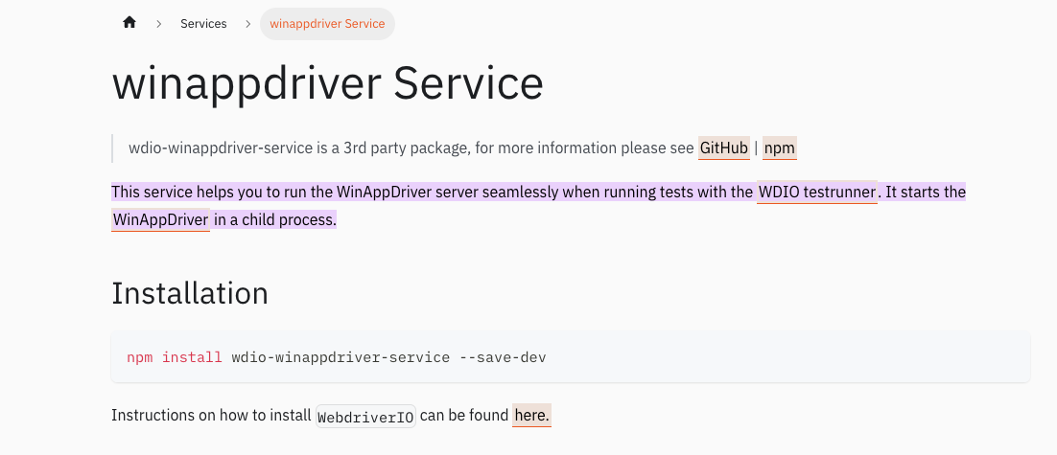
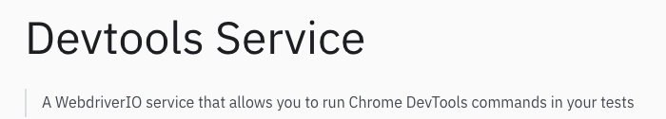
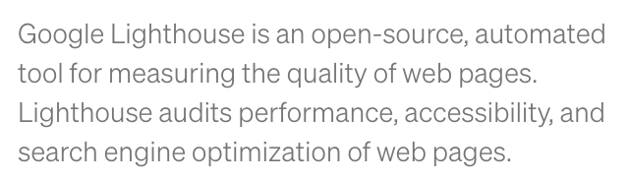
A go-to tool for E2E test automation (Web, Mobile + Extendable to API and other libs)
With WDIO, you can collect the Performance Data
of your Web Page

Slide 4
Main Benefits / Disadvantages of WDIO
Quick and easy setup using a Wizard that can be tailored for your requirements
Has an extensive list of services and reports e.g. Selenoid,
Strong Community Support
Powerful Test Runner.
Highly customisable and supports Mocha, Cucumber, Jasmine, and Jest
Supports Web, Mobile and Desktop. Allows integration for API, Cloud, Performance, amongst others
Supports BDD via Cucumber JS
Yearly release is available
Only available in JS or TS
Synchronous/parallel command mode was deprecated in April 23 due to incompatibilities of a specific package in V8 of the framework

Slide 5
Services
Appium Service
Browserstack Service
Crossbrowsertesting Service
Devtools Service
Firefox Profile Service
Sauce Service
Selenium Standalone Service
Shared Store Service
Static Server Service
Testingbot Service
Webdriver Mock Service
ChromeDriver Service
Geckodriver Service
SafariDriver Service
EdgeDriver Service
VSCode Extension Testing Service
Intercept Service
Electron Service
Gmail Service
Zafira Listener Service
Report Portal Service
Docker Service
UI5 Service
WireMock Service
Slack Service
LambdaTest Service
Image Comparison (Visual Regression Testing) Service
Ng-apimock Service
Novus Visual Regression Service
Re-run Service
winappdriver Service
ywinappdriver Service
PerformanceTotal Service
CleanupTotal Service
AWS Device Farm Service
OCR service for Appium Native Apps Service
Library of useful expected conditions Service
Support for Angular component test harnesses Service
Auto-detect missing imports w/eslint Service
Microsoft Teams Service
Cucumber Viewport Logger Service
Tesults Service
Azure DevOps Test Plans Service
Google Chat Service
Qmate Service
Vitaq AI Service
Robonut Service

Slide 6
Test Runner config
This is managed inside the wdio.conf.ts file

Slide 7
Customisation
npm init wdio -> installs core packages
-> Prompts you with Wizard for Setup

