Slide 1
WDIO
Overview

Slide 2
Agenda
What are the benefits and risks of adopting WebDriverIO?
In the current environment is it feasible to adopt, right now?

Slide 3

What is WDIO?
It is a full test framework with numerous additional features and utilities
It supports Browser, Mobile and Desktop App Automation, and allows integration of API testing (using 3rd party libraries like SuperTest) for Node.js
WebDriverIO is a better implementation of the WebDriver bindings and supports 50+ types of interactions
WebDriver is W3C compliant and is the official standard for browser automation
WebDriver is a remote control interface that enables introspection and control of user agents

Slide 4






Solution Proposed
Potential to achieve better efficiency, cost savings and reusability
Current Toolset
Benefits
Reduced execution time with multi browser / device and parallel execution capabilities
Extensive automation framework for UI (Desktop web and Mobile web ) and API
Reduced script development and maintenance efforts (~20% each)
Easy setup, Quick onboarding, Community Support
Zero tool/framework licensing cost
Common tech and tool stack across QA and Front-end Dev
We have done comparison with multiple automation tools and proposing WebdriverIO as unified solution, which has below silent features
🌐 Modern web applications written in React, Vue, Angular, Svelte or other frontend frameworks
📱 Hybrid or native mobile applications running in an emulator/simulator or on a real device
💻 Native desktop applications (e.g. written with Electron.js)
📦 E2E testing (Unit, Component…) of web components in the browser
True Open Source
£
£
Notes:
Effort Estimates are Proposed based on feedback from Current Users of BTTF framework

Slide 5
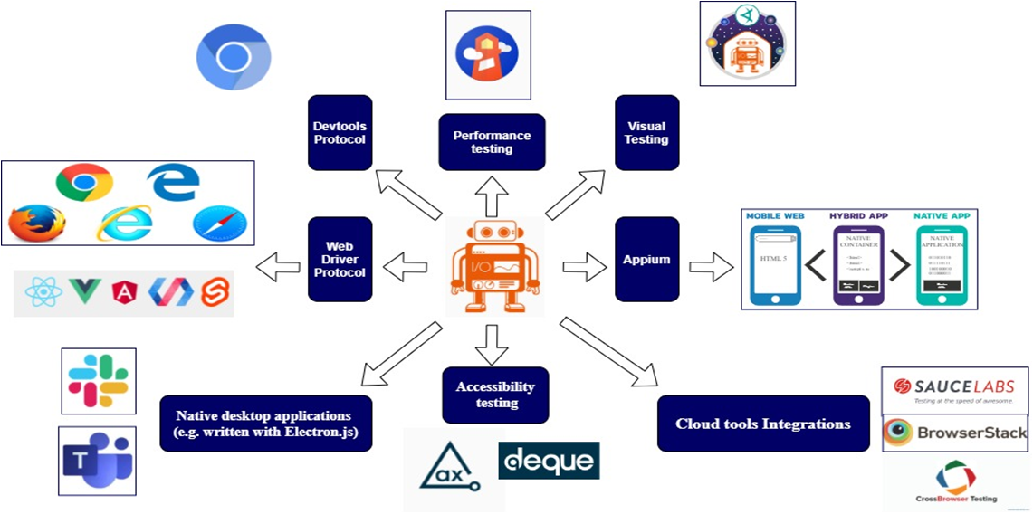
WebdriverIO features
Notes:
WebdriverIO(also known as WDIO) is the established test framework for Node.js. It has got powerful runner that supports Cucumber, Mocha and Jasmine and loaded with many features that makes easier to use.
WDIO can be run on WebDriver or Chrome DevTools Protocol - this means it has a full control over all browser elements to interact with. It is highly extendable that makes easier to automate E2E tests, not just web.

Slide 6




Feature comparison – Playwright / Cypress / Webdriver IO
Feature​ | Playwright | Cypress​ | WebDriver IO​ | Custom, Selenium, RestAssured, Appium
Setup Complexity​ |  | Easy ​ | Easy ​
Configurable |  | Easy | Easy
Open Source​ |  | Yes​ | Yes​
Programming Language Support​ | Multi-Language | JavaScript/Typescript​ | JavaScript/Typescript​
Browser Stack Support​ |  | Yes​ | Yes
Screenshot in Reports |  | Yes​ | Yes​
Videos in Reports |  | Yes​ | Yes​
Browser Support ​
Assertion Libraries/Test Framework​ |  | Mocha, Chai, Cucumber (Using Plugins)​ | Inbuilt, Jasmine, Mocha, and Cucumber​
Multiple Tab/Window Support​ |  | No​ | Yes​
Parallel Test Execution​ |  | One thread at the time​ | Yes​
Reporter​ |  | Default Reporter Spec. Extendable Junit, Mocha supported reporter and Custom Reporters​ | Allure Reporter, Cucumber Reporter , JSON, Spec, Dot Reporter and etc
Documentation & Community Support​ |  | Well-written documentation, Growing community​ | Complete Documentation Available and Good Community Support​
Custom Rich Helper Libraries |  | To Be Configured | To Be Configured
Debugging​ |  | Limited support | Yes and Extra support available (A++)
BDD Driven |  | Yes | Yes
CI/CD Accelerators |  |  | Preconfigured for GitHub Actions
Requires a Proxy

Slide 7
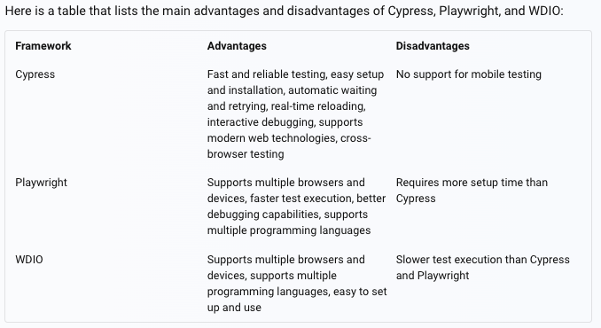

Slide 8
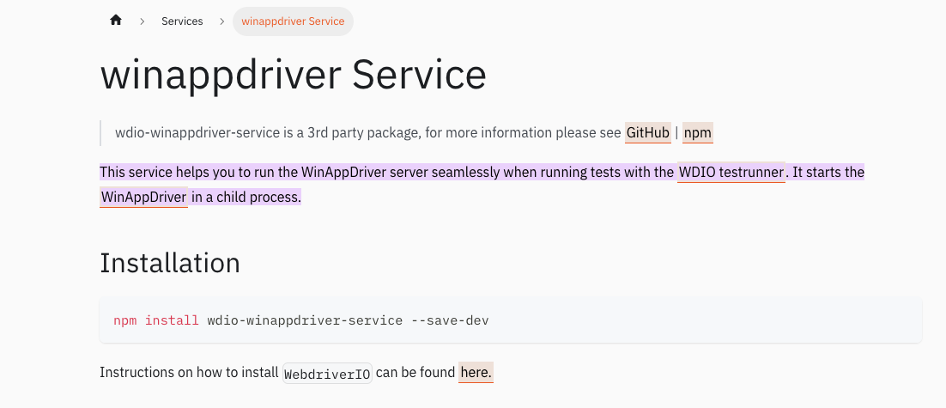
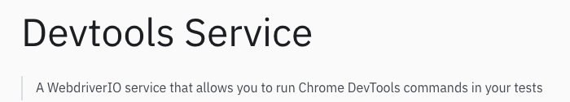
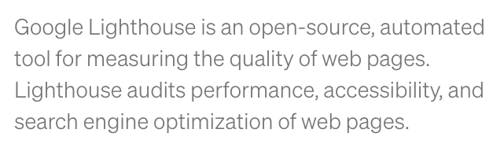
A go-to tool for E2E test automation (Web, Mobile + Extendable to API and other libs)
With WDIO, you can collect the Performance Data
of your Web Page

Slide 9
WDIO Main Benefits & Disadvantages
Quick and easy setup using a Wizard that can be tailored for your requirements
Has an extensive list of services and reports e.g. Selenoid,
Strong Community Support
Powerful Test Runner.
Highly customisable and supports Mocha, Cucumber, Jasmine, and Jest
Supports Web, Mobile and Desktop. Allows integration for API, Cloud, Performance, amongst others
Supports BDD via Cucumber JS
Yearly release is available
Only available in JS or TS
Synchronous/parallel command mode was deprecated in April 23 due to incompatibilities of a specific package in V8 of the framework

Slide 10
Services
Appium Service
Browserstack Service
Crossbrowsertesting Service
Devtools Service
Firefox Profile Service
Sauce Service
Selenium Standalone Service
Shared Store Service
Static Server Service
Testingbot Service
Webdriver Mock Service
ChromeDriver Service
Geckodriver Service
SafariDriver Service
EdgeDriver Service
VSCode Extension Testing Service
Intercept Service
Electron Service
Gmail Service
Zafira Listener Service
Report Portal Service
Docker Service
UI5 Service
WireMock Service
Slack Service
LambdaTest Service
Image Comparison (Visual Regression Testing) Service
Ng-apimock Service
Novus Visual Regression Service
Re-run Service
winappdriver Service
ywinappdriver Service
PerformanceTotal Service
CleanupTotal Service
AWS Device Farm Service
OCR service for Appium Native Apps Service
Library of useful expected conditions Service
Support for Angular component test harnesses Service
Auto-detect missing imports w/eslint Service
Microsoft Teams Service
Cucumber Viewport Logger Service
Tesults Service
Azure DevOps Test Plans Service
Google Chat Service
Qmate Service
Vitaq AI Service
Robonut Service

Slide 11
Customisation
npm init wdio -> Installs the Core Packages
-> Prompts you with a Wizard for Setup to install the
desired Configuration

Slide 12
Test Runner config
This is managed inside the wdio.conf.ts file
To run all your tests type: npx wdio wdio.conf.ts
Configure browser properties:
Has property maxInstances which controls the number of browser threads. By default when the Test Runner starts it identifies the number of feature/spec files to run. The scope is set based on the tags in the tests. It then looks for the number of capabilities – and assigns a feature file to each capability. You can use the exclude option to avoid assigning a feature to a capability
Has property setWindowRect -> Browser Real-estate dimensions

Slide 13
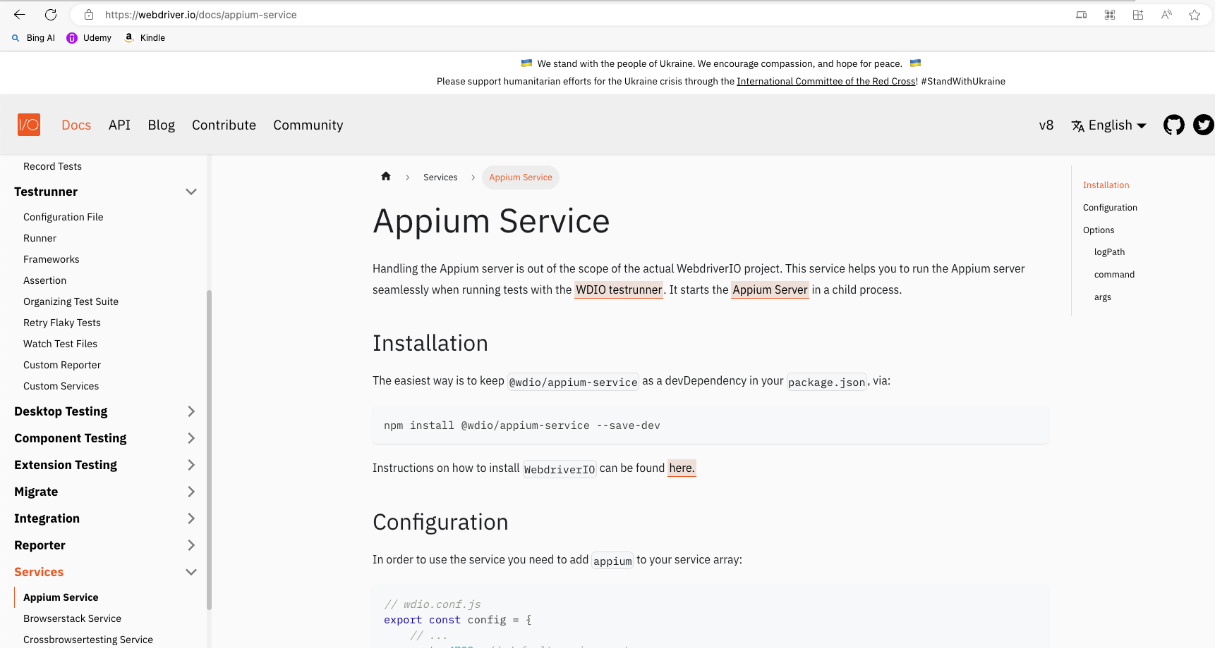
Rich documentation available

Slide 14
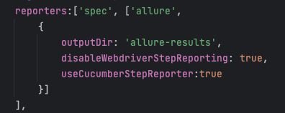
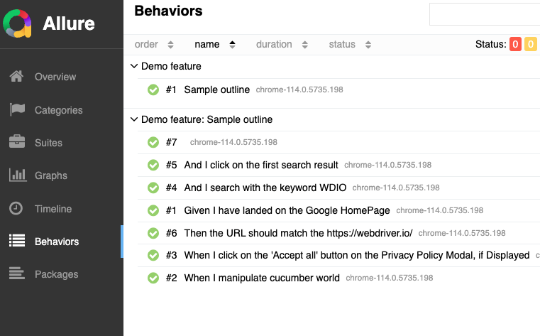
Numerous Reporting Options
You are up and running within minutes!
Install Java 8
npm install –g allure-commandline –save-dev
allure serve -> Generates an interactive HTML report

Slide 15





Overview
Vision
Standardise Test
Automation across
Squads
Reduce time to market
Integrate quality gate in CI/CD process for all squads
Increase frequency of releases to production
Challenges
Multiple test automation frameworks across squads
Inconsistent approach for Test Automation
Unable to move resources across squads
Added cost to BA to maintain multiple frameworks
No single source of Test tools for all squads
Supports modern web applications written in React, Hybris, Vue, Angular, Svelte, AEM or other frontend frameworks
Enables hybrid or native mobile applications running in an emulator/simulator or on a real device
Supports native desktop applications (e.g. written with Electron.js)
Covers E2E testing (Unit, Component etc.) of web components in browser
True Open Source
EE Shop Mobile - 5 e2e Acquisition journey scenarios automated which is the highest priority for BT Shop
Each Test Script can be executed on multiple platforms (Desktop web /Android web/iOS Web)
Capabilities added:
Execution: All Desktop Browsers, Android –Chrome, IOS - Safari
CI/CD: GitHub actions
Cloud Execution: BrowserStack
Appium: Mobile Browser Automation
Dynamic Implementation
Reporting: Cucumber Reports and Allure Reports
Xray: RoadMap
Why WebDriverIO
POC Outcome
£25k NTT DATA Investment
Zero tool/framework licensing cost
20% reduced script development and maintenance effort
Accelerated execution time with multi browser / device and parallel execution capabilities
Easy setup, Quick onboarding, Global community Support
Extensive automation framework for UI (Desktop web and Mobile web ) and API
Common tech and tool stack across QA and Front-end Dev
Capability to automate GraphQL
Benefits

Slide 16
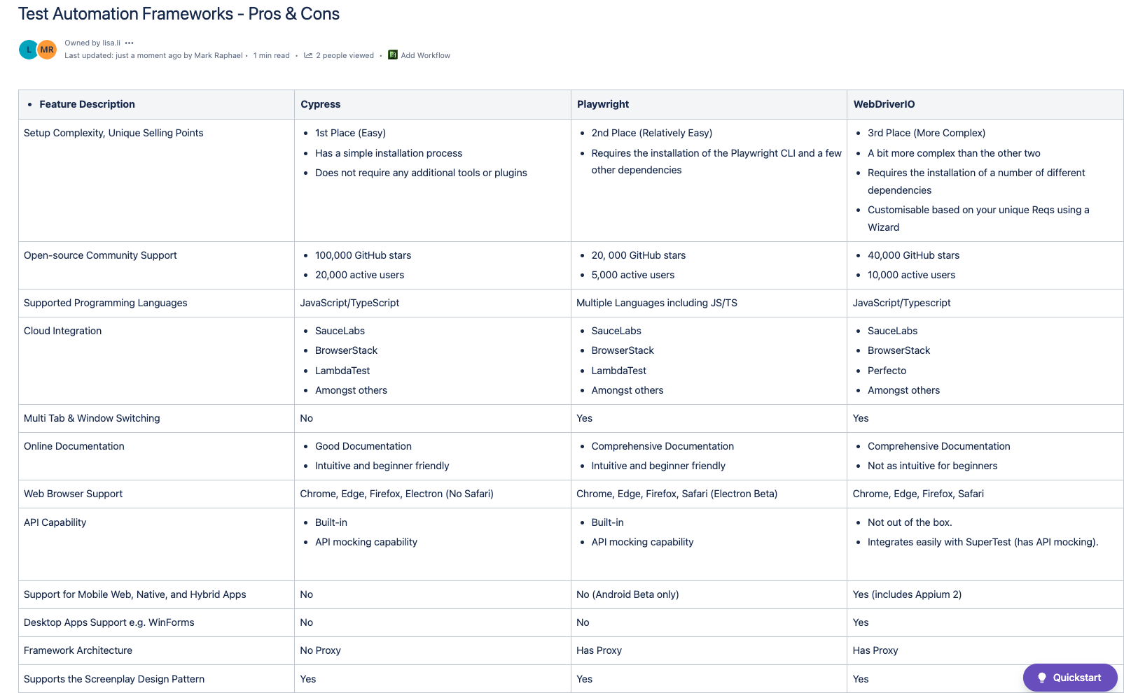

Slide 17
