Slide 1
Sublist3r
Presented by
1905091 - Sadia Tabassum
1905103 - Mayesha Rashid
Supervisor: A. K. M. Mehedi Hasan

Slide 2
Introduction
Sublist3r is a tool to search and list subdomains easily.
It uses search engines and databases like Google, Bing, Yahoo, Ask, Baidu, Virustotal, Netcraft. ThreatCrowd, DNSdumpster, and ReverseDNS.
Brute force ability was added with the integration of subbrute to Sublist3r.

Slide 3
Usage
Short Form | Long Form | Description
-d | -domain | Domain name to enumerate subdomains
-b | -bruteforce | Enable the subbrute bruteforce module
-p | -ports | Scan the found subdomains against specific tcp ports
-v | -verbose | Enable the verbose mode and display results in real time
-t | -threads | Number of threads to use for subbrute bruteforce
-e | -engines | Specify a comma-separated list of search engines
-h | -help | Show the help message and exit

Slide 4
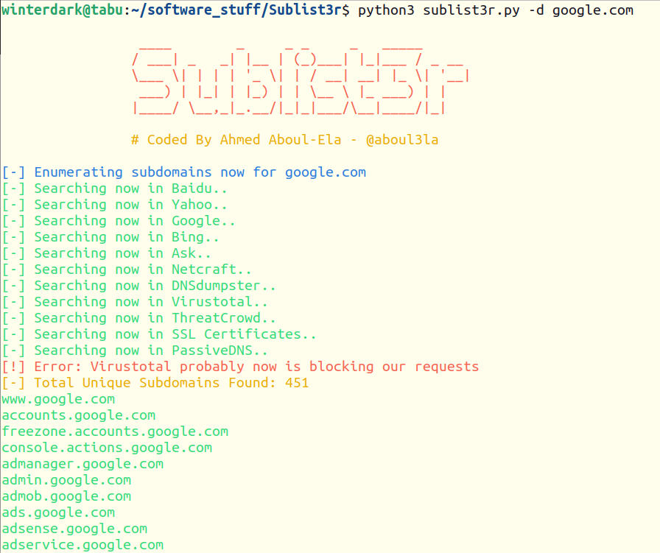
Individual Examples
Finding subdomains of specified domain

Slide 5
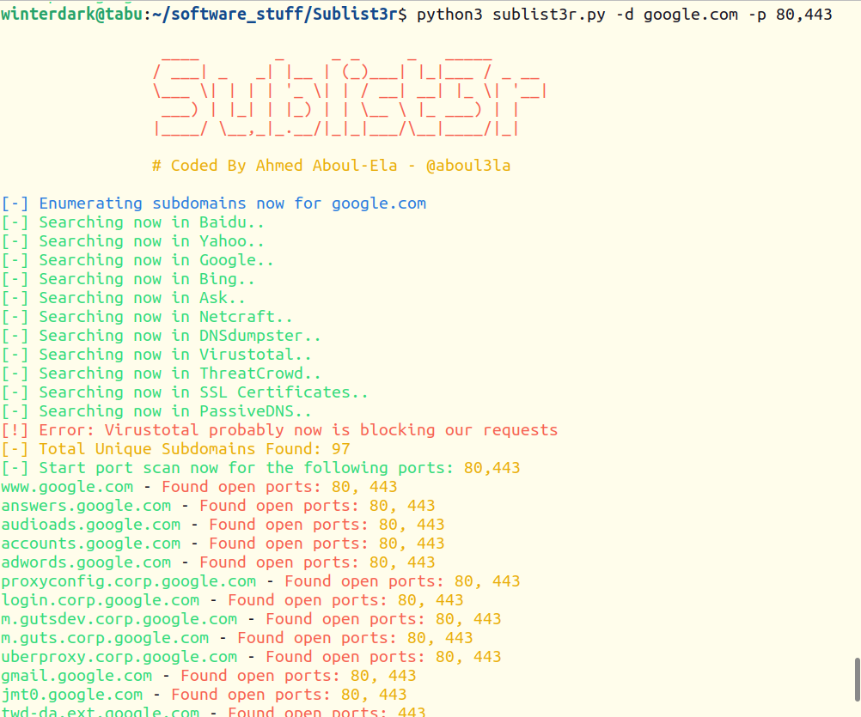
To enumerate subdomains of specific domain and show only subdomains which have specific ports open:

Slide 6
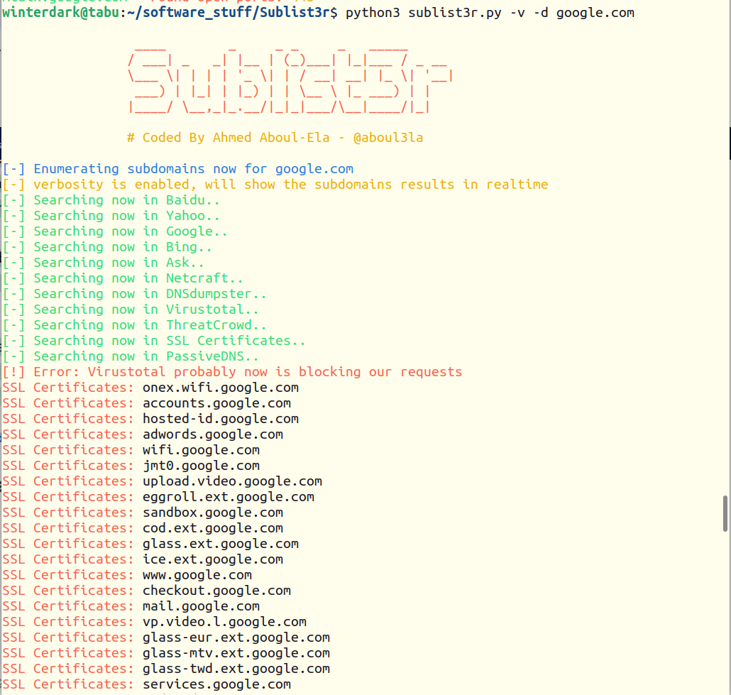
To enumerate subdomains of specific domain and show the results in real time:

Slide 7
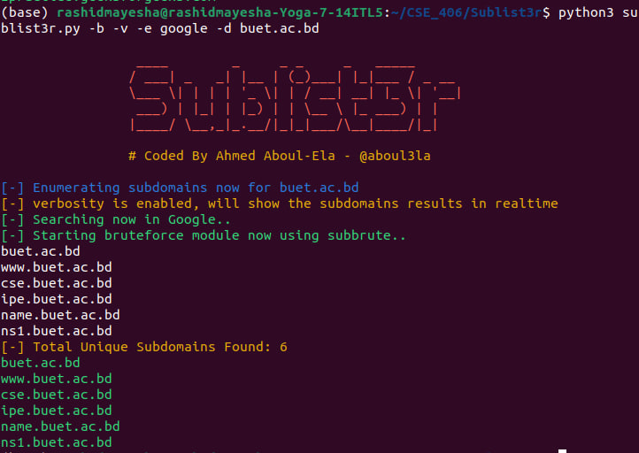
To enumerate subdomains and enable the bruteforce module:

Slide 8
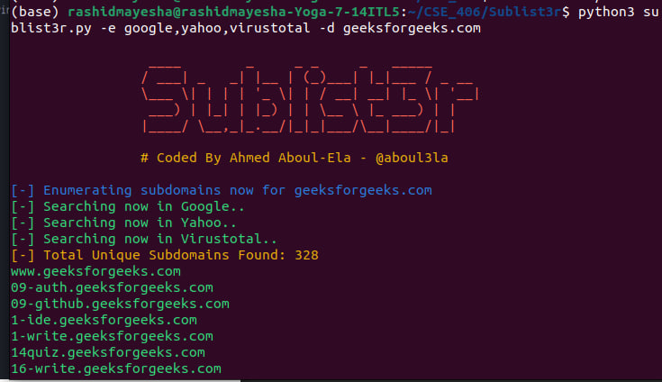
To enumerate subdomains and use specific engines such Google, Yahoo
and Virustotal engines :

Slide 9
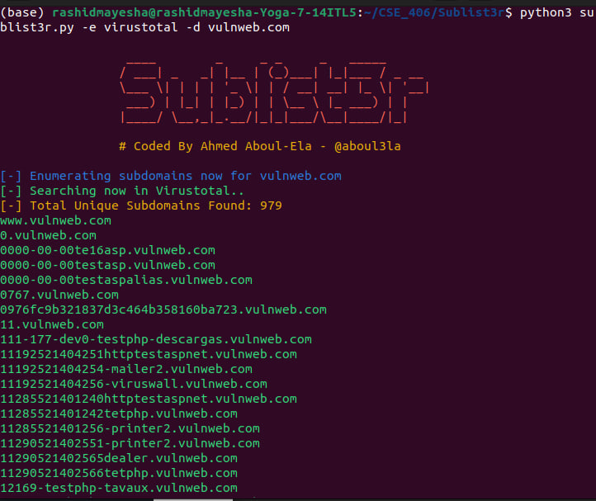
One usage of subdomain enumeration is finding vulnerable endpoints and targeting them for dictionary attack.
We will attempt to do dictionary attack on a testing website named vulnweb.com
We can get its subdomains by using virustotal engine.

Slide 10
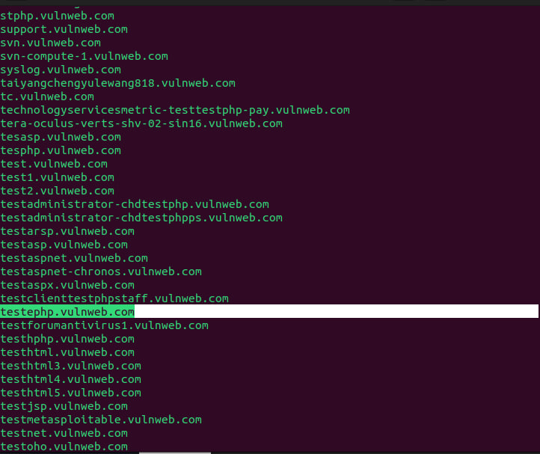
Our target subdomain is testphp.vulnweb.com

Slide 11
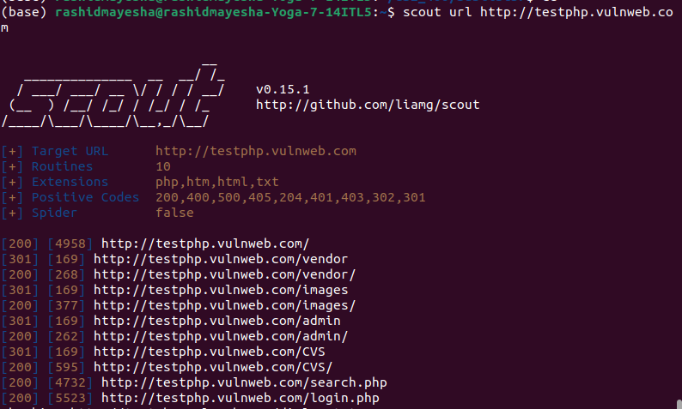
Now we will use another tool named scout to find the login route.

Slide 12
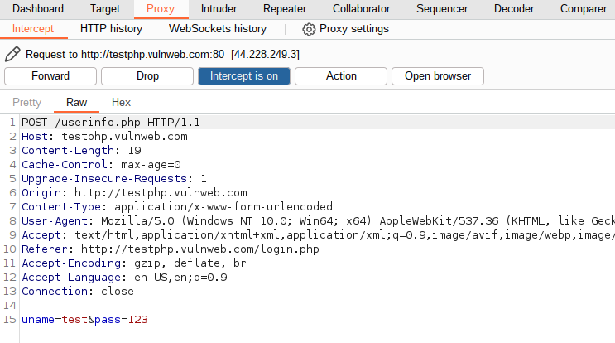
Then we can use burp suite or any other brute forcing tool to do dictionary attack on the vulnerable link.
When we click login button, this post request is being sent, which can be seen in the proxy window if intercept is turned on.

Slide 13
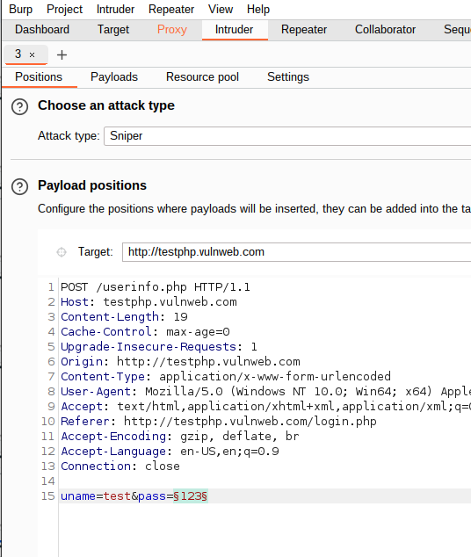
Now we will send this request to intruder and add password as payload by adding curly braces (§) on either side.

Slide 14
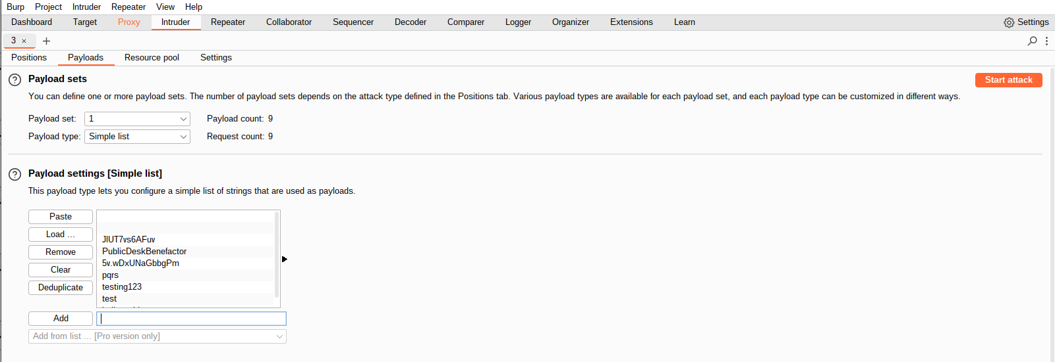
In payloads, we have to load our password list file and then click start attack.

Slide 15
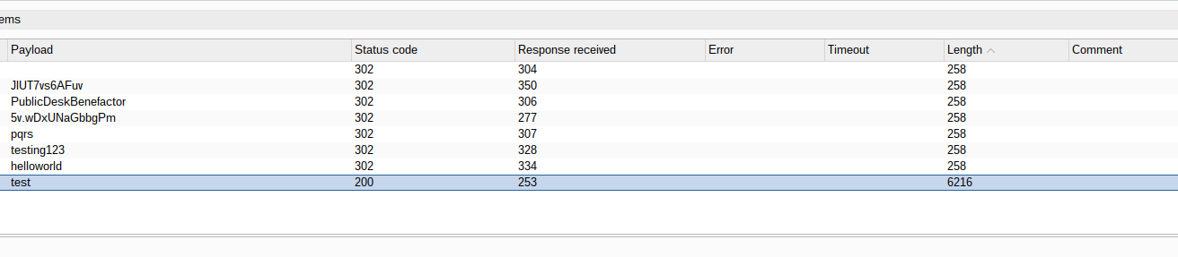
From the attack we can see that, for password test we have got status code 200 and the length is different than others. We now select the request of test and forward it to repeater.

Slide 16
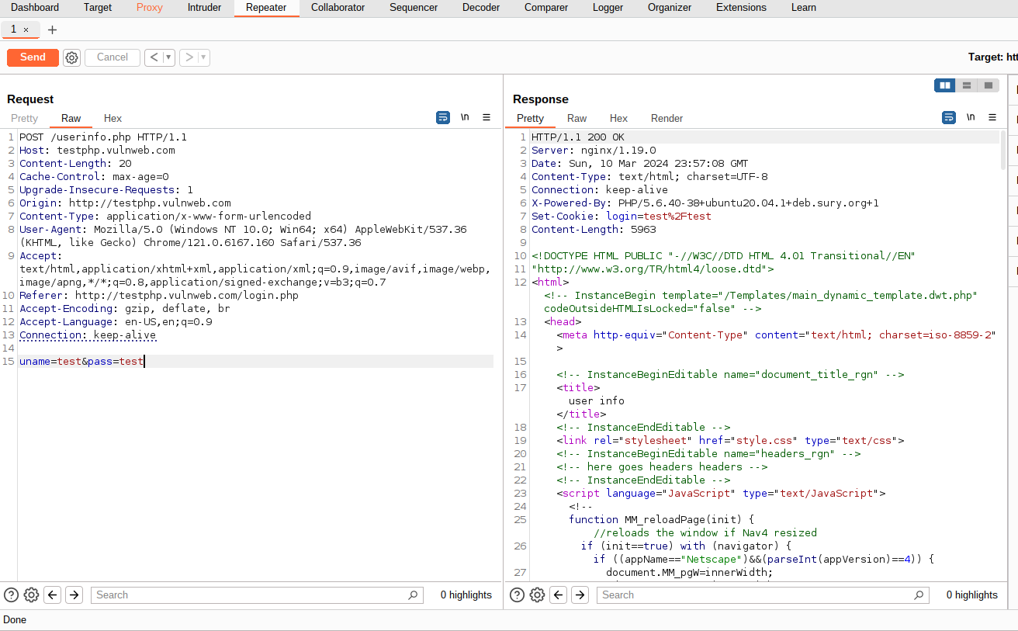
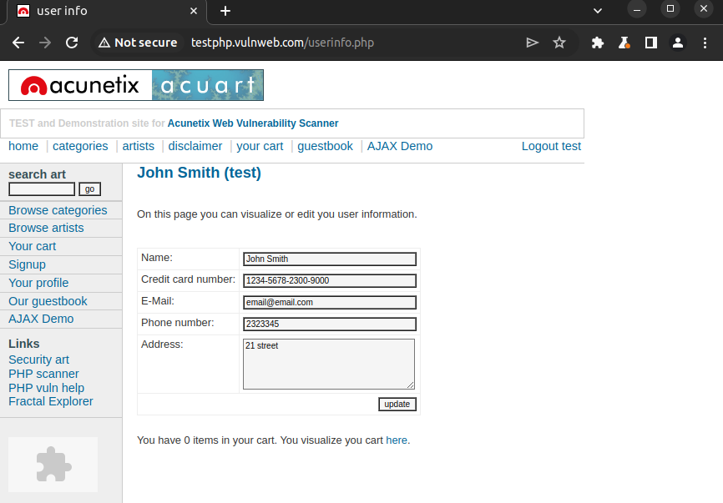
If we click send at repeater, we will see that we get a webpage as a response. Now copying this request to proxy and forwarding it will load the logged in page in browser. Thus a successful dictionary attack has been done.

Slide 17
This shows us that Sublist3r is a useful tool to get knowledge about subdomains and to find and resolve any vulnerability in them.

Slide 18
Thank you

