Slide 1
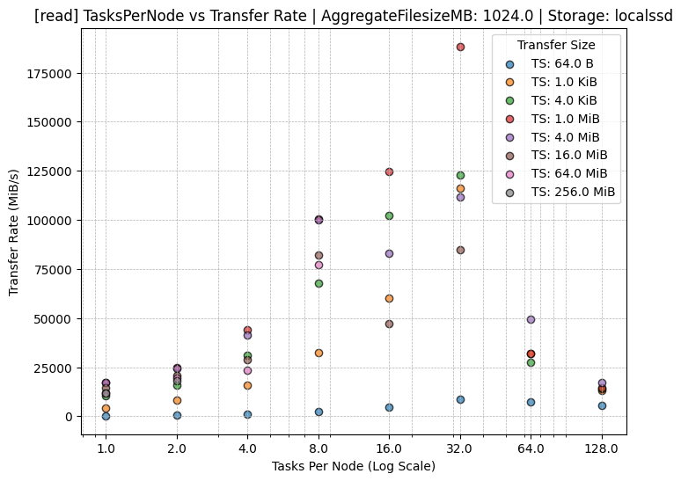
Task I/O Pattern
IOT: Sequential Read
D: 1GB
N: 2 nodes
tpn: 12
Ave: 2KB
Regression
Line
Filtered Performance
Local SSD
Performance
Profile
Estimated Performance

Slide 2
200000
Task I/O Pattern
IO Type: Seq Read
Data Size: 1GB
Num Nodes: 2 nodes
Task Per Node: 26
Ave I/O size: 2KB
Estimated Performance
Transfer Rate (MB/sec)
150000
100000
Regression
Line
Filtered Performance
50000
Local SSD
Performance
Profile
4
16
32
64
Tasks Per Node (Log Scale)

