Slide 1
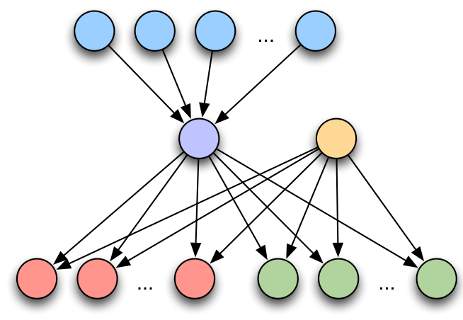
G-0
indiv
sifting
merge
mut
freq

Slide 2
t₂
e₄
d₅
d₁
e₇
e₁₈
e₁
e₁₃
t₇
d₉
t₁
t₂
t₃
t₁
t₂
t₃
d₄
e₈
e₁₀
d₆
e₁₉
e₂₃
e₂₆
d₁₃
d₂
e₂
t₁
e₅
t₄
e₁₄
t₁₂
t₈
d₁₀
t₄
t₅
t₆
t₄
t₅
t₆
e₉
e₁₅
e₂₀
d₃
e₃
t₉
d₁₁
e₆
d₆
e₁₁
e₁₆
e₂₄
t₃
t₅
d₇
t₁₀
e₂₁
t₇
t₈
t₇
t₈
e₂₇
e₁₂
e₁₇
e₂₅
t₁₃
t₆
d₈
t₁₁
d₁₂
d₁₄
t₉
t₉
e₂₂
d₅
d₁
e₇
e₁₈
e₁
e₁₃
t₇
d₉
d₄
e₈
e₁₀
d₆
e₂₃
e₂₆
d₁₃
d₂
e₂
t₁
e₅
t₄
e₁₄
e₁₉
t₁₂
t₈
d₁₀
e₉
e₁₅
t₉
e₂₀
d₃
e₃
d₁₁
d₆

Slide 3
t₁
t₂
t₃
t₄
t₆
t₅
d₀
t₇
t₁
t₂
t₃
t₄
t₅
d₁
d₂
d₃
d₄
d₅
t₆
d₆
t₇
t₁
t₂
t₃
t₄
t₆
t₅
t₇

Slide 4
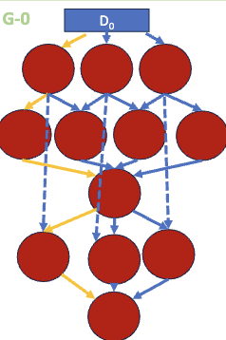

Slide 5
pr_rlut.nc
track.nc
cloudid.nc
trackstats.nc
tracks_pf.nc
mcstrack.nc
trknum.nc
mcs_tracks.nc
tracks_robust.nc
trknum.nc
gettr
idmcs
robmcs
IMERG.nc
trksg
trkst
idfea
n-n
mtpf
mapf
trksg
n-n
Stage 1
Stage 2
Stage 3
Stage4
Stage 5
Stage 6
Stage 7
Stage 8
Stage 9

Slide 6
chr1.tar.gz
chr1n.tar.gz
mut_olp
chr1n.tar.gz
ind_mer
chr1n.tar.gz
indiv
freq
Stage 1
Stage 2
Stage 3

Slide 7
agg
stage.h5,virt.h5
aggregated.h5
virt.h5
virt.h5
train
infer
sim
Stage 1
Stage 2
Stage 3

Slide 8
cposs.fits
1-ucor.tbl
1-fit.txt
1-.fits.tbl
1-cors.tbl
Bg
1-mos.fits
1-mos.png
region.hdr,
poss2.fits
region.hdr
pposs2.fits
n-n
1-img.tbl
1-pro.tbl
region.hdr
ConF
BgM
1-cor.tbl
Img
Add
View
pro
n-n
DiffF
Stage 1
Stage 2
Stage 3
Stage 4
Stage 5
Stage 6
Stage 7
Stage 8

Slide 9
diff.npz
test.npy
infer
preproc
train
10nm_full.npy
train.npy
weights.h5
Stage 1
Stage 2
Stage 3

