Slide 1
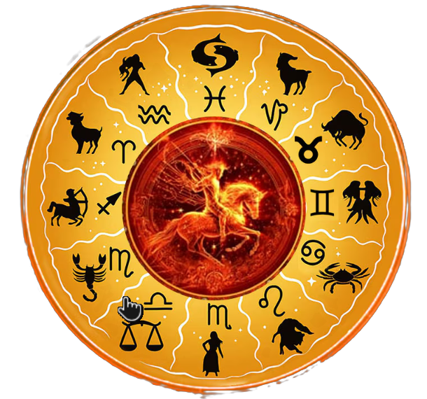

Sūryasiddhānta
Computational Library with
AI-Powered Query Interface
A Python library implementing classical
Indian astronomical algorithms
MTP2
Ashutosh Nigam | M25AI2006
Supervisor: Dr Dinesh Mohan Joshi

Slide 2
Overview
Implement
Explain
Evaluate
Implement the computable methods from all fourteen chapters in a reusable Python library.
Show each calculation step and its source verses for a chosen date.
Compare results with DE440, stating the coordinate frame, time conventions and data sources.
Notes:
Project source: MTP2_Project_Report_Ashutosh_Nigam.docx; src/suryasiddhanta; frontend/src. Author: Ashutosh Nigam, M25AI2006. Prepared 4 November 2026.
The Python library, chapter implementations, chat and evaluation study predate these additions. The new contribution is a coherent learning and evidence-inspection workflow.

Slide 3
Python Library: Computational Scope
Chapters | Implemented subject areas
1–3 | Mean motion, true positions, place and time
4–6 | Eclipse calculations and projected geometry
7–11 | Conjunctions, stars, heliacal events, Moon and patas
12–14 | Cosmography, instruments and reckoning of time
All interfaces use the same chapter modules for astronomical calculations.
Notes:
Project source: MTP2_Project_Report_Ashutosh_Nigam.docx; src/suryasiddhanta; frontend/src. Author: Ashutosh Nigam, M25AI2006. Prepared 4 November 2026.
Coverage means the computable core, not every verse. Gradio and Streamlit remain legacy surfaces; new UI work is in React.

Slide 4
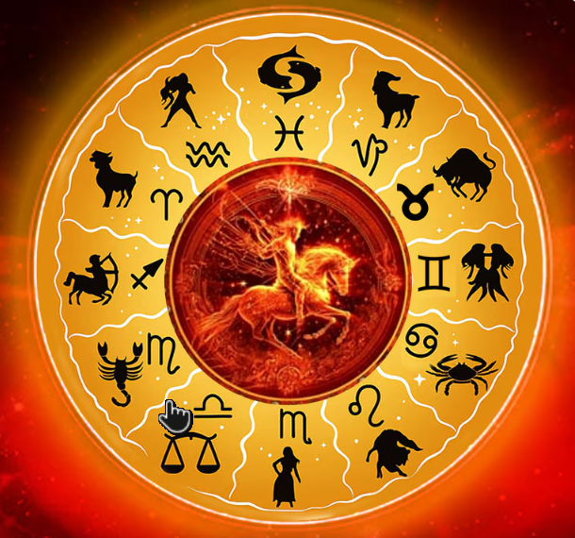
Sūryasiddhānta: Key Algorithms
Mean motion: elapsed days and revolution constants give mean planetary longitude.
Manda and śīghra: epicycle corrections convert mean positions to corrected positions.
Calendar calculations: use Sun and Moon longitudes to calculate tithi and related elements.
Each chapter provides reusable Python functions for its calculations.

Slide 5
SS Corpus: Text Extraction
Extracted Text from the English Burgess edition and the scanned Hindi edition – Vigyan Bhasya (Shri Mahaveer Prasad Shrivastava)
Explored Gemma 4 E2B, Surya OCR 2, Sarvam Document Intelligence and Patram for OCR and translation.
Completed 838-page Hindi OCR runs with Gemma and Surya OCR. A Gemma pass also translated all 838 pages into English.
Saved page-level outputs, progress logs and reusable caches, with text, Markdown and Word exports.
Notes:
Sources: D:/ss_corpus/README.md; gemma-model.ipynb; patram.ipynb; hf.ipynb; sarvam.ipynb; surya_ocr.py; pipeline/s00_extract_pdf.py.
Saved progress: data/interim/gemma4_v2/progress.json records 838/838 OCR pages and 838/838 page translations completed. data/interim/surya_ocr/progress.json records 838/838 OCR and Word-export pages completed.
Model names describe the experiments and tools in this project. No controlled OCR accuracy ranking is claimed. Completed page processing does not establish transcription or translation accuracy.
A separate paragraph-level Word translation run has 27 pending units; it is distinct from the completed page-level Gemma translation pass.
Corpus repository: https://github.com/mrashutoshnigam/ss_corpus (confirmed from the local repository configuration).

Slide 6
SS Corpus: Chapter and Verse Exploration
Organized extracted English text by chapter and verse, keeping verse text separate from commentary.
Stored verse IDs, topics, source references and calculation-tool mappings in JSON/JSONL and SQLite.
The app’s corrected Burgess export contains 500 numbered English verses across all 14 chapters.
Verse Explorer, corpus search and chat retrieval use this export. Hindi OCR outputs remain separate from the bundled verse corpus.
Notes:
Sources: D:/ss_corpus/pipeline/s01_clean.py through s09_validate.py; D:/ss_corpus/retrieve.py; D:/Surya_Siddhanta/docs/corpus-coverage.md; docker/corpus/corpus.json; frontend/src/pages/book; tests/test_corpus_completeness.py.
Fresh inspection on 13 November 2026: the application export has 500 records covering 14 chapters; all 500 have English translations and none has a populated translation_hi field. The external ss_corpus/data/final/corpus.json has 455 records; do not conflate this earlier pipeline output with the repaired application export.
The application coverage repair restored missing verse records and corrected verse/commentary boundaries against the source scans. Complete numbered-verse coverage does not imply a complete critical edition or error-free OCR.
The corpus supports chapter and verse exploration and retrieval. The Python chapter modules independently perform the astronomical calculations.

Slide 7
System Architecture
Source texts
→
Chapter functions
→
Structured results
React + FastAPI
Chat + tool registry
External MCP client
Calculation and book routes
Same Python functions
for numerical answers
Same tool registry
through stdio transport
The Research Explorer reads saved DE440 comparison data separately from the library.
Notes:
Project source: MTP2_Project_Report_Ashutosh_Nigam.docx; src/suryasiddhanta; frontend/src. Author: Ashutosh Nigam, M25AI2006. Prepared 4 November 2026.
Architecture checked against api/main.py, chatbot/agent.py, chatbot/tools.py and mcp_server.py. MCP is stdio; React chat calls the tool registry in-process. It is not MQTT.

Slide 8
Technology Stack: Library and Interfaces
Core library: Python, NumPy and Matplotlib.
Backend: FastAPI, Pydantic and Uvicorn; REST APIs and MCP.
Current web UI: React JS, TypeScript, Vite, React Router, HTML and CSS.
3D Visualization: Three.js, React Three Fiber and Drei.
Equations and text: LaTeX, React Markdown.
Earlier interfaces: Streamlit and Gradio.
Notes:
Sources: pyproject.toml; requirements.txt; frontend/package.json; src/suryasiddhanta/chatbot/providers.py; src/suryasiddhanta/mcp_server.py; streamlit_app; src/suryasiddhanta/ui; corpus index code; Dockerfiles and compose files; D:/ss_corpus notebooks, pipeline and README.
OpenRouter and DeepSeek are configured API providers. The OpenAI Python SDK is the compatible client library; this does not claim that an OpenAI-hosted model was used. Streamlit and Gradio are earlier interfaces; the current web interface uses React and FastAPI.
OCR tools and models describe experiments and processing work, not a comparative accuracy ranking. Hugging Face and LM Studio are model runtimes/tooling, distinct from the application API providers.

Slide 9
Technology stack: AI, corpus and delivery
AI: OpenRouter and DeepSeek APIs, with the OpenAI Python SDK and tool calling.
Corpus: SQLite, JSON and JSONL; Markdown and Word exports.
OCR and translation: Gemma 4 E2B, Surya OCR 2, Sarvam and Patram.
Local model tools: LM Studio, Hugging Face Transformers and PyTorch.
Document processing: PyMuPDF, OpenCV, Pillow and python-docx.
Testing and delivery: pytest, Playwright, Docker, Docker Compose, Git and GitHub.
Notes:
Sources: pyproject.toml; requirements.txt; frontend/package.json; src/suryasiddhanta/chatbot/providers.py; src/suryasiddhanta/mcp_server.py; streamlit_app; src/suryasiddhanta/ui; corpus index code; Dockerfiles and compose files; D:/ss_corpus notebooks, pipeline and README.
OpenRouter and DeepSeek are configured API providers. The OpenAI Python SDK is the compatible client library; this does not claim that an OpenAI-hosted model was used. Streamlit and Gradio are earlier interfaces; the current web interface uses React and FastAPI.
OCR tools and models describe experiments and processing work, not a comparative accuracy ranking. Hugging Face and LM Studio are model runtimes/tooling, distinct from the application API providers.

Slide 10
Current Status
Python library: installable package with chapter modules and planet-wise imports.
Interfaces: React and FastAPI show results, calculation steps and source links.
AI query interface: chat and external MCP clients use the same tool registry.
Learning paths: eight lessons cover all five classical planets, the Sun, Moon and Rahu.
Exploration: chapter and verse browsing, a glossary and a 2D/3D Universe Explorer.

Slide 11
Implementation in numbers
56
167
backend API endpoints
table placements in frontend code
Table placements are counted across the source code, not as tables visible on one screen.
Notes:
Counts verified from current source on 13 November 2026. FastAPI app.openapi(): 56 distinct paths and HTTP operations, comprising 46 POST and 10 GET operations. This includes 54 application operations plus GET / and GET /health; excludes automatic docs/OpenAPI endpoints.
TypeScript compiler AST scan of frontend/src/**/*.tsx: 103 KVTable uses + 58 GridTable uses + 6 direct HTML tables = 167 static render placements. The two HTML table templates in components/Tables.tsx are definitions, not additional placements. Placements include conditional or repeatedly rendered components; this is not a runtime count or a count of distinct data sets.
The previous number 49 referred to an earlier focused Python test run. It was not an API count. No new test-pass claim is made by this slide.

Slide 12
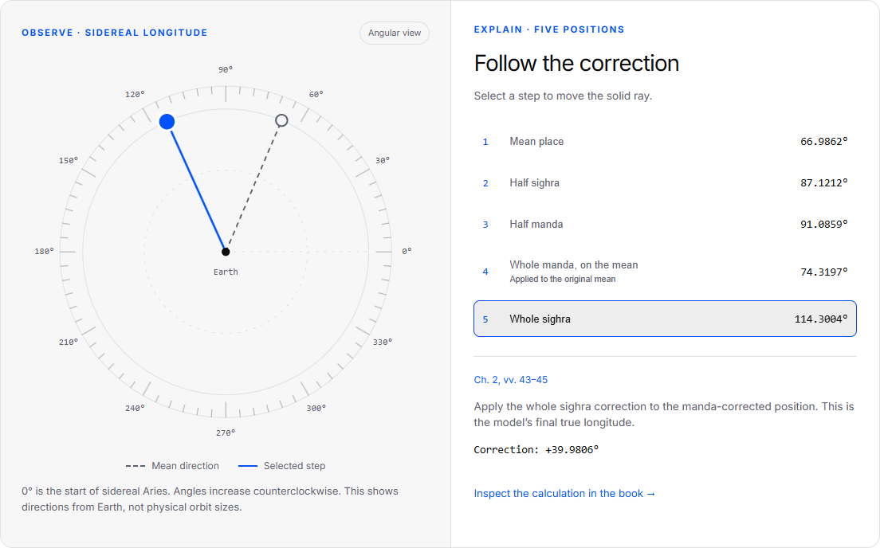
User Interface: Planetary Learning Paths
Eight paths: Sun, Moon, Mars, Mercury, Venus, Jupiter, Saturn and Rahu.
Mars is shown as a worked example. Each lesson links to its source calculation.
Notes:
Project source: MTP2_Project_Report_Ashutosh_Nigam.docx; src/suryasiddhanta; frontend/src. Author: Ashutosh Nigam, M25AI2006. Prepared 4 November 2026.
Screenshot: docs/presentation-assets/mars-learning-lab.png, captured from the implemented app. Explain the dashed mean direction and solid selected step. The diagram is angular, not to physical scale.

Slide 13
Key Algorithms: Mars Worked Example
Stage | Sidereal longitude
Mean place | 66.9862°
Half sighra | 87.1212°
Half manda | 91.0859°
Whole manda on the original mean | 74.3197°
Whole sighra, final position | 114.3004°
4 November 2026 · Ujjain mean time
Notes:
Project source: MTP2_Project_Report_Ashutosh_Nigam.docx; src/suryasiddhanta; frontend/src. Author: Ashutosh Nigam, M25AI2006. Prepared 4 November 2026.
Source: existing /book/chapter/2 endpoint, card ii.43–45. Date: 2026-11-04, midnight Ujjain mean time. All longitudes sidereal. The whole manda is applied to the original mean; do not sum it onto the half-manda row.

Slide 14
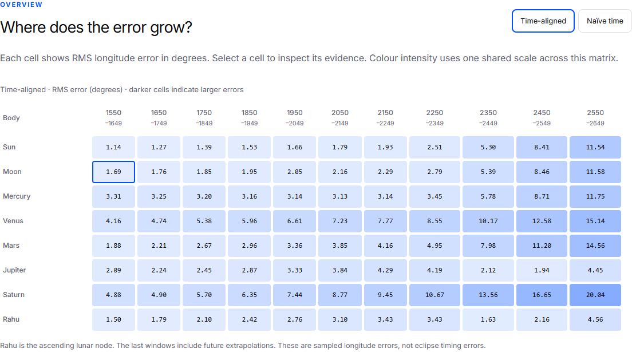
Comparative Analysis: Research Explorer
Notes:
Evidence: docs/evaluation/residuals_deltat.csv; residuals_naive.csv; century_deltat.csv; century_naive.csv; docs/evaluation/paper/surya-siddhanta-vs-de440.md. Snapshot hashes are embedded in frontend/src/pages/research/research-data.json. Existing study, not a new DE440 rerun.
Screenshot from the implemented RMS matrix. Each cell selects a body and window. Native selectors provide equivalent keyboard operation. Rahu is the ascending lunar node.

Slide 15
Comparative Analysis: Time Conventions
Moon · 1550–1649 CE
Treatment | RMS error | Mean signed error
Naïve time | 3.990° | -3.732°
Time-aligned | 1.686° | -0.975°
The reference time changes. The historical SS equations stay the same.
The time-aligned comparison uses the Ujjain meridian conversion and an approximate Delta-T model.
Notes:
Evidence: docs/evaluation/residuals_deltat.csv; residuals_naive.csv; century_deltat.csv; century_naive.csv; docs/evaluation/paper/surya-siddhanta-vs-de440.md. Snapshot hashes are embedded in frontend/src/pages/research/research-data.json. Existing study, not a new DE440 rerun.
Example: Moon, 1550–1649, 3652 ten-day samples. Naive treats library JD as TT. Time-aligned: TT = JD - 75.7873/360 + Delta-T/86400, using the study’s Espenak-Meeus approximation. Reduced RMS is not a fitted correction or proof that all other conventions are exact.

Slide 16
Comparative Analysis: Long-Term Error
Body | 1950–2049 | 2250–2349 | 2550–2649
Sun | 1.658° | 2.506° | 11.536°
Moon | 2.045° | 2.791° | 11.580°
Mars | 3.356° | 4.953° | 14.559°
Venus | 6.608° | 8.555° | 15.142°
Saturn | 7.436° | 10.671° | 20.043°
RMS of tropical longitude residuals · future dates are model extrapolations
Notes:
Evidence: docs/evaluation/residuals_deltat.csv; residuals_naive.csv; century_deltat.csv; century_naive.csv; docs/evaluation/paper/surya-siddhanta-vs-de440.md. Snapshot hashes are embedded in frontend/src/pages/research/research-data.json. Existing study, not a new DE440 rerun.
RMS longitude errors in degrees; time-aligned variant. Future windows are extrapolations of the adopted model. Do not interpret the table as observations or eclipse timing validation.

Slide 17
Project Contributions
A working, traceable
computational edition
Users can follow a source rule through each calculation step and inspect the comparison results.
Next steps: study learning outcomes, add worked examples and check more algorithms against the text.
Notes:
Project source: MTP2_Project_Report_Ashutosh_Nigam.docx; src/suryasiddhanta; frontend/src. Author: Ashutosh Nigam, M25AI2006. Prepared 4 November 2026.
References: Burgess (1860), Translation of the Surya-Siddhanta, JAOS 6:141–498; Srivastava (1982–83), Surya Siddhanta: Vigyan Bhashya; Park et al. (2021), DE440/DE441, AJ 161:105, doi:10.3847/1538-3881/abd414; Ashutosh Nigam (2026), repository evaluation manuscript.
Next work is proposed, not completed: learner evaluation, more guided lessons, and continued audits of remaining astronomical procedures.

Slide 18
Limitations
Historical interpretation
The library implements computable methods and documents its assumptions and remaining gaps.
Numerical comparison
Ten-day sampling can miss peak errors. Longitude comparisons alone do not verify event timing.
Educational use
Lessons include understanding checks. Their effect on student learning has not been measured.
Notes:
Project source: MTP2_Project_Report_Ashutosh_Nigam.docx; src/suryasiddhanta; frontend/src. Author: Ashutosh Nigam, M25AI2006. Prepared 4 November 2026.
These limits are also present in the updated report and the application method disclosure. Do not claim measured learning improvement, historical validation, or new model calibration.

Slide 19
Future Work
Check more algorithms against the source texts and document the remaining gaps.
Add more worked examples and calculations to the eight learning paths.
Run a structured student study to assess learning outcomes.
State the time conventions and data sources used in each numerical comparison.

Slide 20
References and Project Links
GitHub: mrashutoshnigam/Surya_Siddhanta
Paper manuscript: Running the Text (computational edition)
Paper manuscript: SS algorithms vs JPL DE440, 1550-2649 CE
Project report: implementation, learning paths and evaluation
Source text: Ebenezer Burgess, English translation (1860)
SS corpus: OCR, translation and corpus pipeline (GitHub)

Slide 21
Thank You
Ashutosh Nigam (M25AI2006)
Supervisor: Dr Dinesh Mohan Joshi

