Slide 1
MTech major project · MTP2
Computational edition of
the Surya Siddhanta
A Python library, traceable learning,
and interactive numerical evaluation
Ashutosh Nigam · M25AI2006
4 November 2026
Notes:
Project source: MTP2_Project_Report_Ashutosh_Nigam.docx; src/suryasiddhanta; frontend/src. Author: Ashutosh Nigam, M25AI2006. Prepared 4 November 2026.
Opening: the project makes historical rules executable and inspectable. The new interfaces expose the calculation and its evaluation; they do not invent new astronomical formulas.

Slide 2
Project objectives and contribution
Implement
Explain
Evaluate
Translate the computable procedures across all fourteen chapters into a reusable Python library.
Connect a chosen date to intermediate values, historical rules and verse references.
Expose the existing DE440 comparison with explicit frame, time and provenance information.
New additions: eight guided learning paths and the full Research Explorer
02
Notes:
Project source: MTP2_Project_Report_Ashutosh_Nigam.docx; src/suryasiddhanta; frontend/src. Author: Ashutosh Nigam, M25AI2006. Prepared 4 November 2026.
The Python library, chapter implementations, chat and evaluation study predate these additions. The new contribution is a coherent learning and evidence-inspection workflow.

Slide 3
One calculation core, several interfaces
Source texts
→
Chapter functions
→
Structured results
React + FastAPI
Chat + tool registry
External MCP client
Calculation and book routes
Same Python functions
for numerical answers
Same tool registry
through stdio transport
Saved DE440 data feeds the Research Explorer separately from the calculation core.
03
Notes:
Project source: MTP2_Project_Report_Ashutosh_Nigam.docx; src/suryasiddhanta; frontend/src. Author: Ashutosh Nigam, M25AI2006. Prepared 4 November 2026.
Architecture checked against api/main.py, chatbot/agent.py, chatbot/tools.py and mcp_server.py. MCP is stdio; React chat calls the tool registry in-process. It is not MQTT.

Slide 4
Computational scope across fourteen chapters
Chapters | Implemented subject areas
1–3 | Mean motion, true positions, place and time
4–6 | Eclipse calculations and projected geometry
7–11 | Conjunctions, stars, heliacal events, Moon and patas
12–14 | Cosmography, instruments and reckoning of time
Chapter modules remain the numerical source of truth; interfaces do not reimplement astronomy.
04
Notes:
Project source: MTP2_Project_Report_Ashutosh_Nigam.docx; src/suryasiddhanta; frontend/src. Author: Ashutosh Nigam, M25AI2006. Prepared 4 November 2026.
Coverage means the computable core, not every verse. Gradio and Streamlit remain legacy surfaces; new UI work is in React.

Slide 5
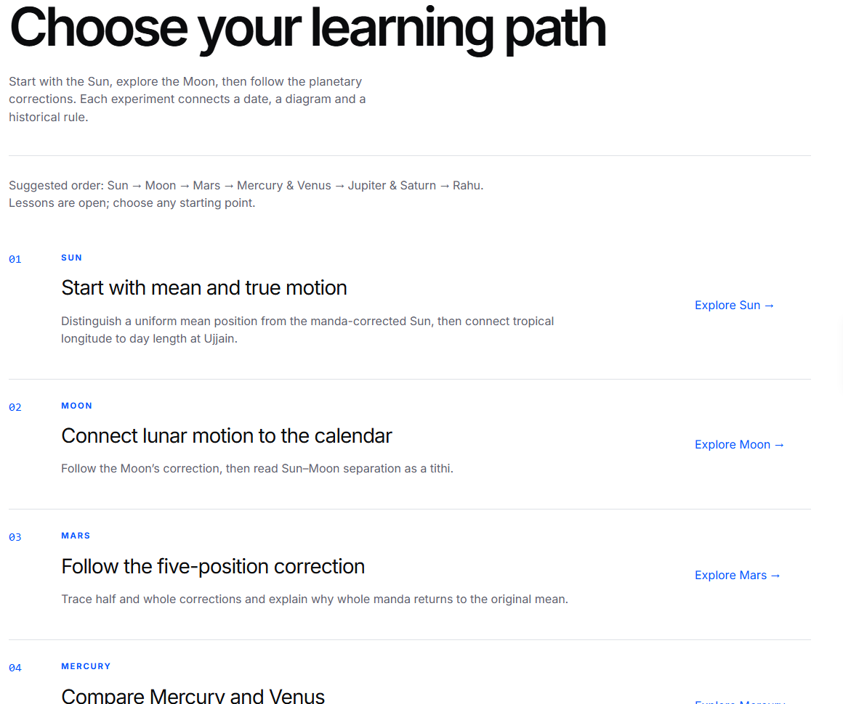
Eight guided learning paths
Sun and Moon
Mean and true motion, seasons,
elongation and tithi
Five planets
Correction stages and paired
comparisons on the same date
Rahu
Lunar nodes and eclipse geometry
05
Notes:
Project source: MTP2_Project_Report_Ashutosh_Nigam.docx; src/suryasiddhanta; frontend/src. Author: Ashutosh Nigam, M25AI2006. Prepared 4 November 2026.
Routes: /learn and /learn/{sun,moon,mars,mercury,venus,jupiter,saturn,rahu}. The directory screenshot is from the implemented application. All eight routes are implemented. Each body lesson uses existing book API results. Rahu is the lunar node.

Slide 6
The correction sequence is inspectable
Stage | Sidereal longitude
Mean place | 66.9862°
Half sighra | 87.1212°
Half manda | 91.0859°
Whole manda on the original mean | 74.3197°
Whole sighra, final position | 114.3004°
4 November 2026 · Ujjain mean time
The fourth step returns to the original mean. “True” denotes the corrected SS-model position.
06
Notes:
Project source: MTP2_Project_Report_Ashutosh_Nigam.docx; src/suryasiddhanta; frontend/src. Author: Ashutosh Nigam, M25AI2006. Prepared 4 November 2026.
Source: existing /book/chapter/2 endpoint, card ii.43–45. Date: 2026-11-04, midnight Ujjain mean time. All longitudes sidereal. The whole manda is applied to the original mean; do not sum it onto the half-manda row.

Slide 7
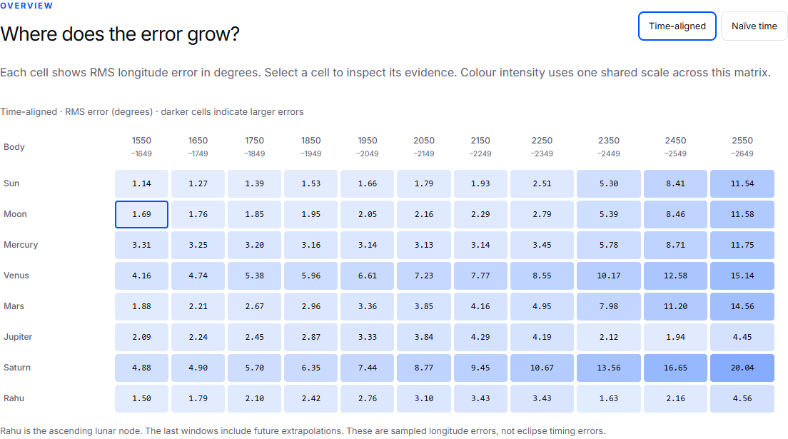
Research Explorer
07
Notes:
Evidence: docs/evaluation/residuals_deltat.csv; residuals_naive.csv; century_deltat.csv; century_naive.csv; docs/evaluation/paper/surya-siddhanta-vs-de440.md. Snapshot hashes are embedded in frontend/src/pages/research/research-data.json. Existing study, not a new DE440 rerun.
Screenshot from the implemented RMS matrix. Each cell selects a body and window. Native selectors provide equivalent keyboard operation. Rahu is the ascending lunar node.

Slide 8
Time conventions change the comparison
Moon · 1550–1649 CE
Treatment | RMS error | Mean signed error
Naïve time | 3.990° | -3.732°
Time-aligned | 1.686° | -0.975°
The reference epoch changes; the historical SS equations stay the same.
The time-aligned variant includes the Ujjain meridian conversion and an approximate Delta-T model.
08
Notes:
Evidence: docs/evaluation/residuals_deltat.csv; residuals_naive.csv; century_deltat.csv; century_naive.csv; docs/evaluation/paper/surya-siddhanta-vs-de440.md. Snapshot hashes are embedded in frontend/src/pages/research/research-data.json. Existing study, not a new DE440 rerun.
Example: Moon, 1550–1649, 3652 ten-day samples. Naive treats library JD as TT. Time-aligned: TT = JD - 75.7873/360 + Delta-T/86400, using the study’s Espenak-Meeus approximation. Reduced RMS is not a fitted correction or proof that all other conventions are exact.

Slide 9
Long-term error differs by body
Body | 1950–2049 | 2250–2349 | 2550–2649
Sun | 1.658° | 2.506° | 11.536°
Moon | 2.045° | 2.791° | 11.580°
Mars | 3.356° | 4.953° | 14.559°
Venus | 6.608° | 8.555° | 15.142°
Saturn | 7.436° | 10.671° | 20.043°
RMS of tropical longitude residuals · future dates are model extrapolations
09
Notes:
Evidence: docs/evaluation/residuals_deltat.csv; residuals_naive.csv; century_deltat.csv; century_naive.csv; docs/evaluation/paper/surya-siddhanta-vs-de440.md. Snapshot hashes are embedded in frontend/src/pages/research/research-data.json. Existing study, not a new DE440 rerun.
RMS longitude errors in degrees; time-aligned variant. Future windows are extrapolations of the adopted model. Do not interpret the table as observations or eclipse timing validation.

Slide 10
Verification and reproducibility
1,653
176
Python tests passed
body / window / treatment groups
checked against saved tables
Browser checks
Portable evidence
Eight lessons, date changes, retry,
source links, exports and mobile layout
JSON and CSV include source hashes,
conventions and sample counts
10
Notes:
Project source: MTP2_Project_Report_Ashutosh_Nigam.docx; src/suryasiddhanta; frontend/src. Author: Ashutosh Nigam, M25AI2006. Prepared 4 November 2026.
Current full repository run: PYTHONPATH=src python -m pytest -q => 1653 passed. npm run build passes. Browser scripts: frontend/check-learning-lab.cjs and check-research-explorer.cjs. The full Python suite passed after the learning-path expansion. Source-data checks do not rerun the DE440 kernel.

Slide 11
Limits of the evidence
Historical interpretation
The adopted implementation covers computable procedures, with documented choices and remaining gaps.
Numerical comparison
Ten-day sampling can miss extrema between samples. Longitude error does not validate event timing.
Educational use
The understanding check is implemented. Its effect on student learning has not been measured.
11
Notes:
Project source: MTP2_Project_Report_Ashutosh_Nigam.docx; src/suryasiddhanta; frontend/src. Author: Ashutosh Nigam, M25AI2006. Prepared 4 November 2026.
These limits are also present in the updated report and the application method disclosure. Do not claim measured learning improvement, historical validation, or new model calibration.

Slide 12
Live demonstration
1
Choose a learning path
Explore Sun, Moon and the correction stages.
2
Explain the geometry
Compare tithi, paired planets or lunar nodes.
3
Compare the model
Select a matrix cell and switch time treatments.
4
Export the evidence
Download reproducible statistics and conventions.
localhost:5173/learn · localhost:5173/research
12
Notes:
Project source: MTP2_Project_Report_Ashutosh_Nigam.docx; src/suryasiddhanta; frontend/src. Author: Ashutosh Nigam, M25AI2006. Prepared 4 November 2026.
Run the local FastAPI backend on port 8000 and Vite on 5173. The learning calculation needs the backend; verse text is optional. Research evidence is bundled locally. Use docs/learning-lab-demo.md for the step-by-step presentation script.

Slide 13
Contribution and next work
An executable and inspectable
computational edition
The new interfaces connect the historical rule, its intermediate calculation and the evidence used to evaluate it.
Next: measure learning outcomes and continue the source-based algorithm audits.
Sources and implementation references are recorded in the speaker notes.
13
Notes:
Project source: MTP2_Project_Report_Ashutosh_Nigam.docx; src/suryasiddhanta; frontend/src. Author: Ashutosh Nigam, M25AI2006. Prepared 4 November 2026.
References: Burgess (1860), Translation of the Surya-Siddhanta, JAOS 6:141–498; Srivastava (1982–83), Surya Siddhanta: Vigyan Bhashya; Park et al. (2021), DE440/DE441, AJ 161:105, doi:10.3847/1538-3881/abd414; Ashutosh Nigam (2026), repository evaluation manuscript.
Next work is proposed, not completed: learner evaluation, continued source audits, and broader teaching evaluation of remaining astronomical procedures.

