Slide 1
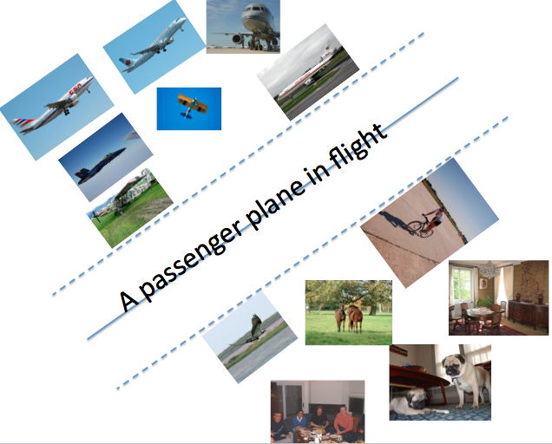
Review
CS 164 Project Final Presentation Mohammad Rastegari
Max-Margin Content Based Image Search

Slide 2
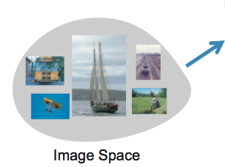
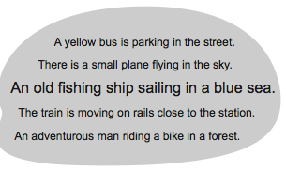
Review
How can we relate texts to images?
Meaning Space
Text Space

Slide 3
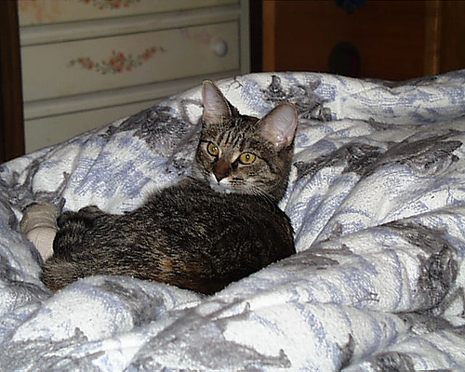
Let solve a smaller problem
Do this image and text have same semantics?
+1/YES
A cat sleeping on a bed
-1/No
A car parked in a street

Slide 4
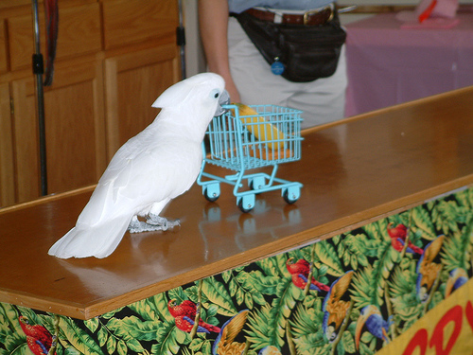
We can learn the semantic
+1/YES
A cat sleeping on a bed
-1/No
A car parked in a street
+1/YES
A bird standing on a table
-1/No
A cat looking at TV
.
.
.
.
.
.
.
.
.
.
.
.

Slide 5
We can learn the semantic
[visual feature image1]
+1/YES
[text feature sentence1]
[visual feature image1]
-1/No
[text feature sentence2]
[visual feature image2]
+1/YES
[text feature sentence3]
[visual feature image2]
-1/No
[text feature sentence4]
.
.
.
.
.
.
.
.
.
.
.
.

Slide 6
We can learn the semantic
[visual feature image1]
[text feature sentence1]
+1/YES
[visual feature image1]
[text feature sentence2]
-1/No
[visual feature image2]
[text feature sentence3]
+1/YES
[visual feature image2]
[text feature sentence4]
-1/No
.
.
.
.
.
.
.
.
.
.
.
.

Slide 7
We can learn the semantic
[visual feature image1 ,
text feature sentence1]
+1
[visual feature image1 ,
text feature sentence2]
-1
[visual feature image2 ,
text feature sentence3]
+1
[visual feature image2 ,
text feature sentence4]
-1
.
.
.
.
.
.
.
.

Slide 8
Apply a classifier (SVM)
[visual feature image ,
text feature sentence]
SVM
+1/-1

Slide 9
Feature Extraction
Text Features:
Bag-of-Words does not work for low number of sentences.
Words Similarity Model can be used as an alternative.
Car
Bus - Person - Street - ……. - Dog - Sun - Walking
S(1) - S(2) - S(3) - ……. - S(k) - S(k+1) - S(K+2)
NLP Lab at UIUC

Slide 10
Feature Extraction
Image Features
Classemes (Torresani, et al. ECCV10)
Visual Features are a combination of scene descriptors and object detection histogram (The Same as used in Farhadi, et al. ECCV10)

Slide 11
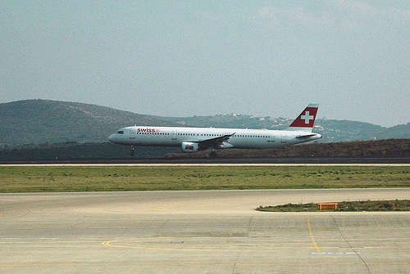
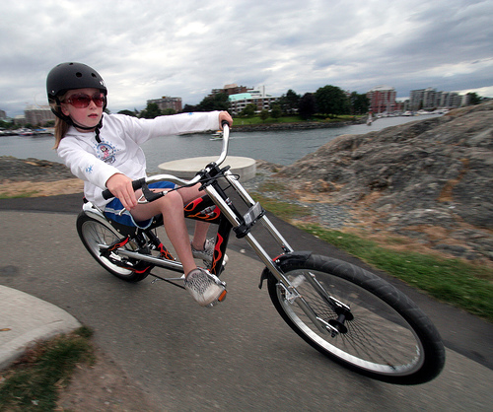
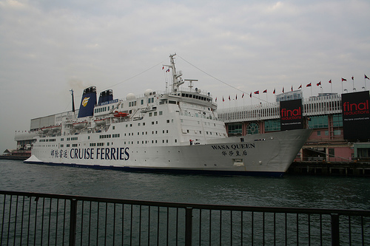
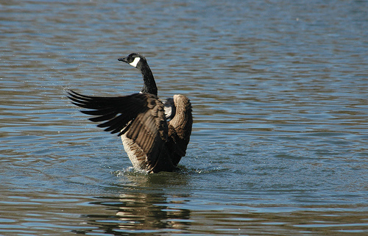
Qualitative Result
The white airplane is flying
The girl is riding her bicycle down the road.
A black swan flapping its wings on the water.
A docked cruise ship.

Slide 12
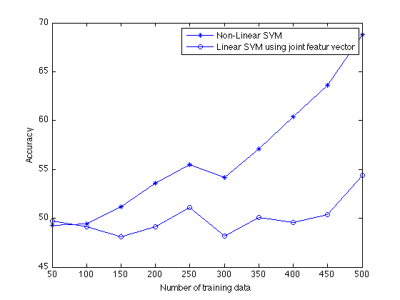
Quantitative Result

Slide 13
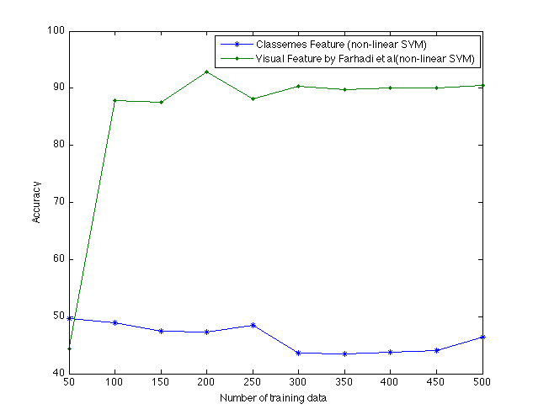
Classemes
Classemes designed to describe an image containing one object

Slide 14
Semantic Image Descriptor
Creating A non-Linear semantically descriptor for Images.
T1
A man smiling in a restaurant
A man seating on achair
T2
A man smiling in a restaurant
A man smiling in a restaurant
A man smiling in a restaurant
A man smiling in a restaurant
Clustering(Kmeans)
T4
A dog jumping in a forest
A man smiling in a restaurant
A man smiling in a restaurant
A cat sleeping on abed
T3
A cat sleeping on abed
A cat sleeping on abed
A cat sleeping on abed
A man smiling in a restaurant
T5
A cat sleeping on abed
A man smiling in a restaurant

Slide 15
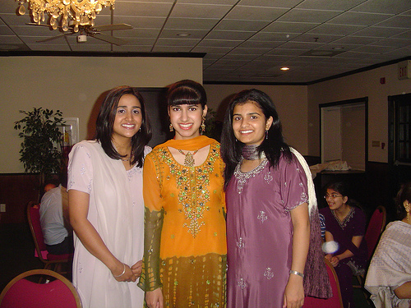
Semantic Image Descriptor
T1
T2
T4
T3
[ H(I,T1), ]
T5
H(I,T1) is a hypothesis that comes from the result of SVM which learned before

Slide 16
Semantic Image Descriptor
T1
T2
T4
T3
[ H(I,T1), H(I,T2) ]
T5
H(I,T1) is a hypothesis that comes from the result of SVM which learned before

Slide 17
Semantic Image Descriptor
T1
T2
T4
T3
[ H(I,T1), H(I,T2), H(I,T3) ]
T5
H(I,T1) is a hypothesis that comes from the result of SVM which learned before

Slide 18
Semantic Image Descriptor
T1
T2
T4
T3
[ H(I,T1), H(I,T2) , H(I,T3) , H(I,T4) ]
T5
H(I,T1) is a hypothesis that comes from the result of SVM which learned before

Slide 19
Semantic Image Descriptor
T1
T2
T4
T3
[ H(I,T1), H(I,T2) , H(I,T3) , H(I,T4) , H(I,T5)]
T5
H(I,T1) is a hypothesis that comes from the result of SVM which learned before

Slide 20
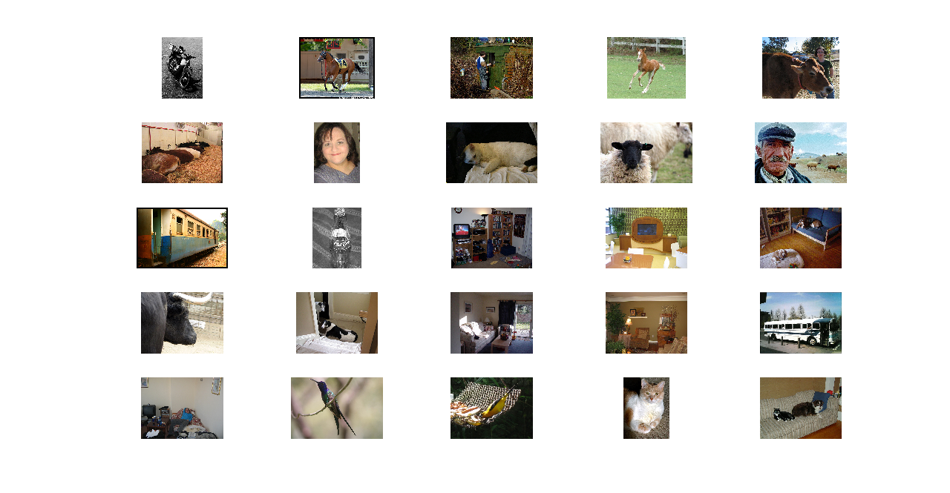
Qualitative Result
Random 5 Nearest Neighbors with 20 text cluster centers

Slide 21
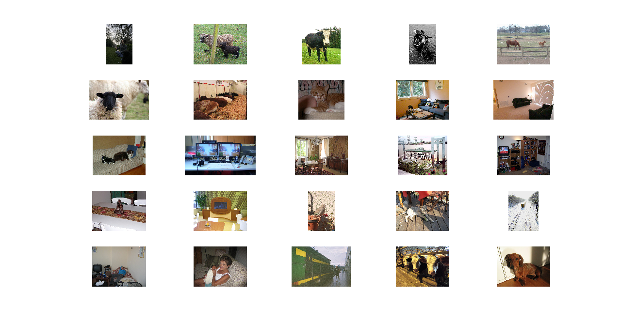
Qualitative Result
Random 5 Nearest Neighbors on binarized semantic descriptor

Slide 22
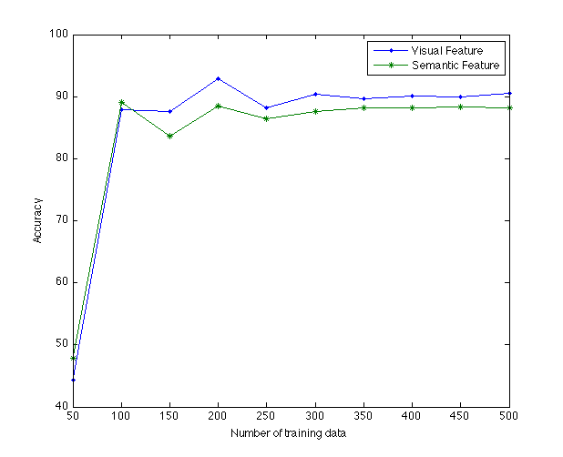
Quantitative Result

