Slide 1
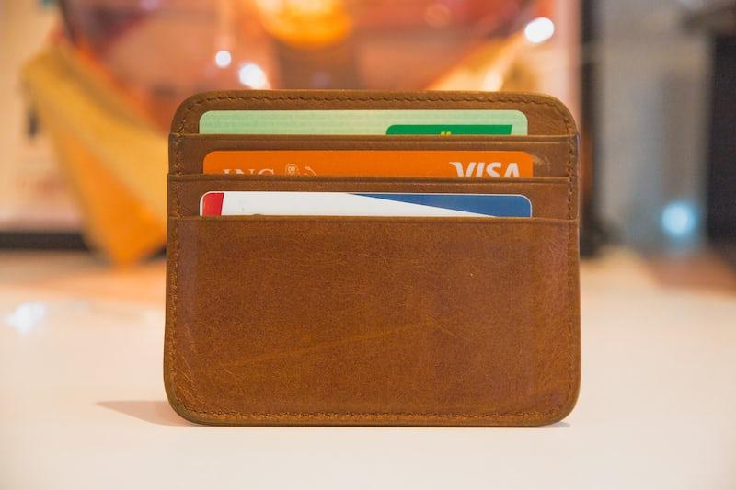
Wallet
By
Maminiaina, Christelle, Amanda

Slide 2
Card Validator Application Using .NET MAUI
An application that checks for the validity of a credit card number and identifies its type (Visa, MasterCard, Amex or Unknown) using the Luhn algorithm.

Slide 3
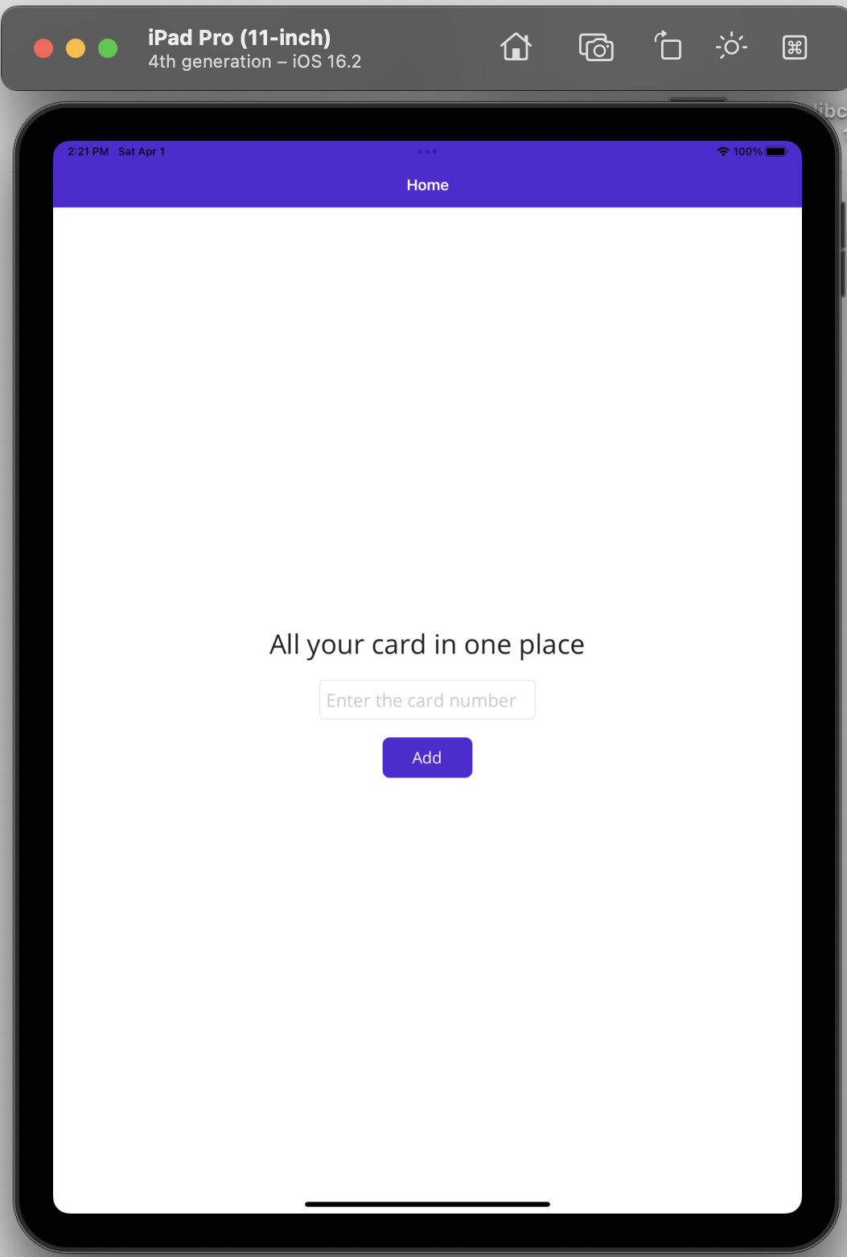
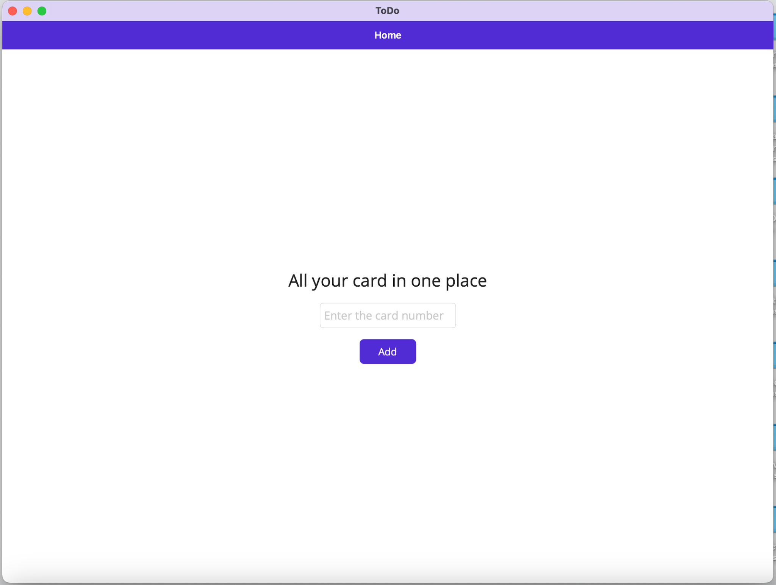
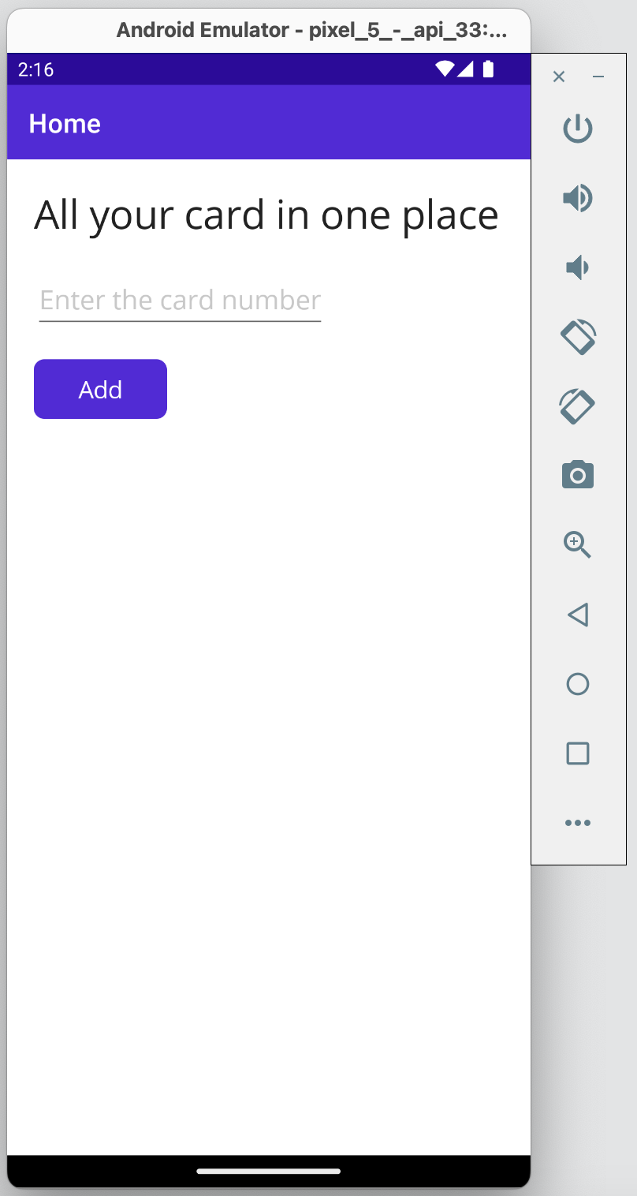
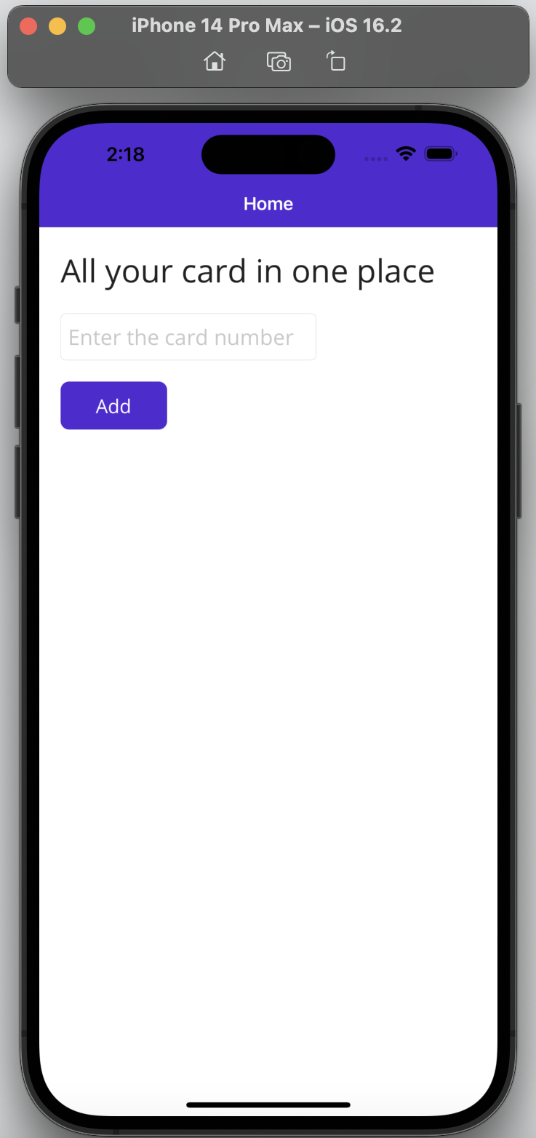
Introduction
- The Card Validator is a .NET MAUI application that checks the validity of a credit card number and identifies its type, then store it if it is a valid number.
- The app can run on IOS, Android, MacOs, Windows
Photo by Pixabay

Slide 4
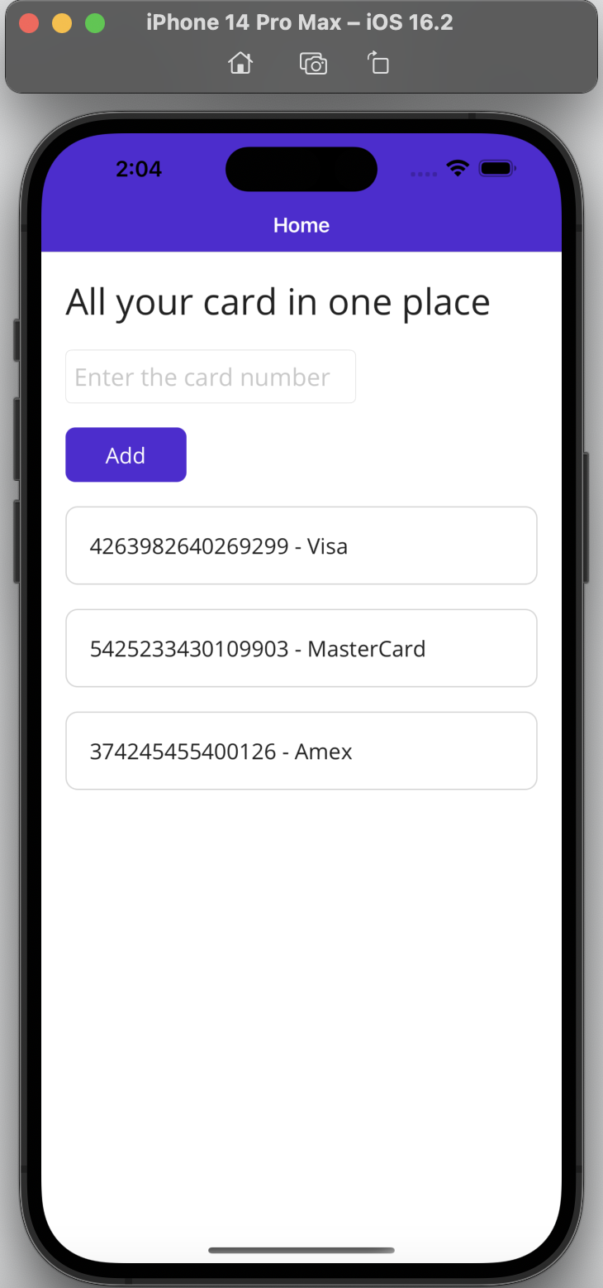
User Interface
The application has a simple user interface
1) a single text box to input the credit card number
2) a button to submit the number for validation.
3) When the validation is successful, a label is added to the stack layout showing the credit card number and its type.
1
2
3
Photo by Pixabay

Slide 5
Usage
- To use the application, run it on your local machine or emulator
- Input a credit card number into the text box provided.
- The application will add a label showing the card number and its type (Visa, MasterCard, Amex or Unknown) to the stack layout if the card number is valid.
- An error message will be displayed if the card number is invalid.
Photo by Pixabay

Slide 6
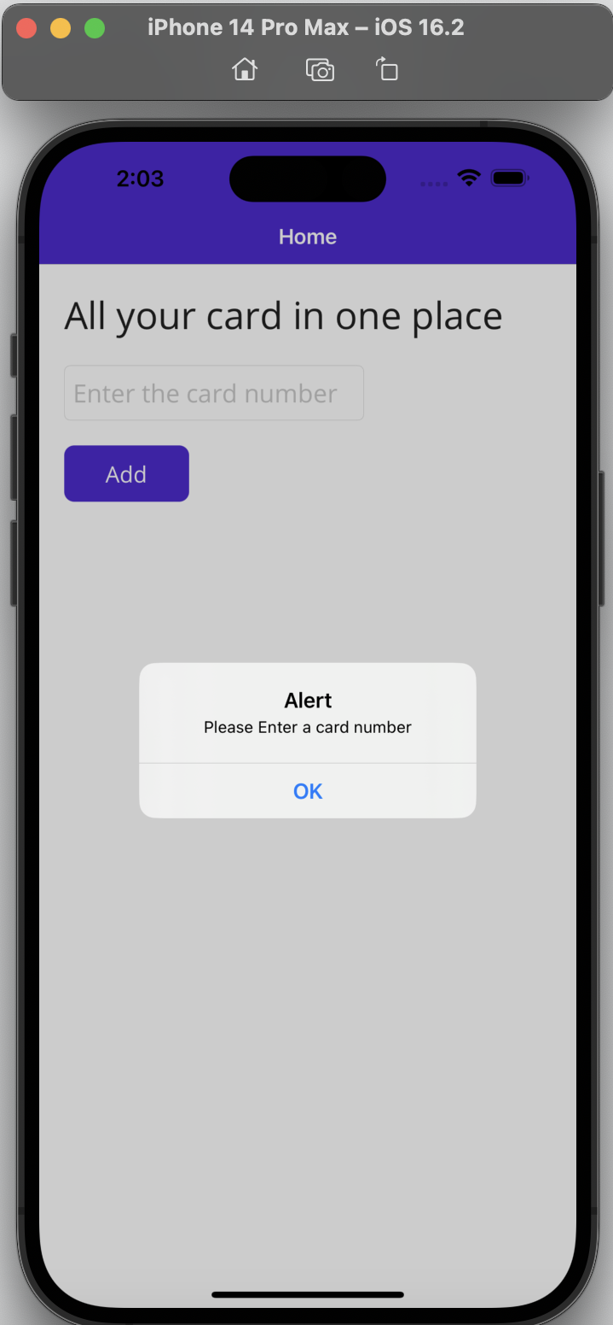
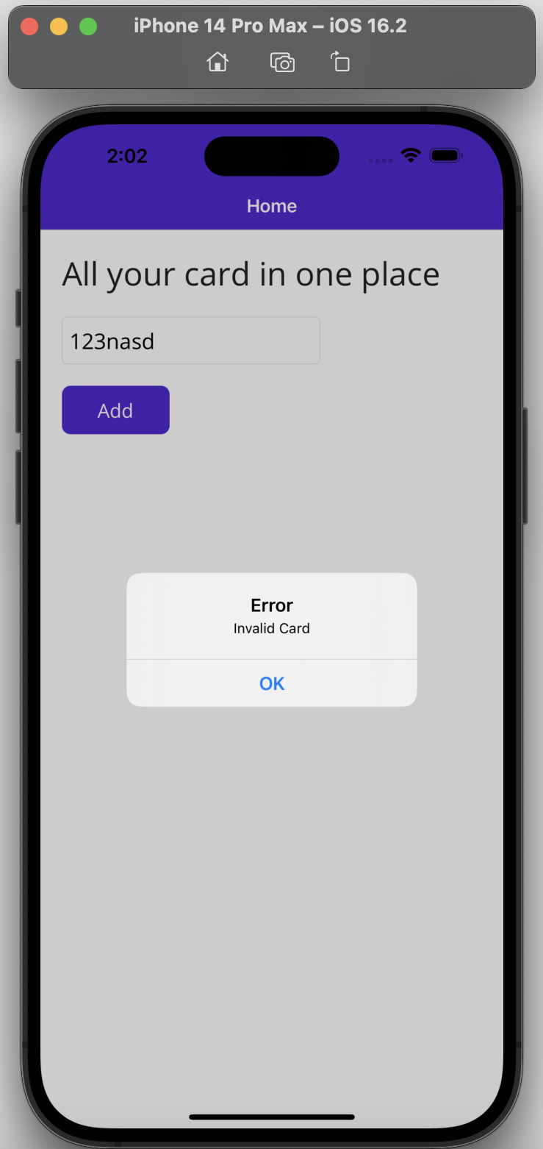

Slide 7
The C# Code
Let’s dig into the code

Slide 8
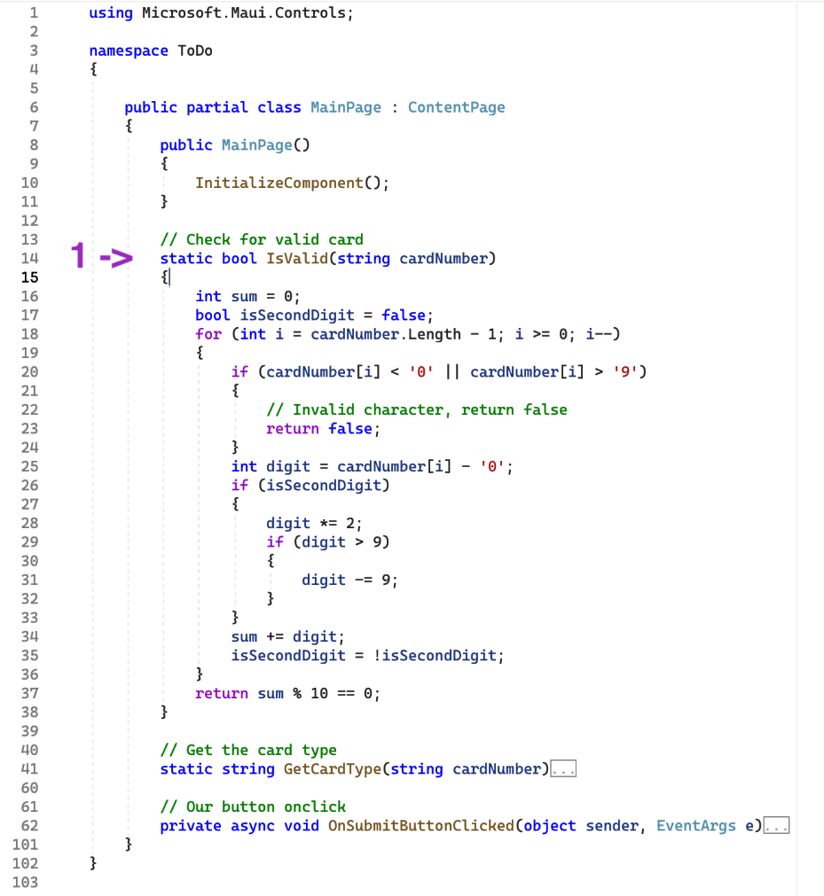
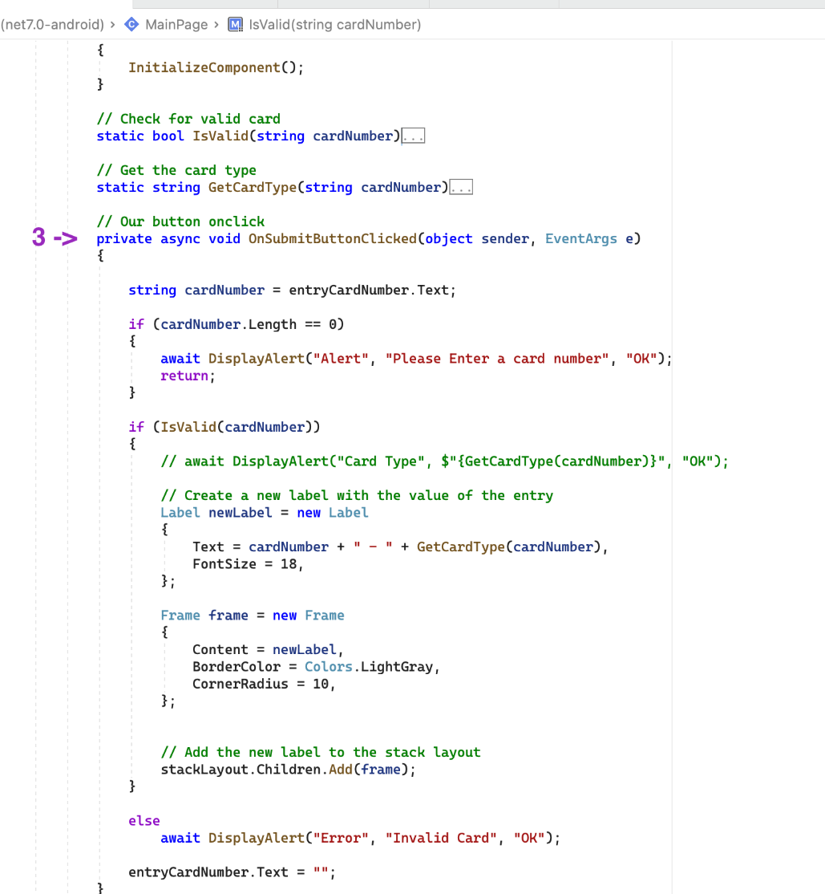
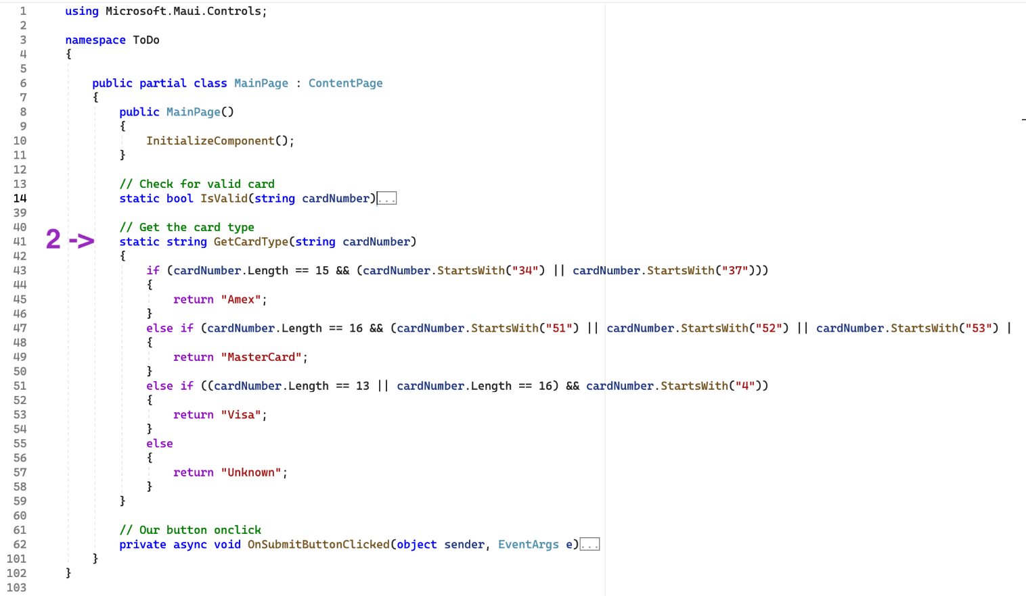
Photo by Pixabay

Slide 9
Photo by Pixabay

Slide 10
Photo by Pixabay

Slide 11
How does the code works
- The application uses the Luhn algorithm to check the validity of the entered credit card number.
- It identifies the type of the credit card based on the first few digits of the card number.
- A new label is created with the card number and its type, and added to the stack layout if the card number is valid.

Slide 12
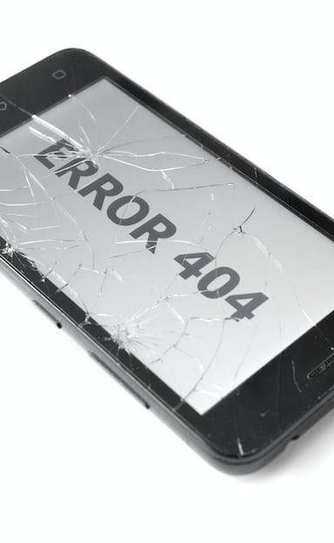
Issues Encountered
- Compatibility issues with macOS version, Xcode and .NET MAUI installation errors were encountered while working on a macOS desktop.
- Few issues related to dependencies or libraries were also encountered.
- They were resolved by updating the software, reinstalling or repairing the installation, and troubleshooting dependencies and libraries.
Photo by Pixabay

Slide 13
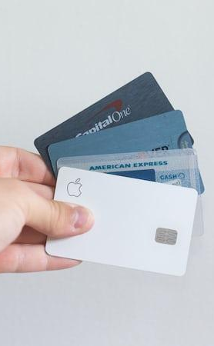
Future improvements
- Adding support for additional credit card types
- improving the user interface
- adding support for international credit card numbers.
- expiration date validation, CVV validation, and more.
Photo by Pixabay

Slide 14
Conclusion
Microsoft .NET MAUI is a powerful cross-platform framework that allows developers to create high-quality applications for multiple devices and platforms with ease.

Slide 15
Ressources
Microsoft .NET MAUI website is an excellent resource for developers looking to learn more about this framework.

Slide 16
Thank you for your time 😊

