Slide 1


Facebook – Native Ads SDK Integration
August 29, 2017

Slide 2
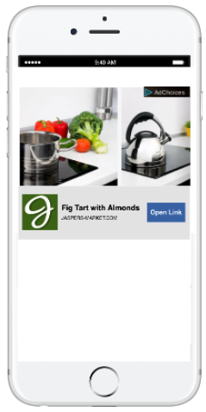
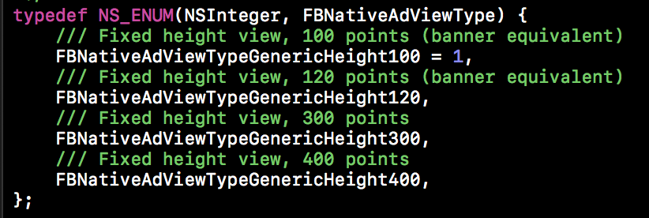


Overview
Custom Audience Network Native Ads Templates
Four Templates available to publishers seeking a more hands-off approach to integration with the Native Ads SDK
Flexibility to customize an ad’s size, color, and font to match the look and feel of the application
Integrated with Leanplum via a single variable that determines the FBNativeAdViewType
Custom Native Ad Views
Native Ad API enables publishers to build customized in-app ad experiences
Rather than receiving an ad ready for display, publishers receive a group of ad properties (title, image, call to action)
In conjunction with Leanplum variables, these ad properties can be manipulated and dynamically updated

Slide 3
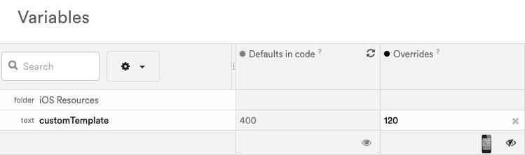

Custom Audience Network Native Ad Templates
LP Integer Variable – controls the ad View Type to display
OnVariablesChangedAndNoDownloadsPending Callback – callback in the nativeAdDidLoad() method in the ViewController.m file to ensure all content is up to date
If…Else Block – inside the LP Callback construct the Native Ad view based on the value of the LP customTemplate variable
Template View Type | Height | Attributes Included
FBNativeAdViewTypeGenericHeight100 | 100dp | icon, title, context, CTA button
FBNativeAdViewTypeGenericHeight120 | 120dp | icon, title, context, description, CTA button
FBNativeAdViewTypeGenericHeight300 | 300dp | image, icon, title, context, description, CTA button
FBNativeAdViewTypeGenericHeight400 | 400dp | image, icon, title, subtitle, context, description, CTA button

Slide 4
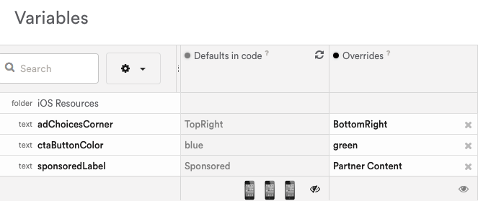

Custom Native Ad Views
Ad Properties – 8 UI elements required for displaying a native ad
LP String Variables – configured in the ViewController.m file to drive the customization of specific ad properties
nativeAdDidLoad() – conditionals inside LP callbacks to drive customization based on the values of LP string variables

Slide 5
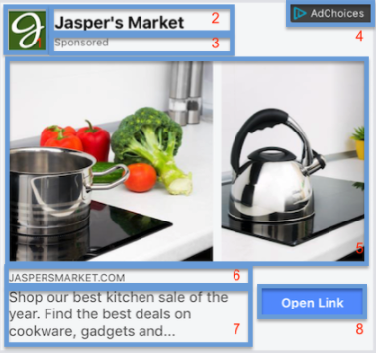
Ad Properties Overview
Key | Ad Property Name | Implementation Name | Class
1 | advertiser icon | adIconImageView | UIImageView
2 | ad title | adTitleLabel | UILabel
3 | sponsored label | sponsoredLabel | UILabel
4 | advertiser choice label | adChoiceView | FBAdChoicesView
5 | ad media view | adCoverMediaView | FBMediaView
6 | social context | adSocialContext | UILabel
7 | ad body | adBodyLabel | UILabel
8 | ad call to action button | adCallToActionButton | UIButton
RESOURCES:
Native Ad Templates: https://developers.facebook.com/docs/audience-network/ios/nativeadtemplate
Custom Native Ads: https://developers.facebook.com/docs/audience-network/ios-native

