Slide 1
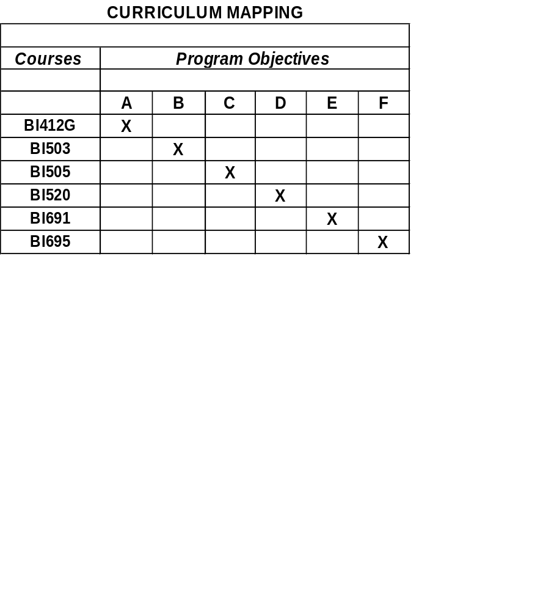
CURRICULUM MAPPING
CURRICULUM MAPPING
College of Natural and Applied Sciences
Degree
Master of Science in
Biology
8 Faculty:
From CNAS, WERI & Marine Lab
Core Program Learning Objectives
A. Demonstrate ability to analyze data and design experiments using standard statistical procedures
B. Demonstrate ability to write highly technical scientific reports and articles
C. Demonstrate a knowledge of basic organismal and ecological principles
D. Demonstrate a knowledge of basic cellular and molecular-level principles
E. Demonstrate a knowledge of the latest advances in a variety of fields in biology
F. Demonstrate ability to conceive, conduct and report original research
Assessment Tool Used to Measure Selected Program Objectives:
Achieve a grade of B or better in all coursework (2 C rule)
Demonstrate knowledge and tools obtained in coursework in development and completion of a thesis research project
Assessment of Core Program Learning Objectives A - E
Assessment Tool Used to Measure Selected Program Objectives:
Evaluation and approval of thesis proposal and completed thesis by the student’s Thesis Committee following publication presentation of research proposal and research results in seminars open to Guam’s scientific community
Assessment of Core Program Learning Objective F
Comprehensive Assessment of the Graduate Biology Program
Evaluate the performance of students and faculty in meeting the objectives of the Graduate Biology Program
Assessment Tool Used to Evaluate the Graduate Biology Program:
Survey of graduates, non-graduates and currently active students in BIOL Program
Evaluation of professional activities of BIOL Program faculty, i.e. Publications in peer reviewed journals, publications with student co-authors, presentations at scientific meetings, other professional activities
Evaluation of institutional support of the university’s for BIOL Program Activities
Completed Assessment or Other Assessment Activities
Ongoing Outcomes from Assessments
A Comprehensive BIOL Program Self Study will be completed by December 2007 as part of an ongoing 6-year Program Review. The program self study included the following items:
Written survey seeking student and graduate input into various aspects of the BIOL Program.
Evaluation of the status of professional journals accepting Graduate Biology student theses for publication completion of MS degree requirements
Determination of the employment/continuing status of students successfully completing degree requirements of the program
Analysis of factors contributing to students not completing all requirements for MS degree in Biology
Evaluation of institutional support to the BIOL Program, including student work space, laboratories, office space, facility maintenance, etc.
Consideration is being given to altering core class requirements to reflect changes in the disciplines comprising Graduate Biology
Consideration is given to enhancing on-line access to information about the BIOL Program research activities members’ research
Efforts are underway to streamline the admissions process and to develop on-line admission capabilities for BIOL Program applicants.

