Slide 1
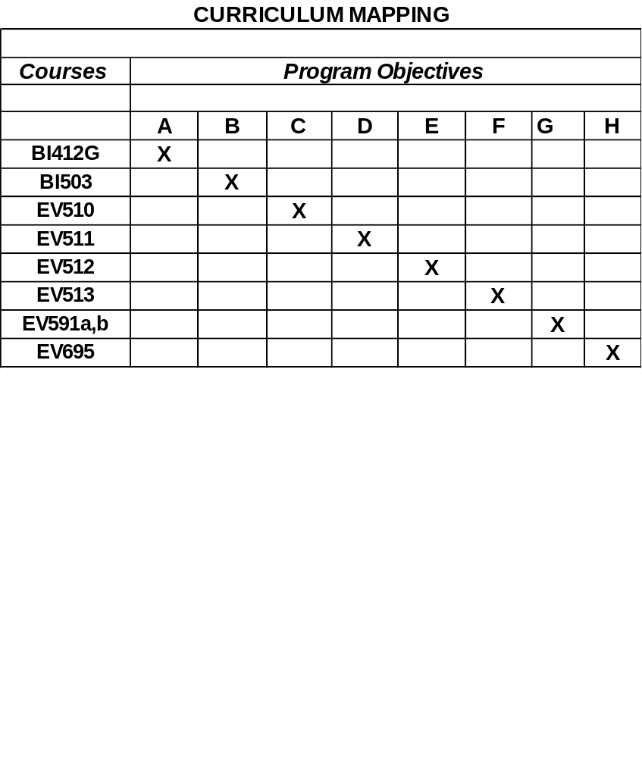
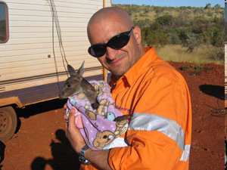
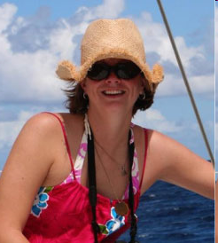
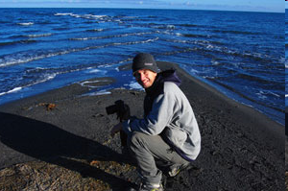
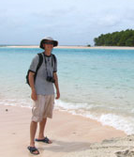
CURRICULUM MAPPING
CURRICULUM MAPPING
College of Natural and Applied Sciences
Degree
Master of Science in
Environmental Science
21 Faculty:
From CNAS, CLASS, WERI & Marine Lab
Core Program Learning Objectives
A. Demonstrate ability to analyze data and design experiments using standard statistical procedures
B. Demonstrate ability to write highly technical scientific reports and articles
C. Demonstrate a knowledge of basic biological and ecological principles
D. Demonstrate a knowledge of basic geosciences and engineering principles
E. Demonstrate a knowledge of management of environmental resources
F. Demonstrate a knowledge of environmental impact assessment
G. Demonstrate a knowledge of current topics and research activities related to environmental science in the literature and in Guam
H. Demonstrate ability to conceive, conduct and report original research
Assessment Tool Used to Measure Selected Program Objectives:
Achieve a grade of B or better in all coursework (2 C rule)
Demonstrate knowledge and tools obtained in coursework in development and completion of a thesis research project
Assessment of Core Program Learning Objectives A - F
Assessment Tool Used to Measure Selected Program Objectives:
Evaluation and approval of thesis proposal and completed thesis by the student’s Thesis Committee following publication presentation of research proposal and research results in seminars open to Guam’s scientific community
Assessment of Core Program Learning Objective G.
Comprehensive Assessment of the Environmental Science Program
Evaluate the performance of students and faculty in meeting the objectives of the Environmental Science Program
Assessment Tool Used to Evaluate the Environmental Science Program:
Survey of graduates, non-graduates and currently active students in EV Program
Evaluation of professional activities of EV Program faculty, i.e. Publications in peer reviewed journals, publications with student co-authors, presentations at scientific meetings, other professional activities
Evaluation of institutional support of the university’s for EV Program Activities
Completed Assessment or Other Assessment Activities
Student Learning Assessment
A Comprehensive EV Program Self Study was completed in December 2006 as part of an ongoing 6 year Program Review. The program self study included the following items:
Written survey seeking student and graduate input into various aspects of the EV Program.
Evaluation of the status of professional journals accepting Environmental Science student theses for publication completion of MS degree requirements
Determination of the employment/continuing status of students successfully completing degree requirements of the program
Analysis of factors contributing to students not completing all requirements for MS degree in Environmental Science
Evaluation of institutional support to the EV Program, including student work space, laboratories, office space, facility maintenance, etc.
Since 1997, some twenty-nine graduates have earned their Master
of Environmental Science Degree from the University of Guam’s
Graduate Environmental Science Program. A concerted effort was
recently undertaken to survey our graduates to obtain an assessment
of our program from their perspective. The following are some
excerpted comments from this survey. A more complete version can
be found at,
www.uog.edu/dynamicdata/CNASEnviroScienceTestimonials.aspx?siteid=2&p=498
(1) “The Masters of Environmental Science program at the
University of Guam is a well designed and robust curriculum.”
(2) “I have called upon the knowledge that I acquired in UOG’s
Environmental Science program many times during my career
as a hydrogeologist.”
(3) “I quickly landed a fantastic job.”
(4) “The program -- like its institution and location -- is a
truly singular blend of American standards, island lifestyle, Asia
Pacific setting, and an international outlook.”
Closing the Loop
Evidence
Action taken
Problem: Enrollment declines, and loss
of students to outside employment.
Dramatic decline of Guam public
teacher enrollment in the 1990s.
(2) Loss of several graduate students
to outside employment before they
could complete thesis work.
(3) Student survey critiques of the
EV Program.
(4) Program Review findings and
recommendations.
Environmental Science Program Revision
to include a thesis (Research) and non-thesis
(Professional) option.
Thesis (Research) option for those desiring to
continue on to PhD or other research pursuits
Non-Thesis (Professional) option for those already
In careers who need advanced degree, but lack
time (or need) for pursuit of thesis.

