Slide 1
Gun Laws & Gun Deaths
Maxfield Raynolds
Data 608
Spring 2026
Story 3
Focus: Chart Selection

Slide 2
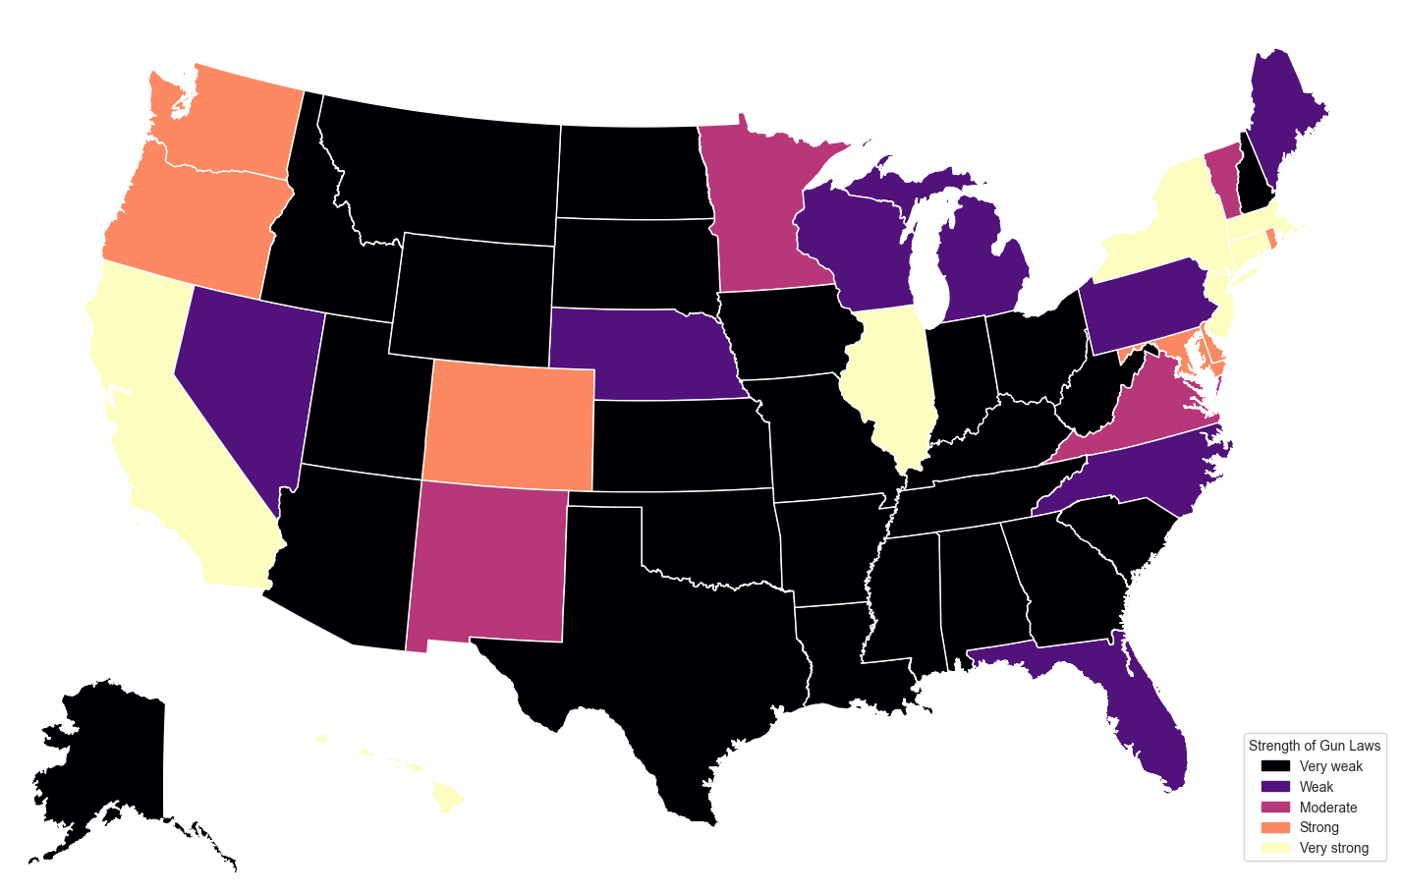
The 2nd Amendment and the United States Federal system allows for wide range of strictness among gun laws…
Do stricter gun laws help reduce firearm mortality?

Slide 3
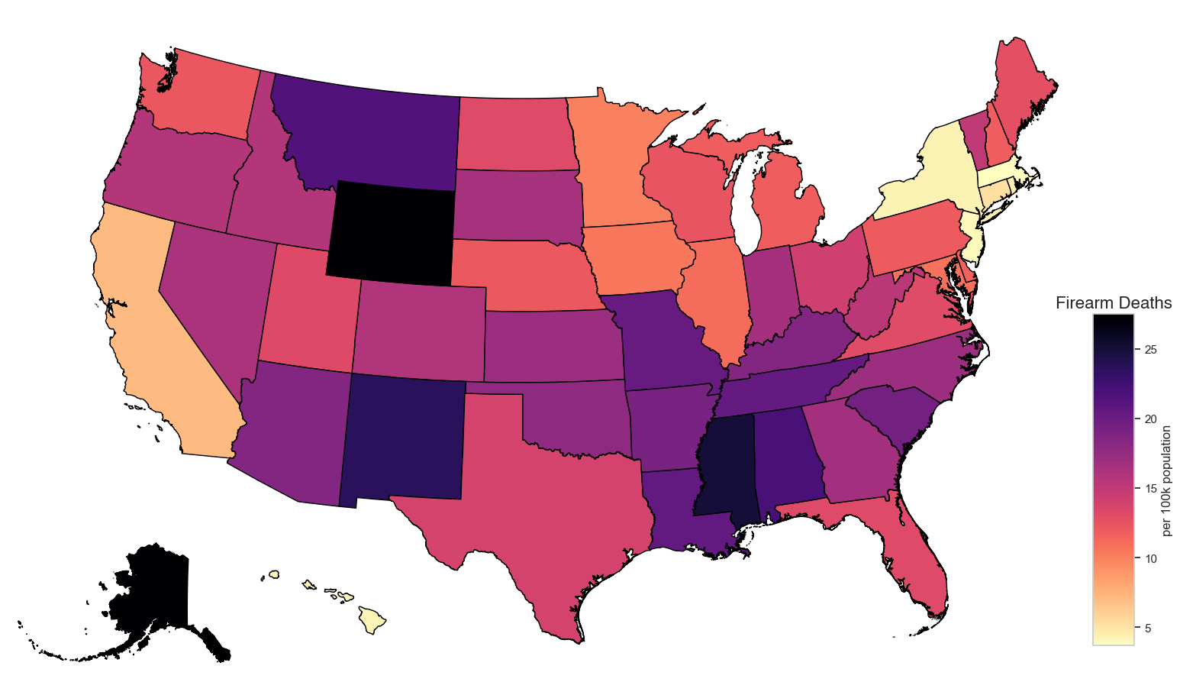
Firearm Deaths per 100k

Slide 4
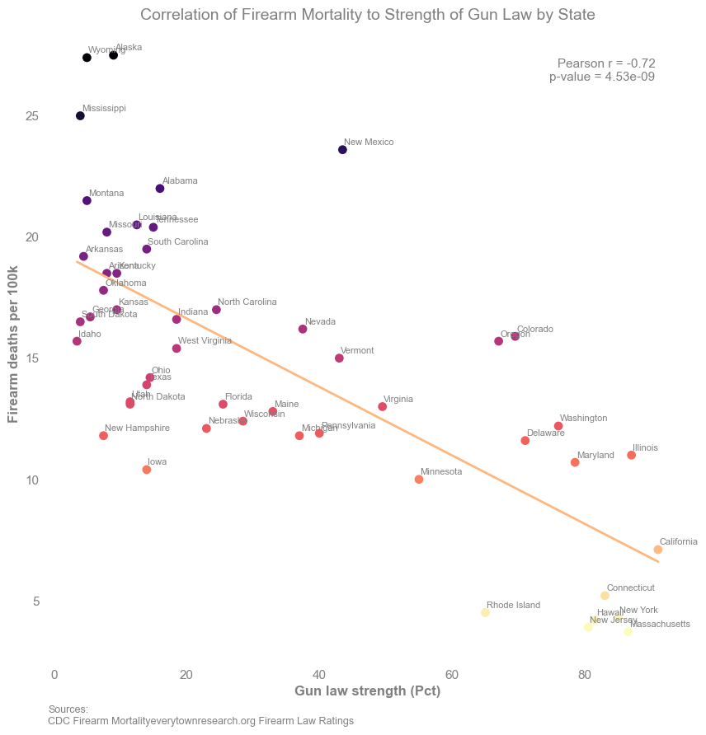
Pearson’s correlation indicates that at -0.72, with a p-value <0.0000001, there is a statistically significant negative correlation between Firearm Deaths and Strict Gun Laws
This correlation indicates that stricter gun laws DO reduce firearm mortality.

