Slide 1
Gun Laws & Gun Deaths
Maxfield Raynolds
Data 608
Spring 2026
Story 3
Focus: Chart Selection

Slide 2
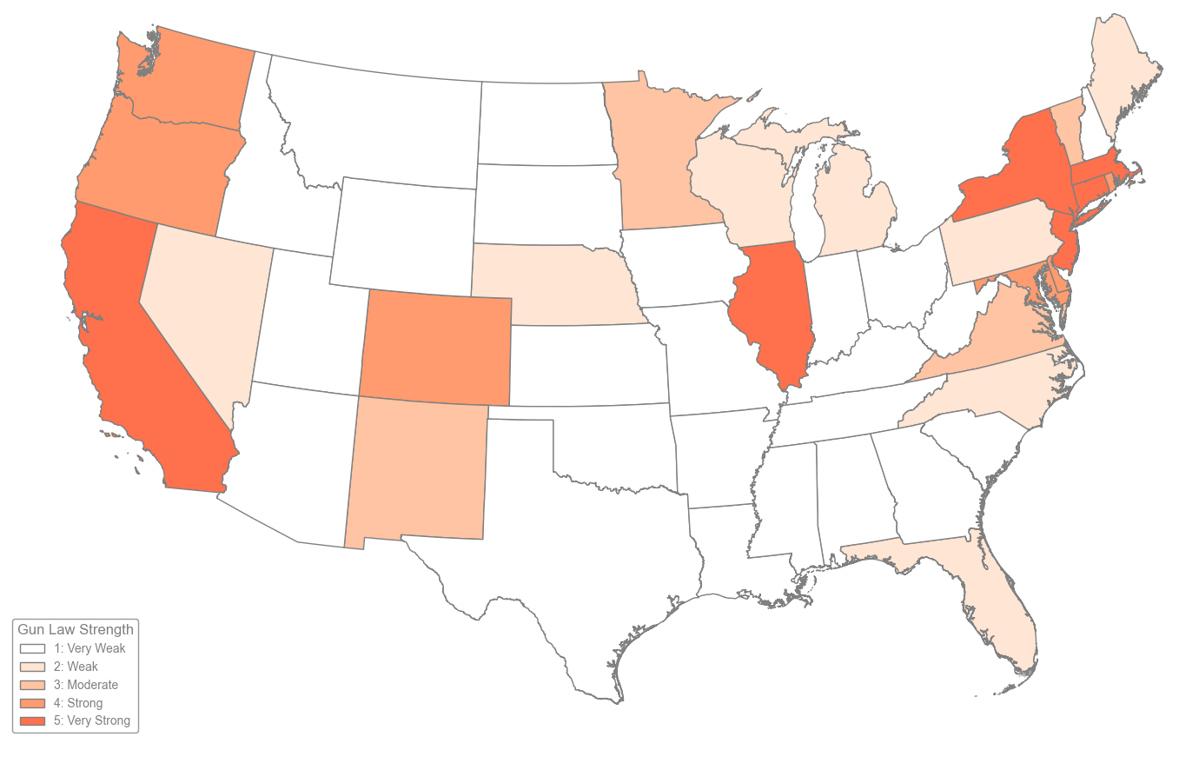
Gun law strength
Every state has different laws to control firearms.
Do differences in the strength of gun laws affect firearm deaths in US states?

Slide 3
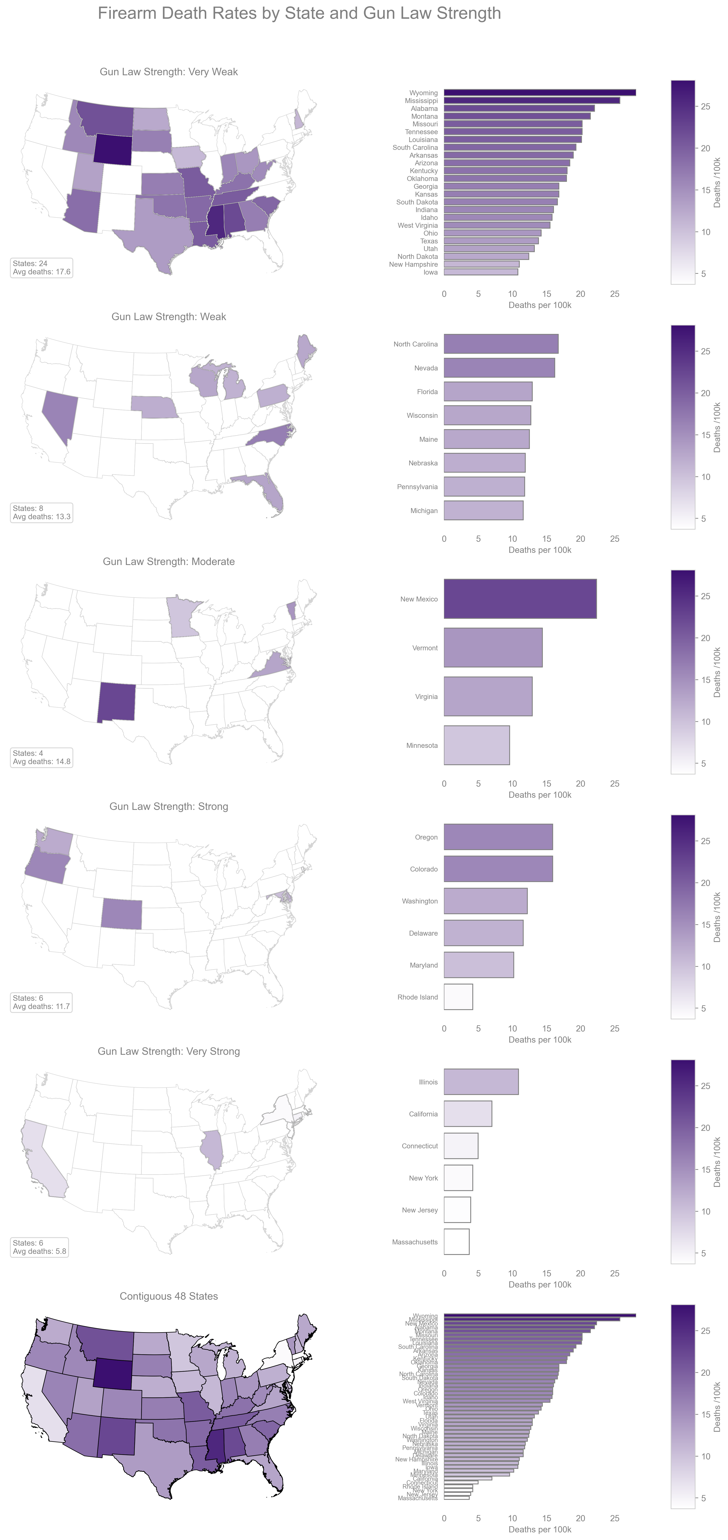
Very weak gun laws
States with very weak gun laws average 17.6 firearm deaths per 100k people
and a high of more than 25 firearm death per 100k people.

Slide 4
Weak gun laws
States with weak gun laws average 13.3 firearm deaths per 100k people .

Slide 5
Moderate gun laws
States with moderate gun laws average 14.8 firearm deaths per 100k people .

Slide 6
Strong gun laws
States with strong gun laws average 11.7 firearm deaths per 100k people .

Slide 7
Very strong gun laws
States with very strong gun laws average 5.8 firearm deaths per 100k people .

Slide 8
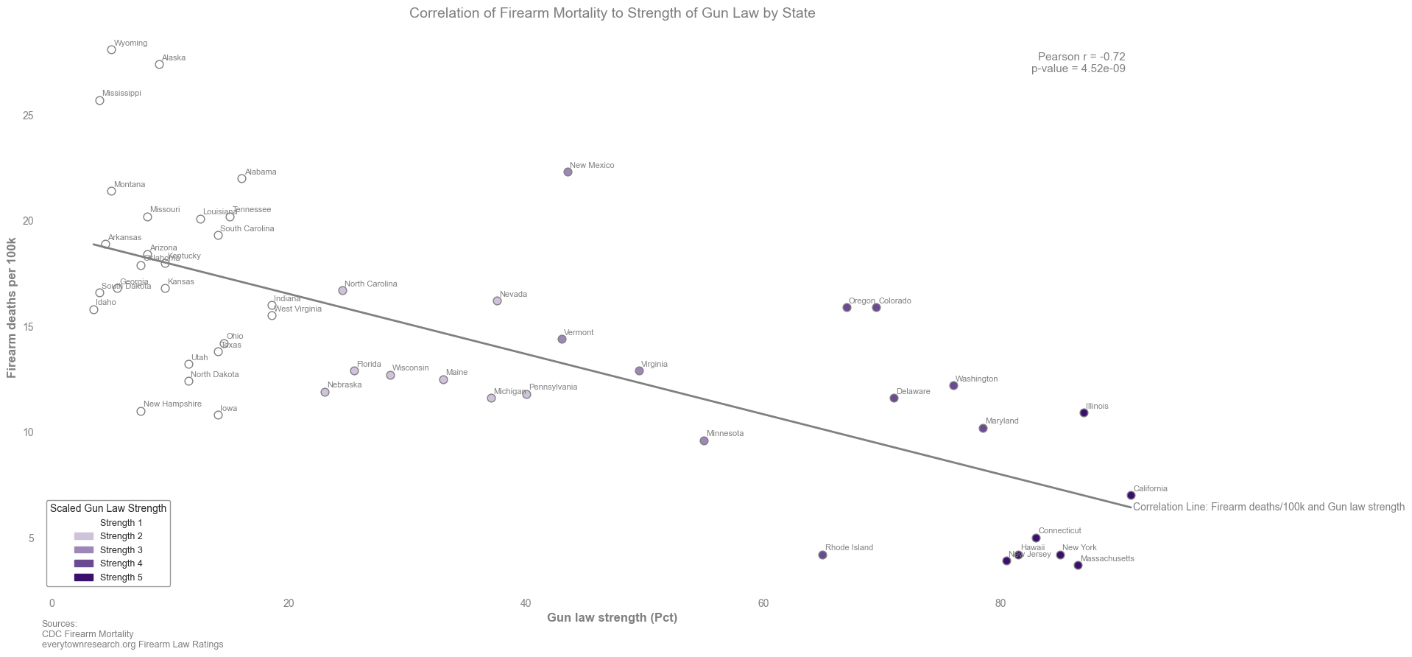
Correlation: Gun Laws & Firearm Deaths
There is a strong negative correlation between an increase in the strength of firearm laws and a decrease in firearm deaths. In other words:
When laws get stronger, firearm deaths decrease.

