Slide 1
The Fed Paradox: Inflation & Employment
Maxfield Raynolds
Data 608
Story 2
February 22, 2026
Focus: Chart Focus

Slide 2
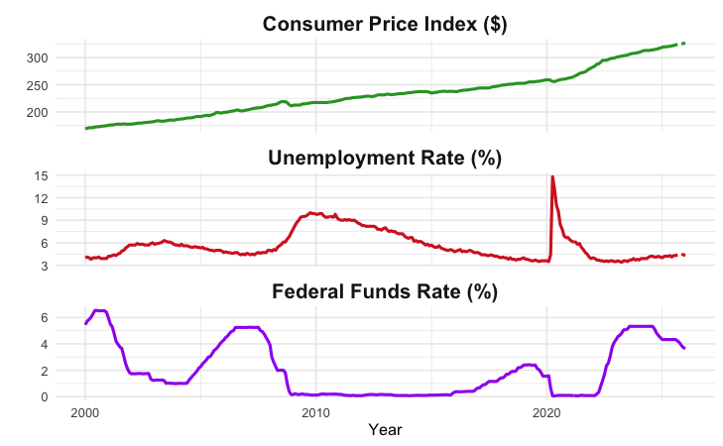
Inflation & Employment
The Federal Reserve Bank (The Fed) has a dual mandate:
Control inflation, monitored with the Consumer Price Index
Minimize unemployment
By adjusting the Federal Funds Rate

Slide 3
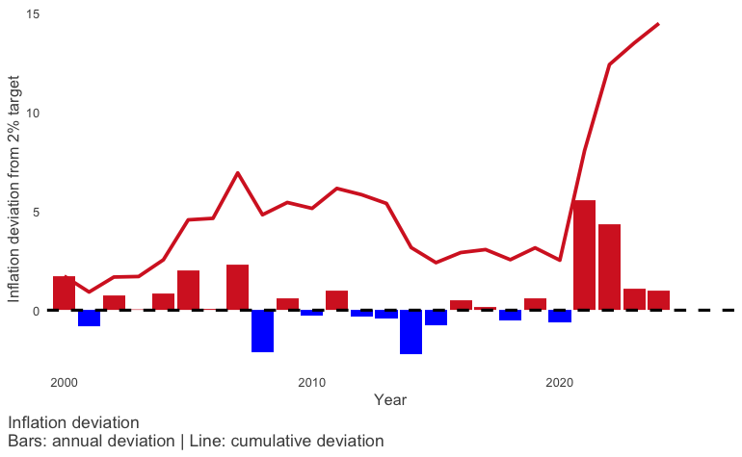
Inflation
The Fed “seeks to achieve inflation at the rate of 2 percent over the longer run…”¹
Average inflation over the last 25 years: 2.5%
Cumulative deviation over target is 14.5%
The Fed has not achieved their goal.
Deviation over target 16 of the last 25 years
Notes:
I wanted to start by considering each element of the Fed’s mandate individually.
For inflation the Fed seeks to achieve a rate of 2 percent over the longer run. This chart shows the annual deviation above or below the target of 2%. by year.
The deviation has been over target 16of the last 25 years .
The deviation has been a cumulative 14.5% above target.
The average inflation over the last 25 years is 2.5%.
By their own metrics they have not achieved their target.

Slide 4
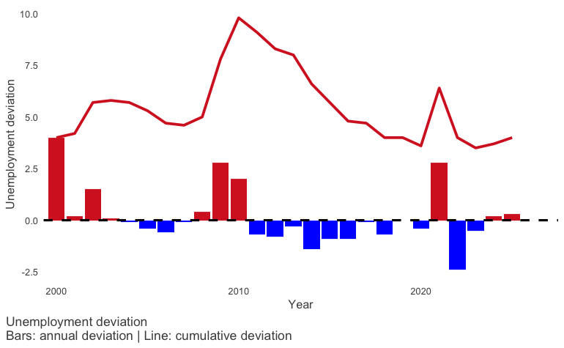
Unemployment
The Fed seeks “to promote maximum employment…”¹
Average unemployment: 5.5%
The Fed has done a relatively good job controlling unemployment.
Decreases in unemployment 16 of the last 25 years
Notes:
For unemployment, the Fed has performed relatively well controlling unemployment. Here we see a chart of the unemployment deviation from the previous year, along with a line indicating the cumulative unemployment deviation.
In general we see that unemployment tends to increase in isolated spikes, and then declines at a slower rate over time.

Slide 5
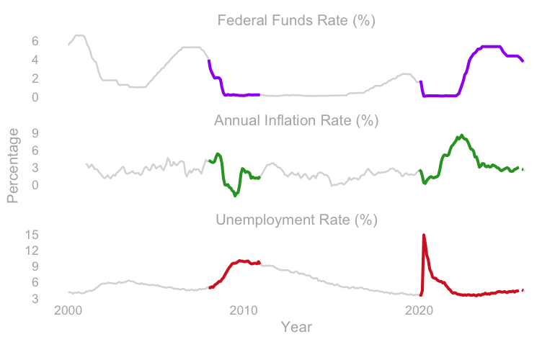
The Fed Funds Rate In Action
Does the Funds Rate play a role in correcting a financial crisis?
The 2008 financial crisis
The COVID caused financial crisis
Notes:
So while, I explored the individual

Slide 6
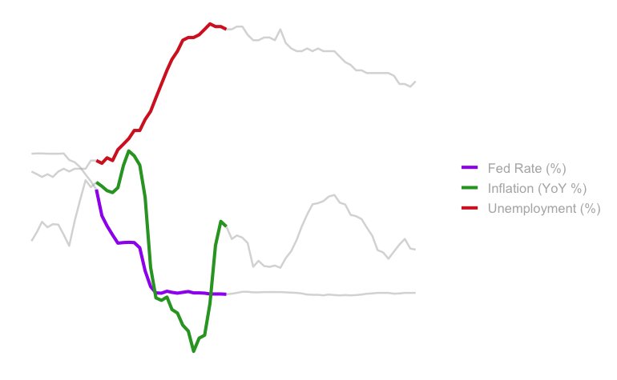
2008 Financial Crisis
4. Unemployment continues to rise
1. Unemployment begins to rise
3. Inflation increases at first, then markets collapse
2. The Fed cuts rates
5. The Fed continues to cut rates

Slide 7
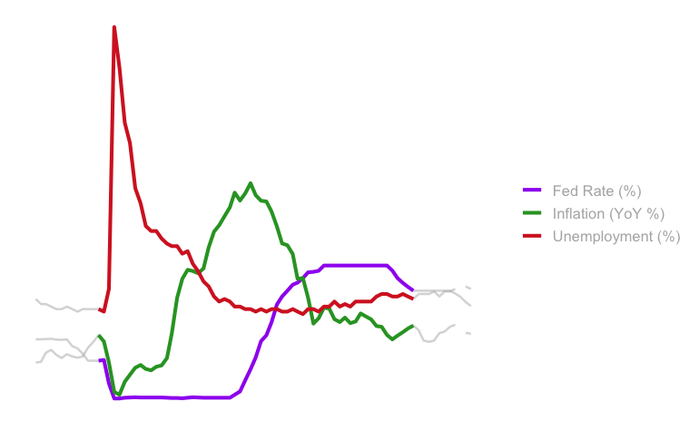
2020 COVID Financial Crisis
The Feds use of the Funds Rate does appear to aid in achieving their dual mandate.
1. Unemployment skyrockets
4. Unemployment comes down
6. Inflation comes down
5. The Fed begins to raise the rate again
2. The Fed cuts already low rates to very low levels
3. Inflation initially drops, then rises while the Fed Rate is low

Slide 8
Inflation & Employment
The Federal Reserve Bank (The Fed) has a dual mandate:
Control inflation
Maximize employment (minimize unemployment)
Influenced by the Department of Labor’s Consumer Price Index and Unemployment Rate, The Fed’s primary tool for achieving its mandate is controlling the The Fed Funds Rate.
Over the last 25 years has The Fed been able to achieve this dual mandate?

Slide 9
Inflation
The Fed “seeks to achieve inflation at the rate of 2 percent over the longer run…”¹
The Fed has not achieved their target.
Over the last 25 years:
Average annual inflation: 2.5%
16 years had inflation rates above target
Cumulative inflation over target is 14.5% over the last 25 years
Notes:
I wanted to start by considering each element of the Fed’s mandate individually.
For inflation the Fed seeks to achieve a rate of 2 percent over the longer run. By their own metrics they have not achieved their target.
This chart shows the annual deviation above or below the target of 2%.by year. On average annual inflation has been 2.5% and16 years of the last 25 years had inflation rates above target.
The line indicates the cumulative deviation from the target of 2%

Slide 10
Unemployment
The Fed seeks “to promote maximum employment…”¹
The Fed has performed relatively well in controlling unemployment.
Over the last 25 years:
Average annual unemployment rate: 5.5%
16 years had declines in the unemployment rate
Notes:
For unemployment, the Fed has performed relatively well controlling unemployment. Here we see a chart of the unemployment deviation from the previous year, along with a line indicating the cumulative unemployment deviation.
In general we see that unemployment tends to increase in isolated spikes, and then declines at a slower rate over time.

Slide 11
Using the Fed Funds Rate
Inflation is persistent, and difficult to control.
The Fed Funds Rate can be used to influence inflation and unemployment.
One way to consider The Feds ability to influence inflation and unemployment is to observe what happens during a financial crisis, specifically the 2008 financial crisis and the 2020 Covid-caused financial crisis.

Slide 12
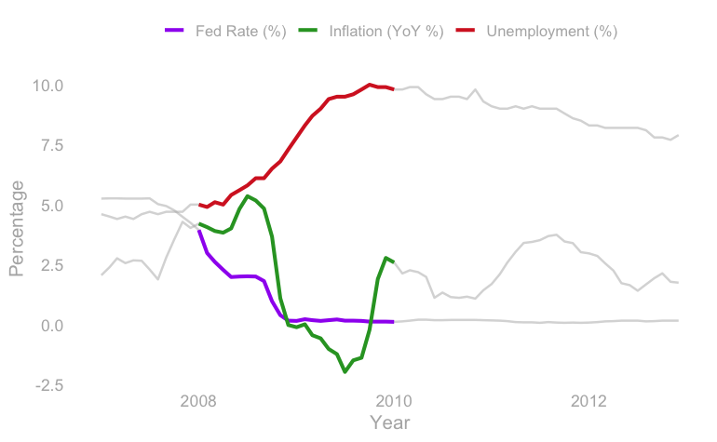
2008
This 2008 highlight shows a potential Fed Fund Rate in action:
As unemployment rises, the fed starts cutting the funds rate.
There is a brief spike in the inflation rate, during which time the Fed keep the funds rate steady, while unemployment rises
As the crisis sets in, inflation falls and the Fed continues to cut the rate.
The Fed holds the rate at a very low level for a long time, inflation fluctuates as the markets recover, while unemployment slowly declines.

Slide 13
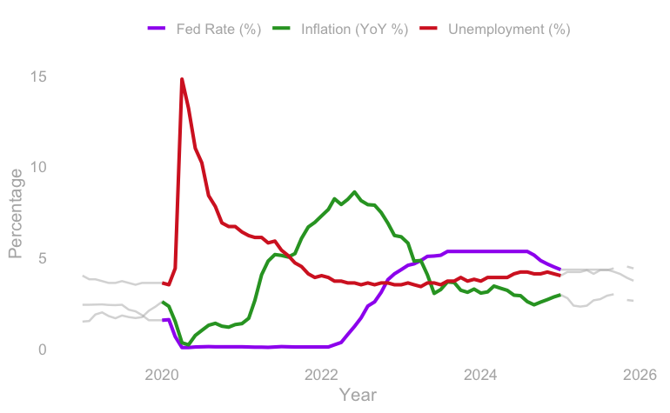
2020
This 2020 highlight shows a potential Fed Fund Rate in action:
As Covid set in, unemployment skyrocketed, the fed cut the Funds rate rapidly to a very low level.
The Fed held the rate at a low level for an extended period, as unemployment began to decline, inflation rose significantly.
Eventually, the Fed began to raise the Funds rate and there was a decline in the rate of inflation, while unemployment stabilized.
While monetary policy is a complex, interconnected process, the action in this progression indicates that the Fed’s use of the Fund Rate is helping them achieve their mandate.

