Slide 1
Bias in the Infrastructure Investment & Jobs Act Funding Allocation
Maxfield Raynolds
Data 608

Slide 2
Is there bias in IIJA spending?
In 2020 Joe Biden defeated Donald Trump for the Presidency of the United States of America. Biden was the candidate for the Democratic Party.
One of his signature pieces of legislation was the Infrastructure Investment & Jobs Funding Act (IIJA).
Has spending from the IIJA been equitable or has it disproportionately benefited the states that were called for Biden in 2020?

Slide 3
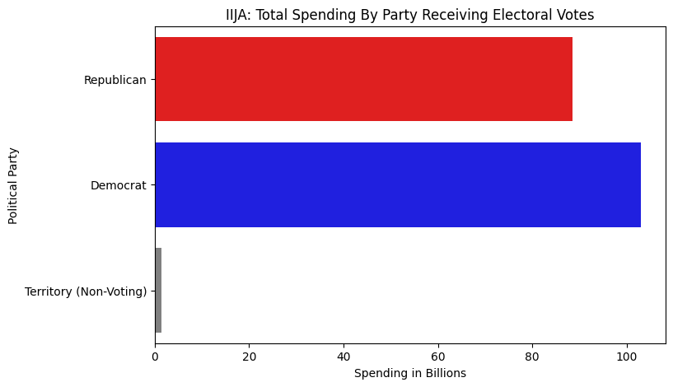
Is there bias in IIJA spending?
When spending is totaled, more money has been spent overall in states that were called for Biden in 2020.
However, this does not immediately mean there is bias.

Slide 4
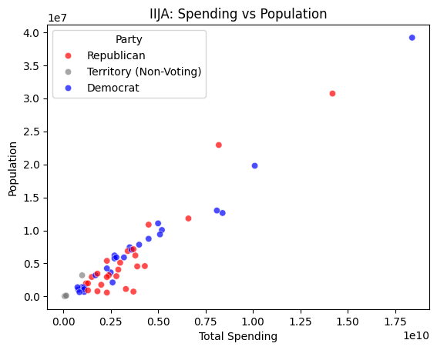
Is there bias in IIJA spending?
Considering spending plotted against population, spending appears generally proportional to population, regardless of party.
This is to say generally, the larger the population, the more money the state received, regardless of party.

Slide 5
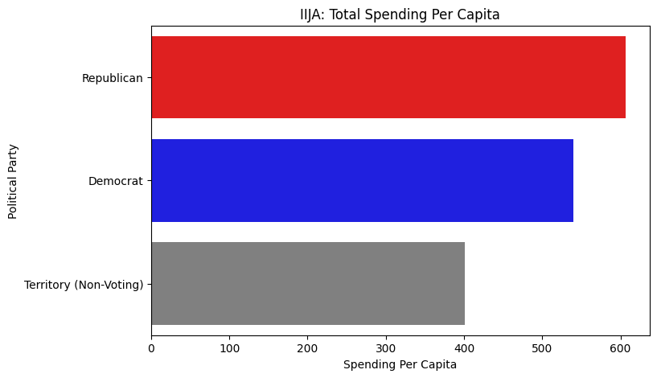
Is there bias in IIJA spending?
When spending is considered per capita,
spending was greater per person in states that were called for the Republican party in the 2020 presidential election

Slide 6
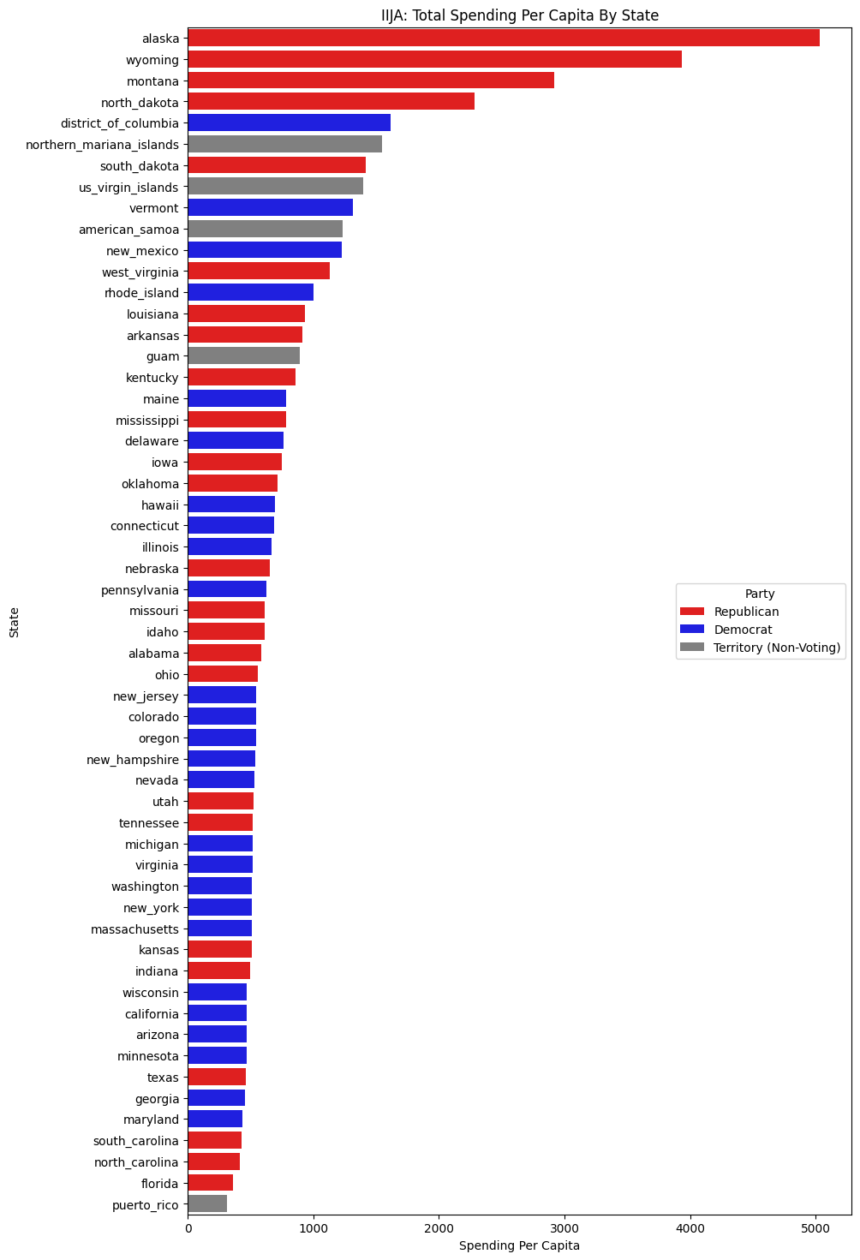
Is there bias in IIJA spending?
When spending is considered per capita, the top four, and most disproportionate, per capita spending was in states that voted Republican.
Considering the per capita spending in the IIJA, there is no indication of bias.

