Slide 1
The Fed Paradox: Inflation & Employment
Maxfield Raynolds
Data 608
Story 2
February 22, 2026

Slide 2
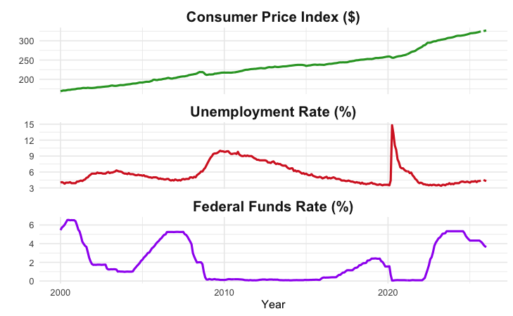
Inflation & Employment
The Federal Reserve Bank (The Fed) has a dual mandate:
Control inflation
Maximize employment (minimize unemployment)
Influenced by the Department of Labor’s Consumer Price Index and Unemployment Rate, The Fed’s primary tool for achieving its mandate is controlling the The Fed Funds Rate.
Over the last 25 years has The Fed been able to achieve this dual mandate?

Slide 3
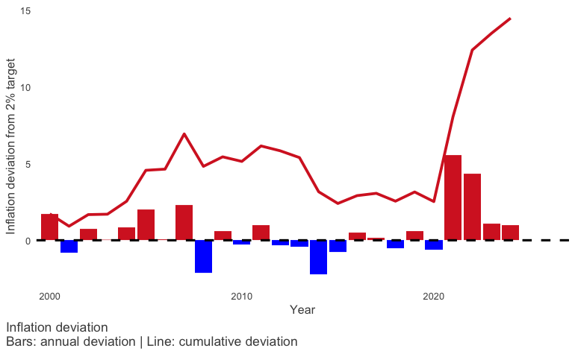
Inflation
The Fed “seeks to achieve inflation at the rate of 2 percent over the longer run…”¹
The Fed has not achieved their target.
Over the last 25 years:
Average annual inflation: 2.5%
16 years had inflation rates above target
Cumulative inflation over target is 14.5% over the last 25 years

Slide 4
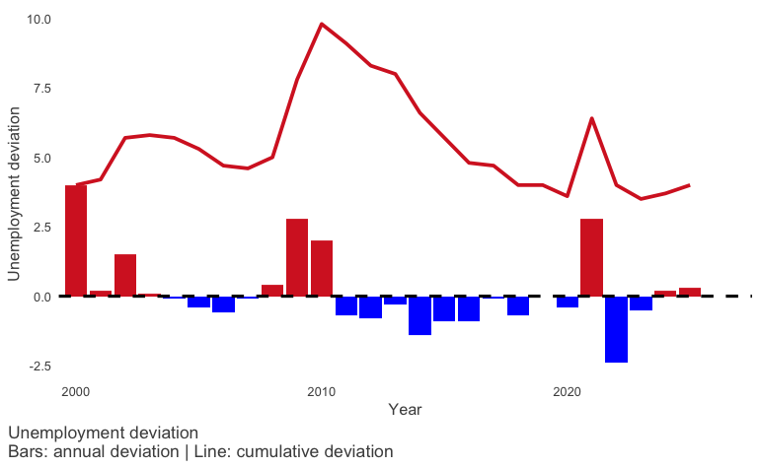
Unemployment
The Fed seeks “to promote maximum employment…”¹
The Fed has performed relatively well in controlling unemployment.
Over the last 25 years:
Average annual unemployment rate: 5.5%
16 years had declines in the unemployment rate

Slide 5
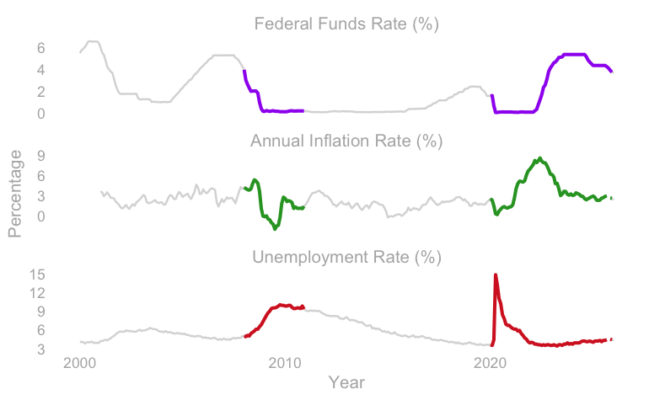
Using the Fed Funds Rate
Inflation is persistent, and difficult to control.
The Fed Funds Rate can be used to influence inflation and unemployment.
One way to consider The Feds ability to influence inflation and unemployment is to observe what happens during a financial crisis, specifically the 2008 financial crisis and the 2020 Covid-caused financial crisis.

Slide 6
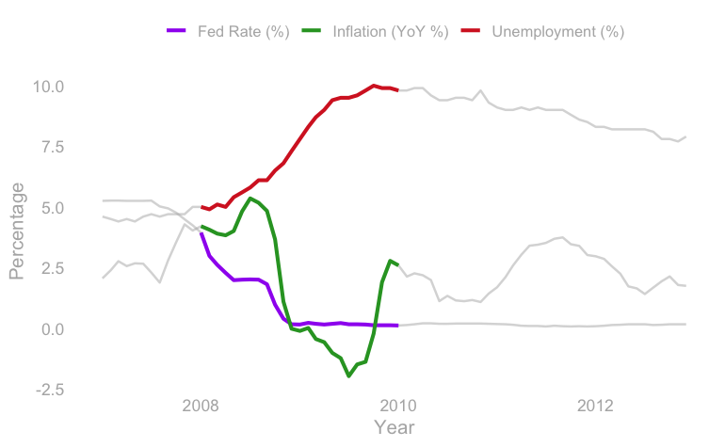
2008
This 2008 highlight shows a potential Fed Fund Rate in action:
As unemployment rises, the fed starts cutting the funds rate.
There is a brief spike in the inflation rate, during which time the Fed keep the funds rate steady, while unemployment rises
As the crisis sets in, inflation falls and the Fed continues to cut the rate.
The Fed holds the rate at a very low level for a long time, inflation fluctuates as the markets recover, while unemployment slowly declines.

Slide 7
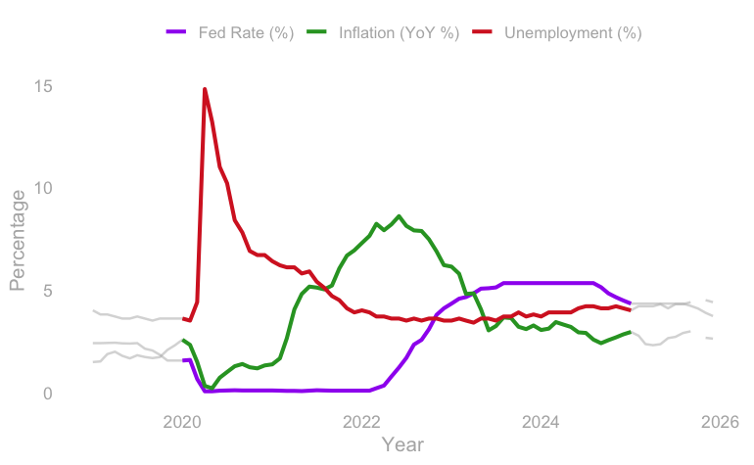
2020
This 2020 highlight shows a potential Fed Fund Rate in action:
As Covid set in, unemployment skyrocketed, the fed cut the Funds rate rapidly to a very low level.
The Fed held the rate at a low level for an extended period, as unemployment began to decline, inflation rose significantly.
Eventually, the Fed began to raise the Funds rate and there was a decline in the rate of inflation, while unemployment stabilized.
While monetary policy is a complex, interconnected process, the action in this progression indicates that the Fed’s use of the Fund Rate is helping them achieve their mandate.

