Slide 1
What Does Data Pay?
Story 4
Maxfield Raynolds
Data 608
Spring 2026
Chart selection

Slide 2
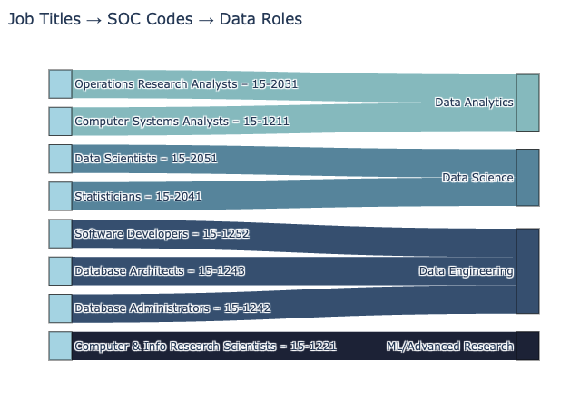
What do data jobs pay when compared to the national average pay?
To analyze wages, SOC codes were collected from the Bureau of Labor Statistics and assigned to four data related job categories:
Data Analytics
Data Science
Data Engineering
Machine Learning/Advanced Research.

Slide 3
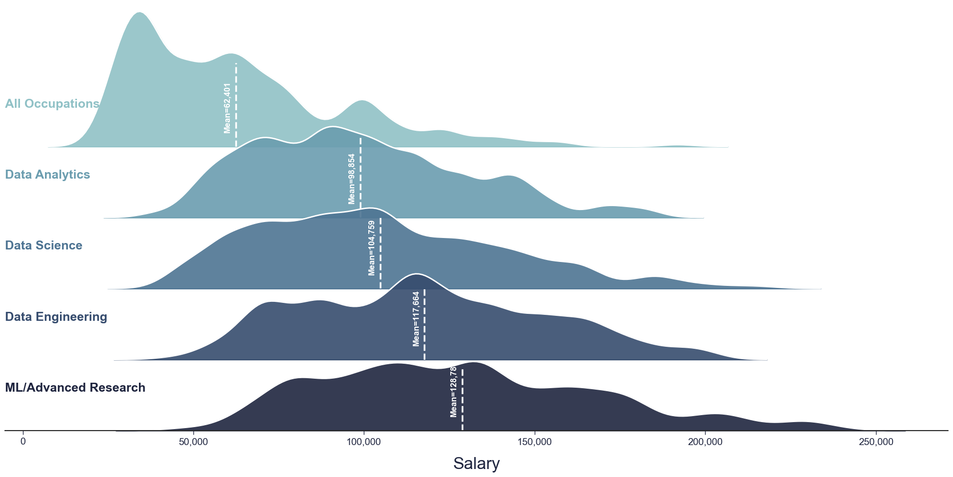
When compared, data roles pay higher than the national average.

Slide 4
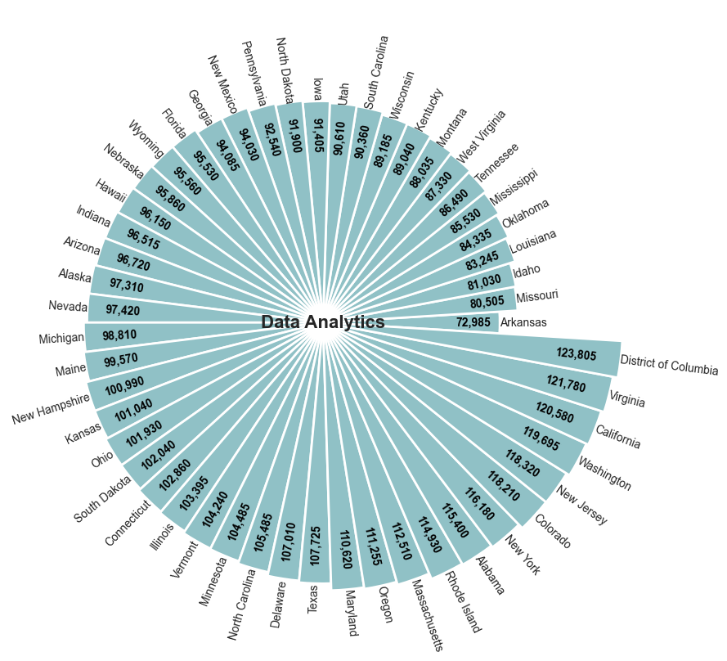
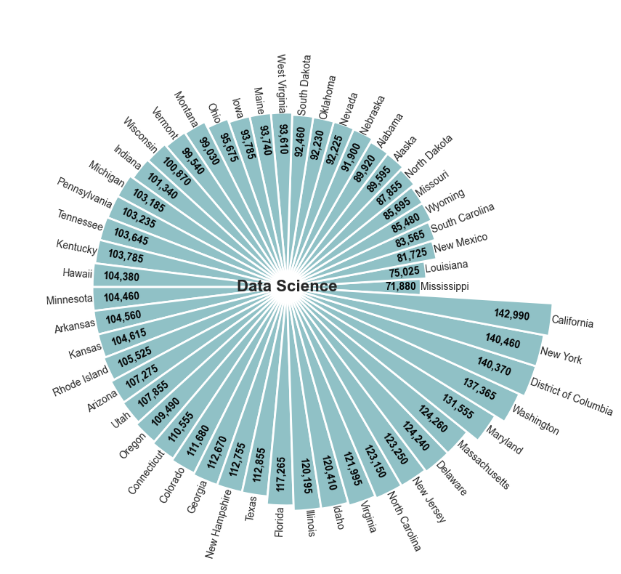
Data Analytics & Data Science:
Average Salary by State
Data Analytics and Data Science have a range of $50,000 and $70,000 each from the lowest paying to the highest paying state, on average.

Slide 5
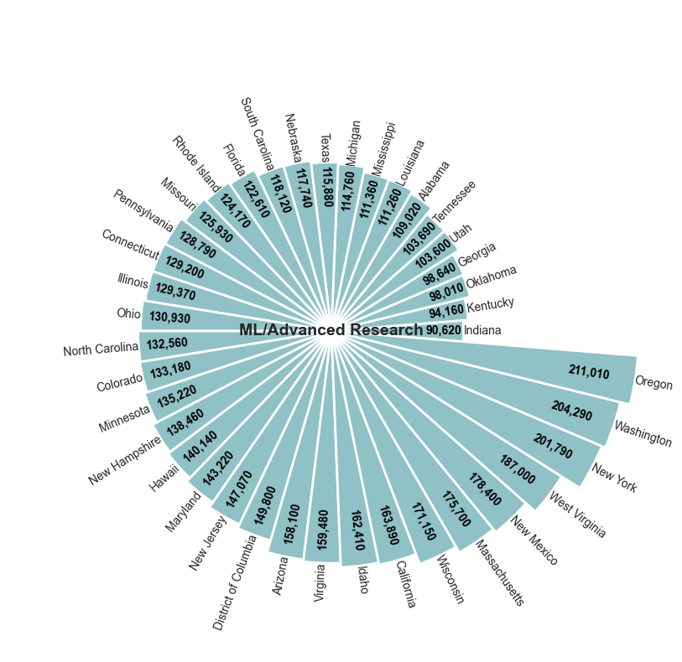
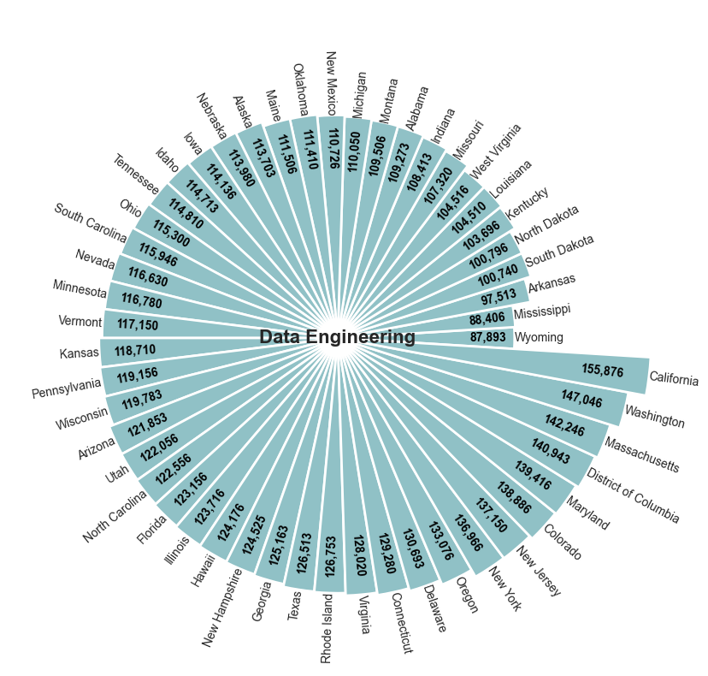
Data Engineering & ML/Advanced Research:
Average Salary by State
Data Engineering and ML/Advanced Research have a range of $70,000 and $120,000 each from the lowest paying to the highest paying state, on average.

Slide 6
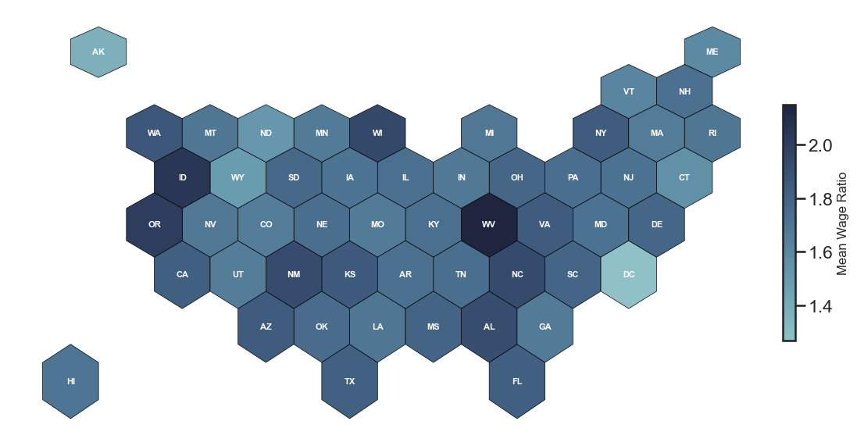
In all states, the data practitioner’s average salary is higher than the state’s average salary

