Slide 1
Analysis of the State of the Union Language and Effect on Congressional Seats
Data 607 Spring 2025 Maxfield Raynolds

Slide 2
A language analysis of the State of The Union
Single most important political speech in the US each year (arguably)
Televised since 1947
Frequently projects the Executive Branch’s (and their party’s) agenda for the coming year.
Does the language of the State of the Union have a lasting political impact on the legislative branch’s composition?

Slide 3
Does the language of the State of the Union have a lasting political impact on the legislative branch’s composition?
How to examine this question?
Acquire the text of the speeches & subsequent changes in congressional makeup
Perform language analysis: Sentiment analysis
Analyze results against changes in congressional makeup following the next election

Slide 4
Data Acquisition
Import Congressional Seat Changes
The following code imports the changes in congress house seats by year from The Brookings Institute.
cong_raw <- read_csv("https://www.brookings.edu/wp-content/uploads/2024/11/2-3.csv", show_col_types = FALSE)

Slide 5
Congressional data sorted, filtered and cleaned
The congressional data is then sorted, filtered, cleaned a little, and placed into tidy format.
cong_tidy <- cong_raw |> filter( Year >= 1947, ElectionType == "General", ) |> select(!NumSpecialElections) |> rename(gainingparty = GaingingParty) |> clean_names()

Slide 6
Import List of Presidents
A list of Presidents is imported into the work environment from the OpenIntro.
This data is appended with the two most recent presidents and is then cleaned, filtered and sorted into a more functionally usable tidy format.
## # A tibble: 10 × 4 ## year potus party party_abbrev ## <dbl> <chr> <chr> <chr> ## 1 1945 Harry S. Truman Democratic D ## 2 1946 Harry S. Truman Democratic D ## 3 1947 Harry S. Truman Democratic D ## 4 1948 Harry S. Truman Democratic D ## 5 1949 Harry S. Truman Democratic D ## 6 1950 Harry S. Truman Democratic D ## 7 1951 Harry S. Truman Democratic D ## 8 1952 Harry S. Truman Democratic D ## 9 1953 Dwight David Eisenhower Republican R ## 10 1954 Dwight David Eisenhower Republican R

Slide 7
A False Start: Speech Data
Searched and obtained some speech data through govinfo.gov api
API acquistion successful but:
Speeches labelled and notated in many different ways
Made data acquisition very granular

Slide 8
API Data Acquisition
govinfo_apikey <- key_get("govinfo.gov")
query <- "PRESIDENTIAL ADDRESS BEFORE A JOINT SESSION OF CONGRESS" collection <- "PPP"
govinfo_url <- "https://api.govinfo.gov/search"
header <- add_headers( `X-Api-Key` = govinfo_apikey, `Content-Type` = "application/json", `Accept` = "application/json" )
body <- list( query = query, pageSize = 1000, offsetMark = "*", sorts = list(list( field = "relevancy", sortOrder = "DESC" )), historical = TRUE, resultLevel = "default" )
search <- POST(govinfo_url, header, encode = "raw", body = toJSON(body, auto_unbox = TRUE) )
content_json <- content(search, as = "text", encoding = "UTF-8") results <- fromJSON(content_json) data <- results$results data1 <- data |> filter(dateIssued >= 1947-01-01, str_detect(title, regex("joint session", ignore_case = TRUE))) |> arrange(dateIssued)
links <- as.data.frame(results$results$download$txtLink) first_url <- links$`results$results$download$txtLink`[1]
detail_url <- paste0(first_url, "?api_key=", govinfo_apikey) res_detail <- GET(detail_url) detail_content <- read_html(content(res_detail, as = "text")) html_speech <- detail_content |> html_elements("pre") |> html_text()

Slide 9
A Better Source
Web Scrape: The American Presidency Project
Performed two scrapes for URLs that linked to the text of speeches while also extracting their dates and the President that delivered them.
Cleaned, prepped and compiled them into a single dataframe

Slide 10
Web Scrape Code
speech_urls_html <- read_html("https://www.presidency.ucsb.edu/advanced-search?field-keywords=%22Address%20Before%20A%20Joint%22&field-keywords2=&field-keywords3=&from%5Bdate%5D=&to%5Bdate%5D=&person2=&category2%5B0%5D=406&category2%5B1%5D=8&category2%5B2%5D=45&items_per_page=100&order=field_docs_start_date_time_value&sort=desc") date_node <- html_elements(speech_urls_html, ".views-field-field-docs-start-date-time-value") president_node <- html_elements(speech_urls_html, ".views-field-field-docs-person") url_node <- html_elements(speech_urls_html, ".views-field-title a") date_txt <- (xml_text(date_node, trim = TRUE))[-1] pres_txt <- (xml_text(president_node, trim = TRUE))[-1] url_txt <- html_attr(url_node, "href") url_table <- tibble( date = date_txt, pres = pres_txt, url = url_txt )

Slide 11
Web Scrape Code 2
sou_urls_html <- read_html("https://www.presidency.ucsb.edu/documents/app-categories/spoken-addresses-and-remarks/presidential/state-the-union-addresses?items_per_page=100") date_node <- html_elements(sou_urls_html, ".date-display-single") president_node <- html_elements(sou_urls_html, ".col-sm-4 p") url_node <- html_elements(sou_urls_html, ".field-title a") date_txt <- (xml_text(date_node, trim = TRUE)) pres_txt <- (xml_text(president_node, trim = TRUE)) url_txt <- html_attr(url_node, "href") sou_table <- tibble( date = date_txt, pres = pres_txt, url = url_txt ) url_table <- url_table |> rbind(sou_table)

Slide 12
URL Tibble
head(url_table, n = 10)
## # A tibble: 10 × 3 ## date pres url ## <chr> <chr> <chr> ## 1 Mar 04, 2025 Donald J. Trump (2nd Term) /documents/address-before-joint-sess… ## 2 Mar 07, 2024 Joseph R. Biden, Jr. /documents/address-before-joint-sess… ## 3 Feb 07, 2023 Joseph R. Biden, Jr. /documents/address-before-joint-sess… ## 4 Dec 21, 2022 U.S. Congress /documents/address-before-joint-sess… ## 5 Mar 16, 2022 U.S. Congress /documents/address-before-joint-sess… ## 6 Mar 01, 2022 Joseph R. Biden, Jr. /documents/address-before-joint-sess… ## 7 Apr 28, 2021 Joseph R. Biden, Jr. /documents/address-before-joint-sess… ## 8 Feb 04, 2020 Donald J. Trump (1st Term) /documents/address-before-joint-sess… ## 9 Feb 05, 2019 Donald J. Trump (1st Term) /documents/address-before-joint-sess… ## 10 Jan 30, 2018 Donald J. Trump (1st Term) /documents/address-before-joint-sess…

Slide 13
Clean and prep the scrapes
The following code cleans the data collected when scraping for the URLs and prepares the urls to be scraped for the actual text of the speeches.
url_table1 <- url_table |> mutate( date = as_date(date, format = "%B %e, %Y"), pres = str_trim(pres), pres = str_replace_all(pres, "-", " "), url = paste0("https://www.presidency.ucsb.edu",url) ) |> arrange(desc(date)) |> filter(pres != "U.S. Congress", date >= as.Date("2001-01-01")) |> distinct(url, .keep_all = TRUE)

Slide 14
Function to scrape the actual speech text
speech_conversion <- function(url) { speech <- read_html(url) date_node <- html_elements(speech, ".date-display-single") pres_node <- html_elements(speech, ".diet-title") speech_node <- html_elements(speech, ".field-docs-content") date_txt <- xml_text(date_node, trim = TRUE) pres_txt <- xml_text(pres_node, trim = TRUE) speech_txt <- xml_text(speech_node, trim = TRUE) speech_tbl <- tibble( date = date_txt, pres = pres_txt, speech = speech_txt) }

Slide 15
Web Scrape The List of URLs
The list of urls was then scraped and combined into a dataframe using the function written above and the code below utilizing the map_dfr() function.
raw_speech_data <- map_dfr(url_table1$url, speech_conversion) head(raw_speech_data, n=5)
## # A tibble: 5 × 3 ## date pres speech ## <chr> <chr> <chr> ## 1 March 04, 2025 Donald J. Trump (2nd Term) "The President. Thank you. Thank… ## 2 March 07, 2024 Joseph R. Biden, Jr. "[Before speaking, the President… ## 3 February 07, 2023 Joseph R. Biden, Jr. "The President. Mr. Speaker——\n[… ## 4 March 01, 2022 Joseph R. Biden, Jr. "The President. Thank you all ve… ## 5 April 28, 2021 Joseph R. Biden, Jr. "The President. Thank you. Thank…

Slide 16
Clean & Tidy Speech Data
The acquired speech text was then formatted and cleaned to allow for consistent referencing during the analysis process.
speech_data <- raw_speech_data |> mutate( date = as.Date(date, format = "%B %e, %Y"), pres = str_remove_all(pres, regex("\\(1st Term\\)|\\(2nd Term\\)")), pres = trimws(pres), speech = str_remove_all(speech, "\\[.*?\\]"), pres = str_remove_all(pres, ", Jr."), pres = str_remove_all(pres, "\\.") ) |> separate_wider_delim( pres, delim = " ", names = c("first", "last"), too_many = "merge", cols_remove = FALSE ) |> separate_wider_delim( last, delim = " ", names = c("initial", "last"), too_few = "align_end", ) |> mutate( id = paste0(year(date), "_", last) ) |> select(!first:last) |> relocate(id, .before = speech) |> filter( year(date) %in% cong_tidy$Year, !between(date, as.Date("1960-02-01"),as.Date("1960-12-31")), !date %in% c(as.Date("1948-04-19"), as.Date("1976-01-31"), as.Date("1978-09-18"), as.Date("1982-02-09"), as.Date("1982-03-15"), as.Date("1982-03-16"), as.Date("1984-06-04"), as.Date("1990-09-11")) )

Slide 17
Speech text split in to sentences to track progression of sentiment over speech
The speech text was then split into individual sentences so that the sentences could be tracked for analysis.
sentence_data <- speech_data |> arrange(date) |> mutate( speech_number = row_number() ) |> separate_longer_delim(speech, delim = ". ") |> separate_longer_delim(speech, delim = "! ") |> separate_longer_delim(speech, delim = "? ") |> separate_longer_delim(speech, delim = "!") |> separate_longer_delim(speech, delim = "?") |> group_by(speech_number) |> mutate( sentence_number = row_number()) |> ungroup()

Slide 18
Loaded Stop Words
A list of stop words was loaded and the text of the speeches were tokenized.
data(stop_words) tidy_speech <- sentence_data |> unnest_tokens(word, speech) |> anti_join(stop_words, by = "word")

Slide 19
Speech text tokenized and stop words removed
Following toeknization and removal of common stop words, an inspection of the remaining words by frequency reveals that the first ten words are fairly common and non-descriptive.
tidy_speech |> group_by(word) |> summarize( count = n(), ) |> arrange(desc(count)) |> slice_max(n = 10, order_by = count)
## # A tibble: 0 × 2 ## # ℹ 2 variables: word <chr>, count <int>
head(tidy_speech, n=10)
## # A tibble: 0 × 6 ## # ℹ 6 variables: date <date>, pres <chr>, id <chr>, speech_number <int>, ## # sentence_number <int>, word <chr>

Slide 20
Create a list of custom stop words…
A list of custom stop words were created to eliminate the most commonly used words.
custom_stop_words <- tidy_speech |> group_by(word) |> summarize( count = n(), ) |> arrange(desc(count)) |> slice_max(n = 10, order_by = count) |> mutate(lexicon = "custom") |> select(!count)

Slide 21
…and removed them
tidy_speech <- tidy_speech |> anti_join(custom_stop_words, by = "word")

Slide 22
New list of most common words
The current ten most common words. The counts of these words are much more similar than the previously removed words.
tidy_speech |> group_by(word) |> summarize( count = n(), ) |> arrange(desc(count)) |> slice_max(n = 10, order_by = count)
## # A tibble: 0 × 2 ## # ℹ 2 variables: word <chr>, count <int>

Slide 23
Sentiment Analysis
For sentiment analysis the AFINN lexicon was selected as it gives sentiments with an ordinal magnitude from -5 to 5. The following code joins the speech tokens with the AFINN lexicon.
afinn <- tidy_speech |> inner_join(get_sentiments("afinn"), by = join_by(word)) |> group_by(id, index = sentence_number %/% 5) |> summarise(sentiment = sum(value)) |> mutate(method = "AFINN")

Slide 24
Created a dataframe to aid in plotting the results
The following code then prepares the data to be plotted.
afinn_plot <- afinn |> separate_wider_delim(id, delim = "_", names = c("year", "pres"), cols_remove = FALSE) |> mutate(year = as.numeric(year)) |> left_join(us_pres, by = join_by(year))

Slide 25
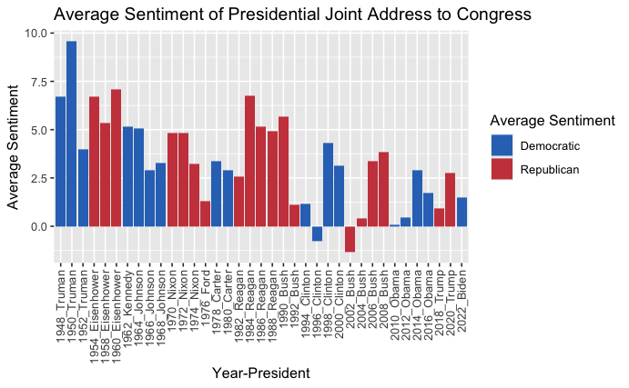
A plot of the average sentiment over time
afinn_plot |> group_by(id, party) |> summarise(avg_sentiment = mean(sentiment), .groups = "drop") |> ggplot(aes(id, avg_sentiment, fill = party)) + geom_col() + xlab("Year-President") + ylab("Average Sentiment") + ggtitle("Average Sentiment of Presidential Joint Address to Congress") + labs(fill = "Average Sentiment") + theme(axis.text.x = element_text(angle = 90, vjust = 0.5, hjust = 1)) + scale_fill_manual(values = c("Democratic" = "#2E74C0", "Republican" = "#CB454A"))

Slide 26
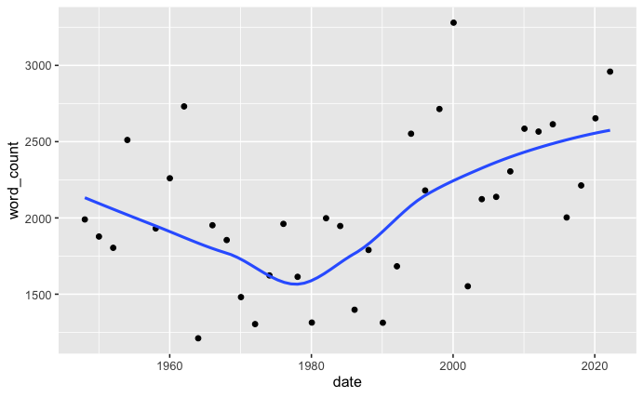
Word count for speeches
tidy_speech |> group_by(date, id) |> summarise( word_count = n(), .groups = "drop" ) |> ggplot(aes(date, word_count)) + geom_point() + geom_smooth(method = "loess", se = FALSE)

Slide 27
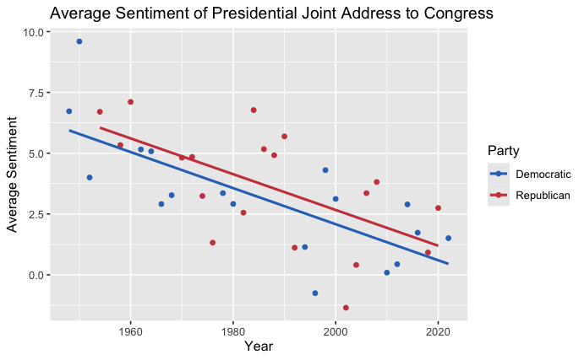
Scatterplot of decline in sentiment
afinn_plot |> group_by(year, party) |> summarise(avg_sentiment = mean(sentiment), .groups = "drop") |> ggplot(aes(year, avg_sentiment, color = party)) + geom_point() + xlab("Year") + ylab("Average Sentiment") + ggtitle("Average Sentiment of Presidential Joint Address to Congress") + labs(color = "Party") + scale_color_manual(values = c("Democratic" = "#2E74C0", "Republican" = "#CB454A")) + geom_smooth(method = "lm", se = FALSE)

Slide 28
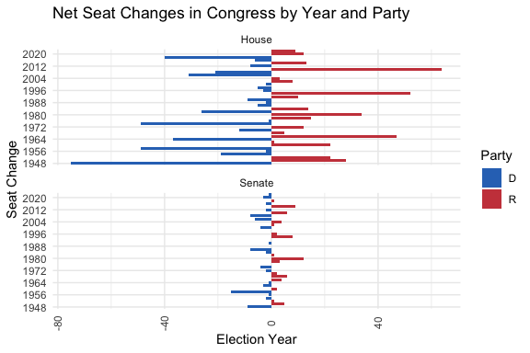
Seat Changes in Congress
election_results <- cong_tidy |> mutate( seats = as.numeric(seats), seat_change_sign = case_when( gainingparty == "D" ~ -seats, gainingparty == "R" ~ seats, TRUE ~ 0 ) ) ggplot(election_results, aes(y = factor(year), x = seat_change_sign, fill = gainingparty)) + geom_col() + geom_hline(yintercept = 0, color = "black") + facet_wrap(~ chamber, ncol = 1, scales = "free_y") + scale_fill_manual(values = c("D" = "#2E74C0", "R" = "#CB454A")) + labs( x = "Election Year", y = "Seat Change", title = "Net Seat Changes in Congress by Year and Party", fill = "Party" ) + scale_y_discrete(breaks = function(x) x[seq(1, length(x), by = 4)]) + theme_minimal() + theme(axis.text.x = element_text(angle = 90, vjust = 0.5))

Slide 29
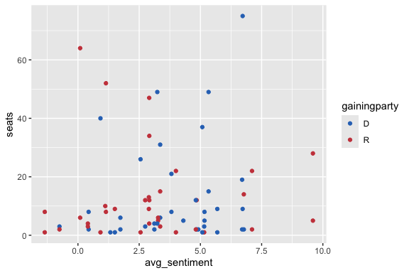
Scatterplot of avg_sentiment vs seat changes by chamber
ggplot(afinn_avg_senti, aes(x = avg_sentiment, y = seats, color = gainingparty)) + geom_point() + scale_color_manual(values = c("D" = "#2E74C0", "R" = "#CB454A"))

Slide 30
Linear regression of the relationship between sentiment and seat changes
Call:
lm(formula = change ~ avg_sentiment, data = afinn_avg_senti)
Residuals:
Min 1Q Median 3Q Max
-54.257 -6.052 2.408 9.891 77.123
Coefficients:
Estimate Std. Error t value Pr(>|t|)
(Intercept) -9.8455 4.1994 -2.345 0.022 *
avg_sentiment 1.1485 0.9965 1.152 0.253
---
Signif. codes: 0 ‘***’ 0.001 ‘**’ 0.01 ‘*’ 0.05 ‘.’ 0.1 ‘ ’ 1
Residual standard error: 20.05 on 68 degrees of freedom
Multiple R-squared: 0.01916, Adjusted R-squared: 0.004734
F-statistic: 1.328 on 1 and 68 DF, p-value: 0.2532

Slide 31
Thanks for Listening
These slides were produced directly from R Studio.

