Slide 1
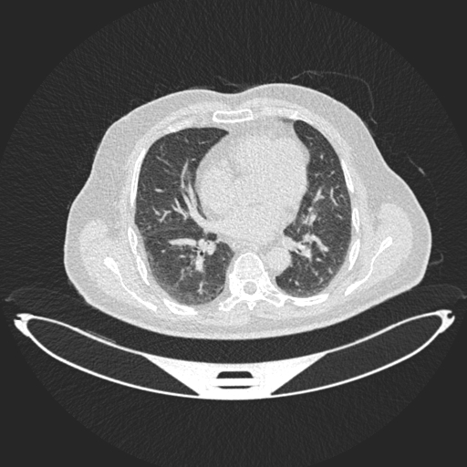
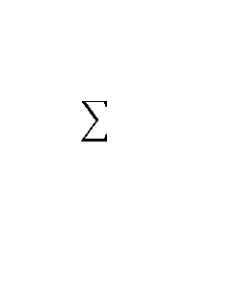
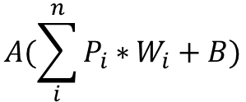

Conv2D Layer
Image
Pixels
Filters
B
P1
W1
$$A(\sum_{i}^{n}{P_{i}∗}W_{i}+B)$$
126
W2
$$A$$
P2
Kernal = 3x3, Strip = 1
128
W3
3
W4
P1 | P2 | P3
P4 | P5 | P6
P7 | P8 | P9
P3
P1 | P2 | P3
P4 | P5 | P6
P7 | P8 | P9
126
3
P1 | P2 | P3
P4 | P5 | P6
P7 | P8 | P9
W5
P4
W6
W7
128
P5
W8
W9
P6
P7
P8
P9
Forward Propagation

Slide 2
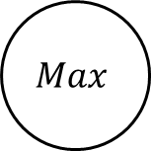

Max Pooling Layer
Image
Pixels
Filters
$$Max$$
63
$$Max(P_{1}, P_{2},P_{3}, P_{4})$$
2
126
P1 | P2
P3 | P4
P1 | P2
P3 | P4
63
2
P1
P1 | P2
P3 | P4
P2
126
P3
P4
Forward Propagation

Slide 3









Forward Propagation
$$X_{1}$$
$$w_{1}$$
$$w_{2}$$
$$X_{2}$$
$$g$$
g$(Z)$
$$w_{3}$$
$$X_{3}$$
$$Z=X_{1}∗W_{1}+X_{2}∗W_{2}+X_{3}∗W_{3}$$

Slide 4












Backward Propagation
$$X_{1}$$
$$w_{1}$$
$$w_{2}$$
$$X_{2}$$
$$g$$
g$(Z)$
$$w_{3}$$
$$X_{3}$$
$$W_{new}=W_{old}−β∗\frac{ⅆL}{dW}$$
$$L=−y\log{(p\left(\hat{y}\right)}−\left(1−y\right)\log{(p(1−\hat{y})}$$
$$\hat{y}=W∗X+B$$

Slide 5
K-fold Validation
Dataset
Training Set | Testing Set
Fold 1 | Fold 2 | Fold 3 | Fold 4 | Fold 5
Fold 1 | Fold 2 | Fold 3 | Fold 4 | Fold 5
Fold 1 | Fold 2 | Fold 3 | Fold 4 | Fold 5
Fold 1 | Fold 2 | Fold 3 | Fold 4 | Fold 5
Fold 1 | Fold 2 | Fold 3 | Fold 4 | Fold 5

Slide 6
Dropout Layer
Without dropout
With dropout
X
X

