Slide 1
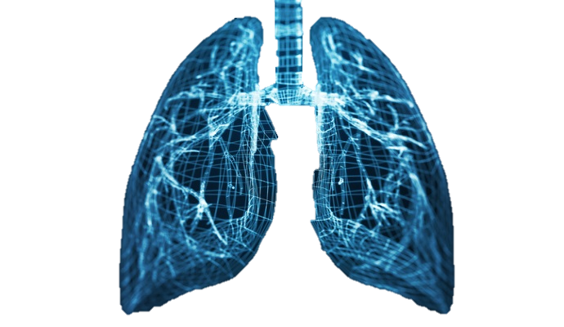

Lung Cancer prediction System
Using Deep Learning
Heba Abu-Shareefeh 2019980186
Rudainah Alyaseen
Mohammed Mrayyan 2019980212
Supervisor: Dr.Mahmoud Massadeh
Computer Engineering Department

Slide 2
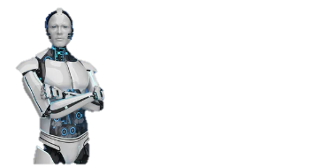
Introduction
Lung Cancer Diagnosis Challenging
High rate of Death.
Time and effort needed to Diagnosis.
The poor outcomes in patients with lately stages.
Early detection of lung cancer can lead to better treatments and outcomes

Slide 3
Introduction
How we Solved this Challenges
Lung Cancer Prediction System is a web-based platform designed to help doctor prediction lung cancer in early stage
Through its user-friendly interface, healthcare professionals can securely upload medical CT scans images, for analysis
The system employs deep learning algorithm (CNNs) to process the images and provide predictive probabilities of lung cancer presence

Slide 4
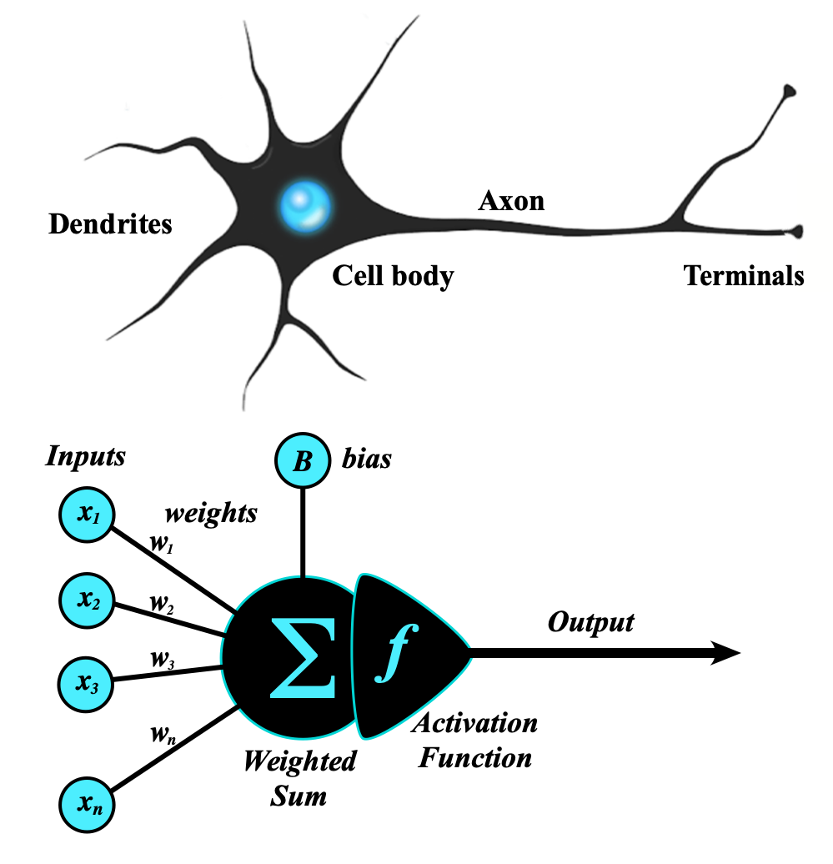
Deep Learning
Deep learning is the subset of machine learning methods based on neural networks.
It works like human’s neurons
Train the DL model on CT-Scan Images to gain experience from them, and then use it to predict the probability of Lung Cancer for new unseen images.

Slide 5
Steps
Data Collecting
Data Preparing
Model Building
Validation
Evaluation
Deployment

Slide 6
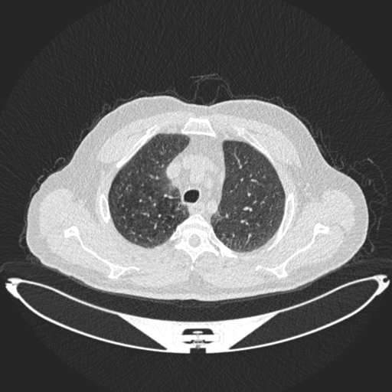
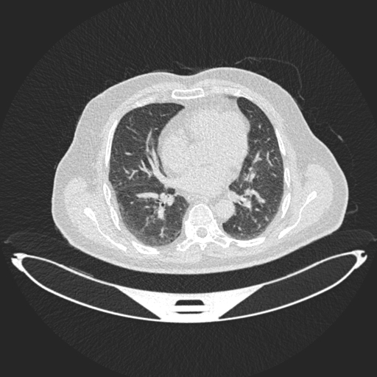
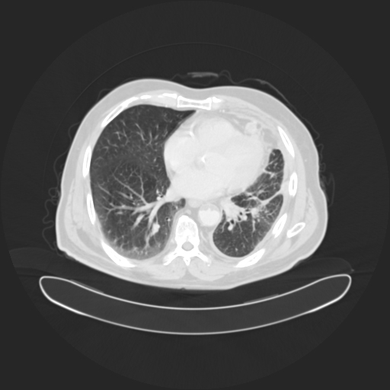
Data Collecting
We used Image Dataset from Kaggle.
It contains 1097 images grouped into 3 classes.
Samples from the dataset:

Slide 7
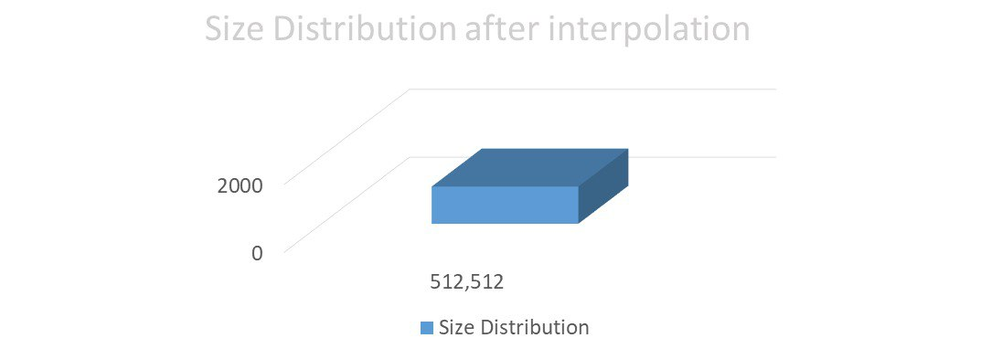
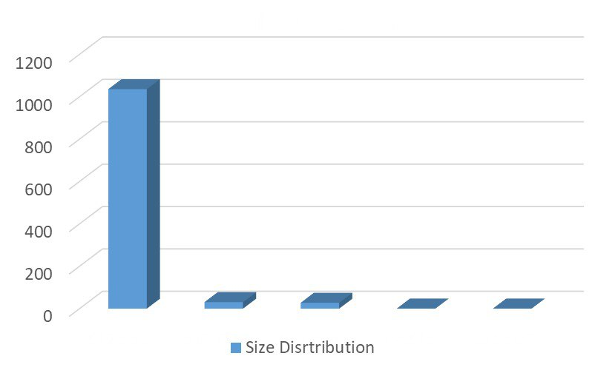

Data Preparing
Resizing
1097
1036
1097
31
28
1
1

Slide 8
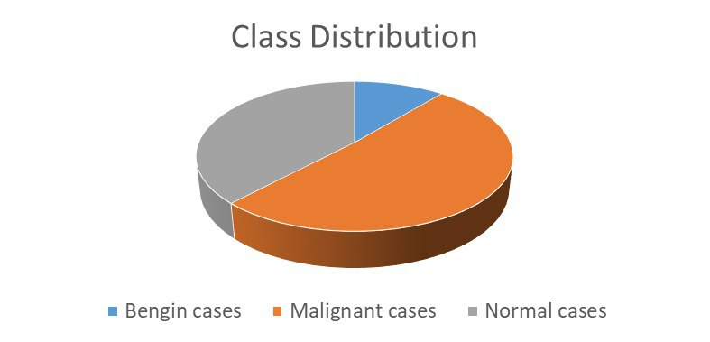
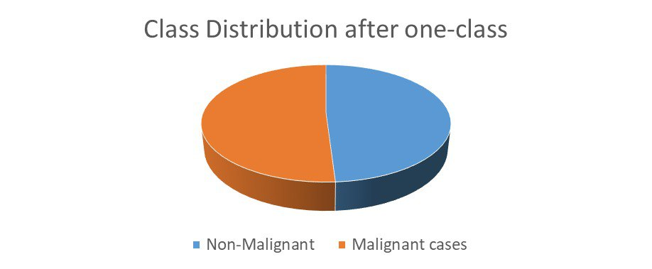
Data Preparing
Balancing the data using One-Class classification

Slide 9
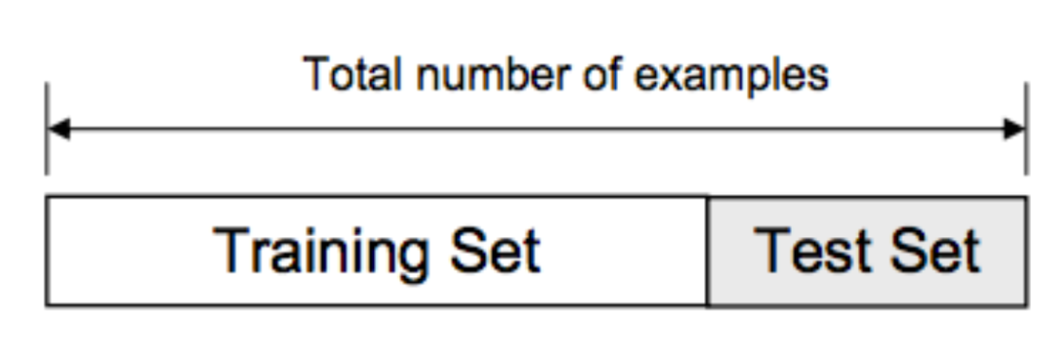
Data Preparing
Splitting Dataset to train and test
Training Set used for train the model.
Testing Set used for evaluation.
70%
30%

Slide 10
Data Preparing
Data Encoding
Computer can’t work with string directly.
Convert categorical values to numeric.

Slide 11
Convolutional Neural networks CNNs
CNNs:
Type of neural network Architecture that is widely used for performing deep learning on image data.
CNN consists of an input layer, a hidden layer(s), and an output layer
the hidden layers of a CNN consist of a special series of layers called the convolutional and pooling layers (Feature Extraction).

Slide 12
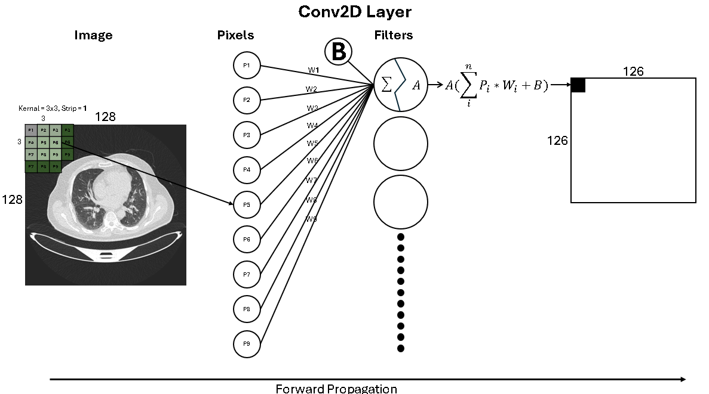
Convolutional Neural networks CNNs
Conv2D Layer
Starting with random kernal.
Applying the kernal on the input.
It works as filter.
Find the optimal kernal.

Slide 13
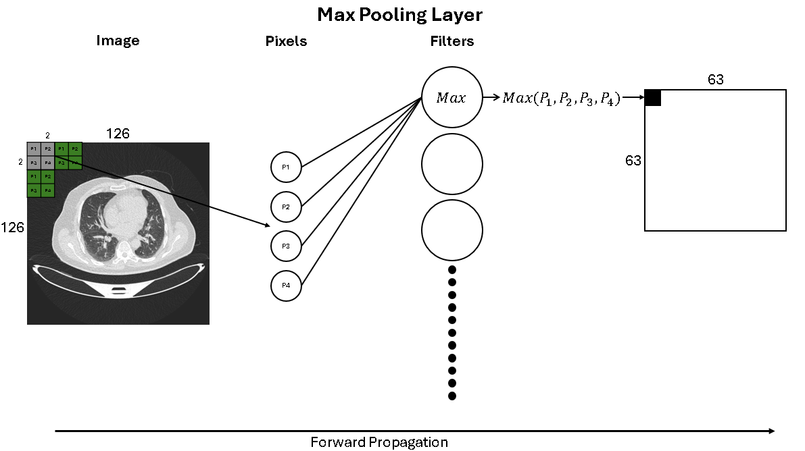
Convolutional Neural networks CNNs
Max Pooling
It used to decrease the size of image
Increase the speed of training

Slide 14
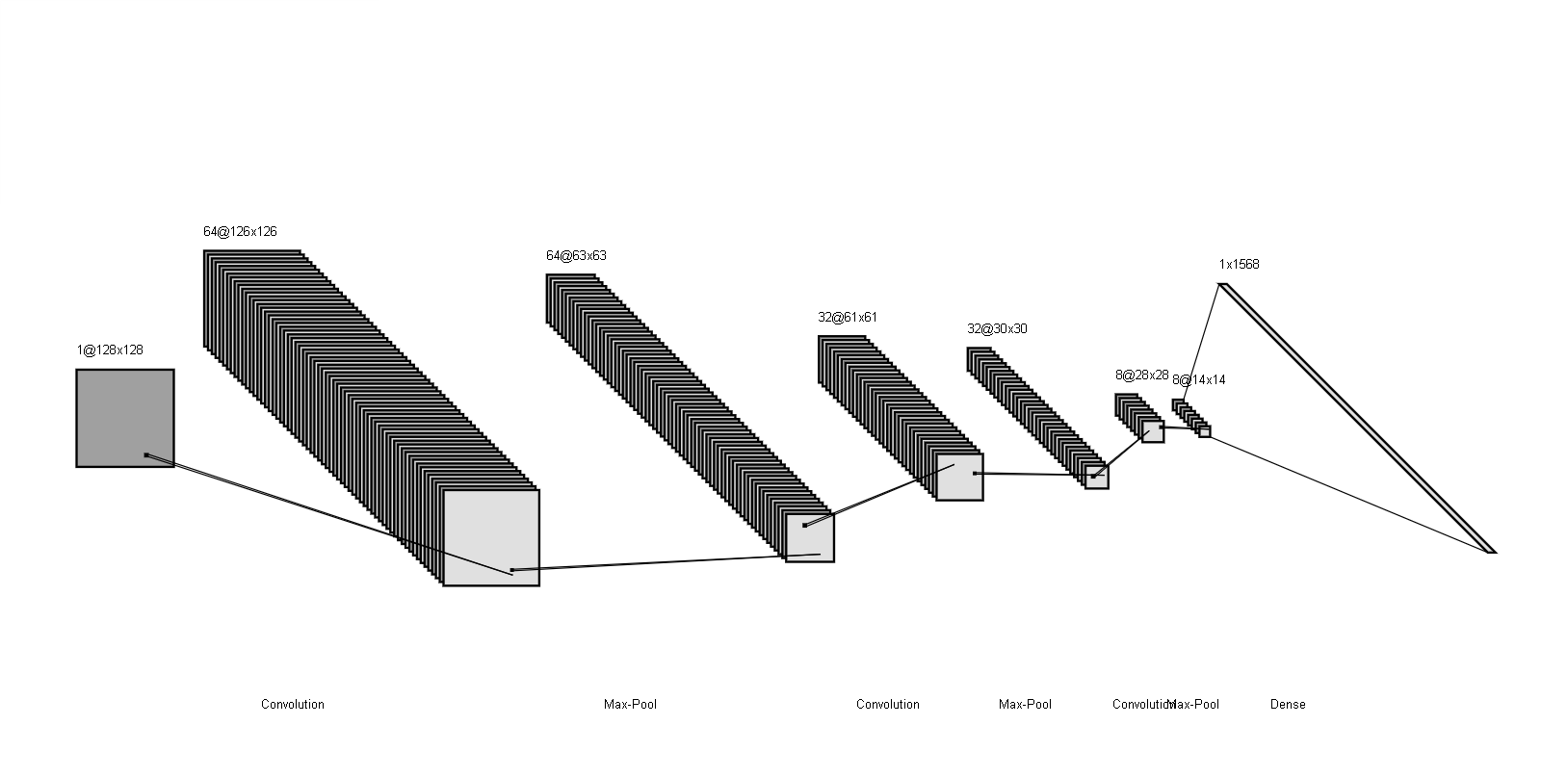
Model Structure
Our model consists of 3 conv2D, 3 Max Pooling, 1 Flatten and 1 Dense Layer

Slide 15
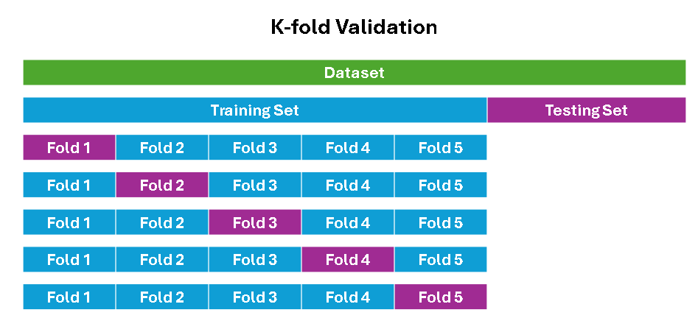
Hyperparameter Tuning
We used GridSearchCV
It’s a technique to find the best parameters by trying different combinations.
CV stands for K-fold Cross validation
This phase takes 1 hour of running to try 108 different combinations.

Slide 16
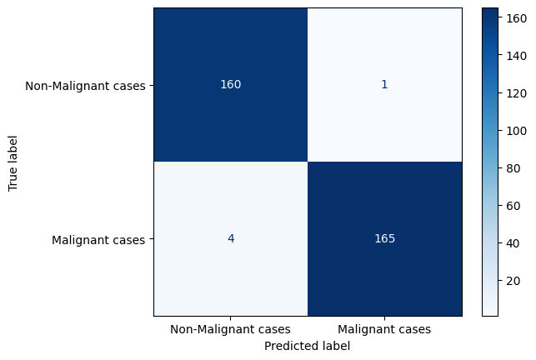
Evaluation
Confusion Matrix
Accuracy: 99.091%
Sensitivity: 99.379%
Precision: 97.561%
F1 Score: 98.462%

Slide 17
Web
Confusion Matrix
Web:why we used web with ai (team work, used to work in companies with other fields, out with complete production that we can market to the ….)

Slide 18
Future Work
[ ] Future work.
[ ] Enechance the model/ speed/ precession.
[ ] Add new models to the website for another diseas
[ ] Predict of cancer/ object detection
[ ] Improve the dataset to containg the patient records

Slide 19
References
[ ] Future work.
[ ] Enechance the model/ speed/ precession.
[ ] Add new models to the website for another diseas
[ ] Predict of cancer/ object detection
[ ] Improve the dataset to containg the patient records

Slide 20
Thank You

