Slide 1
NYC Rental Giants
Exploring the rental empire built by Corcoran, Douglas Elliman and Compass in New York City
By Michael Razumovsky

Slide 2
Why do we care?
As of 2018, 65.1 % of New York residents rent, while 34.9% are homeowners ¹
The most recent Federal census shows that the American homeownership rate is 64.1% ²
New York, like many urban cities, attracts people from around the country and world
Many residents live in NYC for the short to medium-term
The home sales market is irrelevant for most people, particularly younger people making the effort to work and live in NY (or come for a bootcamp)
Notes:
https://patch.com/new-york/new-york-city/two-thirds-new-yorkers-now-rent-their-apartments-data-show
https://www.census.gov/housing/hvs/files/currenthvspress.pdf

Slide 3
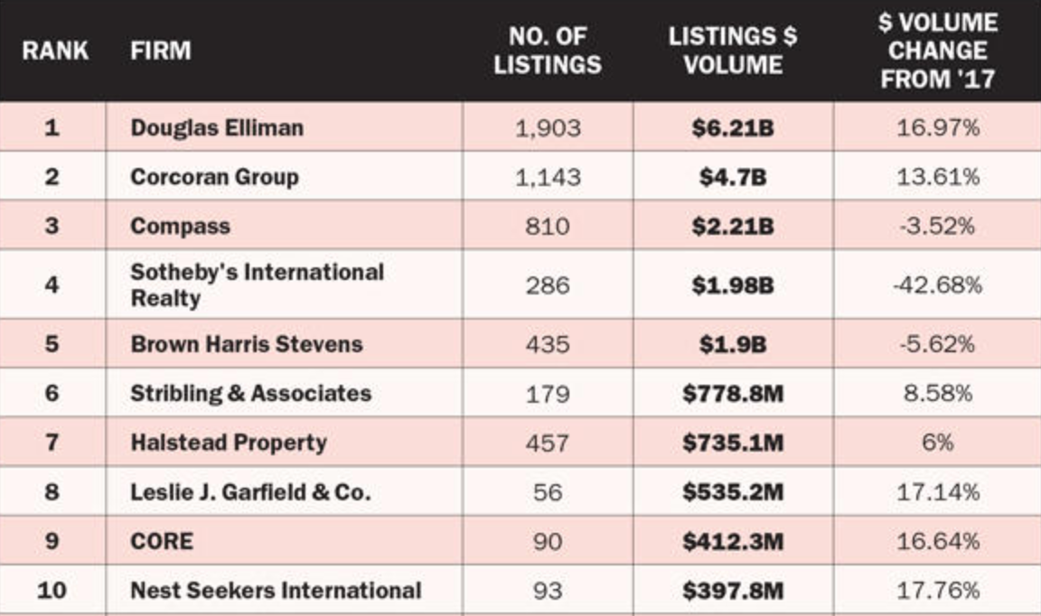
What companies occupy the rental market?
³
Notes:
3) https://therealdeal.com/issues_articles/top-residential-brokerages-nyc-listings/

Slide 4
Project Outline & Motive
Analyze differences in data between selection of top ten real estate companies
Scrape all active listings in Manthattan, Brooklyn and Queens from Elliman, Corcoran and Compass (top 3 companies)
Normalize data across the three extractions so analysis is uniform
Explore differences in price, neighborhood, boro and bedroom in each of the 3 rental companies
Provide findings for customer (preferences may change after looking through data in different neighborhoods)

Slide 5
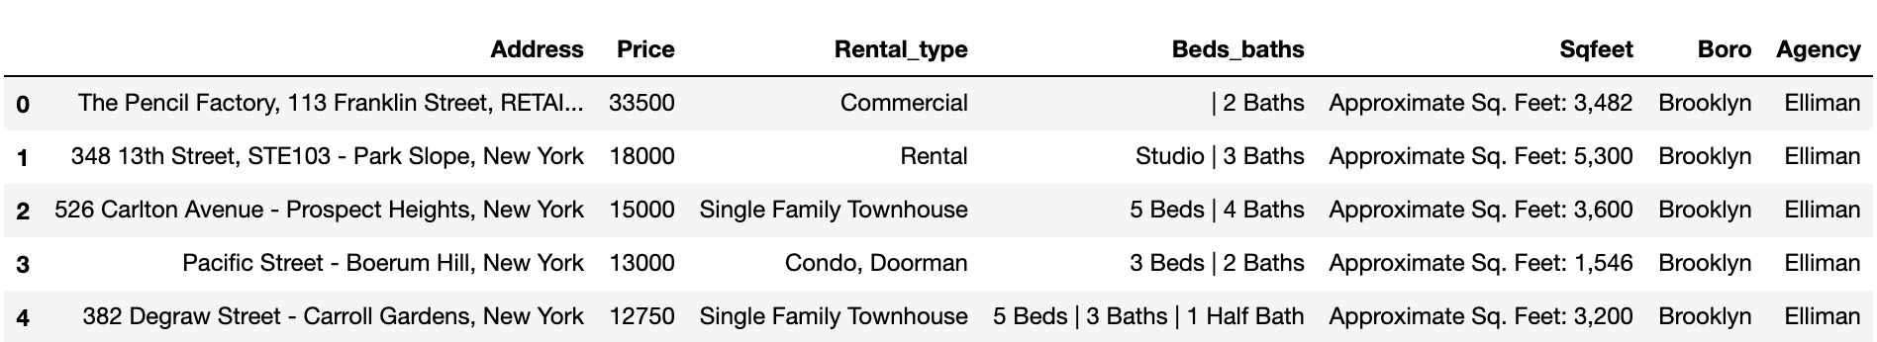
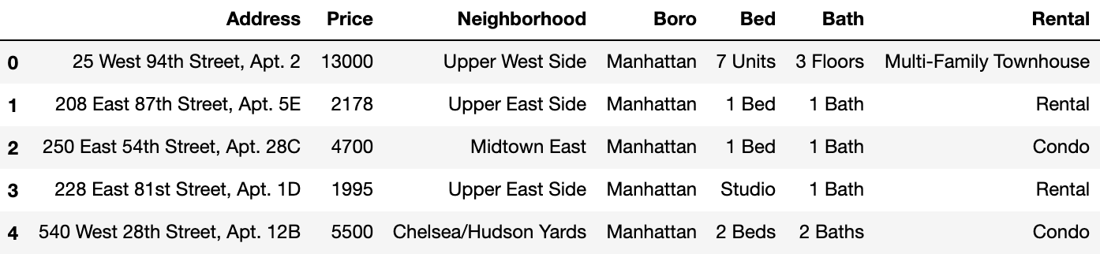
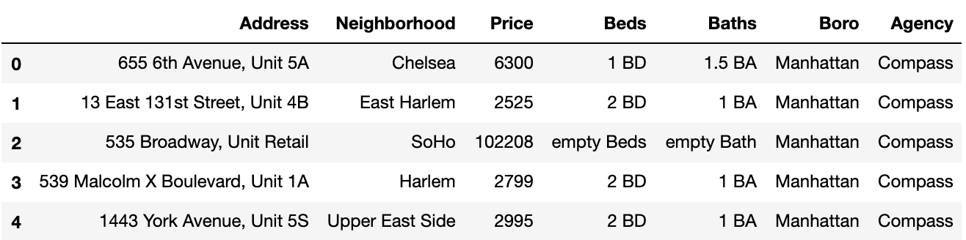
Original Data
Douglas Elliman:
Corcoran:
Compass:

Slide 6
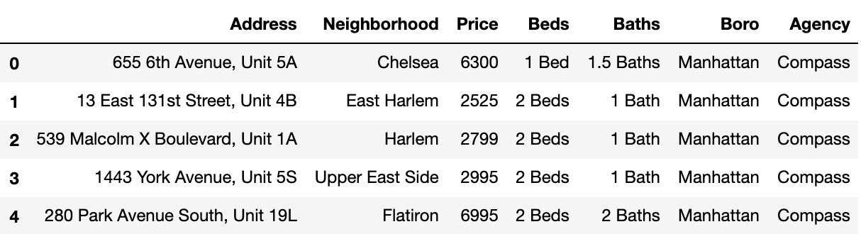
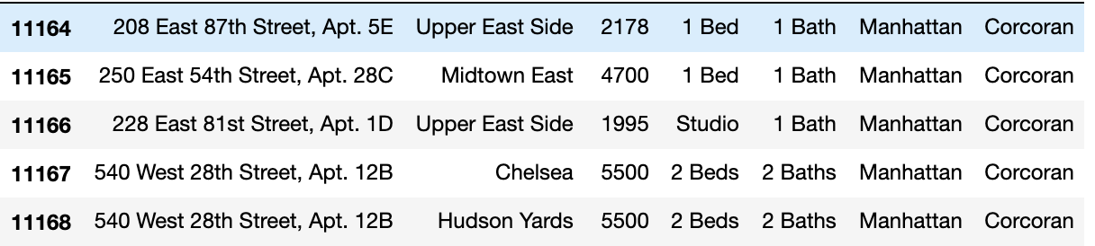
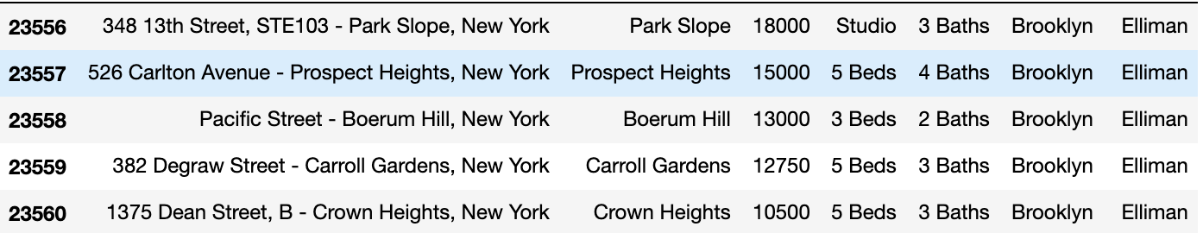
Normalized Data

Slide 7
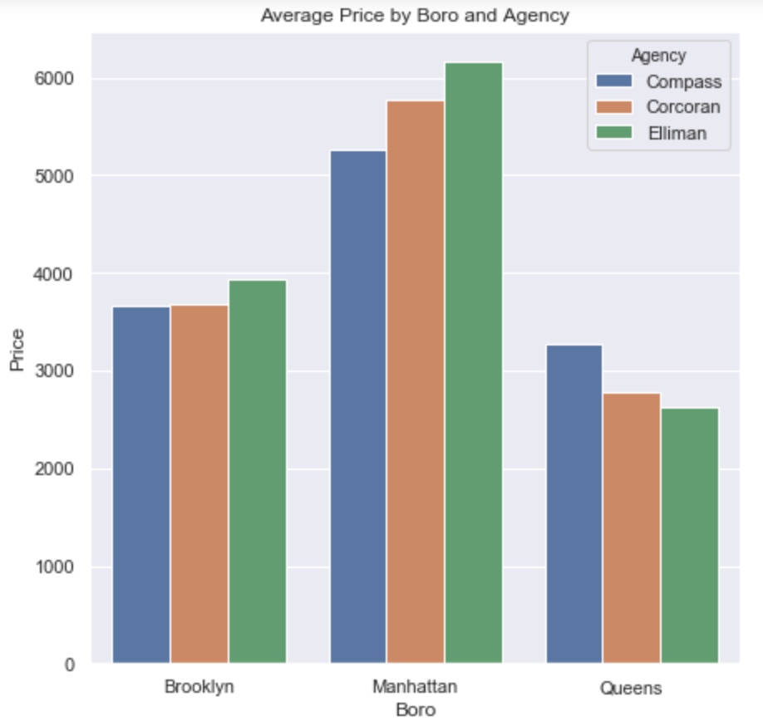
Boroughs and Company

Slide 8
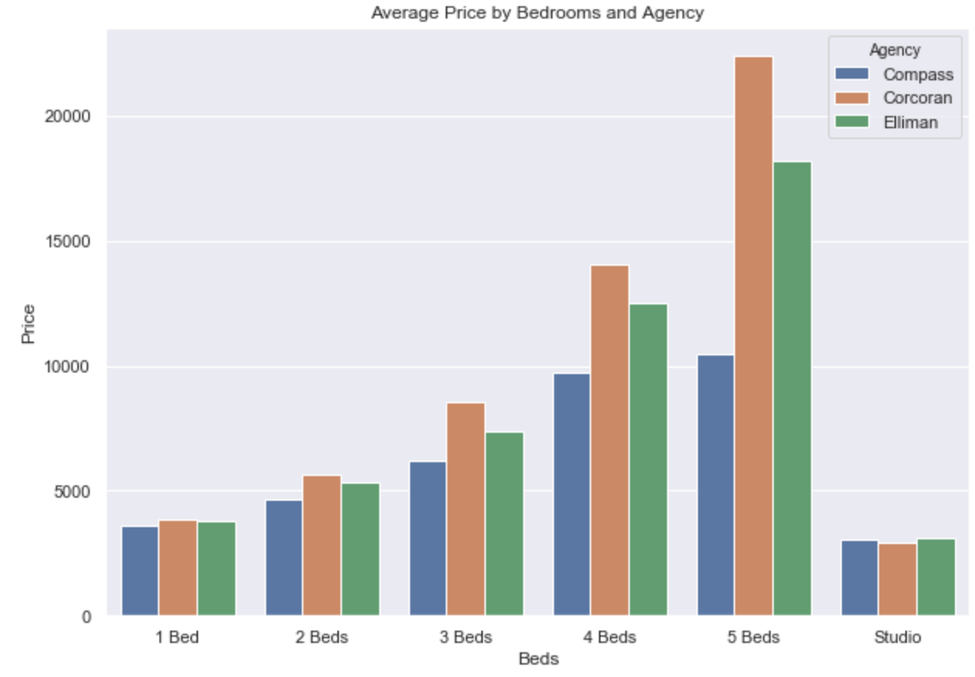
Bedrooms and Company Average Price

Slide 9
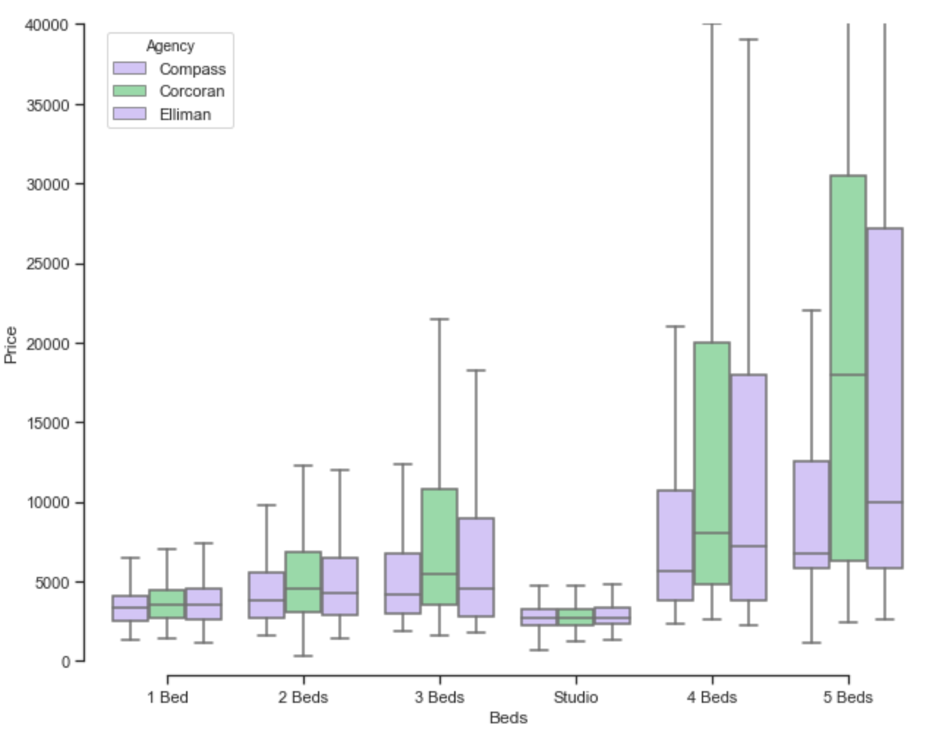
Distribution of Prices by # of Beds

Slide 10
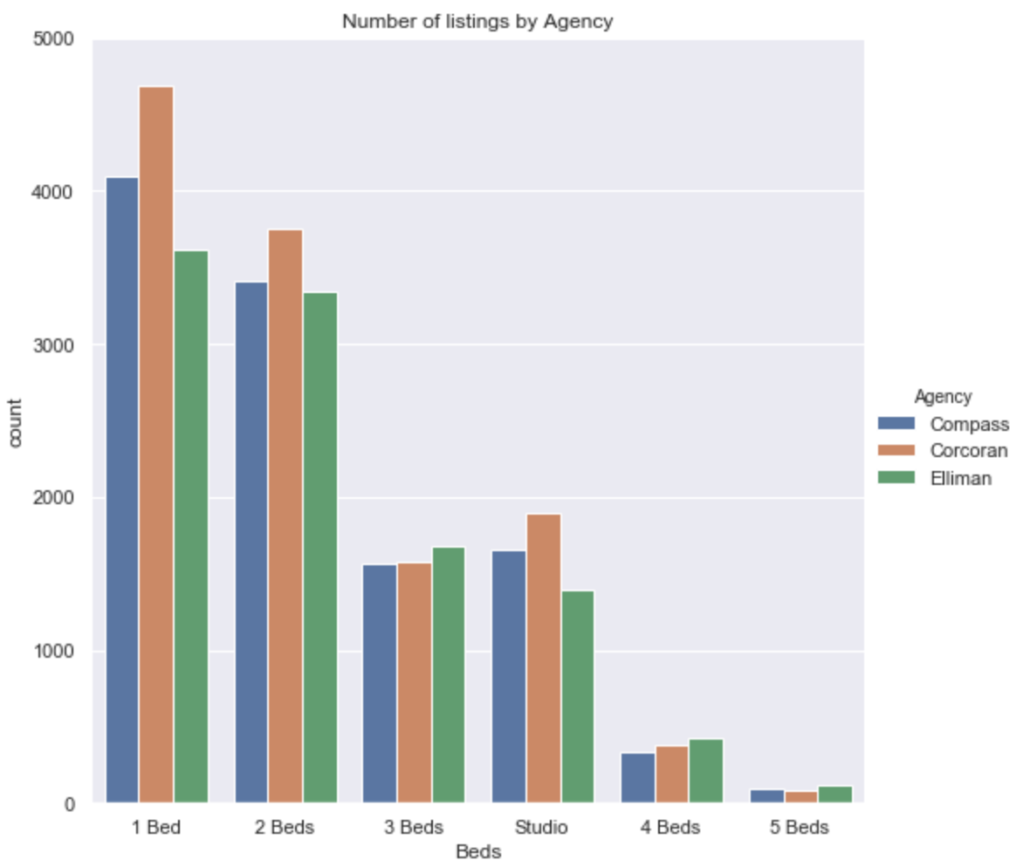
Simpson’s Paradox

Slide 11
How to sort?
Much of the value in this dataset lies not in aggregating overall data but in choosing what it is you want to look for
When renters want to find prices of active listings, they can just go on familiar websites
If sellers want to know how competitive their prices are, they can compare themselves to other agencies since this data is publically available

Slide 12
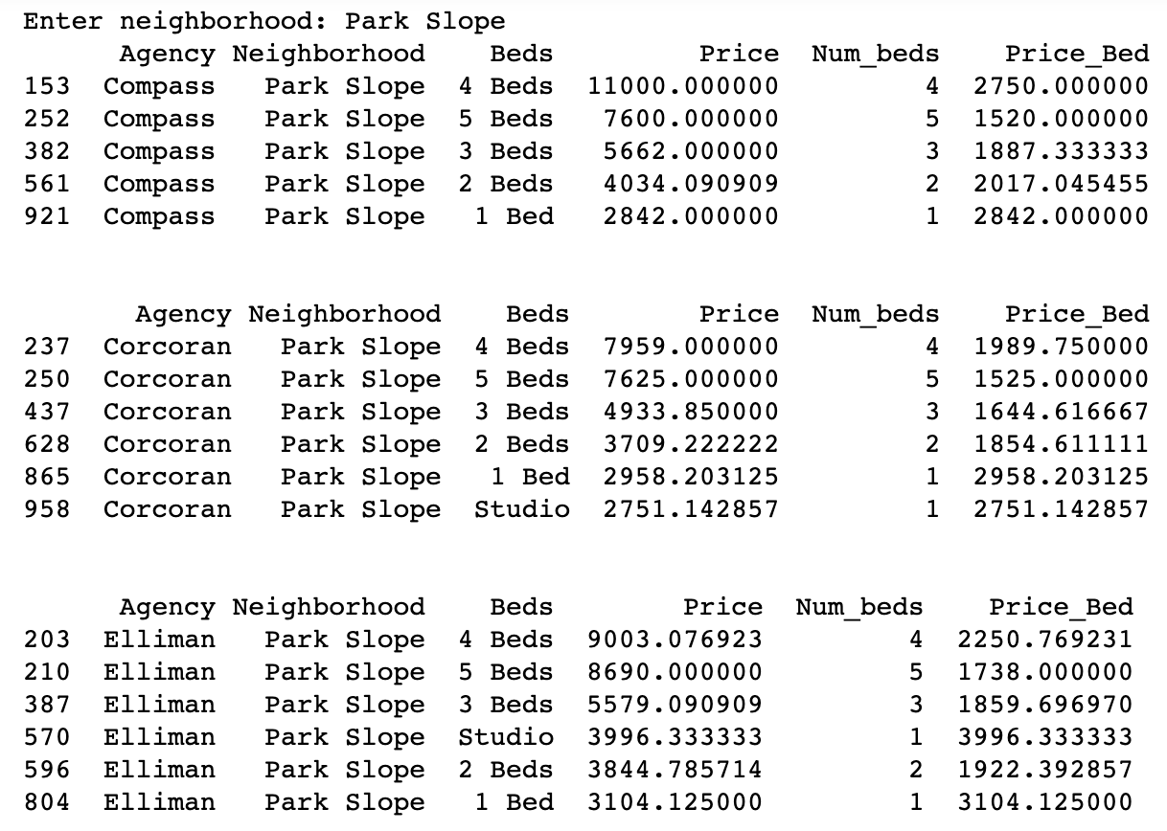
What neighborhood are you interested in?

Slide 13
Conclusions & Considerations
New York’s real estate market is vastly diverse, even in comparing the three top agencies against one another
Such data for renters is already transparent in the form of Zillow and StreetEasy
Though helpful to see overall trends by agency, bedroom or borough, those in the real estate market should look to analyze specifics that matter to renters, like price differences in bedrooms by neighborhood, since aggregated data of this sort isn’t currently available
Future work would include a continual aggregation of listings under a dataset that takes in each new listing, and compiles such data on a daily basis so time-series trends can be developed

Slide 14
QuestionS?

