Slide 1
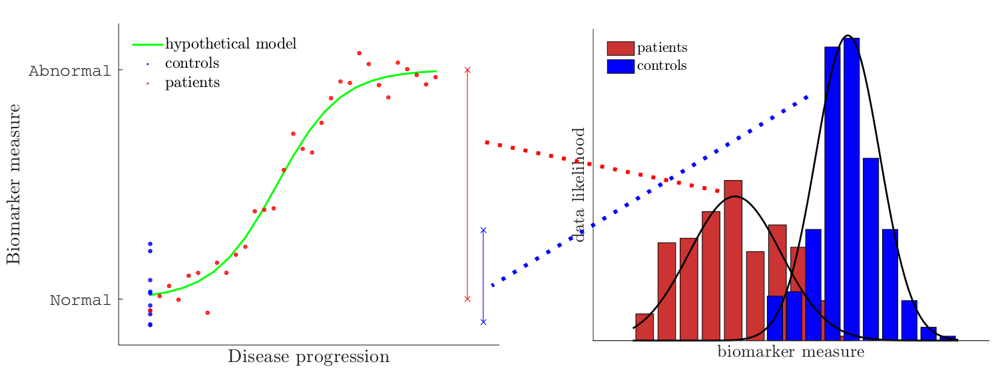
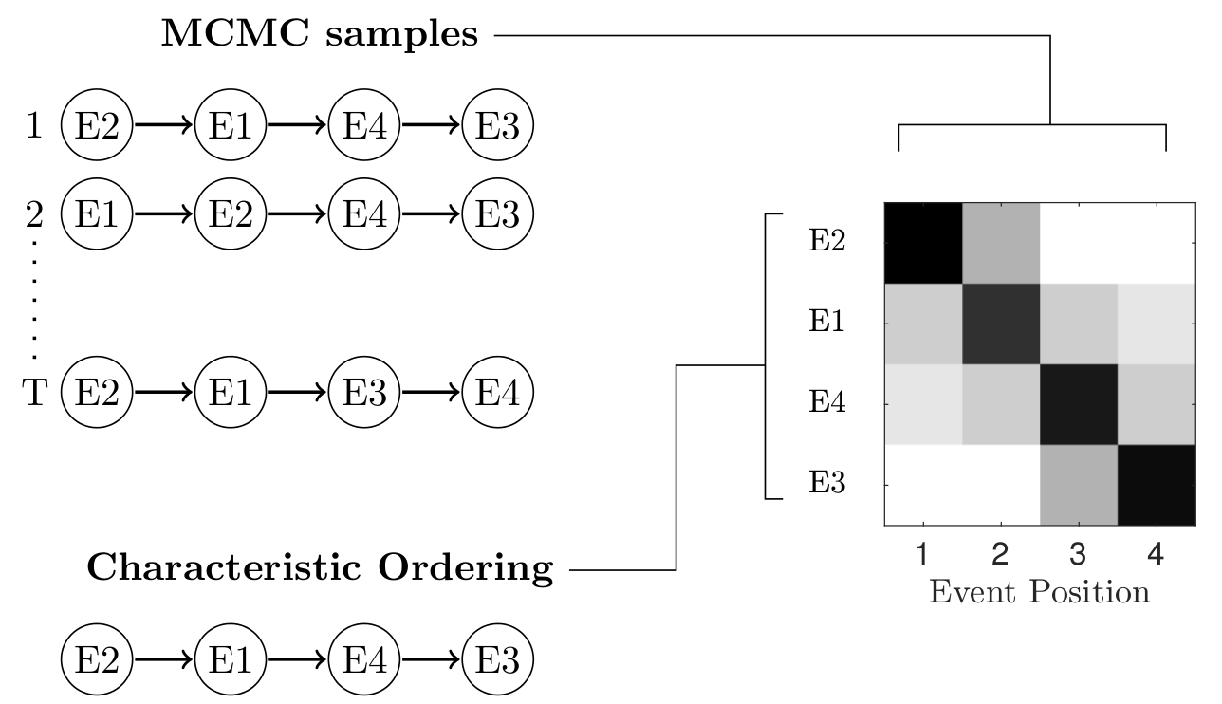

Improved estimation of event-based disease progression through an iterative process
Biomarker distributions
Sequence sampling
Previous idea
Sample distribution parameters and sequences → better positional variance estimate
Re-estimate distribution parameters using staging probabilities
Subject staging
New Idea
Iterate between these 3 steps until convergence (without sampling) → better maximum likelihood sequence

