Slide 1
Automatic classification of MR scans in Alzheimer's Disease (Klöppel et al., 2008)
CMIC Journal Club, 29 Oct 2014

Slide 2
Contents
Introduction
Research hypotheses
Methodology
Results
Contributions
Limitations

Slide 3
Introduction
Up to 2008, Alzheimer’s disease (AD) was only “manually” diagnosed by clinicians using clinical exam, history, neuropsychological testing
Pattern recognition methods applied to structural MRI were reported for the separation of mild cognitive impairment (MCI) from cognitively normal individuals (Davatzikos et al., 2006; Teipel et al., 2007)
The machine learning technique used was Support Vector Machines
However, not all patients with amnestic MCI will eventually develop AD

Slide 4
Research hypotheses
Structural MRI can automatically distinguish AD from normal aging robustly using datasets from multiple scanners and different centres
Classification based on the grey matter segment of pathologically confirmed cases can distinguish this using Support Vector Machines (SVMs)
These methods can be used to differentiate scans between two different types of dementia, AD and frontotemporal lobar degeneration (FTLD)

Slide 5
Methodology
Three datasets were used to distinguish AD from controls (Groups I, II, III) and a fourth one (Group IV) to distinguish between AD and FTLD
Results on grey matter (GM) from the whole brain and part of it (antero-medial lobe) were obtained and contrasted
Three main pre-processing steps:
  Subjects were excluded from analysis if their scans revealed gross structural abnormalities other than atrophy
  Images were fully segmented into GM, white matter and celebro-spinal fluid
  Diffeomorphic registration algorithm (Ashburner,2007) was applied to GM segments

Slide 6
 | Group I |  | Group II |  | Group III |  | Group IV
Group (n) | AD (20) | controls (20) | AD (14) | controls (14) | AD (33) | Controls (57) | AD (18) | FTLD (19)
Sex (F/M) | 11/9 | 10/10 | 5/9 | 5/9 | 10/23 | 16/41 | 6/12 | 8/11
Age at MRI-scan (mean, range) | 81.0 (51–102) | 79.5 (55–91) | 65.0 (53–85) | 63.0 (51–81) | 73.1 (61–80) | 71.9 (61–80) | 66.0* (53–85) | 61.7* (46–73)
MMSE –score (mean, range) | 16.7 (7–29) | 29.0 (27–30) | 16.1 (10–20) | 29.2 (28–30) | 23.5 (20–28) | 29.1 (27–30) | 16.2* (5–29) | 18.0 (0–26)
Years from MRI-scan to death (mean, range) | 1.7 (0.2–3.4) | NA | 3.6 (0.3–7.2) | NA | NA | NA | 3.5 (0.3–7.2) | 5.8 (1.3–11.0)

Slide 7
Results
Up to 96% of pathologically verified AD patients versus control using whole brain images and up to 89% for AD versus FTLD
Data from different centres were successfully combined achieving comparable results from the separate analyses
Cases from Group III were handpicked as ‘mild’ AD and were classified against controls with correct separation of 89% of cases
Qualitatively, SVM assigns a specific weight vector to each scan, whose components reflect the importance on the classification

Slide 8
Group | Correctly classified (%) | Sensitivity (%)* | Specificity (%)*
AD and controls Group I | 95.0 | 95.0 | 95.0
AD and controls Group II | 92.9 | 100 | 85.7
AD and controls Group III | 81.1 | 60.6 | 93.0
Dataset I for training, set II for testing | 96.4 | 100 | 92.9
Dataset II for training, set I for testing | 87.5 | 95.0 | 80.0
Group I + II | 95.6 | 97.1 | 94.1
AD from Dataset II and FTLD Group IV | 89.2 | 83.3 | 94.7

Slide 9
Group | Correctly classified (%) | Sensitivity (%)* | Specificity (%)*
AD and controls Group I | 90.0 | 85.0 | 95.0
AD and controls Group II | 92.9 | 92.9 | 92.9
AD and controls Group III | 85.6 | 75.8 | 91.2
Dataset I for training, set II for testing | 71.4 | 50 | 92.9
Dataset II for training, set I for testing | 70.0 | 95.0 | 45.0
Group I + II | 94.1 | 97.1 | 91.2

Slide 10
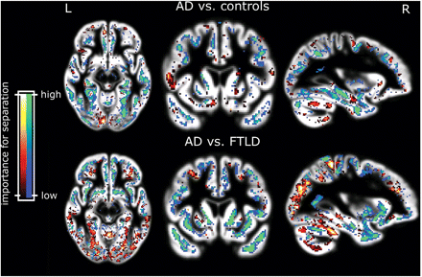

Slide 11
Appendix 1 – Support Vector Machines
An SVM training algorithm is:
a Supervised Learning algorithm used for either classification or regression
a non-probabilistic, binary, linear classifier building a discriminative model
able to create nonlinear classifiers by applying the kernel method*
* So kernel methods can be: Linear (dot product), Gaussian RBF, or even user-defined

Slide 12
Appendix 1 – Support Vector Machines
How SVM works (for linearly separable data):
Find the support vectors
Aim for the maximum optimal margin hyperplane (OMH) that optimally divides the data
Define a weight vector w, which is perpendicular to the OMH
Define an intercept term b, which is the offset/bias of the OMH
Solve the resulting Quadratic Optimisation problem
For nonlinearly separable data: Apply the soft margin, i.e. Add a regularisation hyperparameter C
That is why this specific type of SVM is called C-SVM (or Type 1)

Slide 13
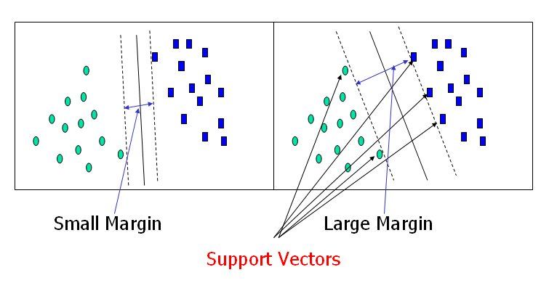
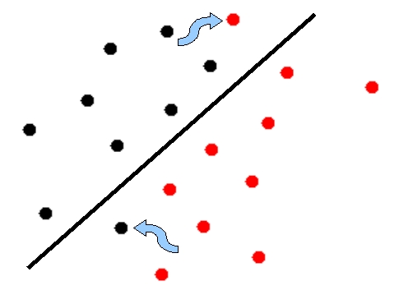
Appendix 1 – Support Vector Machines
Linearly separable case Nonlinearly separable case
OMH

Slide 14
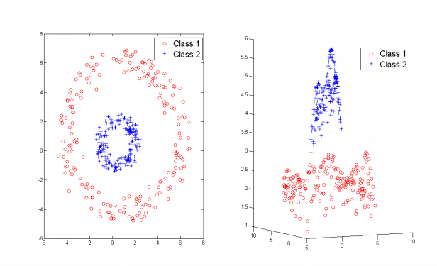
Appendix 1 – Support Vector Machines
Kerned method can transform the data from one domain to an other:
OMH

Slide 15
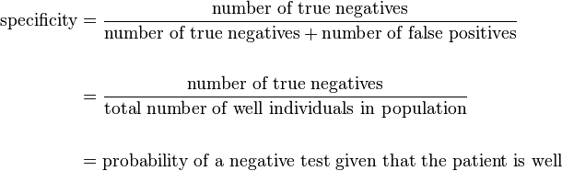
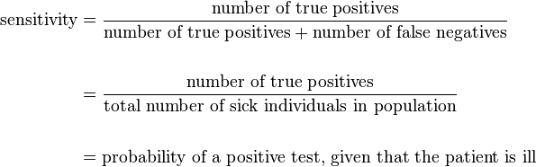
Appendix 2 – Statistical measures
 |  | Actual case
 |  | True | False
Test case | True | True Positive | False Positive
 | False | False Negative | True Negative

Slide 16
‘Limitations’
Konstantinos Georgiadis

Slide 17
Against
No table/figure to compare with existing approaches
Manual inspection of images for artefacts
Insufficient explanation of methodology, Fig. 2 – aimed at people without math/machine learning BG

Slide 18
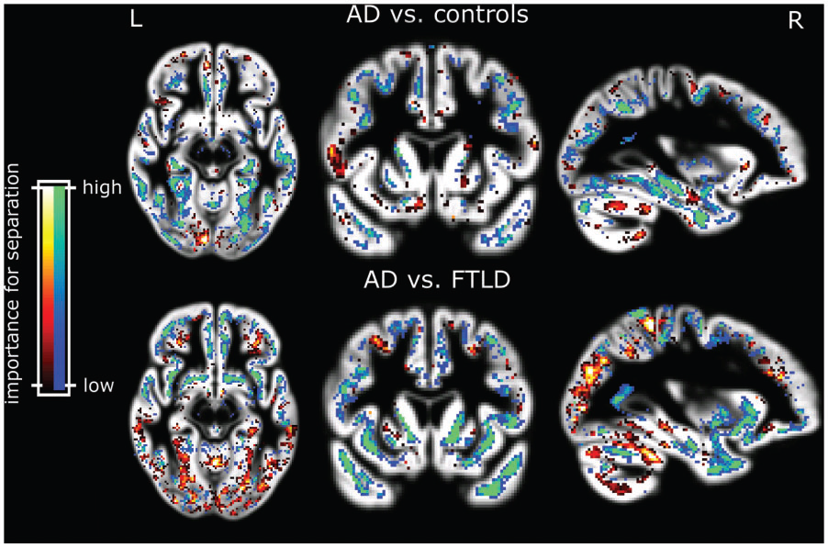
Fig. 2 Voxels most relevant for classification of patients from group I after SVM training with the data from group I (upper panel). The blue and green areas indicate higher grey matter volume increasing the likelihood of classification into normal. Red and yellow show regions where higher grey matter volume indicates the opposite. The lower panel depicts relevant areas for the separation from AD from FTLD. Blue and green indicate areas where lower grey matter volume indicates FTLD. Results are overlaid on the mean grey matter compartment image from all subjects.

Slide 19
Limitations
For clinical use:
  Automation
  Recognize more diseases rather than just AD
  Use many more scans of people with a variety of diseases (or none) for the learning process
Dimensionality Reduction
Probabilistic framework
Use a space other than pixel intensity?
Why only grey matter? White matter, CSF?

Slide 20
‘Contributions’
Thore Bücking

Slide 21
Classification Using the Whole Brain /ROI
Group | Correctly classified (%) |  | Sensitivity (%)* |  | Specificity (%)*
AD and controls Group I | 95.0 | 90.0 | 95.0 | 85.0 | 95.0 | 95.0
AD and controls Group II | 92.9 | 92.9 | 100 | 92.9 | 85.7 | 92.9
AD and controls Group III | 81.1 | 85.6 | 60.6 | 75.8 | 93.0 | 91.2
Dataset I for training, set II for testing | 96.4 | 71.4 | 100 | 50 | 92.9 | 92.9
Dataset II for training, set I for testing | 87.5 | 70.0 | 95.0 | 95.0 | 80.0 | 45.0
Group I + II | 95.6 | 94.1 | 97.1 | 97.1 | 94.1 | 91.2
AD from Dataset II and FTLD Group IV | 89.2 |  | 83.3 |  | 94.7

Slide 22
SVMs Separate AD from Healthy Subjects
  Better than other classification methods
  Takes the whole brain into account
  *p.686 last paragraph
  First to consider every voxel directly for diagnosis
  *Cuingnet et. al., 2011
Better than clinicians performance (?)
  NINCDS-ADRDA or DSM-IIIR criteria have an average sensitivity of 81% (range 49–100%) and specificity of 70% (range 47–100%).
  Formal comparison required
  *p.682 1st paragraph

Slide 23
Of Potential Use for Clinicians
(fully) automated
  No observer bias
  Reproducible
  Time saving
  *p.687 2nd paragraph
Translatable to more general setting
  Comparable results across different centres
  *p.687 3rd paragraph
  Possible to incorporate other degenerative diseases?
  *p.687 1st paragraph

Slide 24
Overall…
Demonstrated success of SVMs as diagnostic tool
Demonstrated generalizability of approach
Showed important role of computer based diagnostic image analysis for clinical practice

