Slide 1
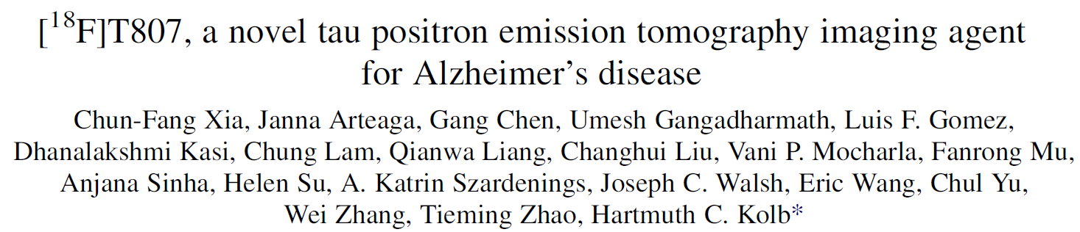
Lead presenter: Anita Karsa
Contributions: Marcel Tella
Limitations: Cara Foley
Journal Club, 4th March 2015

Slide 2
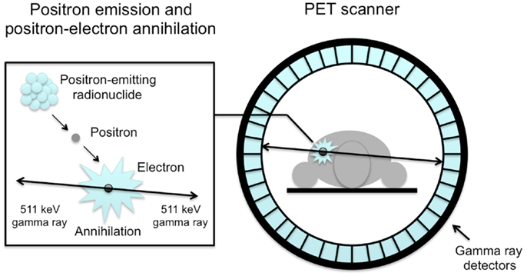

Positron Emission Tomography (PET)
PET tracer

Slide 3
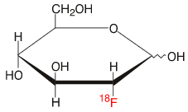
PET tracer
radionuclide
Delivered to site
Selective binding
High binding affinity
Fast uptake
Rapid clearance
Stability
Negative beta decay
Reasonable half-life
tracer body
Fluorodeoxyglucose (FDG)

Slide 4
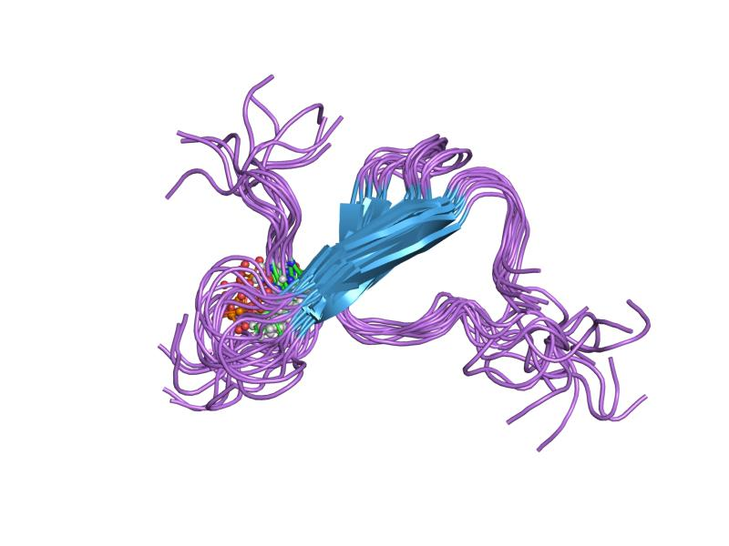
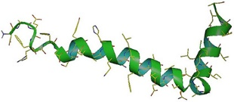

AD biomarkers
Amyloid β (Aβ)
(PHF)-Tau
Quantitative and spatial assessment would be useful for diagnosis

Slide 5
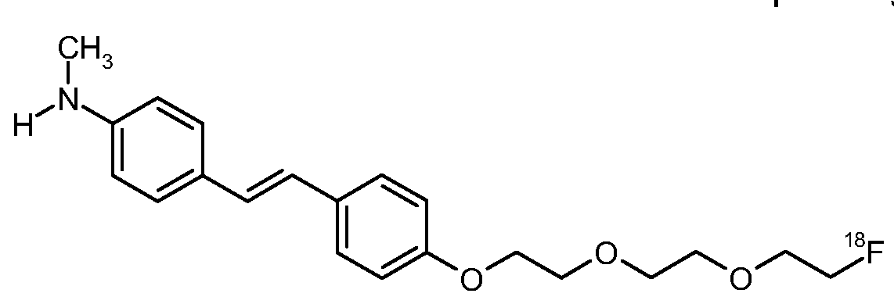
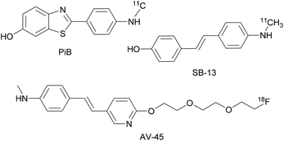
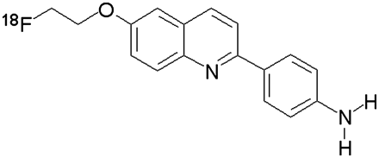
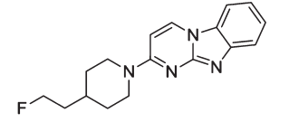
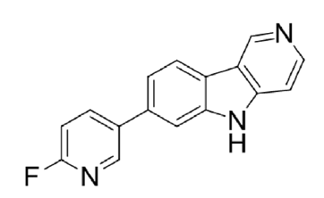
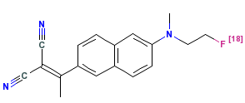
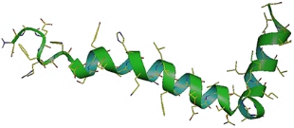
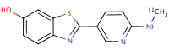
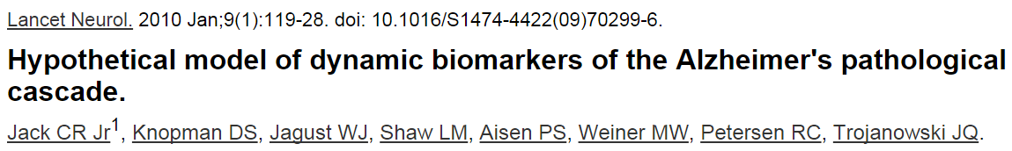
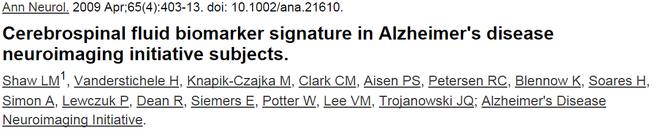
Aβ and PHF-tau tracers
Amyloid β (Aβ)
PHF-tau
¹⁸F-THK523
¹⁸F-T808
¹⁸F-T807
Correlates with neurodegeneration and cognitive impairment
Poorly correlated with severity of AD

Slide 6

Aims
Delivered to site
Selective binding
High binding affinity
Fast uptake
Rapid clearance
Stability
Negative beta decay
Reasonable half-life
¹⁸F-T807
T_{1/2} ~ 2 h

Slide 7
METHODS AND RESULTS

Slide 8
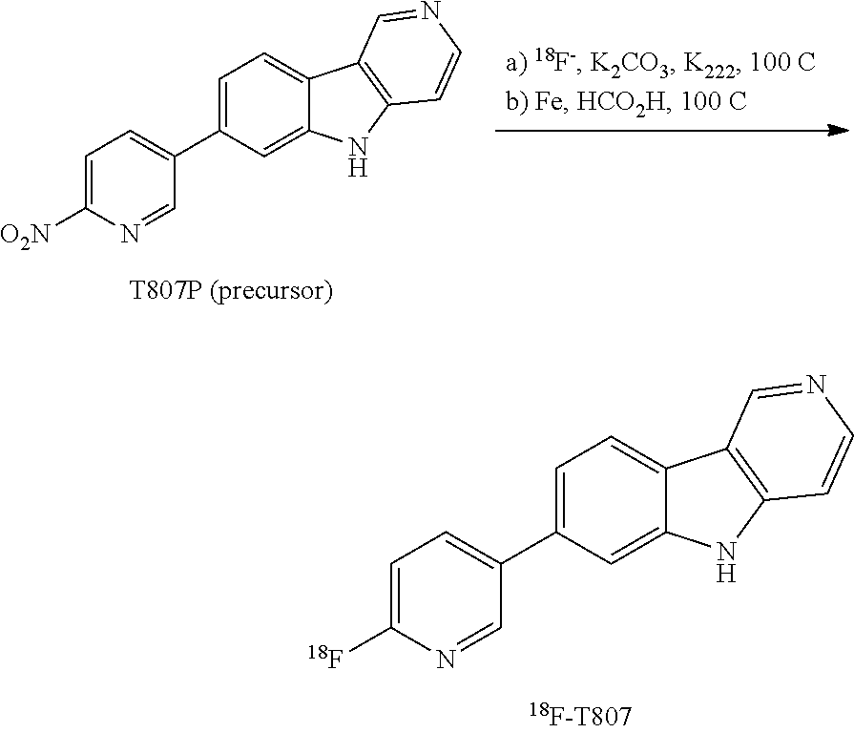
¹⁸F-labelling of T807
Synthesis time: 90 min
Average radiochemical purity > 99%
Average specific activity: 9.63 Ci/µmol

Slide 9
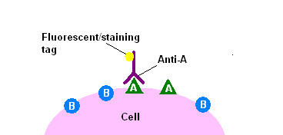
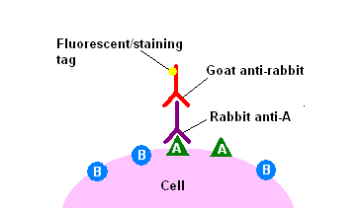
PHF-tau and Aβ double immunohistochemistry (IHC)
45 AD and non-AD human brains
Screening (AD/total)
Aβ
tau
20/20
4/8
7/17

Slide 10
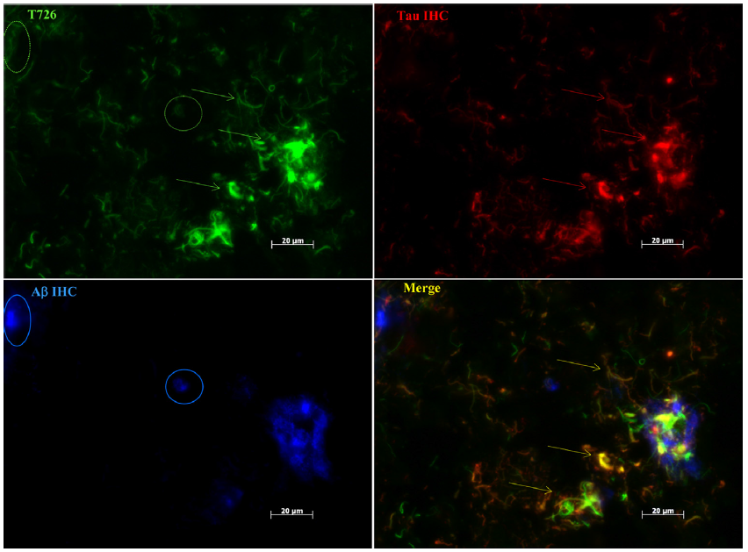
Triple fluorescent compound staining
Colocalisation
~100 fluorescent compounds
From different chemical classes

Slide 11
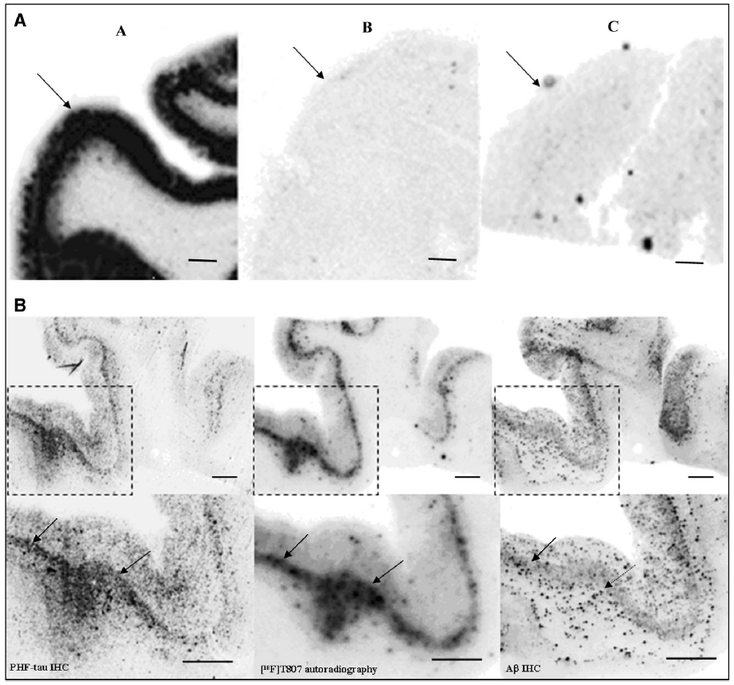
Selective binding of F-T708 to native PHF-tau
Aβ+tau
Aβ
neither
Autoradiography
with F-T807
tau = 25.7 × Aβ
Double IHC

Slide 12
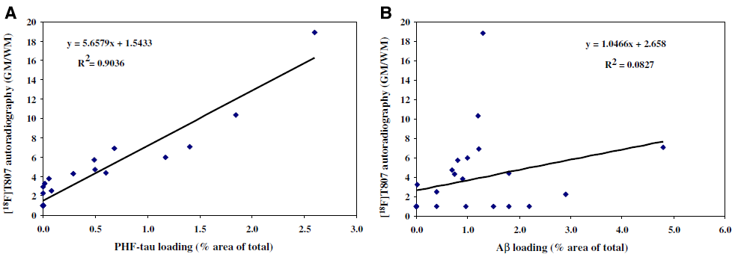
Selective binding of F-T708 to native PHF-tau
Delivered to site
Selective binding
High binding affinity
Fast uptake
Rapid clearance
Stability
Negative beta decay
Reasonable half-life

Slide 13
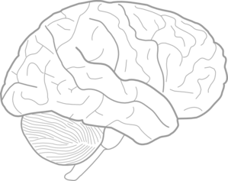

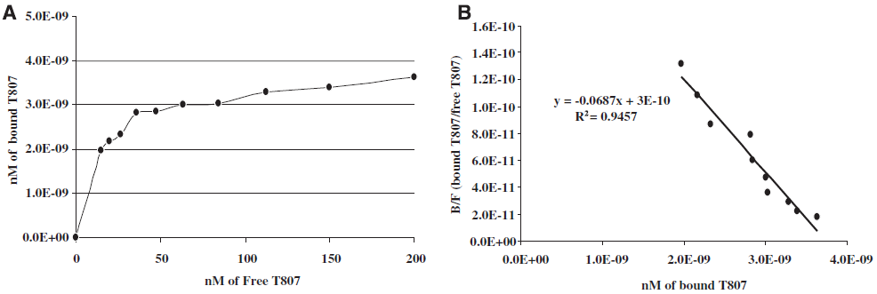
Binding affinity of F-T807 to tau tangles
Saturation binding experiments:
Delivered to site
Selective binding
High binding affinity
Fast uptake
Rapid clearance
Stability
Negative beta decay
Reasonable half-life
Aβ+tau
Aβ
K_{d,tau} = 14.6 nM
-1/K_{d}

Slide 14
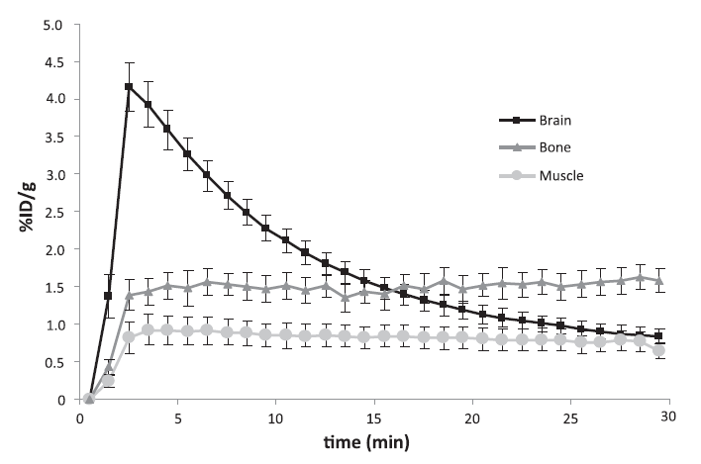
Brain uptake of F-T807 in mice
Delivered to site
Selective binding
High binding affinity
Fast uptake
Rapid clearance
Stability
Negative beta decay
Reasonable half-life
6 mice
Dynamic PET imaging while administering
F-T807
ROI based on PET/CT

Slide 15

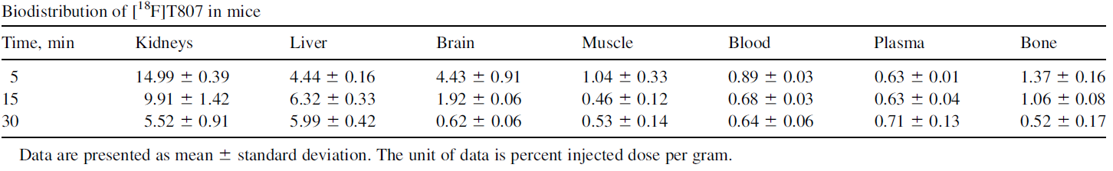
Biodistribution and excretion of F-T807 in mice
Delivered to site
Selective binding
High binding affinity
Fast uptake
Rapid clearance
Stability
Negative beta decay
Reasonable half-life
Weight
Blood sample
+
Gamma counter
+ F-T807
0 min
5 min
15 min
30 min
Time

Slide 16
Metabolic stability and binding potential
Delivered to site
Selective binding
High binding affinity
Fast uptake
Rapid clearance
Stability
Negative beta decay
Reasonable half-life
Separation and quantification of radioactive components
F-T807 was stable in the brain for 30 minutes
Competitive binding assays against the 72 most common CNS targets
The potential for adverse effects resulting from inhibition is low

Slide 17
Pros / Contributions
High selective PET imaging agent.
Selectivity of >25 fold for PHF-tau over Aβ.
The use of the agent has no side effects (does not inhibit enzymes).
Measure of the dissociation constant K_{d} for further studies. (Value of binding to PHF-tau)
Experiments with 72 CNS targets.
45 AD and non-AD human brains!

Slide 18
Limitations
Complex labelling process (2.4)
Compound screening (3.1)
Confusion about number of AD brains (3.2)
Measure of K_{d} (3.4)
Humans vs. transgenic mice? (4)
Tau as a biomarker
Retention of ¹⁸F-T807
No PET images

Slide 19
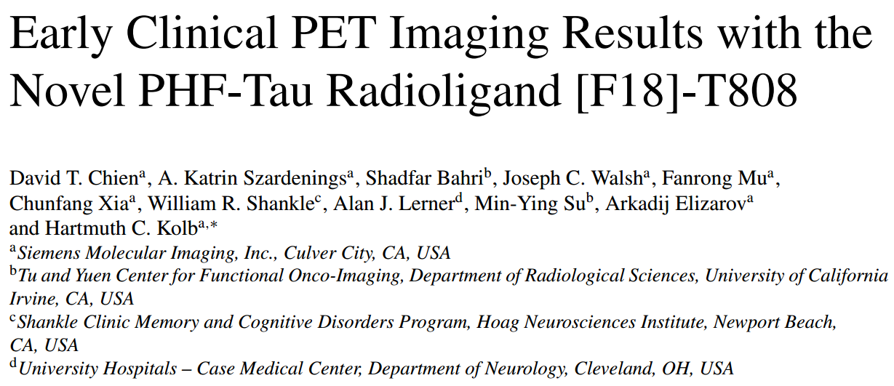
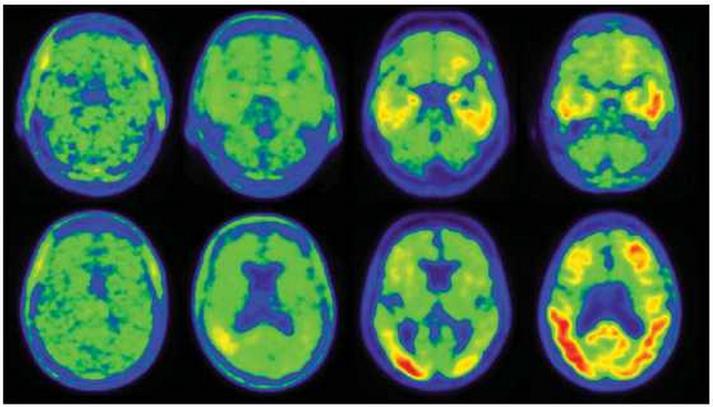
HC MCI mild AD severe AD

Slide 20
