Slide 1
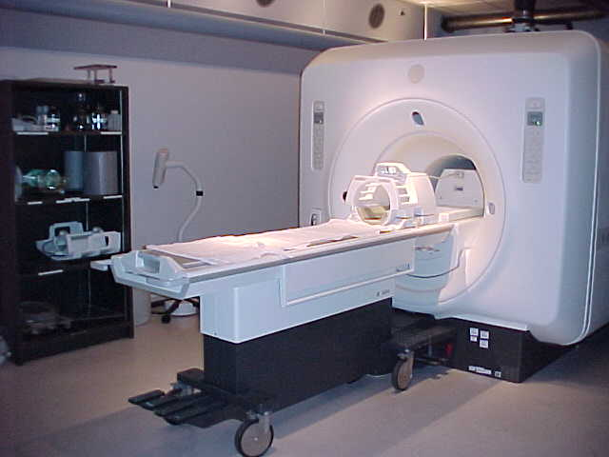
MRI Hardware
Main Magnet
Gradient
Coils
Radiofrequency (RF)
Coil

Slide 2
MRI Hardware
Block diagram of the key components of an MRI system
Gradient Coils
Radiofrequency
Coils
Magnet
X-Gradient
T/R
Switch
RF Transmitter
Y-Gradient
RF Receiver
Z-Gradient
Patient Bed
RF Screen (and Magnetic Shielding)
Computer

Slide 3
MRI Hardware
Main Magnet
Gradient
Coils
Radiofrequency (RF)
Coil

Slide 4
Hardware Overview
The magnet is super-conducting usually has a field strength of 1.5 or 3 Tesla (64Mhz or 128 MHz)
It is cooled with liquid helium
The gradient coils (x, y and z) are used for spatial encoding and are switched on and off by applying electrical current; they are noisy
The RF coil is used to apply RF pulses and collect the signal
It is either designed to be uniform in sensitivity or is a surface coil placed on the outside of the subject next to the tissue to be imaged (non-uniform)
The transmit/receive (T/R) switch stops the high power RF pulse damaging the sensitive receiver electronics
The RF and magnetic shields stop interference of the fields with other devices

Slide 5
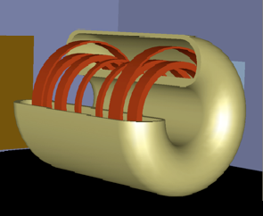
Main MRI Magnet
The magnet usually has a 1 m bore diameter
Smaller systems are used for head-only scanning or animal research
The field strength usually ranges from 1.5 to 9 Tesla (64 to 400 MHz for proton resonance)
The Earth's magnetic field is ~0.5 Gauss (1T = 10⁴ Gauss)

Slide 6
MRI Magnet Types
There are 3 main types of magnet:
(i) Permanent magnet (0.1 to 0.5 T):
  Heavy and of a horseshoe design
  May be easily shielded
  May allow ‘open’ or easily accessible MRI
(ii) Resistive Electromagnet (0.1 to 0.6 T):
  Copper solenoid winding carries direct current
  High operating costs due to large electric power required to generate current
  Large energy dissipation as heat
  Easily turned off (and on)
  Tend to have unstable field strength
(iii) Superconducting magnet: Solenoid of superconducting wire cooled to −269°C by immersion in a liquid helium jacket which keeps the wire cool by boiling at 4 K

Slide 7
Superconducting MRI Magnet
  A superconducting material has the property that its electrical resistance decreases to zero when the temperature falls below a critical value (e.g. ~ 10 K)
  This is the most common type of magnet because it is very stable and can achieve higher field strengths e.g. 9 T
  A refrigerator ‘cold-head’ on the top recycles helium gas into liquid but there is some ‘boil-off’ which means that periodic helium re-fills are needed
  The magnet usually has ~50 km of superconducting wire carrying ~200 Amps which flow continuously without needing a power supply
Advantages
Large homogeneous magnetic fields
Little power input
Disadvantages
Costly due to cooling system (liquid He)
Always on!

Slide 8
Shim Coils
To make the magnet field as homogeneous as possible and to adjust for changes in the magnetic field produced by the body itself, shim coils carrying small currents are used to "flatten" the magnetic field
These currents are often calculated and automatically applied by the MR system
The shim coils are often hidden just inside the bore of the magnet, just outside the gradient coils
Shims are usually applied to correct up to second order (quadratic) variations in the field
Higher order shimming requires more complicated shim coil design

Slide 9
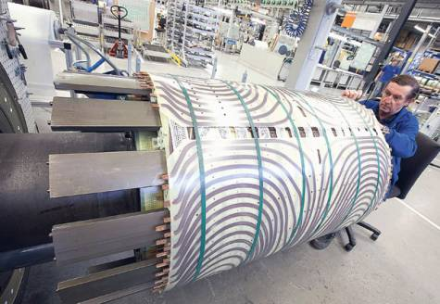
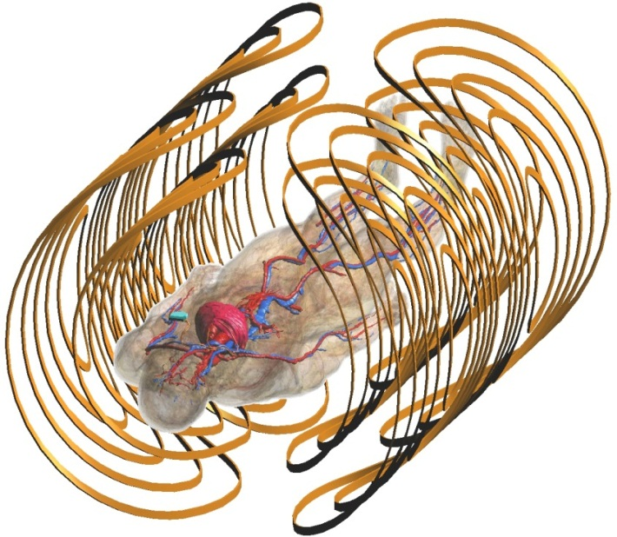
Gradient Coils
These produce the linear magnetic field gradients and should produce a gradient over the whole field of view of the system
They should have a low inductance so that the gradient-producing currents can be rapidly switched on and off
Gradient switching is responsible for the audible noise generated by MRI scanners which can be quite loud

Slide 10
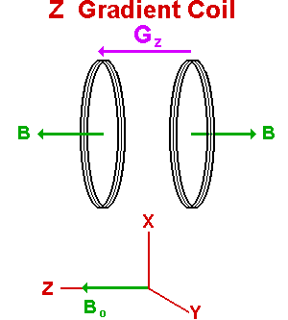
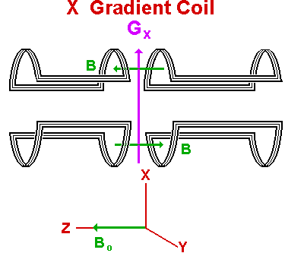
Simple Gradient Coil Designs
Maxwell Pair
Used for G_{z}
Two coils with counter-rotating currents
Golay Coils
Used for G_{x} and G_{y}
This configuration allows them to fit around the magnet bore

Slide 11
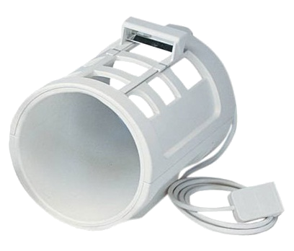
Radiofrequency Coils
Transmit and / or receive radiofrequency energy in the MHz range
Can be fitted for specific anatomy (head, wrist, knee, etc.) or can encompass the entire patient (body coil)

Slide 12
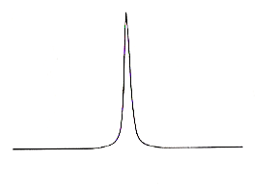
Radiofrequency Coils
RF Coils are used to apply the RF pulses and to detect the much weaker NMR signals from the sample
To increase sensitivity they are always circuits "tuned" to the Larmor resonance frequency using a variable capacitance (C)
In a resonant circuit, ω = 1/√LC The circuit can be tuned to resonate at the Larmor frequency by varying C
The advantage of using a resonant circuit is that the MR signal is multiplied up by a factor Q = ωL/R
ω = γB₀
Resistance (R)
Output
Signal
Q = 50 - 100
Output
RF coil
(inductance L)
Variable capacitor (C)
frequency

Slide 13
Radiofrequency Coils
Volume coils enclose the object and are designed to give a uniform RF B₁ amplitude over the field of view
Surface coils consist of loops that are placed over the region of interest
Although surface coils do not produce uniform B₁ fields, they are very sensitive
This increased SNR can be used to produce images of higher spatial resolution
Arrays of surface coils are often used to image the spinal column and limbs

Slide 14
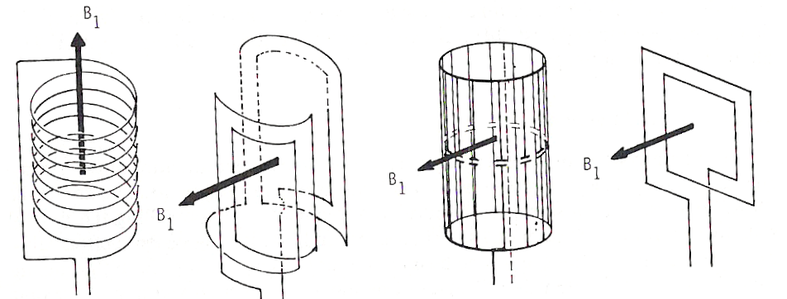
RF Coil Designs
The B₁ field is always applied perpendicular to the direction of B₀
The surface coil, being closer to the tissue of interest, detects more signal that can be used to obtain higher resolution
Four types of RF coil used in MRI:
B₀
B₀
Solenoid
Saddle Coil
Birdcage Coil
Surface Coil
Sensitivity decreases with distance from coil
These volume coils are all designed for RF field uniformity

Slide 15
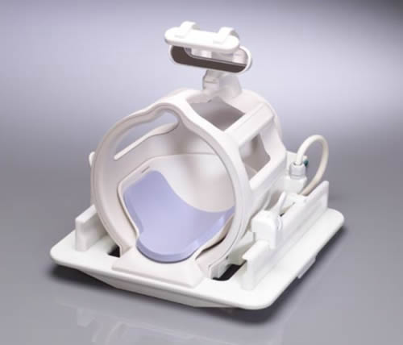
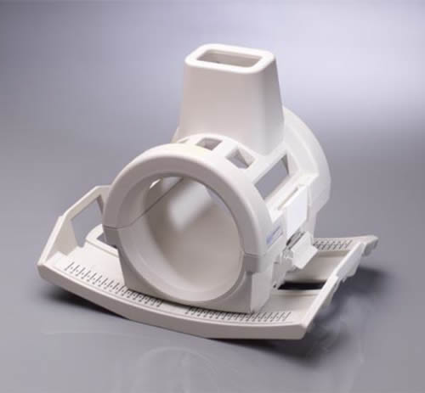
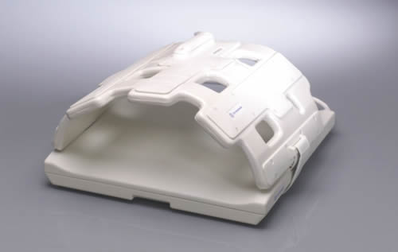
RF coils
Generate and detect the RF pulses
Tuned to the selected resonant frequency
Can be built to
  a) Receive or Transmit
  b) Receive and Transmit
Body coil – b) but usually just transmit
  Transmit coils need to be very homogeneous
Surface coils – usually a) receive only
  As close to object as possible
  Receive circuitry needs sensitive amplifiers

Slide 16
RF Transmit and Receive Electronics
The RF coil must first handle a powerful RF pulse for signal excitation (typically 1Kwatt)
It must then be able to detect NMR signals of a few micro-volts and pass these to a sensitive pre-amplifier
An RF switch is used to isolate the high power transmitter amplifier from the sensitive receiver pre-amplifier
This switch is often called the Transmit/Receive (T/R) Switch
Receiver System
This consists of the main receiver RF amplifier, demodulator and phase sensitive detector, audio filter circuit, and analogue-to-digital converter (ADC)
The purpose of these was explained in the FT NMR data processing section earlier

Slide 17
Computer System
The computer system consists of:
    a central processor for performance of FT's (sometimes an array processor)
    devices for data storage
    an image display processor
    an image display screen
The computer controls the RF pulse and gradient and shaping
The actual pulse sequence is usually timed out using another control processor (the gradient and RF controller) after having been programmed by the computer
The imaging experiment may be triggered through the computer to freeze the effects of cardiac or respiratory motion
The user interacts with the MRI scanner’s computer system through the ‘console’

Slide 18
Magnet Shielding
The magnet is often placed in an iron box or between two large iron plates (passive shielding) in order to reduce the influence of spreading magnetic fields on the surrounding environment
The recommendation is that the public should not be exposed to persistent magnetic fields of greater than 5 Gauss
Approximately 10 to 50 Gauss can affect heart pacemakers, has a strong distortional effect on TV screens, and can wipe credit cards
Some magnets are self-shielded (actively shielded) using a second set of coils external to the main magnet
The opposing set of magnet coils outside of the magnet reduces the spread of the field and may allow the magnet to be sited in a smaller room

Slide 19
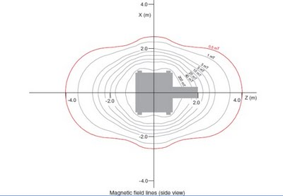
Magnet Shielding
Shielding is needed to reduce the influence of spreading magnetic fields on the surrounding environment
The recommendation is that the public should not be exposed to persistent magnetic fields of greater than 5 Gauss
Approximately 10 to 50 Gauss can affect heart pacemakers, has a strong distortional effect on TV screens, and can wipe credit cards
There are two types of shielding: Passive and Active

Slide 20
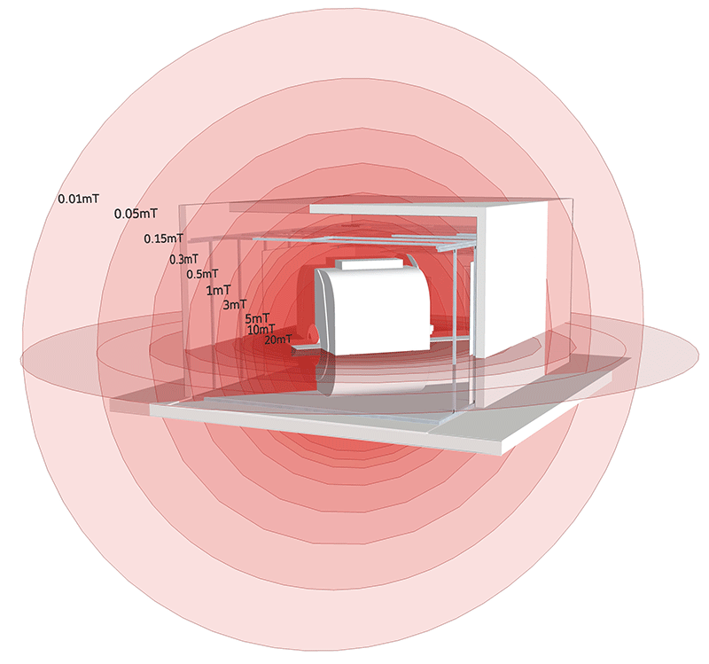
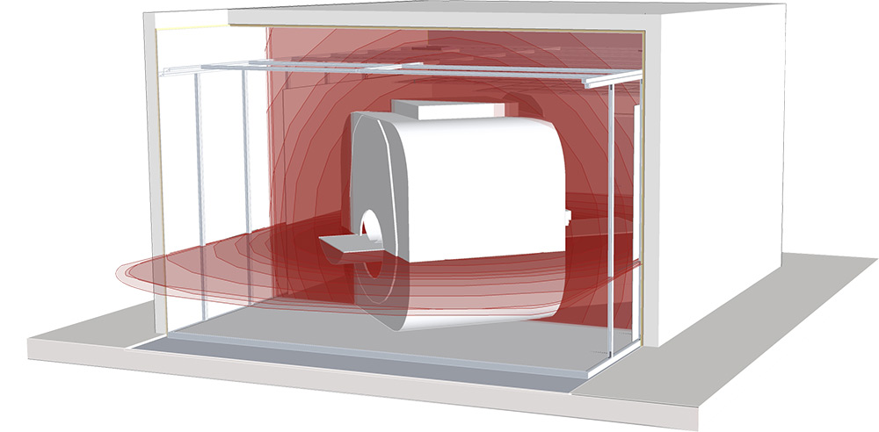
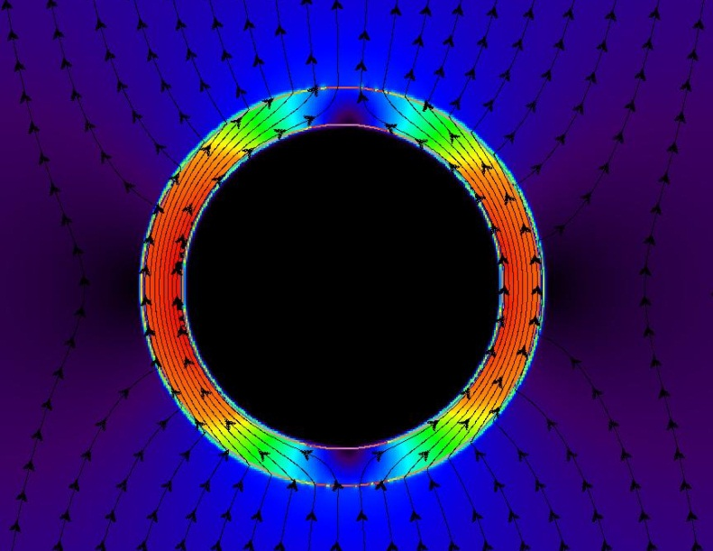
Magnet Shielding: Passive
Passive shielding involves placing the magnet in an iron box or between two large iron plates
Unshielded
Shielded
Magnetic Field Lines
Passive shielding works because the iron concentrates the magnetic field lines within it due to its high magnetic permeability
Iron shield
Zero field

Slide 21
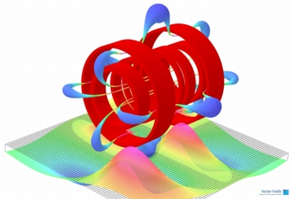
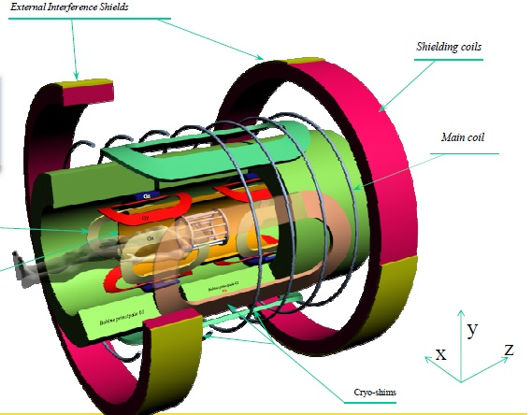
Magnet Shielding: Active
Some magnets are self-shielded (actively shielded) using a second set of superconducting coils wound outside the main magnet
The opposing current in this set of shielding coils leads to partial cancellation of the field outside the main magnet
This reduces the spread of the field (stray or fringe field) and may allow the magnet to be sited in a smaller room

Slide 22
RF Screen
The RF screen is usually incorporated into the magnetic shield if it exists
It is made of copper and completely encloses the system; It usually runs through the scanner room door
It is designed to prevent external RF noise from entering the system and being picked-up by the RF coil (this would reduce the SNR) by adding noise
The RF screen also prevents the RF pulses generated in the system from "polluting" the external environment
Any connections to the outside world must be filtered to remove noise as they enter the RF shielded room to prevent conduction into the system (e.g. gradient cables, physiological monitoring etc.)

Slide 23
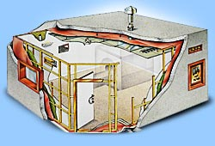
How the RF Screen Works
The RF shield is a ‘Faraday Cage’ of highly conductive material completely enclosing the system
It works to block electromagnetic radiation by:
varying electric fields create currents in the conducting shield material which cancel the applied electric fields
varying magnetic fields generate eddy currents in the conducting shield material which act to cancel the applied magnetic fields
This results in reflection of electromagnetic radiation from the surface of the conducting shield
Even if the reflection is not perfect, for radio frequency radiation is absorbed in a thin surface layer of the conductor (the skin effect)

Slide 24
MRI Hardware
Block diagram of the key components of an MRI system
Gradient Coils
Radiofrequency
Coils
Magnet
X-Gradient
T/R
Switch
RF Transmitter
Y-Gradient
RF Receiver
Z-Gradient
Patient Bed
RF Screen (and Magnetic Shielding)
Computer

